Slide 1
Chapter Sixteen
Control & Quality Control Improvement:
Techniques for Enhancing Organizational
Effectiveness
McGraw-Hill/Irwin
Copyright © 2013 by The McGraw-Hill Companies, Inc. All rights reserved.

Slide 2
Major Questions You Should Be Able to Answer
16.1 How do managers influence productivity?
16.2 Why is control such an important managerial function?
16.3 How do successful companies implement controls?
16.4 How can three techniques—balanced scorecard, strategy maps, and measurement management—help me establish standards and measure performance?

Slide 3
Major Questions You Should Be Able to Answer
16.5 What are the financial tools I need to know about?
16.6 How do top companies improve the quality of their products or services?
16.7 What are the keys to successful control, and what are the barriers to control success?

Slide 4
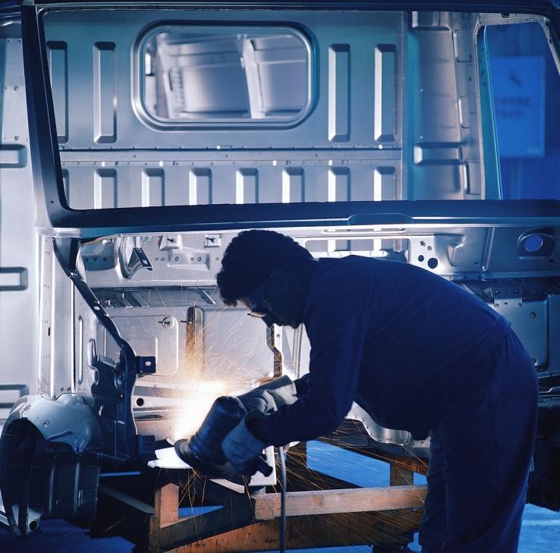
Managing for Productivity
Productivity
outputs divided by inputs where: outputs are the goods and services produced, and inputs are labor, capital, materials, and energy
Notes:
Productivity is important because it determines whether a company will make a profit and affects a country’s standard of living
Multimedia Lecture Support Package to Accompany Basic Marketing
Lecture Script 6-*

Slide 5
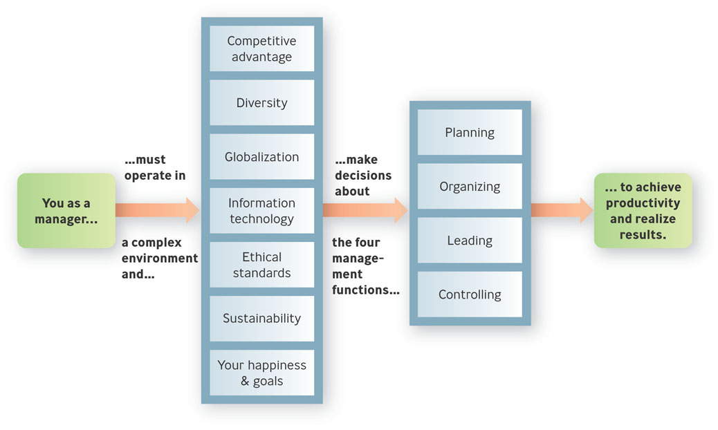
Managing for Productivity and Results
Figure 16.1

Slide 6
The Role of Information Technology
Enterprise resource planning (ERP)
software systems, information systems for integrating virtually all aspects of a business, helping managers stay on top of the latest developments.

Slide 7
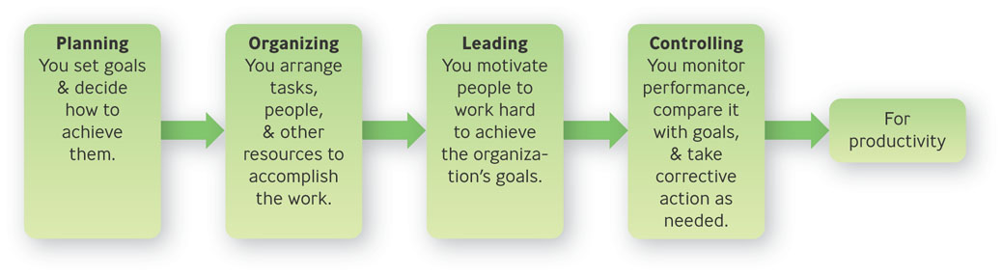
Control: When Managers Monitor Performance
Controlling
defined as monitoring performance, comparing it with goals, and taking corrective action as needed
Figure 16.2 Controlling for Productivity
Notes:
What you as a manager do to get things done, with controlling shown in relation to the three other management functions.
(These are not lockstep; all four functions happen concurrently.)
*

Slide 8
Why Is Control Needed?
To adapt to change & uncertainty
To discover irregularities & errors
To reduce costs, increase productivity, or add value
To detect opportunities
To deal with complexity
To decentralize decision making & facilitate teamwork

Slide 9
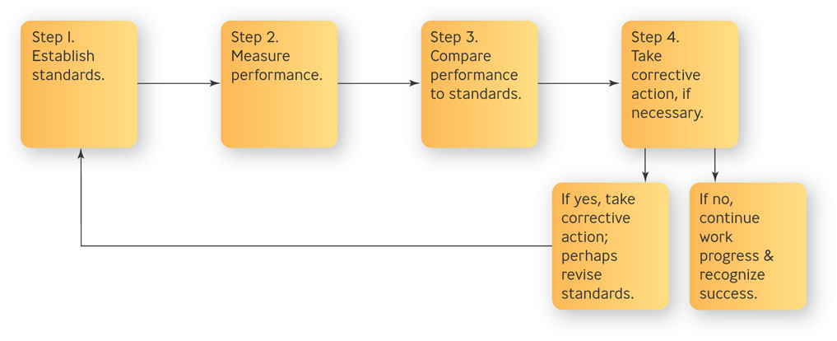
Steps in the Control Process
Figure 16.4

Slide 10
Steps in the Control Process
Establish standards
performance standard is the desired performance level for a given goal
best measured when they can be made quantifiable
Measure performance
usually obtained from written reports, oral reports, and personal observations

Slide 11
Steps in the Control Process
Compare performance to standards
Management by exception – control principle that says managers should be informed of a situation only if data show a significant deviation from standards

Slide 12

Steps in the Control Process
Take corrective action if necessary
Make no changes
Recognize and reinforce positive performance
Take action to correct negative performance

Slide 13
Question?
A UPS driver fails to perform according to the standards set for the route and traffic conditions. A supervisor rides along and gives suggestions for improvement. This is the ____________ stage of the control process.
Compare performance to standards
Establish standards
Take corrective action
Measure performance
Notes:
The correct answer is “C”
Multimedia Lecture Support Package to Accompany Basic Marketing
Lecture Script 6-*

Slide 14
Levels of Control
Strategic control
monitoring performance to ensure that strategic plans are being implemented and taking corrective action as needed
Tactical control
monitoring performance to ensure that tactical plans - those at the divisional or departmental level - are being implemented

Slide 15

Levels of Control
Operational control
monitoring performance to ensure that operational plans - day-to-day goals - are being implemented and taking corrective action as needed

Slide 16
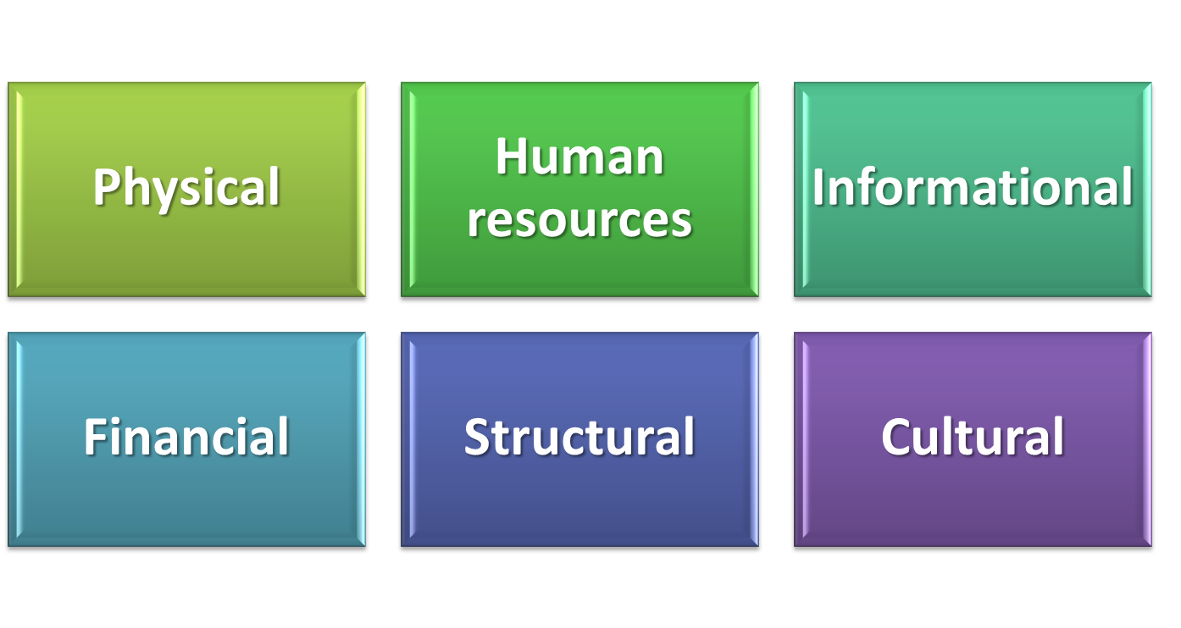
Six Areas of Control

Slide 17
Question?
A drug test employed by an organization in its hiring process is an example of a(n) _______ resource control.
Physical
Human
Financial
Informational
Notes:
The correct answer is “B”
Multimedia Lecture Support Package to Accompany Basic Marketing
Lecture Script 6-*

Slide 18
Structural Area
Bureaucratic control
an approach to organizational control that is characterized by use of rules, regulations, and formal authority to guide performance
Decentralized control
an approach to organizational control that is characterized by informal and organic structural arrangements

Slide 19
The Balanced Scoreboard
Balanced scoreboard
gives top managers a fast but comprehensive view of the organization via four indicators: (1) customer satisfaction, (2) internal processes, (3) innovation and improvement activities and, (4) financial measures

Slide 20
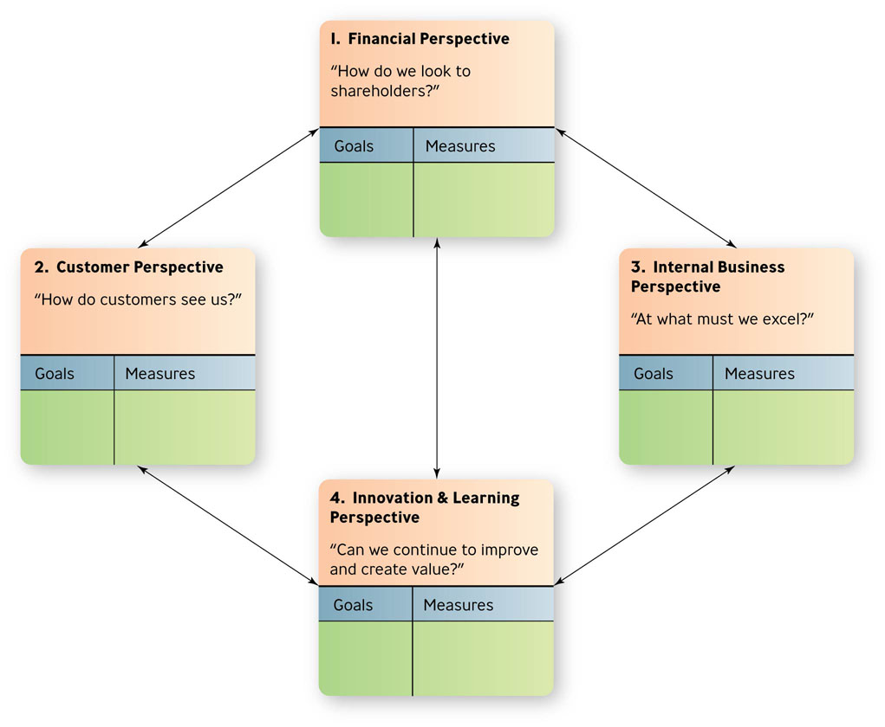
The Balanced Scorecard: Four Perspectives
Figure 16.5

Slide 21
The Balanced Scorecard: Four Perspectives
Financial
profitability, growth, shareholder values
Customer
priority is taking care of the customer
Internal business
quality, employee skills, and productivity
Innovation & learning
learning and growth of employees

Slide 22
The Visual Representation of a Balanced Scorecard
Strategy map
visual representation of the four perspectives of the balanced scorecard that enables managers to communicate their goals so that everyone in the company can understand how their jobs are linked to the overall objectives of the organization

Slide 23
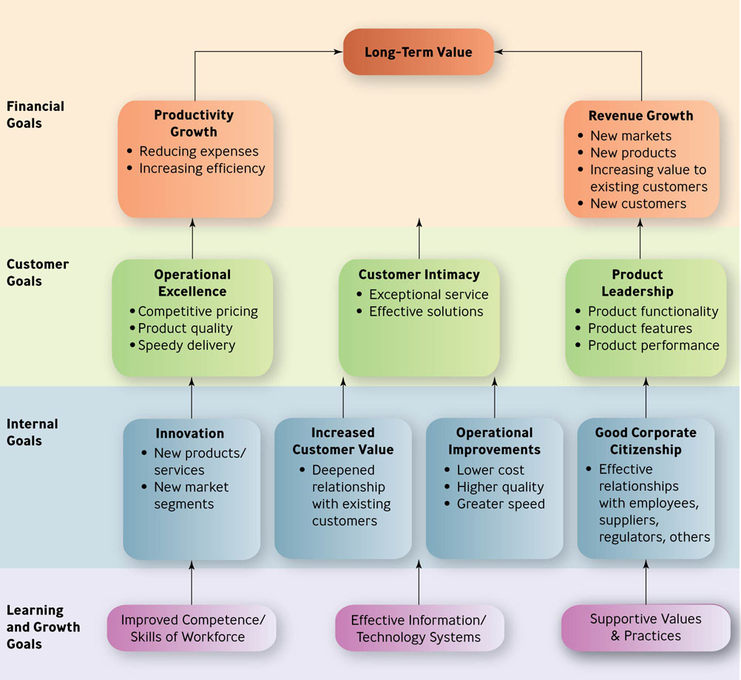
The Strategy Map
Figure 16.6

Slide 24
Why Measure-Managed Firms Succeed
Top executives agree on strategy
Communication is clear
There is better focus and alignment
The organizational culture emphasizes teamwork and allows risk taking

Slide 25
Barriers to Effective Measurement
Objectives are fuzzy
Managers put too much trust in informal feedback systems
Employees resist new measurement systems
Companies focus too much on measuring activities instead of results

Slide 26
Question?
Jeff’s sales goal was to “improve sales”. Which barrier to measurement is this?
Objectives are fuzzy
Managers put too much trust in informal feedback systems
Employees resist new measurement systems
Companies focus too much on measuring activities
Notes:
The correct answer is “A”. See previous slide.
Multimedia Lecture Support Package to Accompany Basic Marketing
Lecture Script 6-*

Slide 27
Financial Tools for Control
Budget
formal financial projection
Incremental budgeting
allocates increased or decreased funds to a department by using the last budget period as a reference point
only incremental changes in the budget request are reviewed

Slide 28
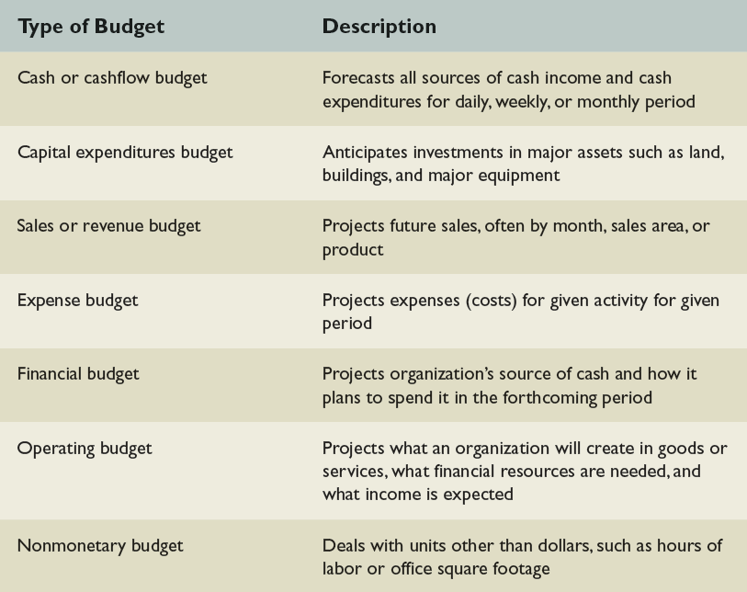
Types of Budgets
Table 16.1

Slide 29

Fixed versus Variable Budgets
Fixed budgets
resources are allocated on a single estimate of costs
Variable budgets
resources are varied in proportion with various levels of activity

Slide 30
Financial Statements
Balanced sheet
summarizes an organization’s overall financial worth – assets and liabilities - at a specific point in time
Income statement
summarizes an organization’s financial results – revenues and expenses - over specified period of time

Slide 31
Ratio Analysis
Liquidity ratios
indicate how easily a firm’s assets can be converted to cash
Debt management ratios
degree to which a firm can meet it’s long-term financial obligations
Return ratios
how effective management is generating a return or profit

Slide 32
Audits
Audit
formal verification of an organization’s financial and operational systems
External – performed by outside experts
Internal – performed by organization’s own professional staff

Slide 33
Deming Management
Quality should be aimed at the needs of the consumer
Companies should aim at improving the system, not blaming workers
Improved quality leads to increased market share, increased company prospects, & increased employment
Quality can be improved on the basis of hard data, using the PDCA cycle

Slide 34
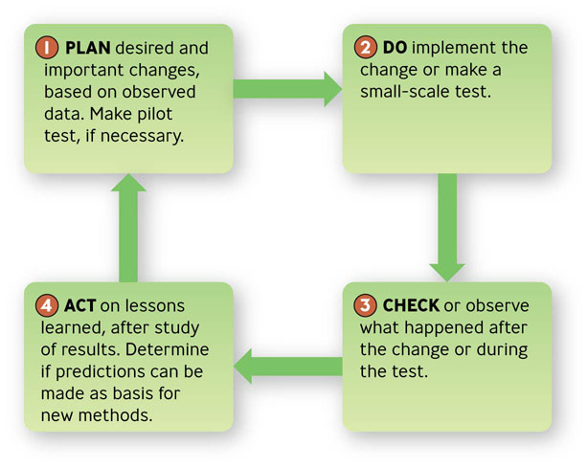
The PDCA Cycle
Figure 16.7

Slide 35
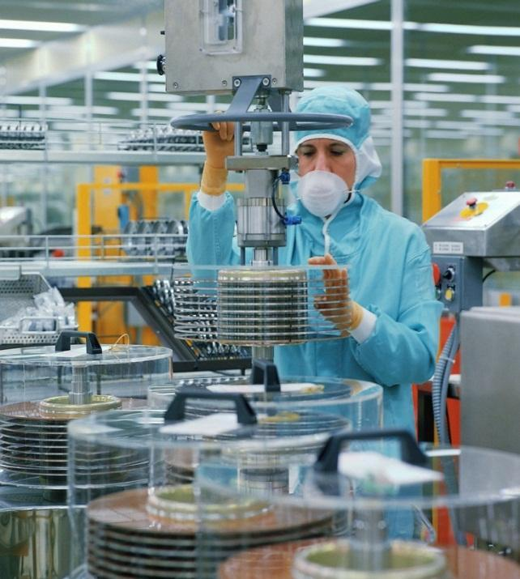
Total Quality Management
Total Quality Management (TQM)
a comprehensive approach - led by top management and supported throughout the organization - dedicated to continuous quality improvement, training, and customer satisfaction

Slide 36

Example: Viking Range Corporation
Fred Carl found restaurant-style commercial stoves impractical for his own home kitchen, so he designed his own
Production is set up so that if there is a problem everyone on the line is instantly aware of it, and the problem is solved right on the plant floor—so that customers are continuously supplied with elegant yet dependable stoves

Slide 37
Two Core Principles of TQM
People orientation
everyone involved in the organization should focus on delivering value to customers
Improvement orientation
everyone should work on continuously improving work processes

Slide 38
People Orientation
Delivering customer value is most important
People will focus on quality if given empowerment
TQM requires training, teamwork, and cross-functional efforts

Slide 39
Improvement Orientation
It’s less expensive to do it right the first time
It’s better to do small improvements all the time
Accurate standards must be followed to eliminate small variations
There must be strong commitment from top management

Slide 40
Applying TQM to Services: The Rater Scale
RATER scale
enables customers to rate the quality of a service along dimensions – reliability, assurance, tangibles, empathy, and responsiveness

Slide 41
Some TQM Techniques
Benchmarking
Outsourcing
Reduced cycle time
ISO 9000 and 14000 Series
Statistical process control
Six Sigma & Lean Six Sigma

Slide 42
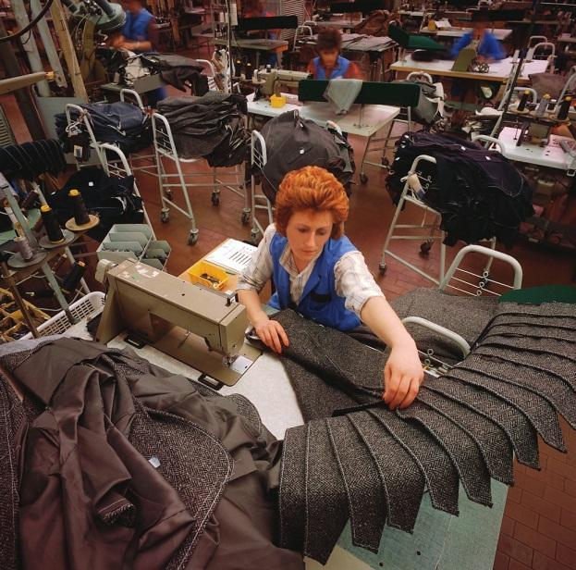
Question?
In Harvey's job, he takes random samples of production runs to ascertain quality. His job involves:
Benchmarking
Statistical process control
Reduced cycle time
Feedforward control
Notes:
The correct answer is “B”.
Multimedia Lecture Support Package to Accompany Basic Marketing
Lecture Script 6-*

Slide 43
The Keys to Successful Control Systems
They are strategic & results oriented
They are timely, accurate, & objective
They are realistic, positive, & understandable & encourage self-control
They are flexible

Slide 44
Barriers to Control Success
Too much control
Too little employee participation
Overemphasis on means instead of ends
Overemphasis on paperwork
Overemphasis on one instead of multiple approaches

Slide 45
Keys to Your Managerial Success
Find your passion and follow it.
Encourage self-discovery, and be realistic.
Every situation is different, so be flexible
Fine-tune your people skills

Slide 46
Keys to Your Managerial Success
Learn how to develop leadership skills
Treat people as if they matter, because they do
Draw employees and peers into your management process
Be flexible, keep your cool, and take yourself lightly

