Slide 1
Chapter Fifteen
Interpersonal &
Organizational
Communication:
Mastering the Exchange of Information
McGraw-Hill/Irwin
Copyright © 2013 by The McGraw-Hill Companies, Inc. All rights reserved.

Slide 2
Major Questions You Should Be Able to Answer
15.1 What do I need to know about the communication process to be an effective communicator?
15.2 What are the important barriers I need to be aware of, so I can improve my communication skills?
15.3 How can I use the different channels and patterns of communication to my advantage?

Slide 3
Major Questions You Should Be Able to Answer
15.4 How do contemporary managers use information technology to communicate more effectively?
15.5 How can I be a better listener, reader, writer, and speaker?

Slide 4
Communication Defined: The Transfer of Information & Understanding
Communication
the transfer of information and understanding from one person to another
81% of a manager’s time in a typical workday is spent communicating

Slide 5
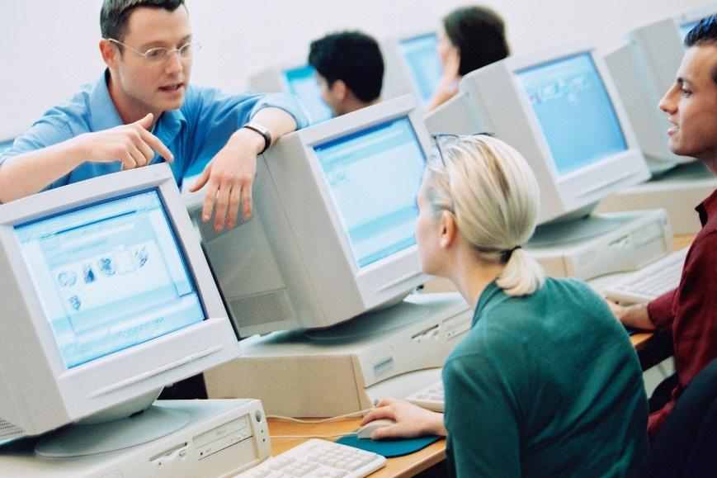
How the Communication Process Works
Sender
person wanting to share information-called a message
Receiver
person for whom the message is intended

Slide 6
How the Communication Process Works
Encoding
translating a message into understandable symbols or language
Decoding
interpreting and trying to make sense of the message

Slide 7
How the Communication Process Works
Medium
the pathway by which a message travels
Feedback
the receiver expresses his reaction to the sender’s message
Noise
any disturbance that interferes with the transmission of a message

Slide 8
Question?
Rachel and Alexa are talking on their cell phones. After Rachel reads her a phone number, Alexa repeats the number back to Rachel. This is an example of:
Feedback
Encoding
Decoding
Medium selection
Notes:
The correct answer is “A” - feedback
Multimedia Lecture Support Package to Accompany Basic Marketing
Lecture Script 6-*

Slide 9
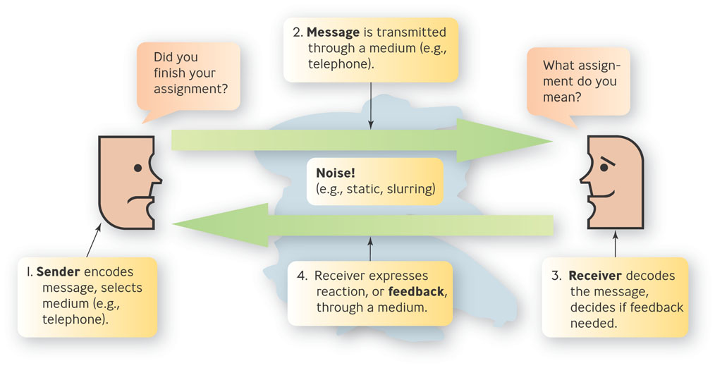
The Communication Process
Figure 15.1

Slide 10
Selecting the Right Medium
Medium richness
indicates how well a particular medium conveys information and promotes learning
Rich medium
best for nonroutine situations and to avoid oversimplification
Lean medium
best for routine situations and to avoid overloading

Slide 11
Barriers to Communication
Physical barriers: sound, time, space, & so on
Semantic barriers: when words matter
Personal barriers: individual attributes that hinder communication

Slide 12
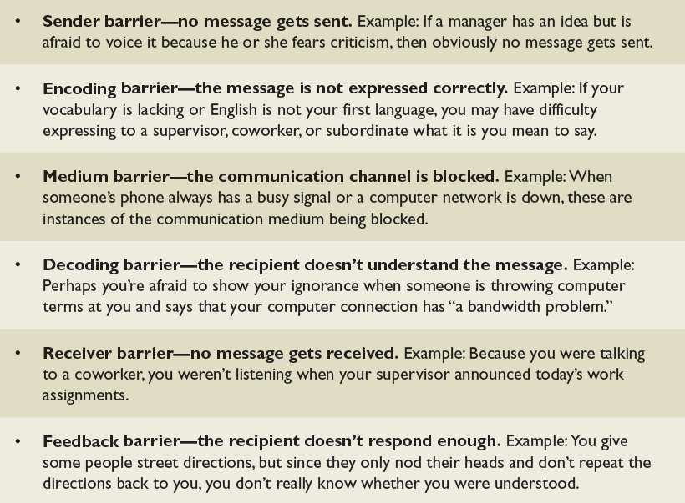
Some Barriers the Happen Within the Communication Process
Table 15.1

Slide 13
Question?
Greg was thinking about how he just did on his Economics test when his Management professor talked about tomorrow's Management quiz. This is an example of a(n) _____ barrier.
Encoding
Decoding
Medium
Receiver
Notes:
The correct answer is “D” – receiver.
Multimedia Lecture Support Package to Accompany Basic Marketing
Lecture Script 6-*

Slide 14
Semantic Barriers
Semantics
study of the meaning of words
Jargon
terminology specific to a particular profession or group

Slide 15
Personal Barriers
Variable skills in communicating effectively
Variations in how information is processed & interpreted
Variations in trustworthiness & credibility
Oversized egos

Slide 16
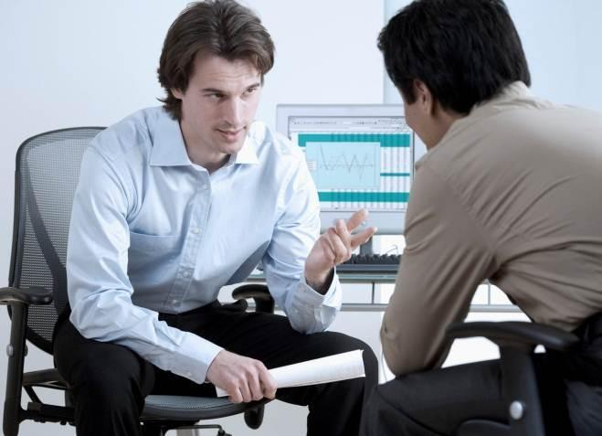
Personal Barriers (cont.)
Faulty listening skills
Tendency to judge others’ messages
Inability to listen with understanding
Stereotypes and prejudices

Slide 17
Nonverbal Communication
Nonverbal communication
consists of messages sent outside of the written or spoken word
Expressed through interpersonal space, eye contact, facial expressions, body movements & gestures, touch, setting and time

Slide 18
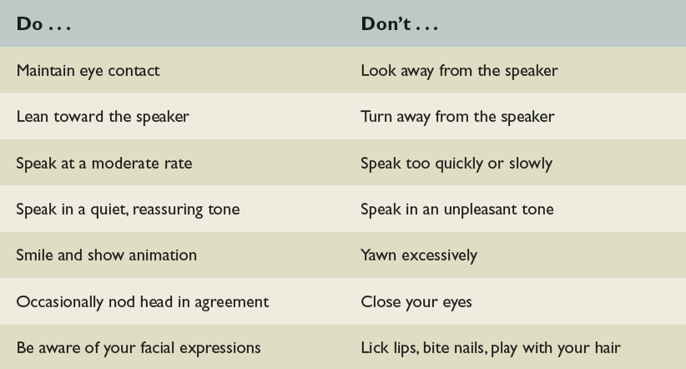
Toward Better Nonverbal Communication Skills
Table 15.2

Slide 19
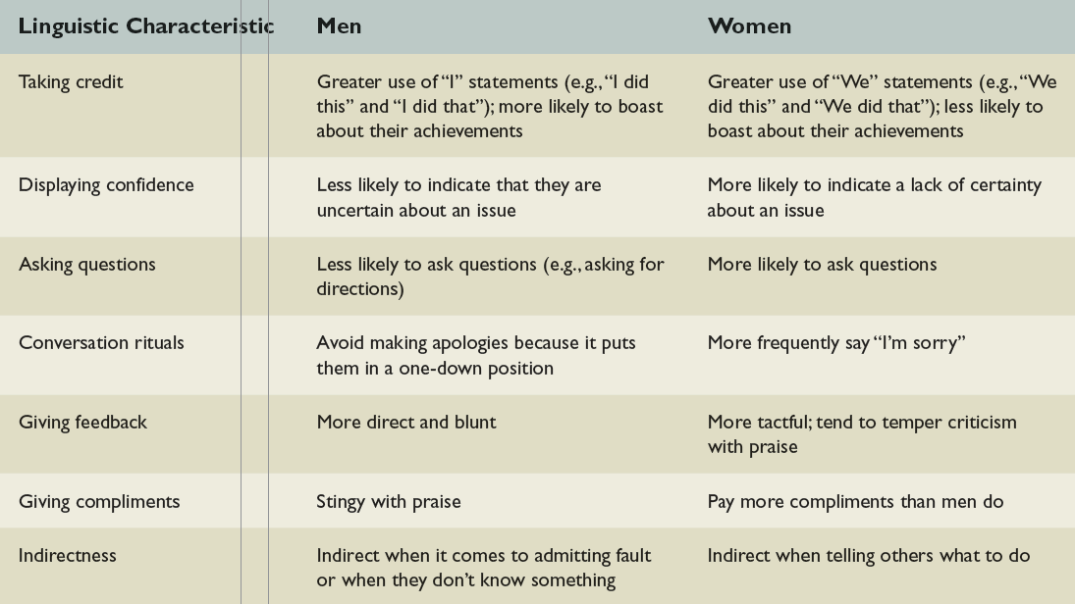
Communication Differences
Table 15.3

Slide 20
Example: Women & Communication
There is evidence that women are superior at multitasking and better at relationships, which is important in developing teams
Women are also more willing to share information

Slide 21
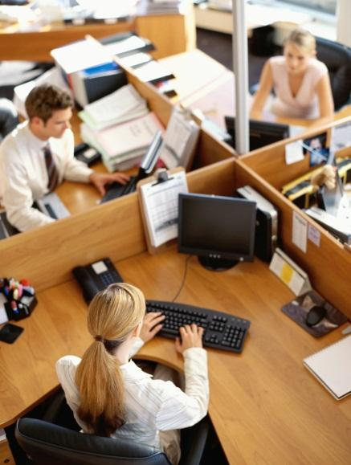
Formal Communication Channels
Formal communication channels
follow the chain of command and are recognized as official
vertical, horizontal, external
Notes:
vertical —meaning upward and downward,
horizontal — meaning laterally (sideways), and
external —meaning outside the organization
*

Slide 22
Question?
Jeremy shares information with his fellow task-force members about their project. Jeremy is communicating:
Externally
Downward
Upward
Horizontally
Notes:
The correct answer is “D
Multimedia Lecture Support Package to Accompany Basic Marketing
Lecture Script 6-*

Slide 23
Informal Communication Channels
Informal communication channels
develop outside the formal structure and do not follow the chain of command

Slide 24
Informal Communication Channels
Grapevine
unofficial communication system of the informal organization
Management by wandering around
term used to describe a manager’s literally wandering around his organization and talking with people across all lines of authority

Slide 25
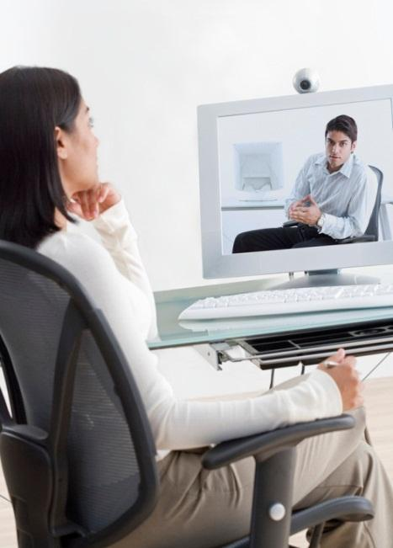
Communication in the Information Age
Multicommunicating
represents the use of technology to participate in several interactions at the same time

Slide 26
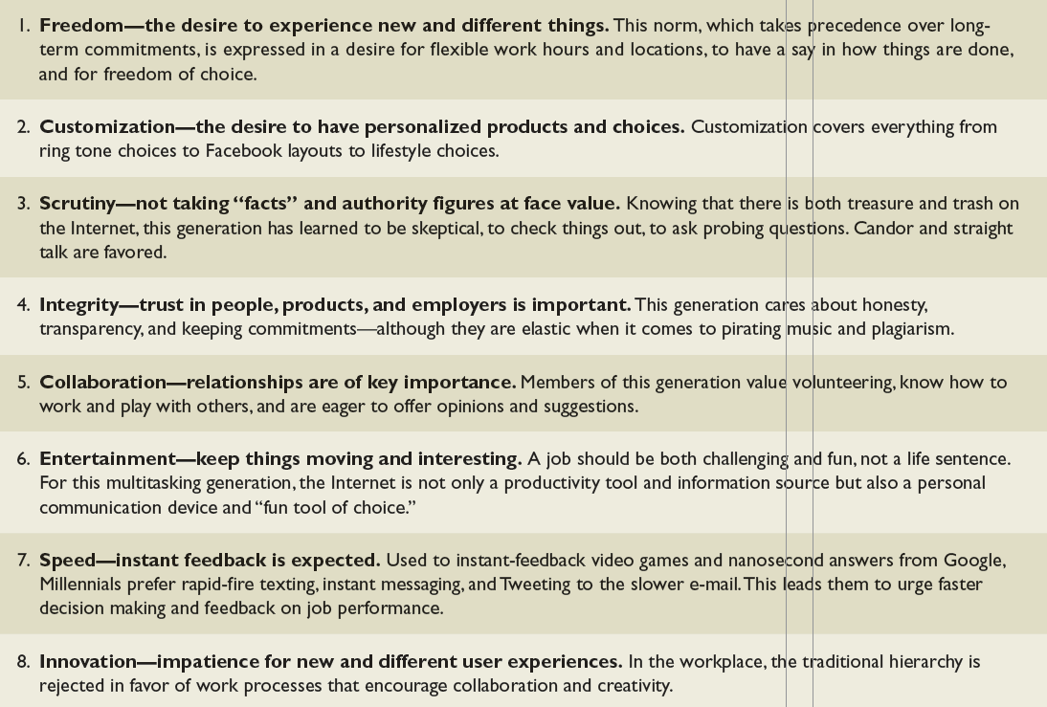
Eight Norms of the Millennial or Internet Generation
Table 15.5

Slide 27
Digital Communication & the New Workplace
Videoconferencing
uses video and audio links along with computers to enable people in different locations to see, hear, and talk with each other
Telepresence technology
high-definition videoconference systems that simulate face-to-face meetings between users

Slide 28
Digital Communication & the New Workplace
Benefits of Telecommuting
Reduces capital costs
Increases flexibility and autonomy for workers
Provides a competitive advantage when recruiting
Increases job satisfaction
Increases productivity
Ability to tap into nontraditional workers

Slide 29
Downside of the Digital Age
Security
a system of safeguards for protecting information technology against disasters, system failures, and unauthorized access that result in damage or loss
Identity theft
thieves hijack your name and identity and use your good credit rating to get cash or buy things

Slide 30
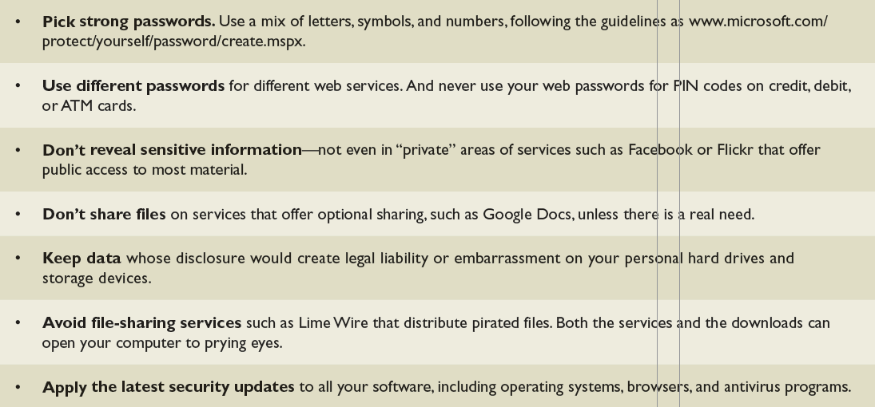
Protecting Against Security and Privacy Breaches on the Internet
Table 15.6

Slide 31
Disadvantages of E-Mail
Has been a decrease in all other forms of communication among co-workers—including greetings and informal conversations
Emotions often are poorly communicated or miscommunicated via e-mail messages
The greater the use of e-mail, the less connected co-workers reportedly feel.

Slide 32
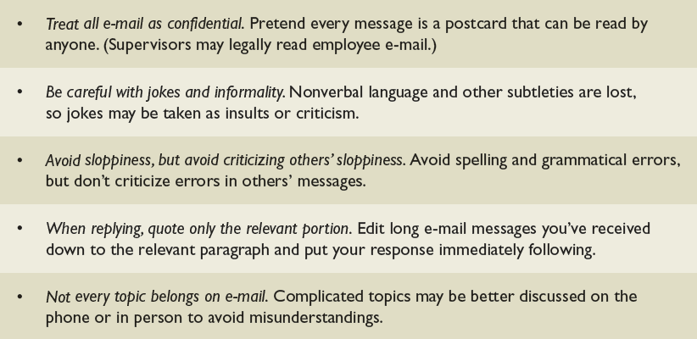
Tips for Better E-Mail Handling
Table 15.7

Slide 33
Smartphones: Use & Abuse
Cell phones are now mostly smartphones
As smartphones develop more features and make available more applications, their importance will only increase

Slide 34
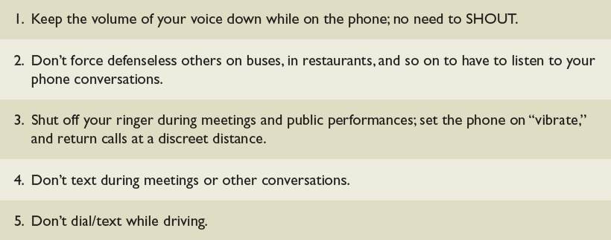
Five Rules for Using Smartphones
Table 15.8

Slide 35



Social Media: Pros & Cons
Social media
Internet-based and mobile technologies used to generate interactive dialogue with members of a network

Slide 36
Some Business Benefits of Social Media
Crowdsourcing
the practice of obtaining needed services, ideas, or content by soliciting contributions from a large group of people and especially from the online community, such as Facebook and Twitter users

Slide 37
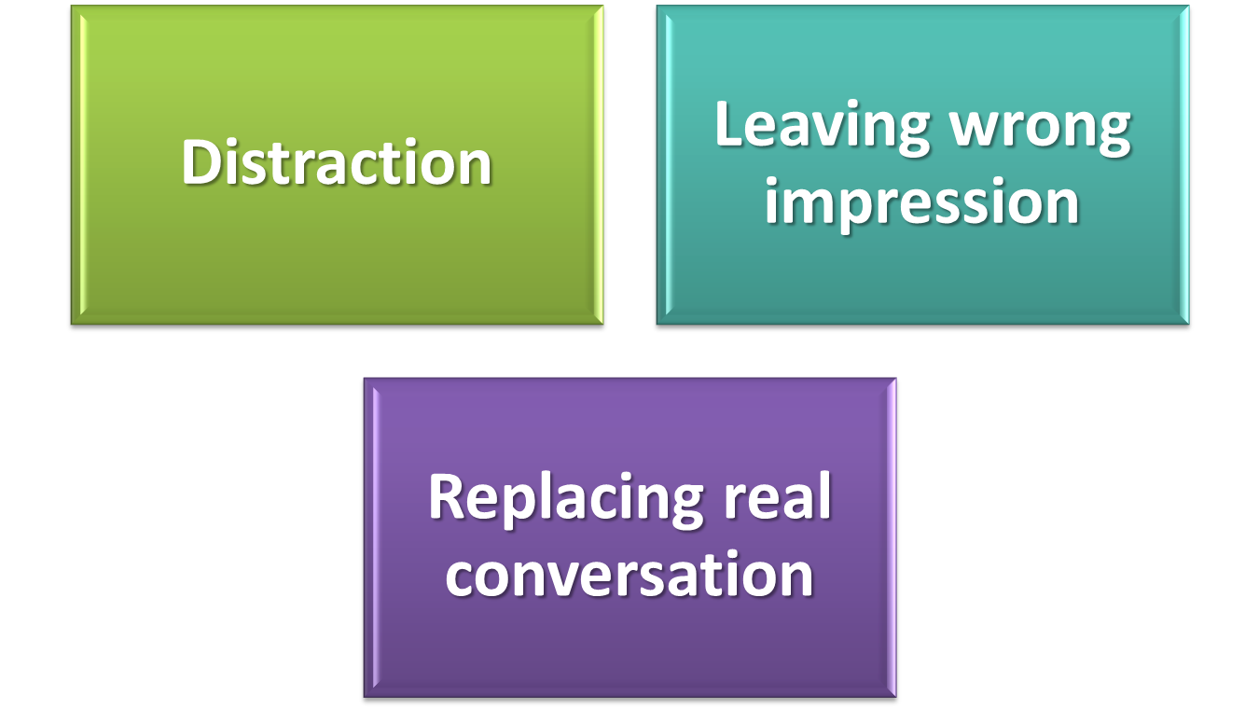
The Downside of Social Media

Slide 38
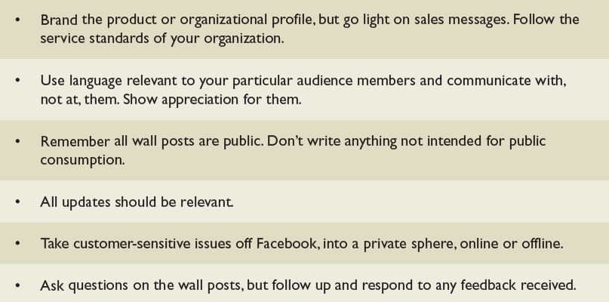
Using Facebook in Your Personal Life
Table 15.9

Slide 39
What ’s Your Listening Style — or Styles?
Appreciative style
listening to be amused
Empathic style
tuning into the speaker ’ s emotions
Comprehensive style
focusing on the speaker ’ s logic

Slide 40
What ’s Your Listening Style — or Styles?
Discerning style
focusing on the main message
Evaluative style
challenging the speaker

Slide 41
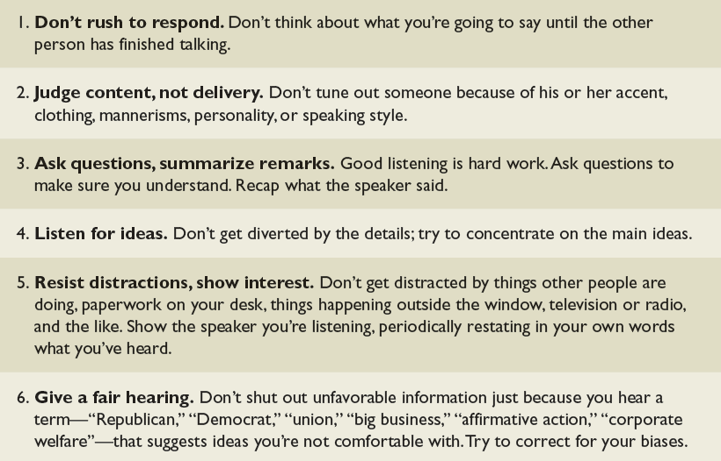
Six Keys to Effective Listening
Table 15.10

Slide 42
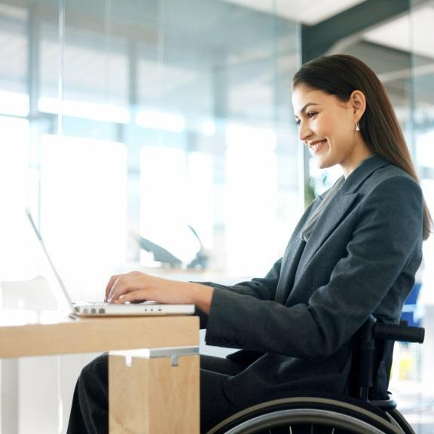
Being an Effective Reader
Realize that speed reading doesn’t work
Learn to streamline reading
Do top-down reading – SQ3R
Notes:
SQ3R (Survey, Question, Read, Recite, Review) method
*

Slide 43
Learn to Streamline Reading
Be savvy about periodicals and books
Transfer your reading load
Make internal memos and e-mail more efficient

Slide 44
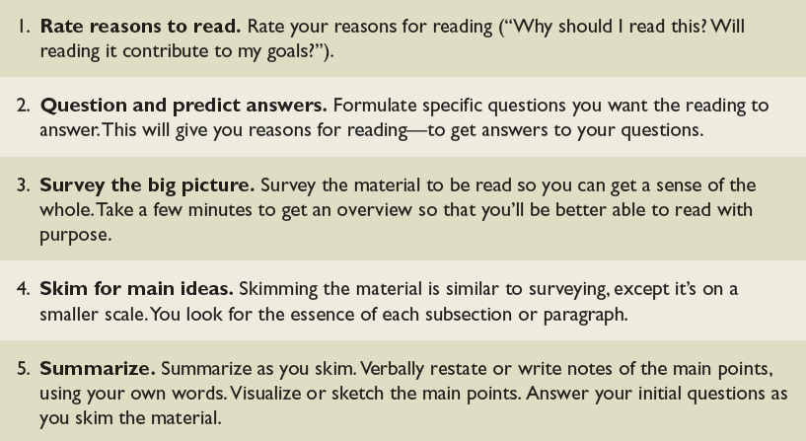
Five Steps to Better Reading
Table 15.11

Slide 45
Being an Effective Writer
Don’t show your ignorance
Understand your strategy before you write
Start with your purpose
Write simply, concisely, and directly
Telegraph your writing with a powerful layout

Slide 46
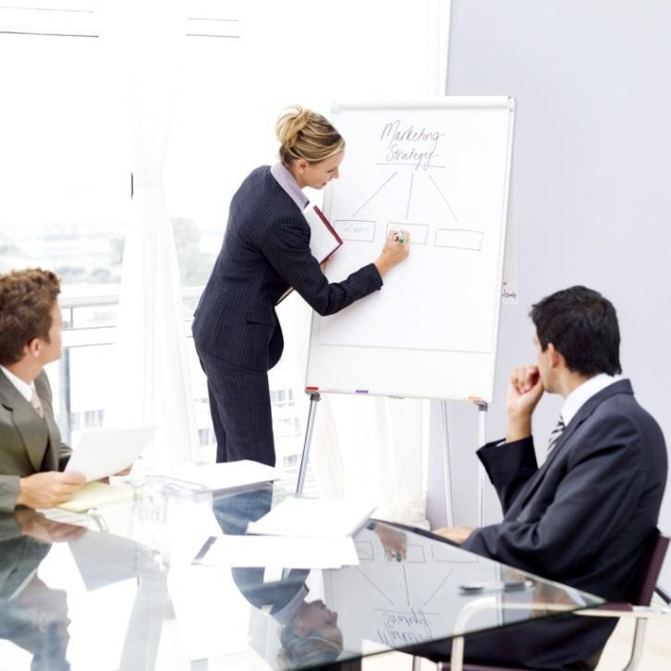
Being an Effective Speaker
Tell them what you’re going to say
Say it
Tell them what you said

