Slide 1
Chapter Fourteen
Power, Influence, & Leadership:
From Becoming a Manager to Becoming
a Leader
McGraw-Hill/Irwin
Copyright © 2013 by The McGraw-Hill Companies, Inc. All rights reserved.

Slide 2
Major Questions You Should Be Able to Answer
14.1 I don’t want to be just a manager; I want to be a leader. What’s the difference between the two?
14.2 What does it take to be a successful leader?
14.3 Do effective leaders behave in similar ways?

Slide 3
Major Questions You Should Be Able to Answer
14.4 How might effective leadership vary according to the situation on hand?
14.5 What does it take to truly inspire people to perform beyond their normal levels?
14.6 If there are many ways to be a leader, which one would describe me best?

Slide 4

The Nature of Leadership
Leadership
  the ability to influence employees to voluntarily pursue organizational gains

Slide 5
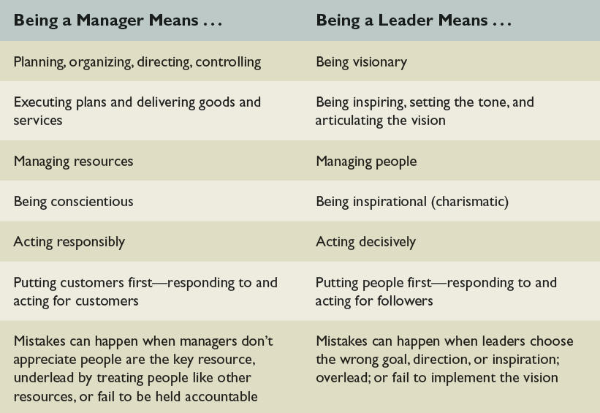
Characteristics of Being a Manager & a Leader
Table 14.1

Slide 6
Being a Manager:
Coping with Complexity
Determining what needs to be done - planning and budgeting
Creating arrangements of people to accomplish an agenda - organizing and staffing
Ensuring people do their jobs - controlling and problem solving

Slide 7
Being a Leader:
Coping with Change
Determining what needs to be done - setting a direction
Creating arrangements of people to accomplish an agenda - aligning people
Ensuring people do their jobs - motivating and inspiring

Slide 8
Five Sources of Power
Legitimate power
  results from managers’ formal positions within the organization
Reward power
  results from managers’ authority to reward their subordinates
Coercive power
  results from managers’ authority to punish their subordinates

Slide 9
Question?
Alex compliments his co-worker Joe on the great job he did on the weekly report, and also informs their mutual boss. Alex is using ______ power.
Legitimate
Referent
Reward
Punishment
Notes:
The correct answer is “C” – reward power.
Multimedia Lecture Support Package to Accompany Basic Marketing
Lecture Script 6-*

Slide 10

Five Sources of Power (cont.)
Expert power
  results from one’s specialized information or expertise
Referent power
  derived from one’s
  personal attraction

Slide 11
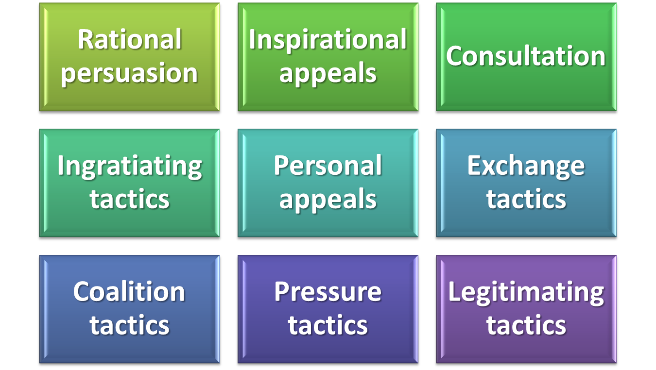
Tactics for Influencing Others
Notes:
The ability to get others to follow your wishes is influence
There are nine ways to try to influence others:
-rational persuasion - convincing someone by using logic, reason, or facts
-inspirational appeals - building enthusiasm or confidence by appeals to emotions, ideals, or values
-consultation - getting others to participate in a decision or change
ingratiating tactics - acting humble or friendly before making a request
-personal appeals - referring to friendship and loyalty when making a request
-exchange tactics - reminding someone of past favors or offering to make a trade
-coalition tactics - getting others to support your effort
-pressure tactics - using demands, threats, or intimidation
-legitimating tactics - basing a request on implied support from superiors, or on rules or policies
Multimedia Lecture Support Package to Accompany Basic Marketing
Lecture Script 6-*

Slide 12
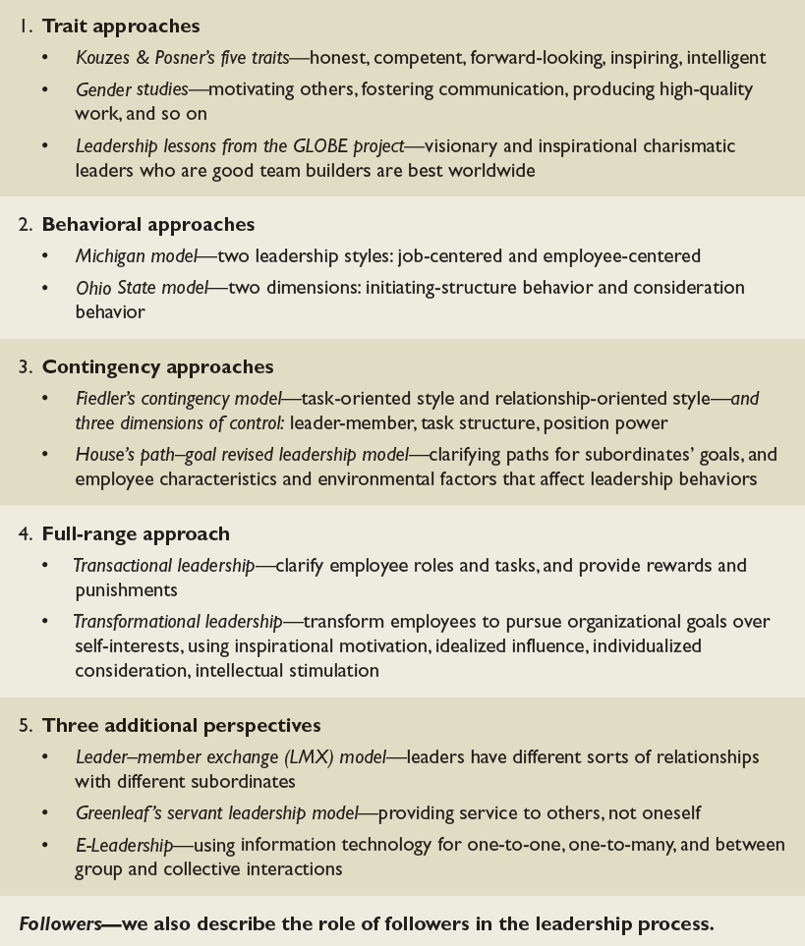
Five Approaches to Leadership
Table 14.2

Slide 13
Do Leaders Have Distinctive Personality Characteristics?
Trait approaches to leadership
  attempt to identify distinctive characteristics that account for the effectiveness of leaders

Slide 14
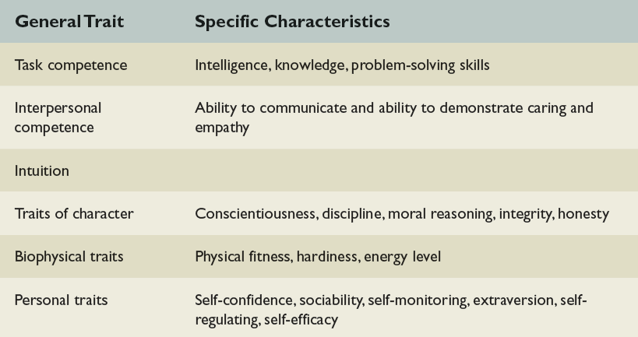
Key Positive Leadership Traits
Table 14.3

Slide 15
Do Women Have Traits that Make Them Better Leaders?
Studies show that women executives score higher than their male counterparts on a variety of measures - from producing high quality work to goal-setting to mentoring employees
Notes:
Women tend to have more leadership traits than men, but hold fewer leadership positions
CEOs believe this may be because women lack significant general management experience, and have not been around long enough to be selected
Women believe that male stereotyping and exclusion from important informal networks contribute to the problem
Other reasons may be because women are not willing to compete as hard as men, or make the necessary personal sacrifices
Multimedia Lecture Support Package to Accompany Basic Marketing
Lecture Script 6-*

Slide 16
Leadership Lessons from the GLOBE Project
Project GLOBE
  ongoing attempt to develop an empirically based theory to “describe, understand, and predict the impact of specific cultural variables on leadership and organizational processes and the effectiveness of these processes

Slide 17

Behavioral Approaches
Behavioral leadership
  approaches attempt to determine the distinctive styles used by effective leaders

Slide 18
Michigan Leadership Model
Job-centered behavior
  principal concerns were with achieving production efficiency, keeping costs down, and meeting schedules
Employee-centered behavior
  managers paid more attention to employee satisfaction and making work groups cohesive

Slide 19
Question?
Clint, a manager, pays close attention to employee productivity and how efficiently the assembly line is moving. Clint is probably ___________.
Path-centered
Job-centered
Employee-centered
Charismatic
Notes:
The correct answer is “B” – job centered
Multimedia Lecture Support Package to Accompany Basic Marketing
Lecture Script 6-*

Slide 20
Ohio State Leadership Model
Initiating structure
  behavior that organizes and defines what group members should be doing
Consideration
  expresses concern for employees by establishing a warm, friendly, supportive climate

Slide 21
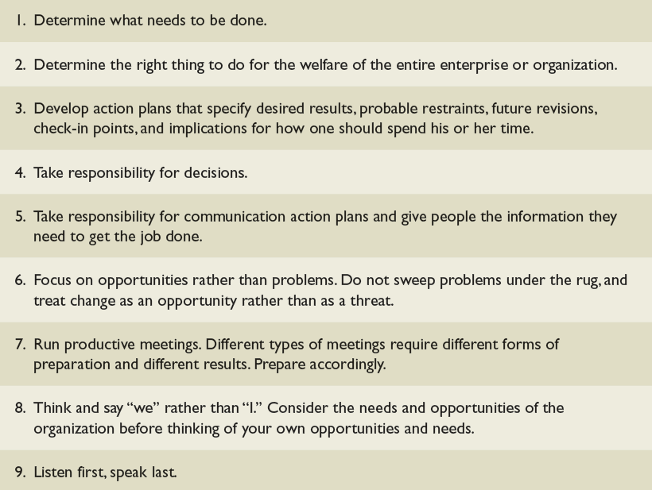
Drucker’s Tips for Improving Leadership Effectiveness
Table 14.5

Slide 22

Contingency Approaches
Contingency leadership model
  determines if a leader’s style is task oriented or relationship-oriented and if that style is effective for the situation at hand

Slide 23
Dimensions of Situational Control
Leader-member relations
  reflects the extent to which the leader has the support, loyalty, and trust of the work group
Task structure
  extent to which tasks are routine and easily understood
Position power
  refers to how much power a leader has to make work assignments and reward and punish

Slide 24
Question?
Rayford is head of a task force consisting of his peers from other departments in the organization. Rayford has:
High leader-member relations
High task structure
High position power
Low position power
Notes:
The correct answer is “D”.
Multimedia Lecture Support Package to Accompany Basic Marketing
Lecture Script 6-*

Slide 25
The Path-Goal Leadership Model
Path-Goal Leadership Model
  holds that the effective leader makes available to followers desirable rewards in the workplace and increases their motivation by clarifying the paths, or behavior, that will help them achieve those goals and providing them with support

Slide 26
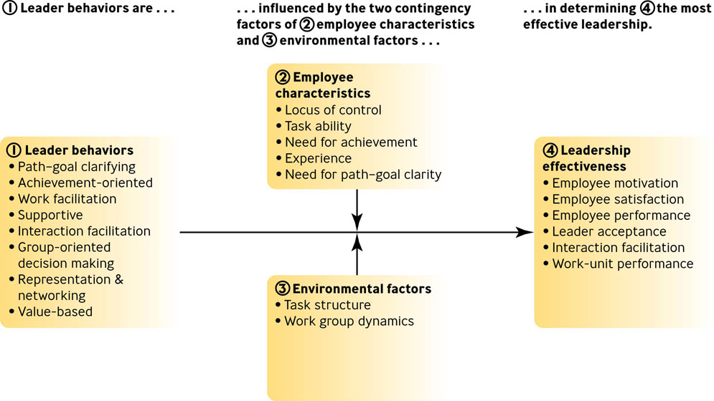
House’s Revised Path-Goal Theory
Figure 14.2

Slide 27
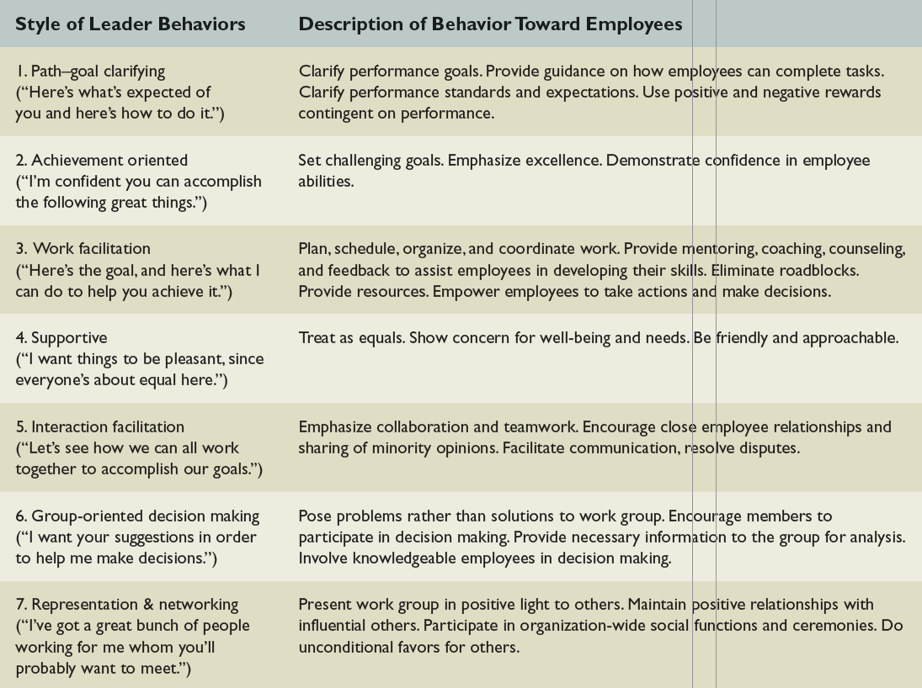
Leadership Styles of the Revised Path-Goal Theory
Table 14.6

Slide 28
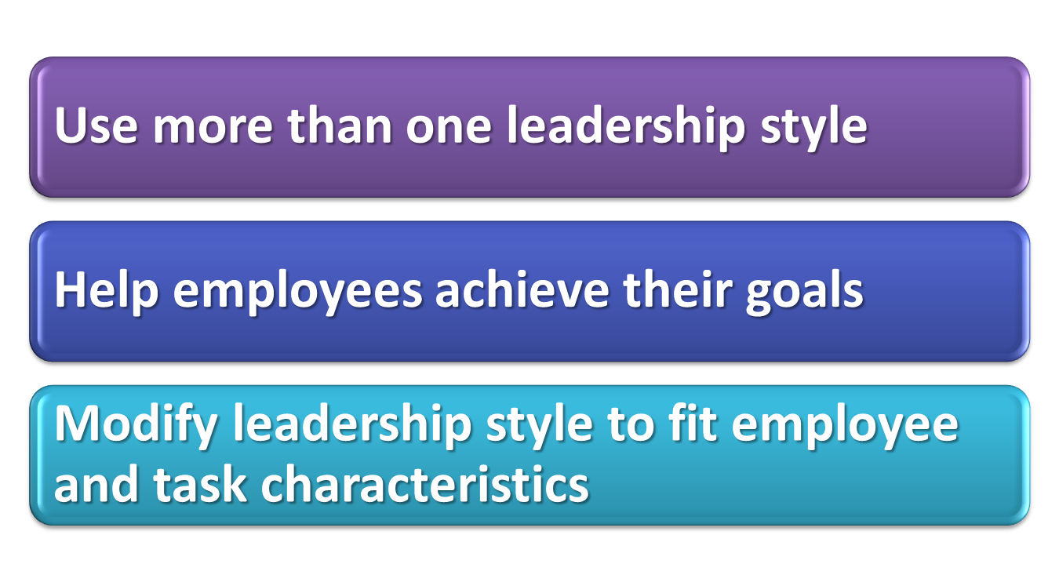
Does the Revised Path – Goal Theory Work?

Slide 29
Applying Situational Theories:
Five Steps
Step 1: Identify Important Outcomes: “What Goals Am I Trying to Achieve?”
Step 2: Identify Relevant Employee Leadership Behaviors: “What Management Characteristics Are Best?”
Step 3: Identify Situational Conditions: “What Particular Events Are Altering the Situation?”

Slide 30
Applying Situational Theories:
Five Steps
Step 4: Match Leadership to the Conditions at Hand: “How Should I Manage When There Are Multiple Conditions?”
Step 5: Determine How to Make the Match: “Change the Manager or Change the Manager ’s Behavior?”

Slide 31
Full-Range Model
Transactional leadership
  focuses on clarifying employees’ roles and task requirements and providing rewards and punishments contingent on performance

Slide 32
Full-Range Model
Transformational leadership
  transforms employees to pursue organizational goals over self-interests
  influenced by individual characteristics and organizational culture

Slide 33
Question?
Jim, a manager, uses rewards and discipline to motivate subordinates, but does this as a way of helping them reach their full potential. This is called:
Contingent leadership
Transformational leadership
Developmental consideration
Democratic leadership
Notes:
The correct answer is “B”
Multimedia Lecture Support Package to Accompany Basic Marketing
Lecture Script 6-*

Slide 34
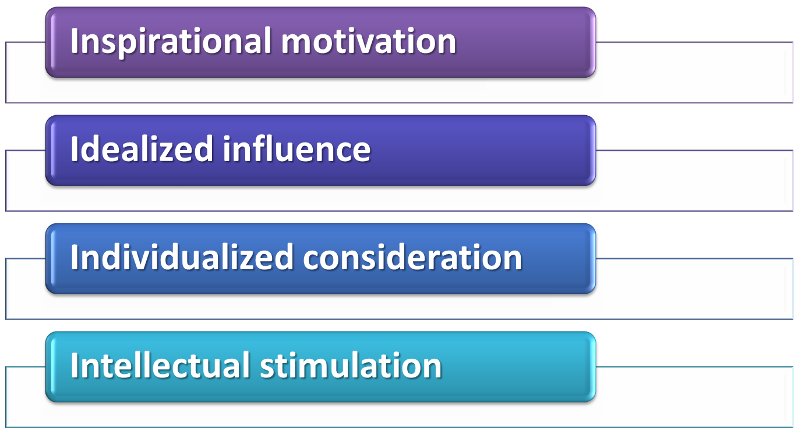
Key Behaviors of Transformational Leaders

Slide 35

Implications of Transformational Leadership
It can improve results for both individuals and groups
It can be used to train employees at any level
It requires ethical leaders

Slide 36
Three Additional Perspectives
Leader-Member Exchange (LMX)
  emphasizes that leaders have different sorts of relationships with different subordinates

Slide 37
Three Additional Perspectives
Servant leaders
  focus on providing increased service to others - meeting the goals of both followers and the organization - rather than to themselves
E-leadership
  can involve one-to-one, one-to-many, and within-group and between-group and collective interaction via information technology

Slide 38
Question?
Laura is involved in leading a virtual team with members in Kansas, South Carolina, Chicago, and India. This is an example of __________.
Servant leadership
Shared leadership
Leader-member exchange
E-leadership
Notes:
The correct answer is “D” – e-leadership. See previous slide.
Multimedia Lecture Support Package to Accompany Basic Marketing
Lecture Script 6-*

Slide 39
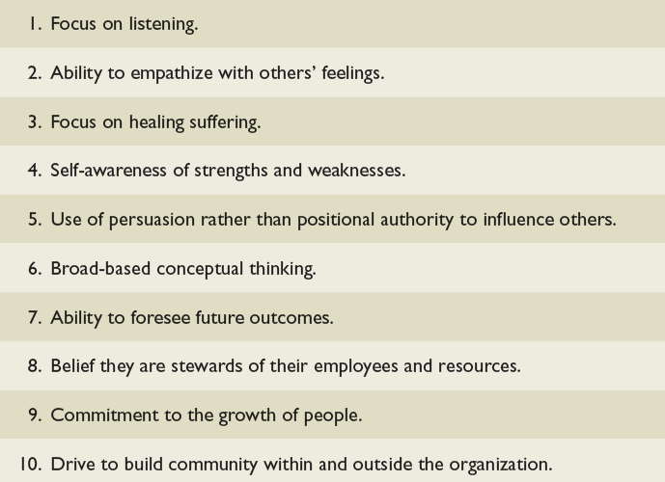
Characteristics of the
Servant Leader
Table 14.8

Slide 40
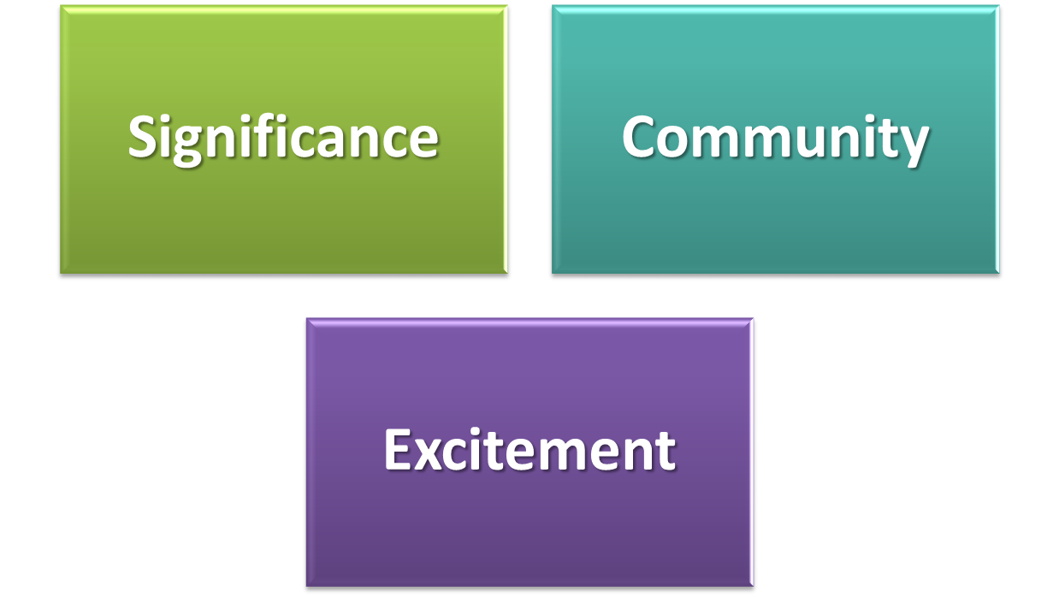
What Do Followers Want in Their Leaders?
Notes:
■ Significance. Such leaders make followers feel that what they do at work is
important and meaningful.
■ Community. These leaders create a sense of unity that encourages followers
to treat others with respect and to work together in pursuit of organizational
goals.
■ Excitement. The leaders make people feel energetic and engaged at
work.
*

