Slide 1
Chapter Thirteen
Groups & Teams:
Increasing Cooperating, Reducing Conflict
McGraw-Hill/Irwin
Copyright © 2013 by The McGraw-Hill Companies, Inc. All rights reserved.

Slide 2
Major Questions You Should Be Able to Answer
13.1 How is one collection of workers different from any other?
13.2 How does a group evolve into a team?
13.3 How can I as a manager build an effective team?
13.4 Since conflict is a part of life, what should a manager know about it in order to deal successfully with it?

Slide 3
The Challenge of Managing
Virtual Teams
Take baby steps and manage by results
State expectations
Write it down
Communicate, but be considerate
Be aware of cultural differences
Meet regularly

Slide 4
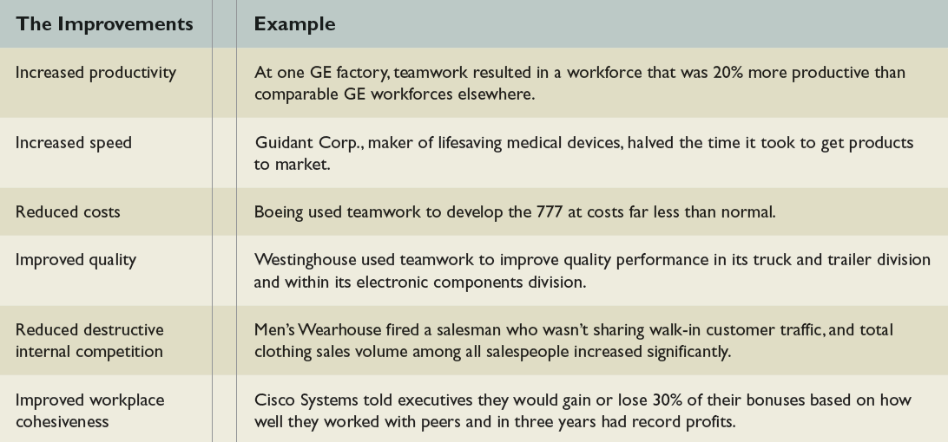
Why Teamwork is Important
Table 13.1

Slide 5

Groups & Teams
Group
  two or more freely acting individuals who share collective norms, collective goals, and have a common identity

Slide 6
Groups & Teams
Team
  small group of people with complementary skills who are committed to a common purpose, performance goals, and approach for which they hold themselves mutually accountable

Slide 7
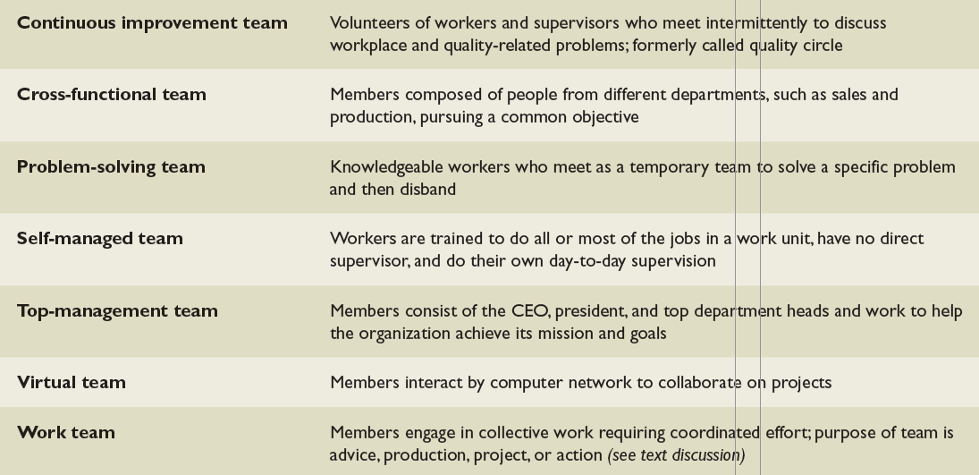
Various Types of Teams
Table 13.2

Slide 8
Formal versus Informal Groups
Formal group
  established to do something productive for the organization
  headed by a leader
Informal group
  formed by people seeking friendship
  has no officially appointed leader, although a leader may emerge

Slide 9

Example: Informal Groups & Informal Learning
Siemens employees gathered often in the lunchroom
More work than chit-chat
Siemens managers placed overhead projectors and notepads in the lunchroom to facilitate the exchange of information

Slide 10
Work Teams for Four Purposes
Advice teams
  created to broaden the information base for managerial decisions
  Committees, review panels
Production teams
  responsible for performing day-to-day operations
  Assembly teams, maintenance crews

Slide 11
Question?
A stakeholder group who provides reactions to new curriculum proposals by a university faculty is an example of a(n):
Production team
Project team
Action team
Advice team
Notes:
The correct answer is “D” – advice team
Multimedia Lecture Support Package to Accompany Basic Marketing
Lecture Script 6-*

Slide 12
Work Teams for Four Purposes
Project teams
  work to do creative problem solving, often by applying the specialized knowledge of members of a cross-functional team
  Task forces, research groups

Slide 13
Work Teams for Four Purposes
Action teams
  work to accomplish tasks that require people with specialized training and a high degree of coordination
  Hospital surgery teams, airline cockpit crews, police SWAT teams

Slide 14

Self-Managed Teams
Self-Managed teams
  groups of workers who are given administrative oversight for their task domains

Slide 15
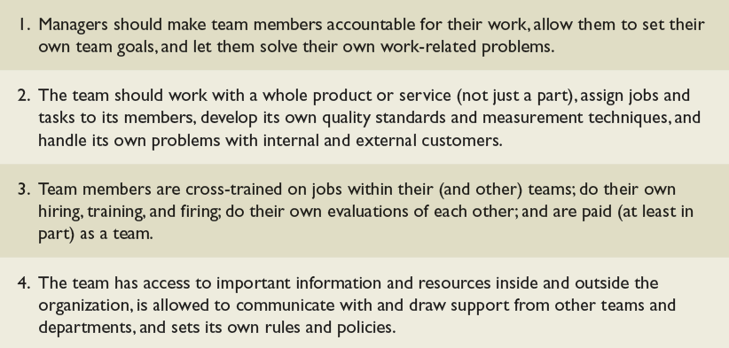
Ways to Empower
Self-Managed Teams
Table 13.3

Slide 16
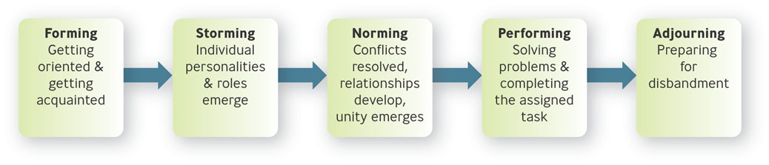
Five Stages of Group and Team Development
Figure 13.1

Slide 17
Stage I: Forming
Forming
  process of getting oriented and getting acquainted
Leaders should allow time for people to become acquainted and socialize

Slide 18
Stage 2: Storming
Storming
  characterized by the emergence of individual personalities and roles and conflicts within the group
Leaders should encourage members to suggest ideas, voice disagreements, and work through their conflicts about tasks and goals

Slide 19
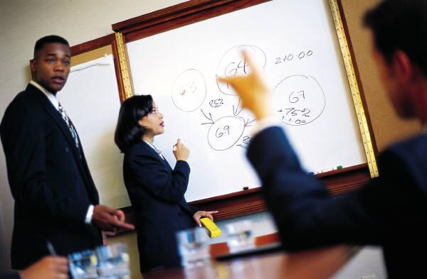
Question?
Jeff’s workgroup is having a lot of disagreement over the direction the group should take. They are involved in the __________ stage of group development.
Forming
Storming
Norming
Performing
Notes:
The correct answer is “B” – storming. See previous slide.
Multimedia Lecture Support Package to Accompany Basic Marketing
Lecture Script 6-*

Slide 20
Stage 3: Norming
Norming
  conflicts are resolved, close relationships develop, and unity and harmony emerge
  Group cohesiveness
Leaders should emphasize unity and help identify team goals and values`

Slide 21
Stage 4: Performing
Performing
  members concentrate on solving problems and completing the assigned tasks
Leaders should allow members the empowerment they need to work on tasks

Slide 22

Stage 5: Adjourning
Adjourning
  members prepare for disbandment
Leaders can help ease the transition by rituals celebrating “the end” and “new beginnings”

Slide 23
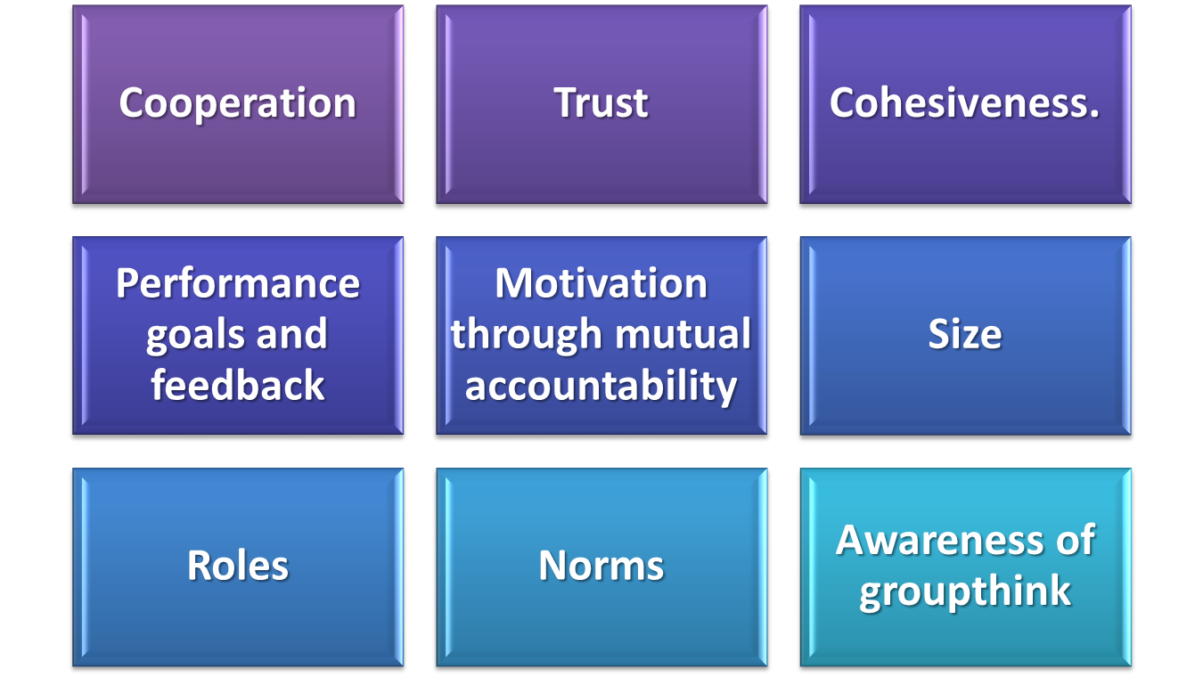
Building Effective Teams

Slide 24
Building Effective teams
Cooperating
  efforts are systematically integrated to achieve a collective objective.
Trust
  reciprocal faith in others’ intentions and behaviors
Cohesiveness
  tendency of a group or team to stick together

Slide 25
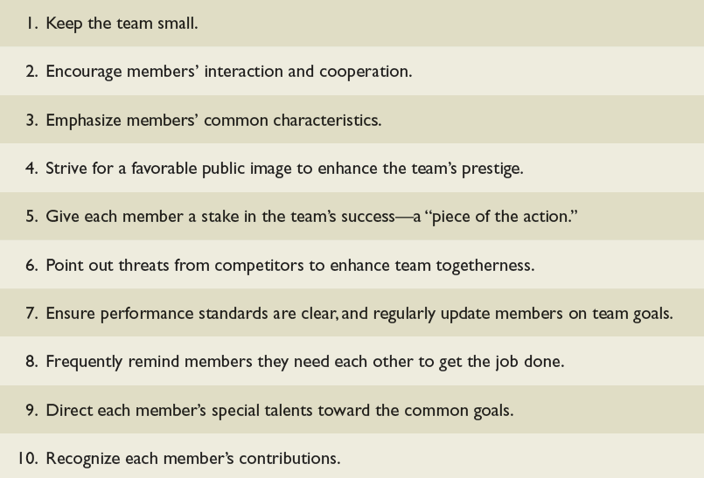
How to Enhance
Cohesiveness in Teams
Table 13.5

Slide 26
Size: Small Teams or Large Teams?
Small teams: 2-9 members
  better interaction
  better morale
Disadvantages
  Fewer resources
  Possibly less innovation
  Unfair work distribution

Slide 27

Size: Small Teams or Large Teams?
Large Teams: 10-16 members
  More resources
  Division of labor
Disadvantages
  Less interaction
  Lower morale
  Social loafing
Notes:
Social loafing – tendency of people to exert less effort when working in groups than when working alone
Multimedia Lecture Support Package to Accompany Basic Marketing
Lecture Script 6-*

Slide 28

Example: Team Size
At Amazon.com, there is a “two pizza” rule – if a team can’t be fed by two pizzas it’s too large
Harvard professor thinks there should be no more than six
Many companies have their own ideal sizes

Slide 29
Roles & Norms
Roles
  a socially determined expectation of how an individual should behave in a specific position
  Task roles, maintenance roles
Norms
  general guidelines that most group or team members follow
Notes:
A task role, or task-oriented role, consists of behavior that concentrates on getting the team’s tasks done.
A maintenance role, or relationship-oriented role, consists of behavior that fosters constructive relationships
among team members.
*

Slide 30
Question?
Layla works during her meeting to pull together the ideas of her committee members into a coherent whole. Layla is performing a ___________ role.
Maintenance
Relationship-oriented
Task
Social
Notes:
The correct answer is “C” – task.
Multimedia Lecture Support Package to Accompany Basic Marketing
Lecture Script 6-*

Slide 31
Why Norms are Enforced
To help the group survive
To clarify role expectations
To help individuals avoid embarrassing situations
To emphasize the group’s important values and identity

Slide 32
Cohesiveness & Groupthink
Groupthink
  a cohesive group’s blind unwillingness to consider
  alternatives

Slide 33
Symptoms of Groupthink
Invulnerability, inherent morality, and stereotyping of opposition
Rationalization and self-censorship
Illusion of unanimity, peer pressure, and mindguards
Groupthink versus “the wisdom of the crowds”

Slide 34
Results of Groupthink
Reduction in alternative ideas
Limiting of other information

Slide 35
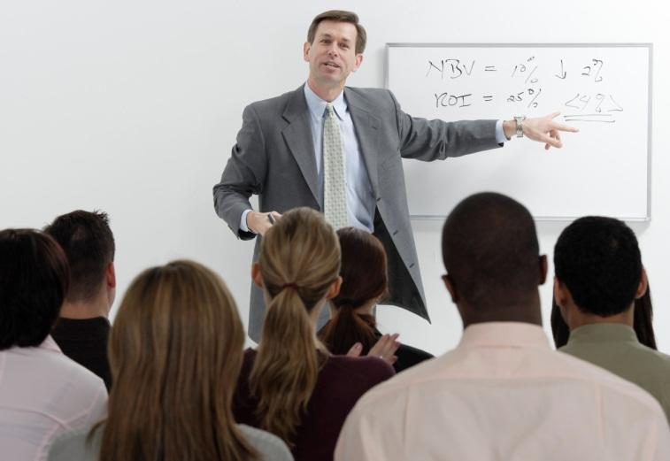
Preventing Groupthink
Allow criticism
Allow other perspectives

Slide 36
The Nature of Conflict
Conflict
  process in which one party perceives that its interests are being opposed or negatively affected by another party

Slide 37
The Nature of Conflict
Dysfunctional conflict
  conflict that hinders the organization’s performance or threatens its interest
Functional conflict
  conflict that benefits the main purposes of the organization and serves its interests

Slide 38
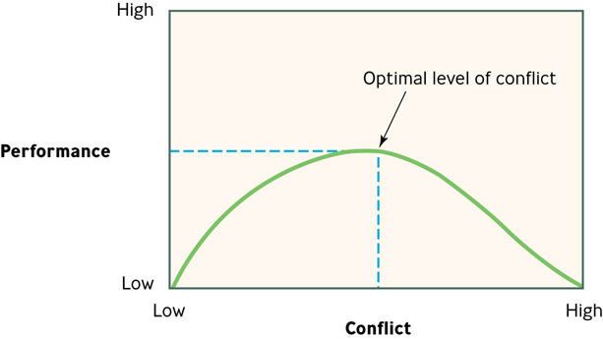
Relationship Between Level of Conflict and Level of Performance
Figure 13.2

Slide 39

Three Kinds of Conflict
Personality conflict
  interpersonal opposition based on personal dislike, disagreement, or differing styles
  Personality clashes, competition for scarce resources, time pressure, communication failures
Notes:
*

Slide 40
Three Kinds of Conflict
Intergroup conflicts
  Inconsistent goals or reward systems, ambiguous jurisdictions, status differences
Multicultural conflicts

Slide 41
Five Conflict-Handling Styles
Avoiding - “Maybe the problem will go away”
Accommodating – “Let’s do it your way”
Forcing – “You have to do it my way”
Compromising – “Let’s split the difference”
Collaborating – “Let’s cooperate to reach a win-win solution that benefits both of us”

Slide 42
Devices to Stimulate Constructive Conflict
Spur competition among employees
Change the organization’s culture & procedures
Bring in outsiders for new perspectives
Use programmed conflict

Slide 43
Programmed Conflict
Devil’s advocacy
  process of assigning someone to play the role of critic to voice possible objections to a proposal and thereby generate critical thinking and reality testing
Dialectic method
  process of having two people or groups play opposing roles in a debate in order to better understand a proposal

