Slide 1
Chapter Twelve
Motivating Employees:
Achieving Superior Performance in
the Workplace
McGraw-Hill/Irwin
Copyright © 2013 by The McGraw-Hill Companies, Inc. All rights reserved.

Slide 2
Major Questions You Should Be Able to Answer
12.1 What’s the motivation for studying motivation?
12.2 What kinds of needs motivate employees?
12.3 Is a good reward good enough? How do other factors affect motivation?
12.4 What’s the best way to design jobs—adapt people to work or work to people?

Slide 3
Major Questions You Should Be Able to Answer
12.5 What are the types of incentives I might use to influence behavior?
12.6 How can I use compensation and other rewards to motivate people?

Slide 4
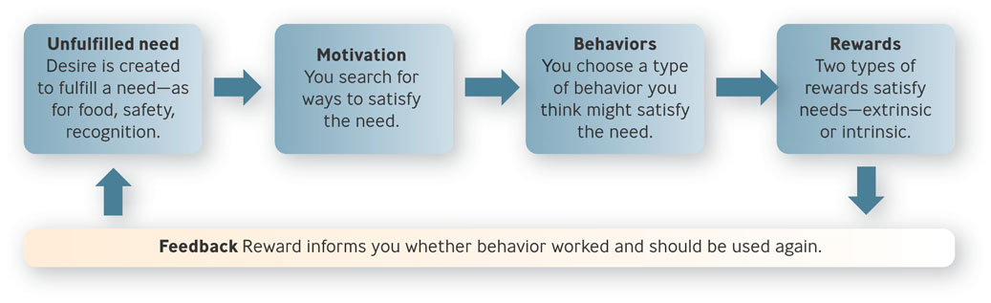
Motivation: What It Is, Why It’s Important
Motivation
  the psychological processes that arouse and direct goal-directed behavior
Figure 12.2

Slide 5
Motivation: What It Is, Why It’s Important
Extrinsic rewards
  payoff a person receives from others for performing a particular task
Intrinsic rewards
  satisfaction a person receives from performing the particular task itself

Slide 6
Question?
Bethany is writing a paper for her Management class. She already has a strong 'A' in the class, and only needs to get a C on the paper to keep her A. As she prepares the final version of the paper, she takes special care that the paper is well-written, insightful, and error-free, something that she can be proud of. Bethany is experiencing:
An intrinsic reward
High equity
A belongingness need
A hygiene factor
Notes:
The correct answer is “A”.
Multimedia Lecture Support Package to Accompany Basic Marketing
Lecture Script 6-*

Slide 7
Why Is Motivation Important?
You want to motivate people to:
Join your organization
Stay with your organization
Show up for work at your organization
Be engaged while at your organization
Do extra for your organization
Notes:
1. Join your organization. You need to instill in talented prospective workers
the desire to come to work for you.
2. Stay with your organization. Whether you are in good economic times or
bad, you always want to be able to retain good people.
3. Show up for work at your organization. In many organizations, absenteeism
and lateness are tremendous problems. 15
4. Be engaged while at your organization. Engaged employees produce higher quality
work and better customer service.
5. Do extra for your organization. You hope your employees will perform extra
tasks above and beyond the call of duty (be organizational “good citizens”).
*

Slide 8
Content Perspectives
Content perspectives
  theories that emphasize the needs that motivate people
Needs
  physiological or psychological deficiencies that arouse behavior

Slide 9
Maslow’s Hierarchy of Needs
Hierarchy of needs theory proposes that people are motivated by five levels of needs
Physiological
Safety
Love
Esteem
Self-actualization
Notes:
1. Physiological Needs These are the most basic human physical needs, in
which one is concerned with having food, clothing, shelter, and comfort and with
self-preservation.
2. Safety Needs These needs are concerned with physical safety and emotional
security, so that a person is concerned with avoiding violence and threats.
3. Love Needs Once basic needs and security are taken care of, people look for
love, friendship, and affection.
4. Esteem Needs After they meet their social needs, people focus on such matters
as self-respect, status, reputation, recognition, and self-confidence.
5. Self-Actualization Needs The highest level of need, self-actualization is self-fulfillment—
the need to develop one’s fullest potential, to become the best one
is capable of being.
*

Slide 10
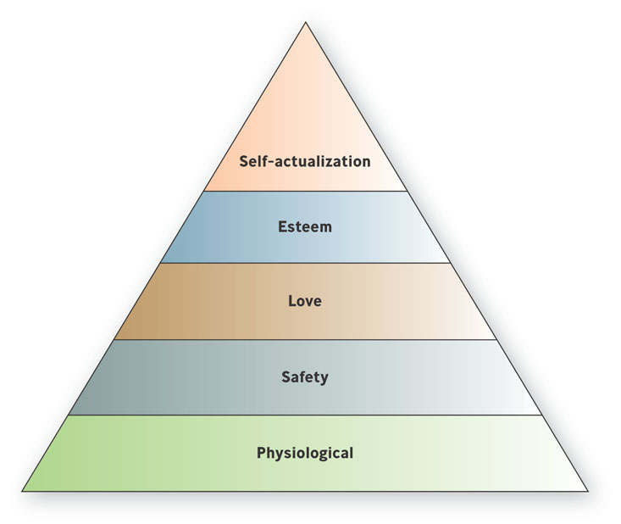
Maslow’s Hierarchy of Needs
Figure 12.1

Slide 11

Example: A Hotel CEO Applies Maslow’s Hierarchy
In Peak: How Great Companies Get Their Mojo from Maslow, CEO Chip Conley describes how JDV used Maslow’s theory to motivate the business’s three key stakeholders—employees, customers, and investors—by tapping into the power of self-actualization to create peak performance

Slide 12

Alderfer’s ERG Theory
ERG theory
  assumes that three basic needs influence behavior-existence, relatedness, and growth
Notes:
ERG theory is consistent with the finding that individual and cultural differences influence our need states
People are motivated by different needs at different times in their lives
Multimedia Lecture Support Package to Accompany Basic Marketing
Lecture Script 6-*

Slide 13
Three Kinds of Needs
Existence needs
  desire for physiological and material well-being
Relatedness needs
  desire to have meaningful relationships with people who are significant to us
Growth needs
  desire to grow as human beings and to use our abilities to their fullest potential

Slide 14
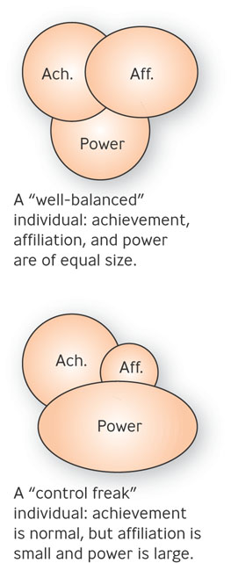
McClelland’s Acquired Needs Theory
Acquired Needs Theory
  states that three needs - achievement, affiliation, and power - are major motives determining people’s behavior in the workplace

Slide 15
The Three Needs
Need for achievement
  desire to achieve excellence in challenging tasks
Need for affiliation
  desire for friendly and warm relations with other people
Need for power
  desire to be responsible for or control other people

Slide 16
Question?
Patty prefers working alone, is comfortable taking moderate risks, and feels good when accomplishing a goal. Patty probably has a:
High need for achievement
High need for affiliation
High need for power
Low need for achievement
Notes:
The correct answer is “A”
Multimedia Lecture Support Package to Accompany Basic Marketing
Lecture Script 6-*

Slide 17
Example: What Motivates Facebook’s COO Sheryl Sandberg?
Facebook chief operating officer (COO) Sheryl Sandberg, 42, was named the fifth most powerful woman in the world by Forbes
She’s also “a passionate advocate for women to claim a far greater share of the top corporate leadership positions.”

Slide 18
Herzberg’s Two-Factor Theory
Two-Factor Theory
  proposed that work satisfaction and dissatisfaction arise from two different factors - work satisfaction from so-called motivating factors and work dissatisfaction from so-called hygiene factors

Slide 19
Herzberg’s Two-Factor Theory
Hygiene factors
  factors associated with job dissatisfaction which affect the job context in which people work
Motivating factors
  factors associated with job satisfaction which affects the job content or the rewards of work performance
Notes:
Using two-factor theory to motivate employees
Managers should first eliminate dissatisfaction making sure that working conditions, pay levels, and company policies are reasonable
Multimedia Lecture Support Package to Accompany Basic Marketing
Lecture Script 6-*

Slide 20
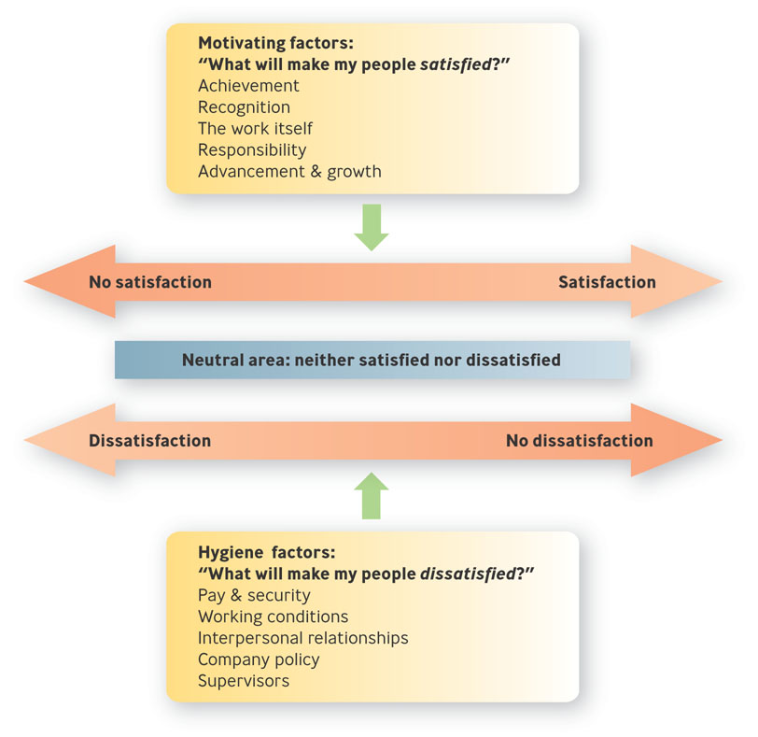
Herzberg’s Two-Factor Theory
Figure 12.5

Slide 21
Equity Theory
Equity theory
  focuses on employee perceptions as to how fairly they think they are being treated compared to others
  Inputs, outputs, comparison

Slide 22
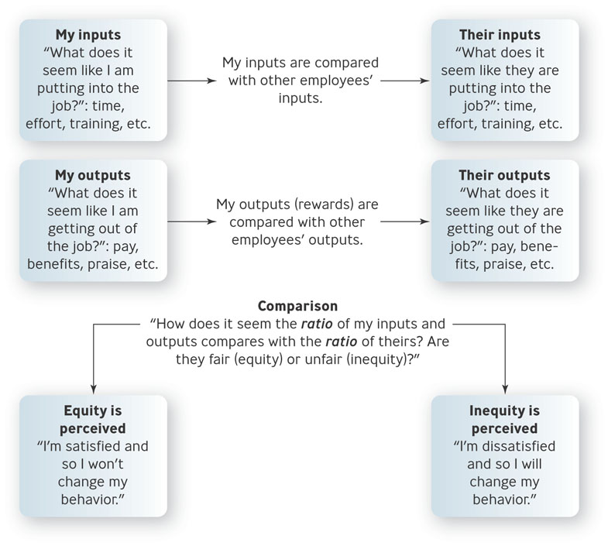
Equity Theory
Figure 12.7

Slide 23

Practical Lessons from Equity Theory
Employee perceptions are what count
Employee participation helps
Having an appeal process helps

Slide 24
Expectancy Theory
Expectancy Theory
  suggests that people are motivated by two things: (1) how much they want something and (2) how likely they think they are to get it

Slide 25
Expectancy Theory
Expectancy
  belief that a particular level of effort will lead to a particular level of performance
Instrumentality
  expectation that successful performance of the task will lead to the desired outcome
Valence
  the value a worker assigns to an outcome

Slide 26
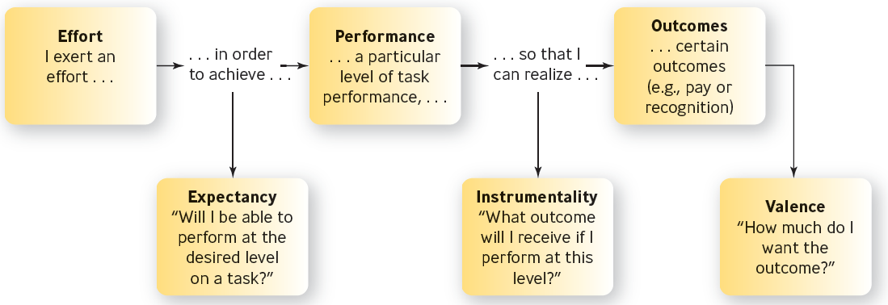
Expectancy Theory: The Major Elements
Figure 12.6

Slide 27
Goal-Setting Theory
Goals should be specific
Goals should be challenging but achievable
Goals should be linked to action plans
Goals need not be jointly set to be effective
Feedback enhances goal attainment

Slide 28
Question?
Last year, Diana’s boss promised her a big bonus if she met her goals. At the end of the year, after Diana had exceeded her goals, she found her bonus was very small. In the future, Diana’s _____ will probably be ____.
Valence; low
Instrumentality; low
Expectancy; low
Expectancy; high
Notes:
The correct answer is “B”
Multimedia Lecture Support Package to Accompany Basic Marketing
Lecture Script 6-*

Slide 29
Job Design Perspectives
Job design
  division of an organization’s work among its employees and the application of motivational theories to jobs to increase satisfaction and performance
  Job simplification, job enlargement, job enrichment
Notes:
Job simplification - the process of reducing the number of tasks a worker performs
Job enlargement consists of increasing the number of tasks in a job to increase variety and motivation
Job enrichment consists of building into a job such motivating factors as responsibility, achievement, recognition, stimulating work, and advancement
*

Slide 30
Question?
Melvin, a manager, asks Edna, his subordinate, to work on one machine for three hours and then move to another machine every other hour. Melvin has engaged in:
Job enlargement
Job rotation
Job simplification
Vertical loading
Notes:
The correct answer is “B”
Multimedia Lecture Support Package to Accompany Basic Marketing
Lecture Script 6-*

Slide 31
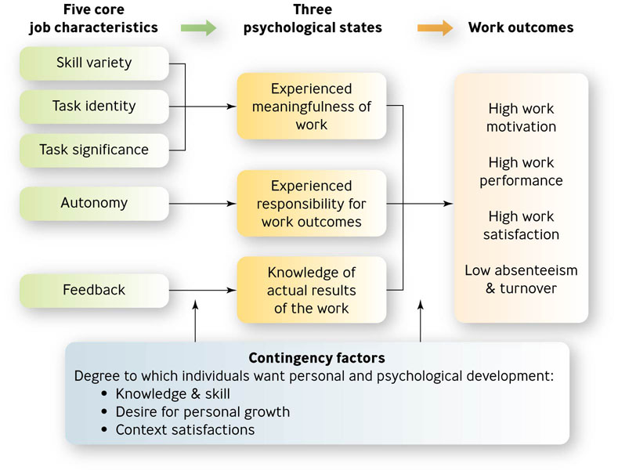
Job Characteristics Model
Figure 12.9
Notes:
Applying the Job Characteristics Model
Diagnose the work environment to see whether a problem exist
Determine whether job redesign is appropriate
Consider how to redesign the job
Multimedia Lecture Support Package to Accompany Basic Marketing
Lecture Script 6-*

Slide 32
Reinforcement Perspectives on Motivation
Reinforcement theory
  attempts to explain behavior change by suggesting that behavior with positive consequences tends to be repeated, whereas behavior with negative consequences tends not to be repeated

Slide 33
Types of Reinforcement
Positive reinforcement
  use of positive consequences to encourage desirable behavior
Negative reinforcement
  process of strengthening a behavior by withdrawing something negative

Slide 34
Question?
When a manager stops nagging a subordinate, the manager is using:
Positive reinforcement
Negative reinforcement
Punishment
Intrinsic motivation
Notes:
The correct answer is “B”
Multimedia Lecture Support Package to Accompany Basic Marketing
Lecture Script 6-*

Slide 35
Types of Reinforcement
Extinction
  weakening of behavior by ignoring it or making sure it is not reinforced.
Punishment
  process of weakening behavior by presenting something negative or withdrawing something positive

Slide 36
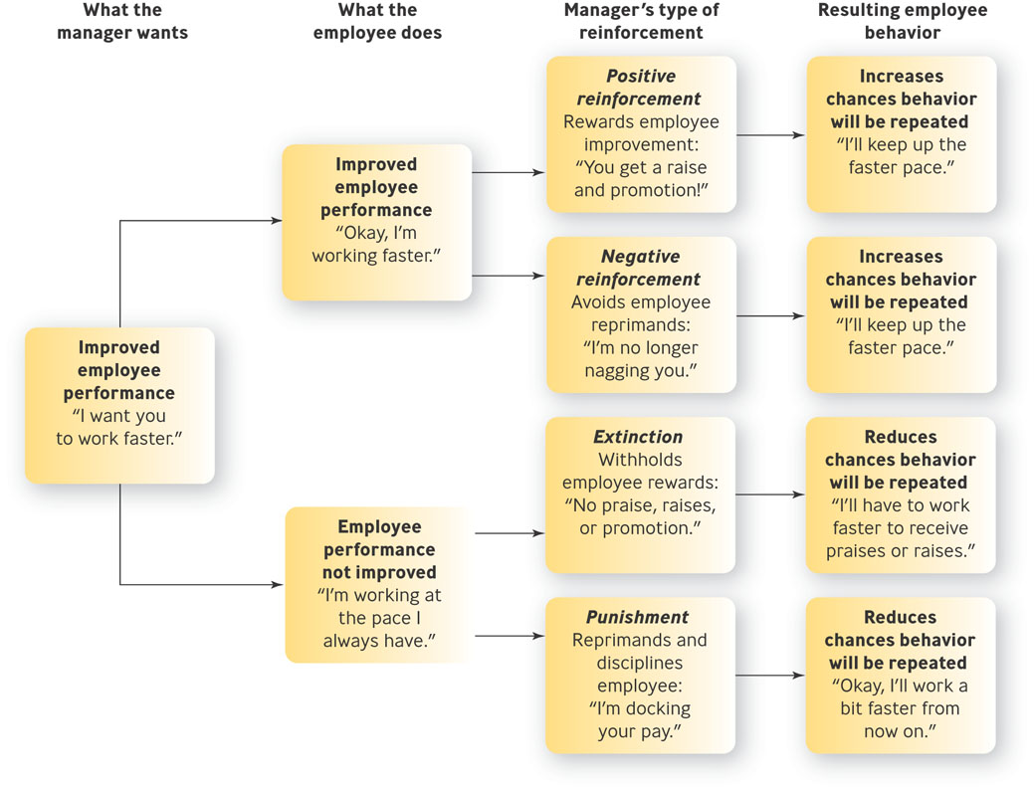
Four Types of Reinforcement
Figure 12.9

Slide 37
Using Reinforcement to Motivate Employees
Positive reinforcement
Reward only desirable behavior
Give rewards as soon as possible
Be clear about what behavior is desired
Have different rewards and recognize individual differences

Slide 38

Popular Incentive
Compensation Plans
Piece rate
Sales commission
Bonuses
Profit-sharing
Gainsharing
Stock options
Pay for knowledge
Notes:
Piece rate
employees paid according to how much output they produce
Sales commission
sales reps are paid a percentage of the earnings the company made from their sales
Bonuses
cash awards given to employees who achieve specific performance objectives
profit sharing - the distribution to employees of a percentage of the company’s profits
-gainsharing - the distribution of savings or gains to groups of employees who reduced costs and increased measurable productivity
-stock options - certain employees are given the right to buy stock at a future date for a discounted price
-pay for knowledge - employee pay is tied to the number of job relevant skills or academic degrees they earn
Multimedia Lecture Support Package to Accompany Basic Marketing
Lecture Script 6-*

Slide 39
Question?
In Earl's department at Pencilchicken, Inc. employees get money based on how much the department has been able to save in costs. This is an example of a ____________ compensation plan.
Pay for performance
Pay for knowledge
Bonus
Gainsharing
Notes:
The correct answer is “D”
Multimedia Lecture Support Package to Accompany Basic Marketing
Lecture Script 6-*

Slide 40
Nonmonetary Ways of Motivating Employees
Flexible workplace
Thoughtfulness
Work-life benefits
Surroundings
Skill-building & educational opportunities
Sabbaticals
Notes:
The most common non-monetary incentive is the flexible workplace
Companies need to offer employees a means of balancing their work and their personal lives
Companies need to create a work environment that is conducive to productivity
Companies can help employees build their skills by developing “shadowing” programs and offering tuition reimbursement
Offering sabbaticals to long-term employees gives people a change to recharge themselves
Multimedia Lecture Support Package to Accompany Basic Marketing
Lecture Script 6-*

