Slide 1
Chapter Ten
Organizational Change & Innovation:
Lifelong Challenges for the Exceptional
Manager
McGraw-Hill/Irwin
Copyright © 2013 by The McGraw-Hill Companies, Inc. All rights reserved.

Slide 2
Major Questions You Should Be Able to Answer
10.1 Since change is always with us, what should I understand about it?
10.2 How are employees threatened by change, and how can I help them adjust?
10.3 What are the uses of OD, and how effective is it?
10.4 What do I need to know to encourage innovation?

Slide 3
Ways to Deal With Change and Innovation
Allow room for failure
Give one consistent explanation for the change
Look for opportunities in unconventional ways
Have the courage to follow your ideas
Allow grieving, then move on

Slide 4
Collins’s Five Stages of Decline
Stage 1 Hubris Born of Success
Stage 2 Undisciplined Pursuit of More
Stage 3 Denial of Risk and Peril
Stage 4 Grasping for Salvation
Stage 5 Capitulation to Irrelevance or Death

Slide 5
Fundamental Change: What Will You Be Called Upon to Deal With?
The marketplace is becoming more segmented & moving toward more niche products
There are more competitors offering targeted products, requiring faster speed-to-market
Some traditional companies may not survive radically innovative change

Slide 6
Fundamental Change: What Will You Be Called Upon to Deal With?
China, India, & other offshore suppliers are changing the way we work
Knowledge, not information, is becoming the new competitive advantage

Slide 7
Two Types of Change
Reactive change
making changes in response to problems or opportunities as they arise

Slide 8
Two Types of Change
Proactive change
involves making carefully thought-out changes in anticipation of possible or expected problems or opportunities
also called planned change

Slide 9
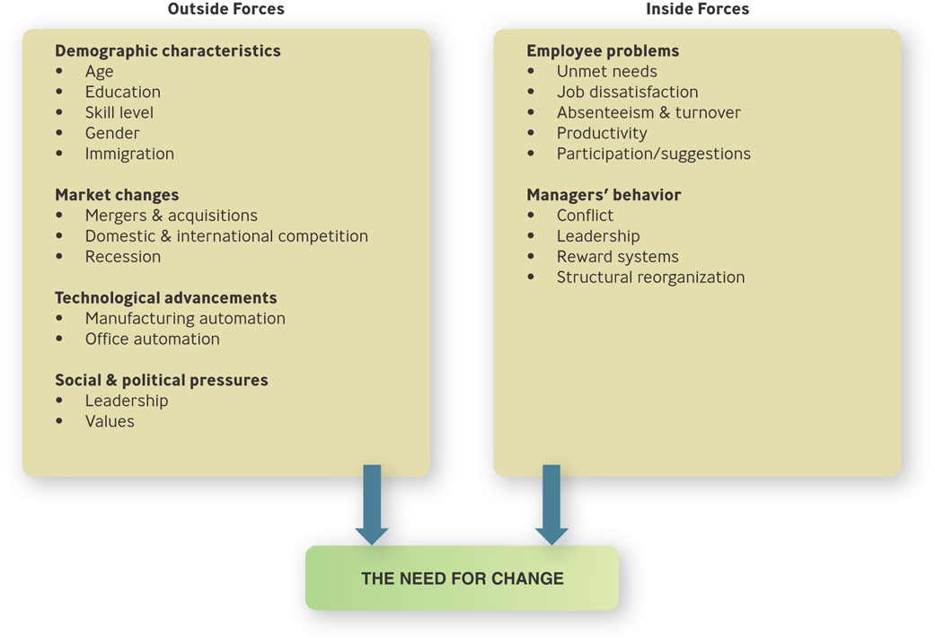
Forces For Change Outside and Inside the Organization
Figure 10.1

Slide 10
The Forces for Change: Outside the Organization
Demographic characteristics
Market changes
Technological advancement
Shareholder & customer demands
Supplier practices
Social & political pressures

Slide 11
Question?
Tony, the owner of Cirodi Pasta restaurant on Cape Cod is open during the “high season” from May until October. He has always hired college students on summer vacation. In recent years, the number of workers who quit mid-summer has risen significantly. When he asks, they say they are quitting because they “have enough money” or “want the time off”. This is probably an example of a(n) ________ change.
Market
Social or political
Economic
Technological
Notes:
The correct answer is “B”
Page: 311 LO: 1 Difficulty: Moderate
Multimedia Lecture Support Package to Accompany Basic Marketing
Lecture Script 6-*

Slide 12

Forces Originating Inside the Organization
Employee problems
Managers’ behavior

Slide 13
Areas in Which Change is Often Needed
Changing people
Perceptions, attitudes, performance, skills
Changing technology
Changing structure
Changing strategy

Slide 14
Changing Technology
Technology
any machine or process that enables an organization to gain a competitive advantage in changing materials used to produce a finished product
not just computer technology

Slide 15
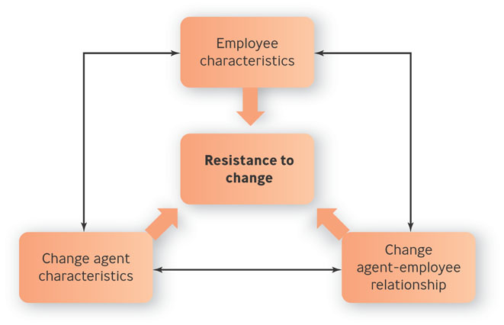
A Model of Resistance to Change
Figure 10.2

Slide 16
The Causes of Resistance to Change
Resistance to change
an emotional/behavioral response to real or imagined threats to an established work routine.

Slide 17
The Degree to Which Employees Fear Change
Least threatening: Adaptive change
Reintroduction of a familiar practice
Somewhat threatening: Innovative change
Introduction of a practice that is new to the organization

Slide 18
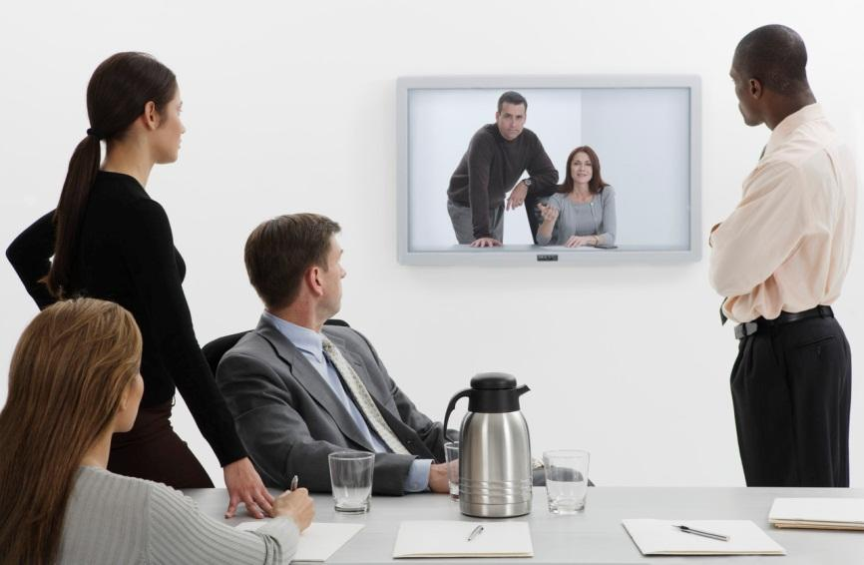
The Degree to Which Employees Fear Change
Very threatening: Radically innovative change
Involves introducing a practice that is new to the industry

Slide 19
Question?
At the Big Peaches Department Store, employees generally know that during annual inventory, they are required to work overnight shifts. This is an example of a(n) __________ change.
Adaptive
Reactive
Innovative
Proactive
Notes:
The correct answer is “A”
Page: 315 LO: 4 Difficulty: Hard
Rationale: This involves reinstituting a practice that employees are already familiar with.
Multimedia Lecture Support Package to Accompany Basic Marketing
Lecture Script 6-*

Slide 20
Reasons Employees Resist Change
Individual’s predisposition toward change
Surprise and fear of the unknown
Climate of mistrust
Fear of failure
Loss of status or job security

Slide 21
Reasons Employees Resist Change
Peer pressure
Disruption of cultural traditions or group relationships
Personality conflicts
Lack of tact or poor timing
Non-reinforcing reward system

Slide 22
Lewin’s Change Model
Unfreezing
creating the motivation to change
Changing
learning new ways of doing things
Refreezing
making the new ways normal

Slide 23
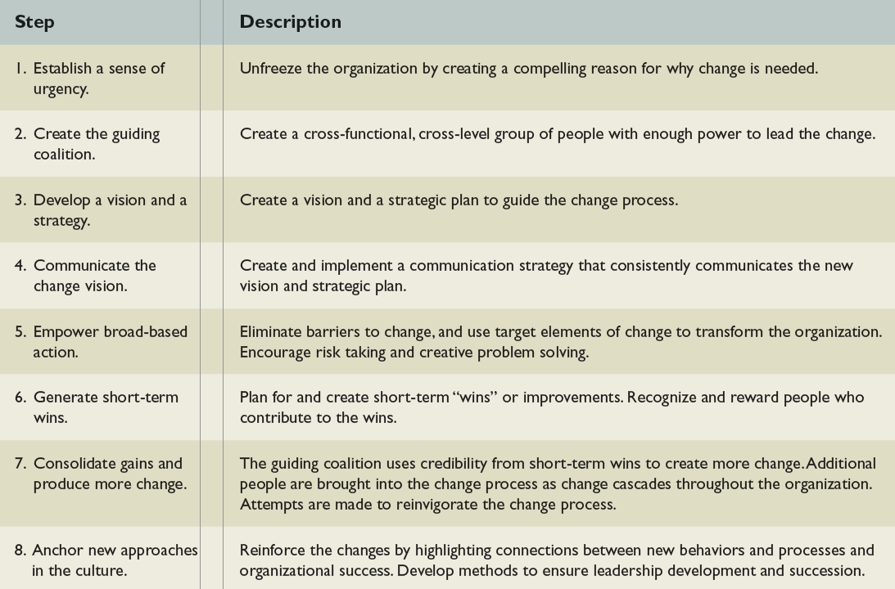
Steps to Leading Organizational Change
Table 10.2

Slide 24
Organization Development
Organization development (OD)
set of techniques for implementing planned change to make people and organizations more effective

Slide 25
Organization Development
Change agent
a consultant with a background in behavioral sciences who can be a catalyst in helping organizations deal with old problems in new ways

Slide 26
What Can OD Be Used For?
Managing conflict
Revitalizing organizations
Adapting to mergers

Slide 27
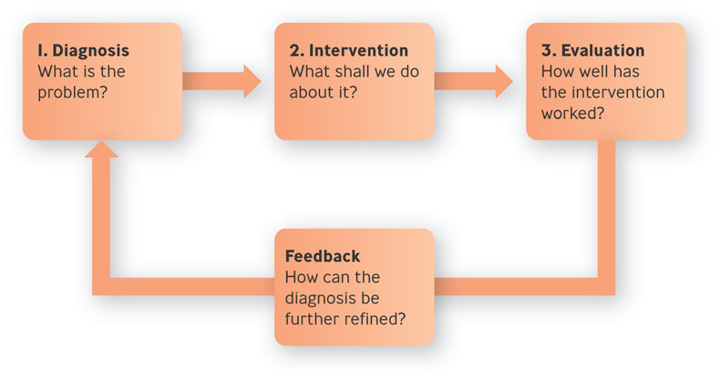
The OD Process
Figure 10.3

Slide 28

How OD Works
Diagnosis: What is the problem?
Intervention: What shall we do about it?
Intervention – attempt to correct the diagnosed problem
Evaluation: How well has the intervention worked?

Slide 29
Question?
Fred, an OD consultant, is designing a survey of employee attitudes to be given to workers at the Lemon Automobile Company. Fred is in the _________ stage of OD.
Intervention
Diagnosis
Evaluation
Process consultation
Notes:
The correct answer is “B”
Page: 321 LO: 2 Difficulty: Hard
Rationale: Fred is collecting information to diagnose problems.
Multimedia Lecture Support Package to Accompany Basic Marketing
Lecture Script 6-*

Slide 30
Example: Patagonia Tries to Become Greener
Patagonia has long been a supporter of the environmental movement
Company wondered how “green” the origins and handling of if products were
Transportation took little energy, but manufacturing sometimes produced ecologically unfriendly by-products
Patagonia did not want to sacrifice quality for environmental reasons

Slide 31
The Effectiveness of OD
Multiple interventions
Management support
Goals geared to both short and long term results
OD is affected by culture

Slide 32
Two Myths about Innovation
Myth No. 1: Innovation happens in a “Eureka!” moment
Myth No. 2: Innovation can be systematized

Slide 33
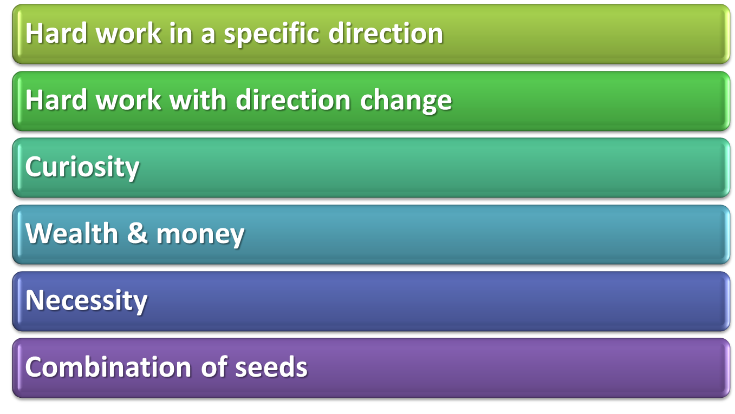
Seeds of Innovation

Slide 34
Types of Innovation
Product innovation
change in the appearance or performance of a product or the creation of a new one
Process innovation
change in the way a product is conceived, manufactured, or disseminated

Slide 35
Types of Innovation
Incremental innovation
creation of products, services, or technologies that modify existing ones
Radical innovation
creation of products, services, or technologies that replace existing ones

Slide 36
Question?
Wendy's created display screens at its drive-thru windows that show customers their orders and prices. This is an example of a(n) _________ innovation.
Product
Process
Adaptive
Reactive
Notes:
The correct answer is “B”
Page: 320 LO: 3
Multimedia Lecture Support Package to Accompany Basic Marketing
Lecture Script 6-*

Slide 37
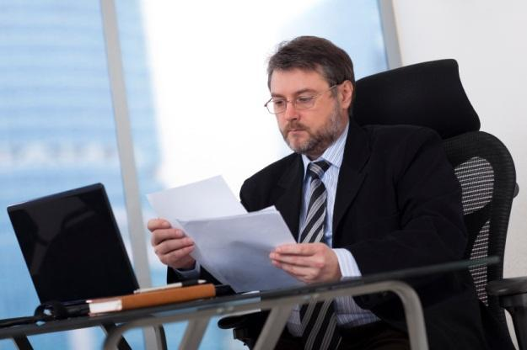
Celebrating Failure: Factors Encouraging Innovation
Organizations can make innovation happen by providing 1) the right organizational culture, 2) the appropriate resources, and 3) the correct reward system

Slide 38
Celebrating Failure: Factors Encouraging Innovation
Culture: Is innovation viewed as a benefit or a boondoggle?
Resources: Do managers put money where their mouths are?
Rewards: Is experimentation reinforced in ways that matter?

Slide 39
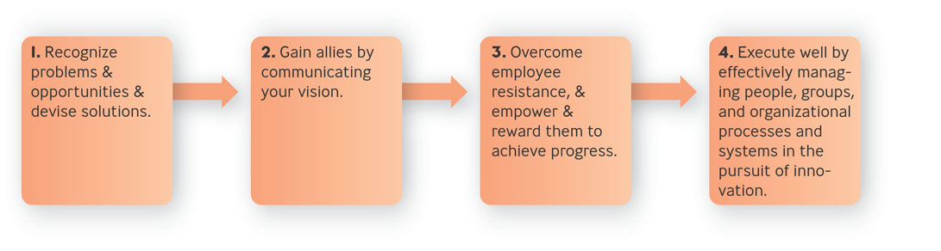
Four Steps For Fostering Innovation
Figure 10.4

Slide 40
Gain Allies by Communicating Your Vision
Showing how the product or service will be made
Showing how potential customers will be reached
Demonstrating how you’ll beat your competitors
Explaining when the innovation will take place

