Slide 1
Chapter Nine
Human Resource
Management:
Getting the Right People for Managerial Success
McGraw-Hill/Irwin
Copyright © 2013 by The McGraw-Hill Companies, Inc. All rights reserved.

Slide 2
Major Questions You Should Be Able to Answer
9.1 How do effective managers view the role of people in their organization’s success?
9.2 To avoid exposure to legal liabilities, what areas of the law do I need to be aware of?
9.3 How can I reduce mistakes in hiring and find great people who might work for me?
9.4 Once people are hired, what’s the best way to see that they do what they’re supposed to do?

Slide 3
Major Questions You Should Be Able to Answer
9.5 How can I assess employees’ performance more accurately and give more effective feedback?
9.6 What are the various forms of compensation?
9.7 What are some guidelines for handling promotions, transfers, disciplining, and dismissals?
9.8 What are the principal processes and issues involved in organizing labor unions?

Slide 4
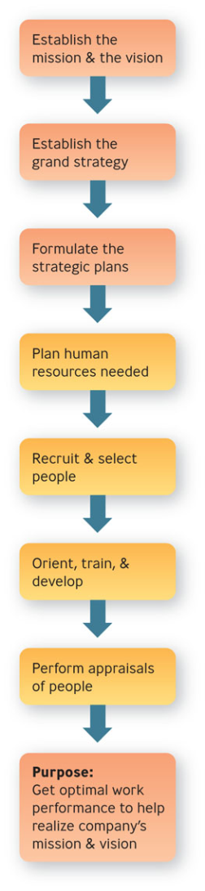
Strategic Human Resource Management
Human Resource Management
consists of the activities managers perform to plan for, attract, develop, and retain an effective workforce

Slide 5
Planning the Human Resources Needed
Strategic human resource planning
consists of developing a systematic, comprehensive strategy for understanding current employee needs and predicting future employee needs

Slide 6
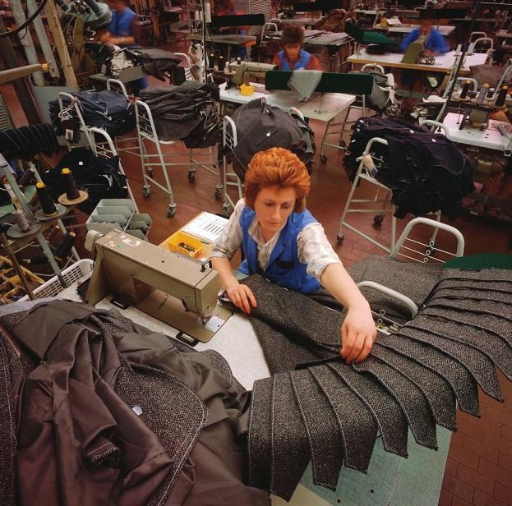
Understanding Current Employee Needs
Job analysis
determining the basic elements of a job by observation and analysis

Slide 7
Question?
Joe, a human resources specialist for Jersey Office Supplies Co., rides along with the furniture delivery people to observe the problems they were encountering and what activities they were required to perform. Joe was performing a:
Personality test
Performance appraisal
BARS
Job analysis
Notes:
The correct answer is “D” – job analysis
Multimedia Lecture Support Package to Accompany Basic Marketing
Lecture Script 6-*

Slide 8
Understanding Current Employee Needs
Job description
summarizes what the holder of a job does and why they do it
Job specification
describes the minimum qualifications a person must have to perform a job successfully

Slide 9
Predicting Future Employee Needs
Human resource inventory
report listing your organization’s employees by name, education, training, languages, and other important information

Slide 10
Labor Relations
National Labor Relations Board
enforces procedures whereby employees may vote for a union and collective bargaining
Collective bargaining
negotiations between management and employees about disputes over compensation, benefits, working conditions, and job security

Slide 11
Compensation & Benefits
Fair Labor Standards Act of 1938
established minimum living standards for workers engaged in interstate commerce, including provision of a federal minimum wage

Slide 12

Equal Employment Opportunity
Equal Employment Opportunity Commission
job is to enforce antidiscrimination and other employment related laws

Slide 13
Equal Employment Opportunity
Discrimination
occurs when people are hired or promoted - or denied hiring or promotion - for reasons not relevant to the job
Affirmative action
focuses on achieving equality of opportunity within an organization including establishment of minority hiring goals

Slide 14
Workplace Discrimination
Adverse impact
occurs when an organization uses an employment practice or procedure that results in unfavorable outcomes to a protected class
Disparate treatment
results when employees from protected groups are intentionally treated differently.

Slide 15
Equal Employment Opportunity
Sexual harassment
consists of unwanted sexual attention that creates an adverse work environment
Quid pro quo – tangible economic injury
Hostile environment – offensive work environment

Slide 16
Question?
Stan is constantly telling off-color jokes and using profanity in front of his administrative assistant. This could be considered a _____________.
Difficult atmosphere
Hostile work environment
Intimidating surroundings
This for that
Notes:
The correct answer is “B” – hostile work environment. See previous slide.
Multimedia Lecture Support Package to Accompany Basic Marketing
Lecture Script 6-*

Slide 17
Recruitment
Recruitment
process of locating and attracting qualified applicants for jobs open in the organization
internal, external
Notes:
Internal recruiting means making people already employed by the organization aware of job openings
External recruiting means attracting job applicants from outside the organization
*

Slide 18
Recruitment
Realistic job preview
gives a candidate a picture of both the positive and negative features of the job and the organization before he is hired
people tend to quit less frequently and be more satisfied

Slide 19
Question?
Melanie scheduled a special interview with Gina before Gina was hired, in which Melanie painted a picture of both the positive and negative features of the job. Mel was performing a:
Structured interview
Unstructured interview
Performance appraisal
Realistic job preview
Notes:
The correct answer is “D” – realistic job preview.
Multimedia Lecture Support Package to Accompany Basic Marketing
Lecture Script 6-*

Slide 20
Selection
Selection process
screening of job applicants to hire the best candidate
application forms, résumés, reference checks

Slide 21

Selection
Unstructured interview
no fixed set of questions and no systematic scoring procedure
involves asking probing questions to find out what the applicant is like

Slide 22
Selection
Structured interview
involves asking each applicant the same questions and comparing their responses to a standardized set of answers
Situational – focuses on hypothetical situations
Behavioral – explore what applicants have actually done in the past

Slide 23
Selection
Employment tests
legally considered to consist of any procedure used in the employment selection decision process
ability, performance, personality
reliability, validity

Slide 24

Example: Finish Line
At Finish Line, store managers use the results of web-based personality tests developed by Unicru to screen applicants
Applicants are scored as green, yellow, or red

Slide 25
Orientation, Training, & Development
Orientation
helping the newcomer fit smoothly into the job and the organization
designed to give employees the information they need to be successful

Slide 26
Orientation, Training, & Development
Following orientation, the employee should emerge with information about:
The job routine
The organization’s mission and operations
The organization’s work rules and employee benefits

Slide 27
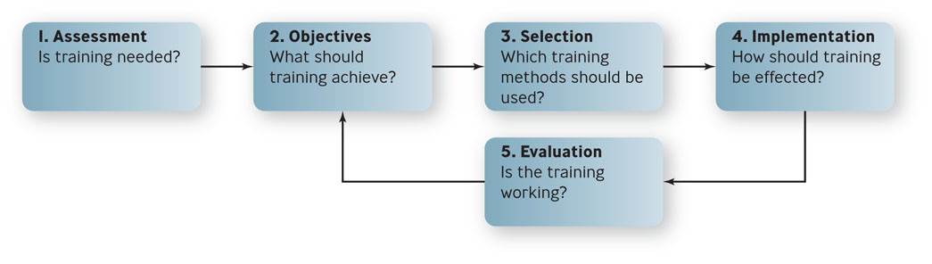
Five Steps in the Training Process
Figure 9.2

Slide 28
Orientation, Training, & Development
Training
educating technical and operational employees in how to better do their current jobs
Development
educating professionals and managers in the skills they need to do their jobs in the future

Slide 29
Question?
Artie is designing a training class that is aimed at improving teamwork among people on task forces. What method should he choose?
Lectures
Role plays
Workbooks
Videotapes
Notes:
The correct answer is “B” – role plays
Multimedia Lecture Support Package to Accompany Basic Marketing
Lecture Script 6-*

Slide 30
Example: E-Learning
Millions of people are taking short-term, practical courses related to their careers
Advantages
No transportation is needed
You can follow a flexible schedule
You can work at your own pace

Slide 31
Performance Appraisal
Performance management
the continuous cycle of improving job performance through goal setting, feedback and coaching, and rewards and positive reinforcement

Slide 32

Performance Appraisal
Performance appraisal
consists of assessing an employer’s performance and providing him with feedback

Slide 33
Performance Appraisal
Objective appraisal
based on fact and often numerical
measure results
harder to challenge legally
also called results appraisal

Slide 34
Question?
Luann is conducting a performance appraisal on Bill. The form her company uses asks her to list the objectives that she and Bill agreed to last year, and indicate how well he met each objective. Luann's company is using a(n) ________ system of performance appraisal.
Objective
BARS
Trait
Informal
Notes:
The correct answer is “A” - objective
Multimedia Lecture Support Package to Accompany Basic Marketing
Lecture Script 6-*

Slide 35
Performance Appraisal
Subjective appraisal
based on a manager’s perceptions of an employees traits and behaviors
BARS - rates employee gradations in performance according to scales of specific behaviors

Slide 36
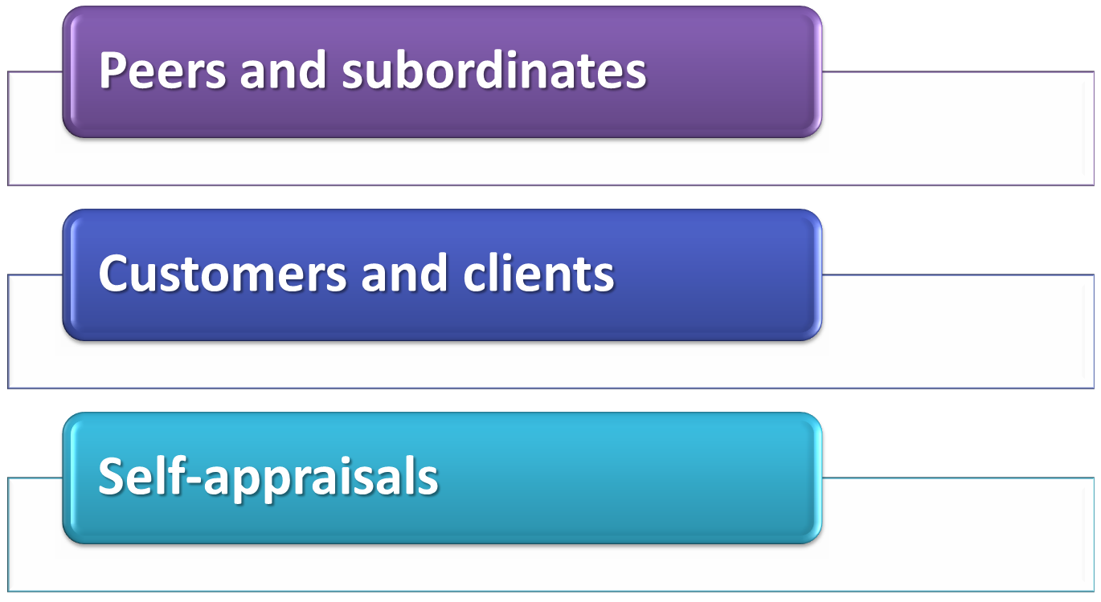
Who Should Make Performance Appraisals?

Slide 37
Performance Appraisal
Forced ranking
all employees within a business unit are ranked against one another and grades are distributed along some sort of bell curve

Slide 38
Effective Performance Appraisal
Formal appraisal
conducted at specific times throughout the year and based on performance measures that have been established in advance
Informal appraisal
conducted on an unscheduled basis and consists of less rigorous indications of employee performance

Slide 39
Compensation & Benefits
Compensation
wages or salaries, incentives, and benefits
Base pay
basic wage or salary paid employees in exchange for doing their jobs

Slide 40
Managing Promotions, Transfers, Disciplining, & Dismissals
Promotion – moving upward
Transfer – moving sideways
Disciplining & Demotion – the threat of moving downward
Dismissal – moving out of the organization

Slide 41

Labor-Management Issues
Labor unions
organizations of employees formed to protect and advance their members’ interests by bargaining with management over job-related issues

Slide 42
Union Security
Union security clause
the part of the labor-management agreement that states that employees who receive union benefits must join the union, or at least pay dues to it

Slide 43
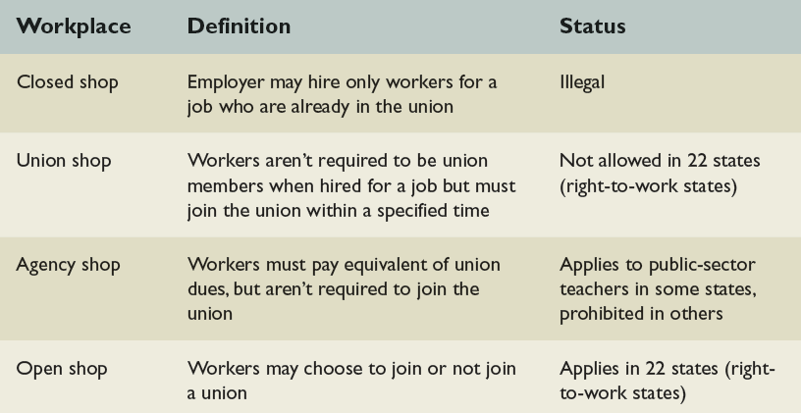
Workplace Labor Agreements
Table 9.6

Slide 44
Compensation
Two-tier wage contracts
new employees are paid less or receive lesser benefits than veteran employees have
Cost-of-living adjustment (COLA)
clause during the period of the contract ties future wage increases to increases in the cost of living
Givebacks
the union agrees to give up previous wage or benefit gains in return for something else

Slide 45
Settling Labor-Management Disputes
Grievance
a complaint by an employee that management has violated the terms of the labor-management agreement

Slide 46
Settling Labor-Management Disputes
Mediation
process in which a neutral third party, a mediator, listens to both sides in a dispute, makes suggestions, and encourages them to agree on a solution.
Arbitration
process in which a neutral third party, an arbitrator, listens to both parties in a dispute and makes a decision that the parties have agreed will be binding on them

