Slide 1
Chapter Eight
Organizational Culture,
Structure, & Design:
Building Blocks of the Organization
McGraw-Hill/Irwin
Copyright © 2013 by The McGraw-Hill Companies, Inc. All rights reserved.

Slide 2
Major Questions You Should Be Able to Answer
8.1 How do I find out about an organization’s “social glue,” its normal way of doing business?
8.2 What can be done to an organization’s culture to increase its economic performance?
8.3 How are for-profit, nonprofit, and mutual-benefit organizations structured?

Slide 3
Major Questions You Should Be Able to Answer
8.4 When I join an organization, what seven elements should I look for?
8.5 How would one describe the three types of organizational design?
8.6 What factors affect the design of an organization’s structure?

Slide 4
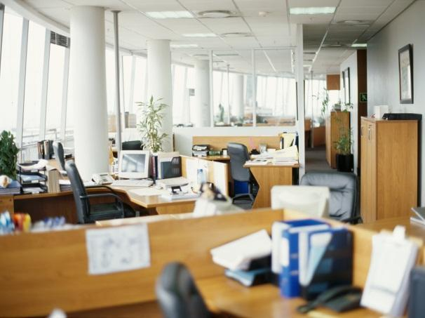
What Is an Organizational Culture?
Organizational culture
  system of shared beliefs and values that develops within an organization and guides the behavior of its members
  Also called
  corporate culture

Slide 5
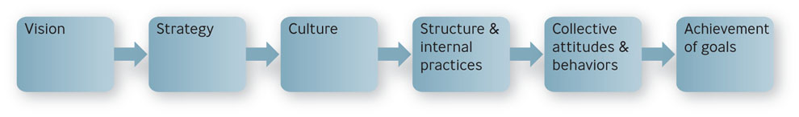
Culture Plus Structure
Figure 8.1

Slide 6
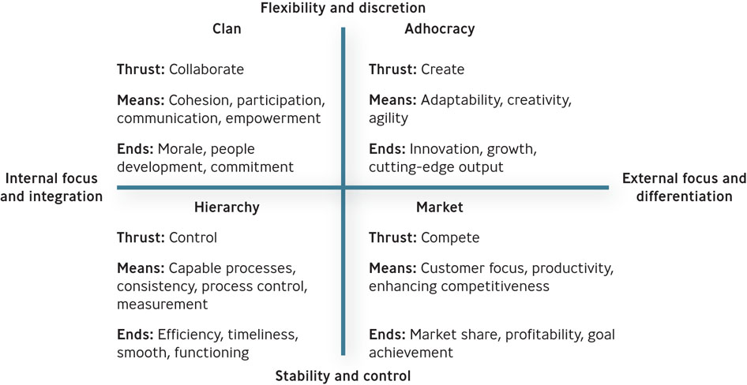
Competing Values Framework
Figure 8.2

Slide 7
Four Types of Organizational Culture
Clan culture
  Internal focused
  values flexibility rather than stability
  encourages collaboration among employees
Adhocracy culture
  attempts to create innovative products by being adaptable, creative, and quick to respond to changes in the marketplace

Slide 8
Four Types of Organizational Culture
Market culture
  focused on the external environment
  driven by competition and a strong desire to deliver results
Hierarchy culture
  apt to have a formalized structured work environment aimed at achieving effectiveness through a variety of control mechanisms

Slide 9

The Three Levels of Organizational Culture
Level 1: Observable artifacts
  physical manifestations such as manner of dress, awards, myths and stories about the company
  visible behavior exhibited by managers and employees

Slide 10
The Three Levels of Organizational Culture
Level 2: Espoused Values
Espoused values
  explicitly stated values and norms preferred by an organization
Enacted values
  represent the values and norms actually exhibited in the organization

Slide 11
The Three Levels of Organizational Culture
Level 3: Basic Assumptions
  represent the core values of the organization’s culture
  those taken for granted and highly resistant to change

Slide 12
How Employees Learn Culture
Symbol
  an object, act, quality, or event that conveys meaning to others
Story
  narrative based on true events, which is repeated – and sometimes embellished upon – to emphasize a particular value

Slide 13
How Employees Learn Culture
Hero
  person whose accomplishments embody the values of the organization
Rites and rituals
  activities and ceremonies, planned an unplanned, that celebrate important occasions and accomplishments in the organization’s life

Slide 14
Question?
In the Mary Kay Cosmetics Co., the best salespeople receive pink Cadillacs in special awards ceremonies. This is an example of a:
Symbol
Value
Rite or ritual
Both A and C
Notes:
The correct answer is “D”.
Page: 240 LO: 1 Difficulty: Moderate
AACSB: 6, 9 BT: Knowledge
Multimedia Lecture Support Package to Accompany Basic Marketing
Lecture Script 6-*

Slide 15
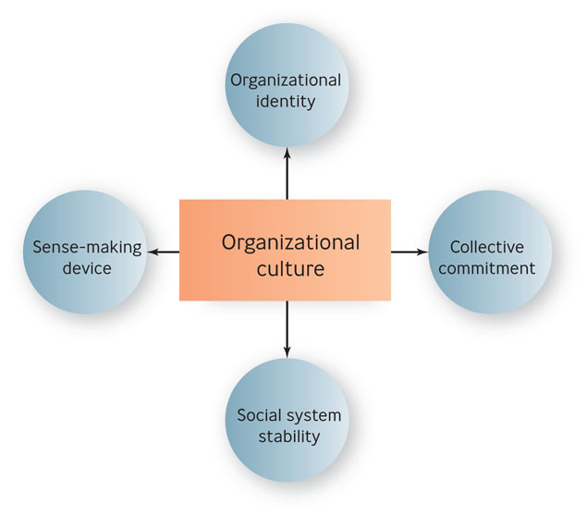
Four Functions of
Organizational Culture
Figure 8.3

Slide 16
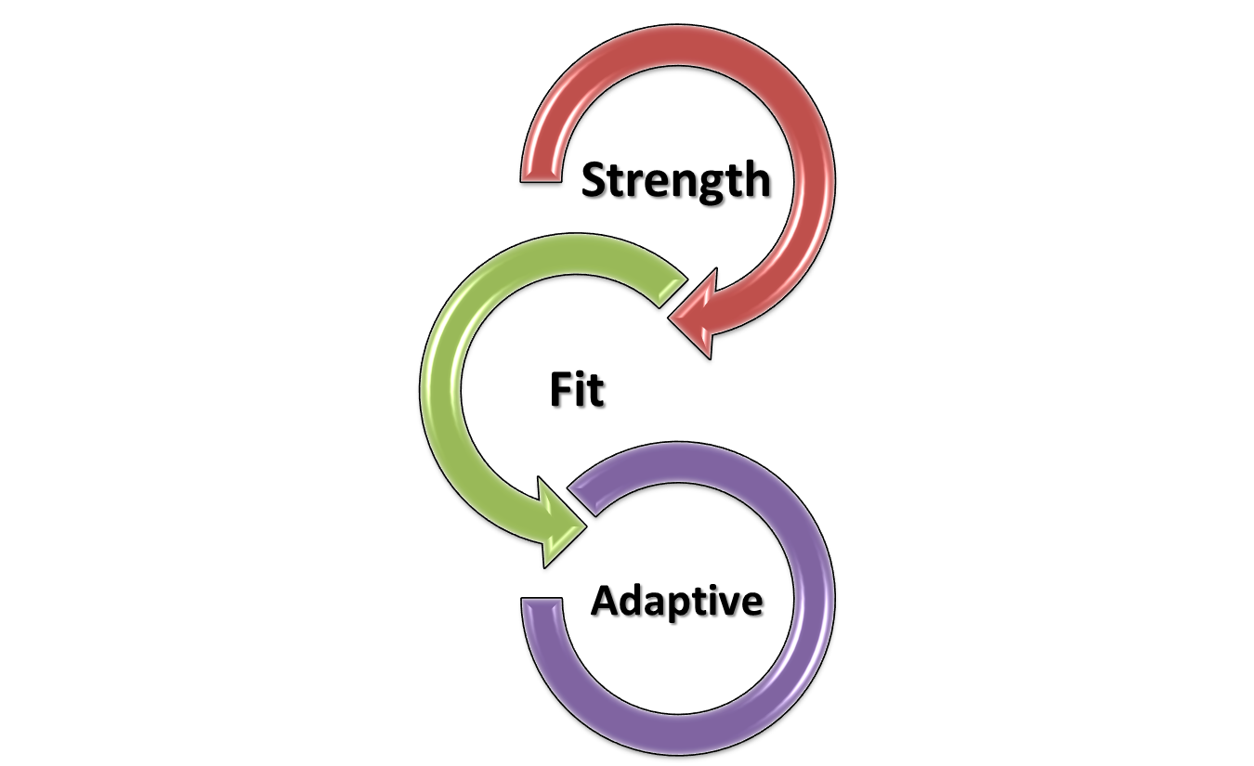
Cultures For Enhancing Economic Performance: Three Perspectives
Notes:
The strength perspective assumes that the strength of a corporate culture is related to a firm’s long-term financial performance.
The fit perspective assumes that an organization’s culture must align with its business or strategic context
The adaptive perspective assumes that the most effective cultures help organizations anticipate and adapt to environmental changes
Multimedia Lecture Support Package to Accompany Basic Marketing
Lecture Script 6-*

Slide 17
The Process of Cultural Change
Formal statements
Slogans & sayings
Stories, legends, & myths
Leader reaction to crises
Role modeling, training, & coaching
Physical design

Slide 18
The Process of Cultural Change (cont.)
7. Rewards, titles, promotions, & bonuses
8. Organizational goals & performance criteria
9. Measurable & controllable activities
10. Organizational structure
11. Organizational systems & procedures

Slide 19

Organizational Structure
Organization
  a system of consciously coordinated activities or forces of two or more people
  For-profit, nonprofit,
  mutual-benefit

Slide 20
Question?
The United Way, a charitable organization, is considered a ______ organization.
For-profit
Nonprofit
Mutual-benefit
May be any one of the above
Notes:
The correct answer is “B” - nonprofit
Multimedia Lecture Support Package to Accompany Basic Marketing
Lecture Script 6-*

Slide 21
The Organization Chart
Organization Chart
  box-and-lines illustration showing the formal lines of authority and the organization’s official positions or work specializations

Slide 22
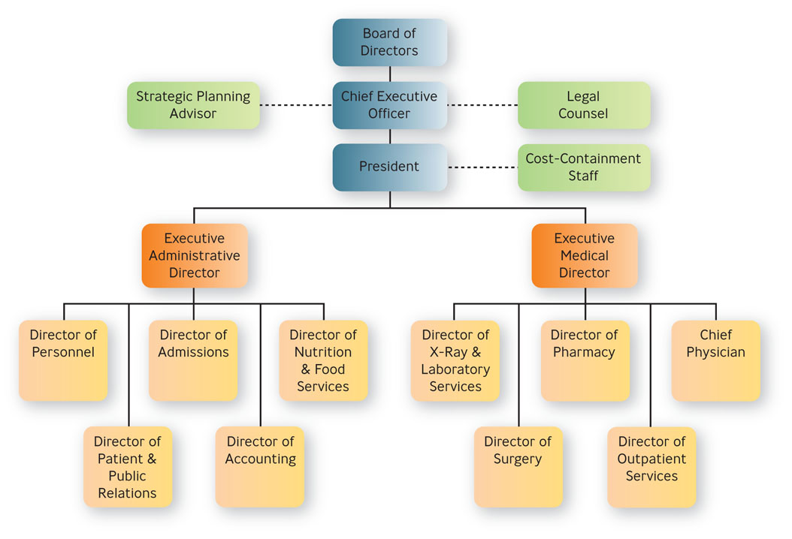
Organization Chart
Figure 8.4
Example for a Hospital

Slide 23
Common Elements of Organizations
Common purpose - unifies employees or members and gives everyone an understanding of the organization’s reason for being
Coordinated effort – the coordination of individual effort into group wide effort
Division of labor – arrangement of having discrete parts of a task done by different people

Slide 24
Common Elements of Organizations
Hierarchy of authority - control mechanism for making sure the right people do the right things at the right time
  Unity of command
Span of control - refers to the number of people reporting directly to a given manager
  Narrow, wide

Slide 25
Common Elements of Organizations
Authority, responsibility, & delegation
  Authority – rights inherent in a managerial position to make decisions and utilize resources
  Accountability – managers must report and justify work results to the managers above them

Slide 26
Common Elements of Organizations
Authority, responsibility, & delegation (cont.)
  Responsibility – obligation you have to perform the tasks assigned to you
  Delegation – process of assigning managerial authority and responsibility to managers and employees lower in the hierarchy
Notes:
Line managers have the authority to make decisions and usually have people reporting to them
Staff personnel have authority functions; they provide advice, recommendations, and research to the line managers
Multimedia Lecture Support Package to Accompany Basic Marketing
Lecture Script 6-*

Slide 27
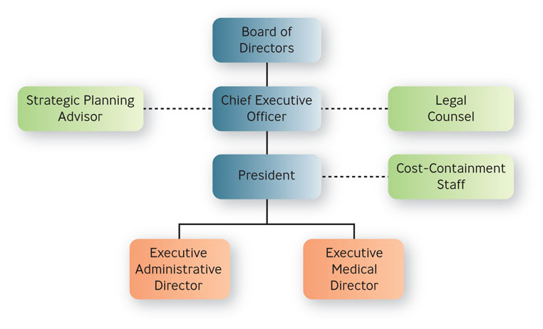
Line and Staff
Figure 8.5

Slide 28
Common Elements of Organizations
Centralization versus decentralization of authority
  Centralized authority – important decisions are made by higher-level managers
  Decentralized authority – important decisions are made by middle-level and supervisory-level managers

Slide 29
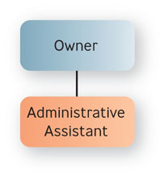
Basic Types of Organizational Structures
Simple structure
  authority is centralized in a single person with few rules and low work specialization

Slide 30
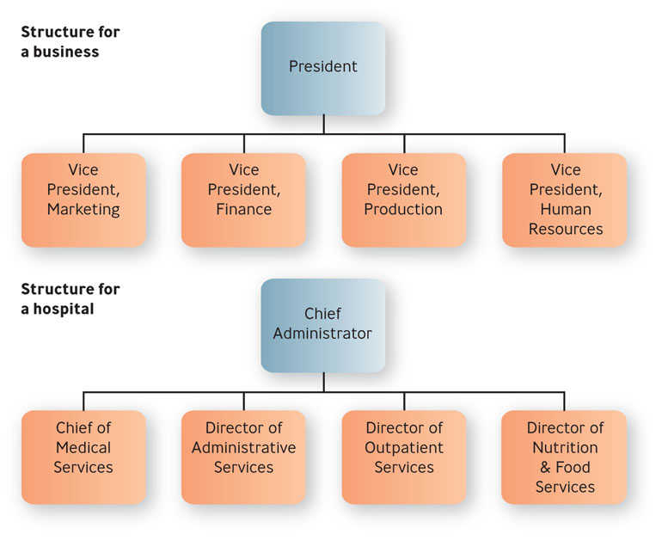
Basic Types of Organizational Structures
Functional structure
  people with similar occupational specialties are put together in formal groups

Slide 31
Question?
XYZ Hospital has a Chief of Medical Services, a Director of Administrative Services, and a Director of Outpatient Services. XYZ has a ___________ structure.
Functional
Simple
Divisional
Matrix
Notes:
The correct answer is “A” – functional.
Multimedia Lecture Support Package to Accompany Basic Marketing
Lecture Script 6-*

Slide 32
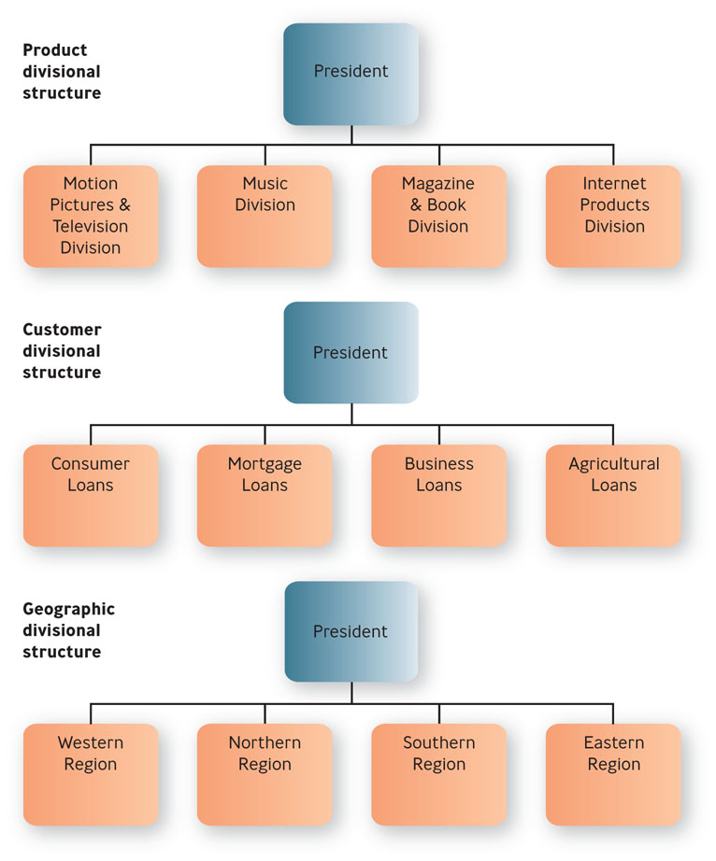
Basic Types of Organizational Structures
Divisional structure
  people with diverse occupational specialties are put together in formal groups by similar products, customers or geographic regions

Slide 33
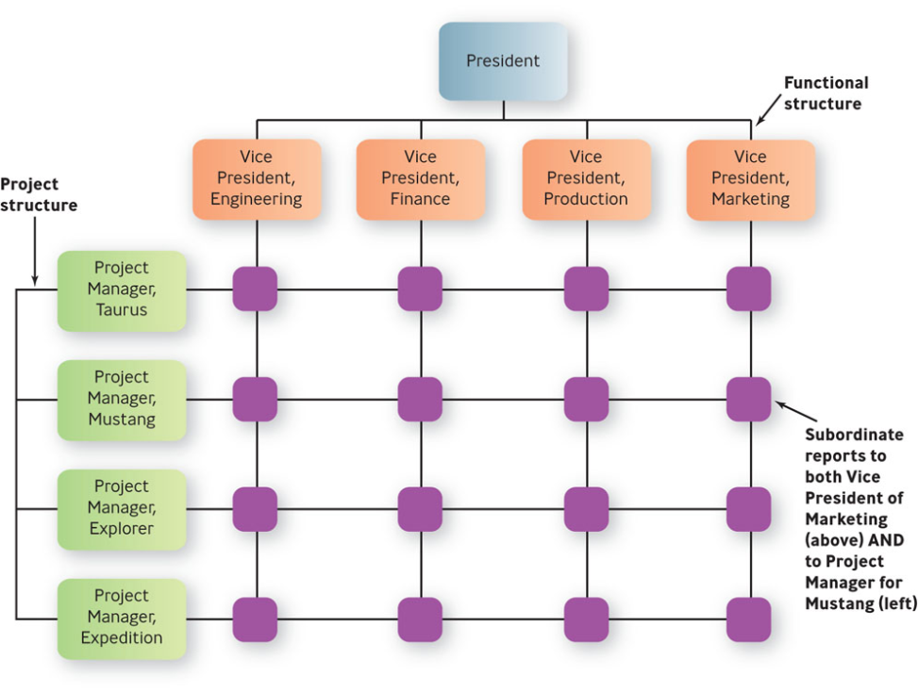
Basic Types of Organizational Structures
Matrix structure
  an organization combines functional and divisional chains
  of command in a
  grid so that there
  are two command
  structures-vertical
  and horizontal

Slide 34
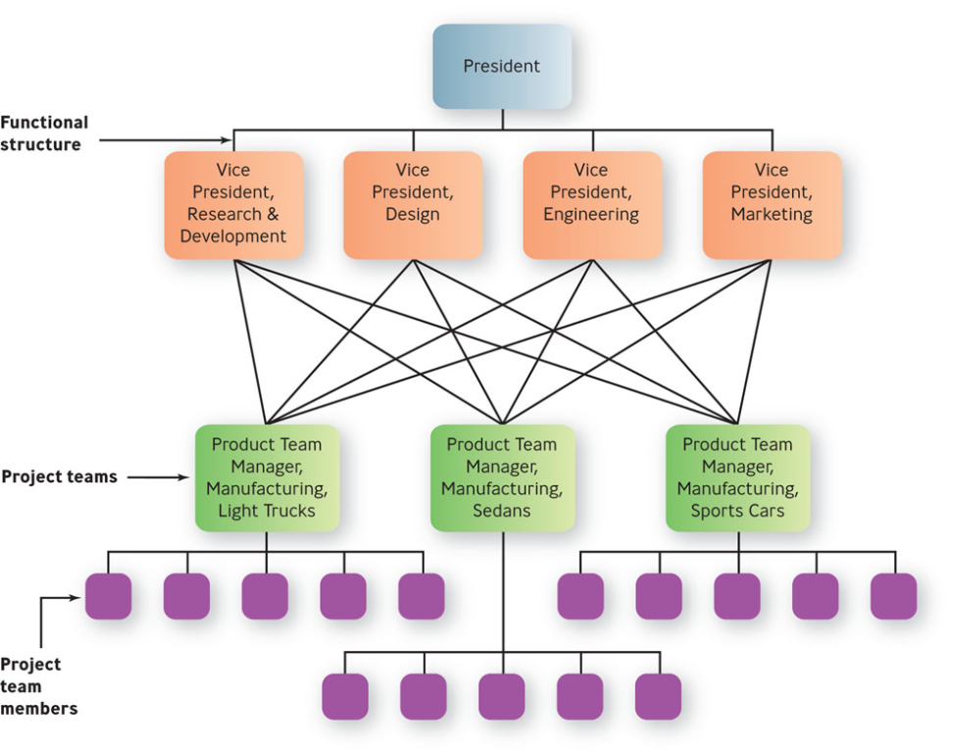
Basic Types of Organizational Structures
Horizontal design
  Teams or workgroups, either temporary or permanent, are used to improve collaboration and work on shared tasks by breaking down internal boundaries.

Slide 35
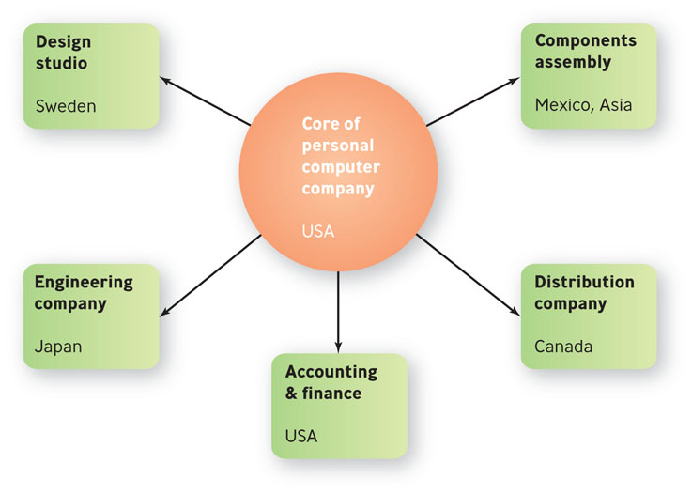
Basic Types of Organizational Structures
Hollow structure
  the organization has a central core of key functions and outsources other functions to vendors who can do them cheaper or faster

Slide 36
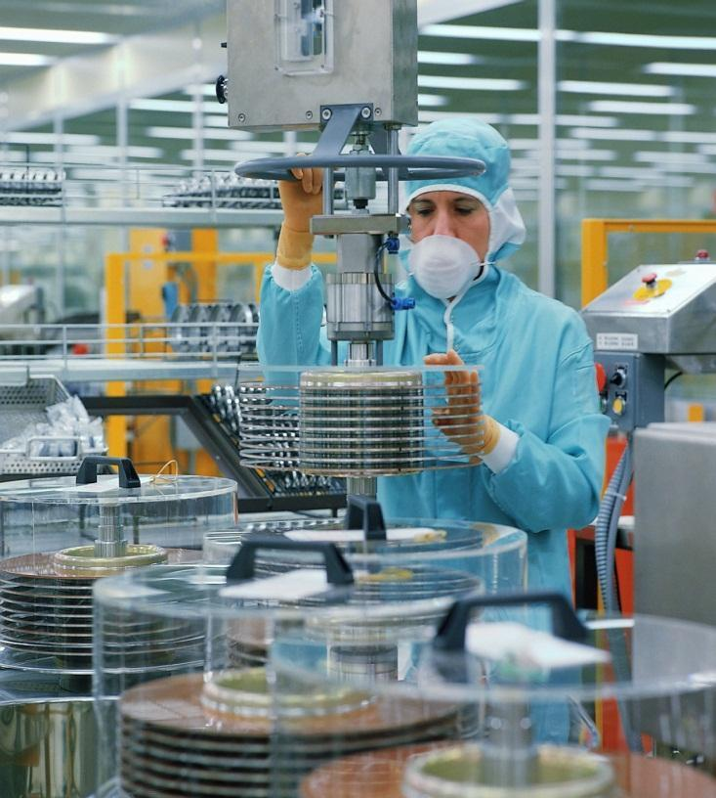
Basic Types of Organizational Structures
Modular structure
  firm assembles product chunks, or modules, provided by outside
  contractors

Slide 37

Example: MySQL
MySQL employs 320 workers in 25 countries
70% work from home
Productivity is measured strictly by output
MySQL hires strictly for skill, not “the ability to play nicely with other

Slide 38
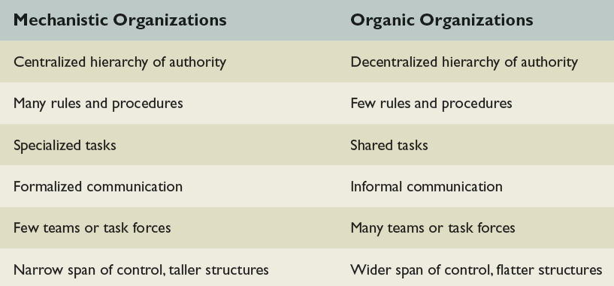
Mechanistic vs. Organic Organizations
Table 8.1

Slide 39
Differentiation vs. Integration
Differentiation
  tendency of the parts of an organization to disperse and fragment
Integration
  tendency of the parts of an organization to draw together to achieve a common purpose

Slide 40
Stages in the Life of an Organization
Stage 1: Birth stage – the organization is created
Stage 2: Youth stage – growth and expansion
Stage 3: Midlife stage – period of growth evolving into stability
Stage 4: Maturity stage -organization becomes very bureaucratic, large, and mechanistic

