Slide 1
Chapter Seven
Individual & Group
Decision Making
How Managers Make Things Happen
McGraw-Hill/Irwin
Copyright © 2013 by The McGraw-Hill Companies, Inc. All rights reserved.

Slide 2
Major Questions You Should Be Able to Answer
7.1 How do people know when they’re being logical or illogical?
7.2 How can I improve my decision making using evidence-based management and business analytics?
7.3 How do I decide to decide?

Slide 3
Major Questions You Should Be Able to Answer
7.4 What guidelines can I follow to be sure that decisions I make are not just lawful but ethical?
7.5 Trying to be rational isn’t always easy. What are the barriers?
7.6 How do I work with others to make things happen?

Slide 4

Two Kinds of Decision Making
Decision
  choice made from among available alternatives
Decision making
  process of identifying and choosing alternative courses of action

Slide 5
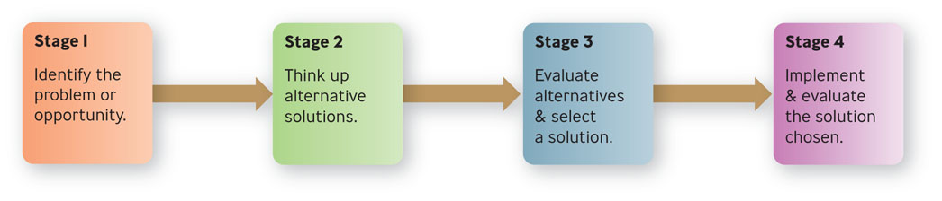
Rational Decision Making
Figure 7.1

Slide 6
Rational Decision Making
Rational model of decision making
  explains how managers should make decisions
  assumes managers will make logical decisions that will be optimum in furthering the organization’s interest
  also called the classical model
Notes:
Successful Implementation - Plan carefully
Be sensitive to those affected
Evaluation - What should you do if action is not working?
Give it more time
Change it slightly
Try another alternative
Start over
Multimedia Lecture Support Package to Accompany Basic Marketing
Lecture Script 6-*

Slide 7
Example: What Do Warren Buffett & Female Investors Have in Common?
Buffett and female investors have something in common.
Women trade much less often than men, do a lot more research, and tend to base their investment decisions on more than just numbers.
Men tend to be frazzled, frenetic day traders.

Slide 8
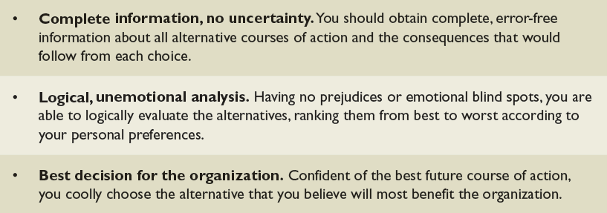
Assumptions of the Rational Model
Table 7.1

Slide 9

Nonrational Decision Making
Nonrational models of decision making
  assume that decision making is nearly always uncertain and risky, making it difficult for managers to make optimal decisions

Slide 10
Bounded Rationality
Bounded Rationality
  suggests that the ability of decision makers to be rational is limited by numerous constraints
  complexity, time and money, cognitive capacity

Slide 11
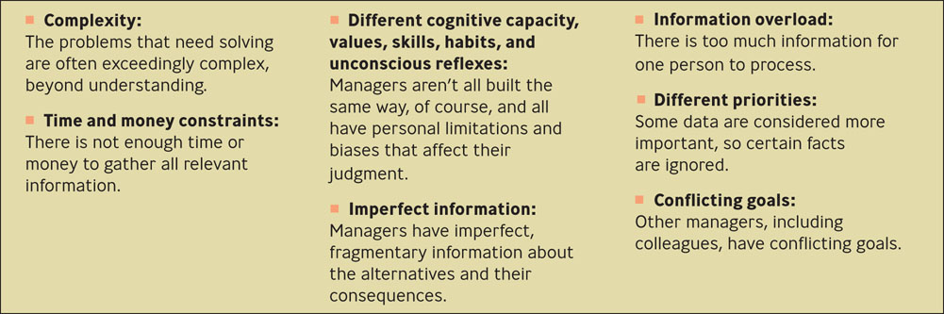
Some Hindrances to Perfectly Rational Decision Making
Figure 7.2

Slide 12
Satisficing and Incremental Models
Satisficing Model
  managers seek alternatives until they find one that is satisfactory, not optimal
Incremental Model
  managers take small, short-term steps to alleviate a problem

Slide 13

Intuition Model
Intuition
  making a choice without the use of conscious thought or logical inference
  sources are expertise and feelings

Slide 14
Question?
Bill has been a manager for 14 years. He has seen many different situations with his employees. He often makes decisions without really thinking about them. This is called __________.
Intuition
Satisficing
Bounded rationality
Unbounded rationality
Notes:
The correct answer is “A” – intuition. See previous slide.
Multimedia Lecture Support Package to Accompany Basic Marketing
Lecture Script 6-*

Slide 15
Implementation Principles of Evidence-Based Decision Making
Treat your organization as an unfinished prototype.
No brag, just facts.
See yourself and your organization as outsiders do.
Evidence-based management is not just for senior executives.

Slide 16
Implementation Principles of Evidence-Based Decision Making (cont.)
Like everything else, you still need to sell it
If all else fails, slow the spread of bad practice
The best diagnostic question: What happens when people fail?

Slide 17
What Makes It Hard to Be Evidence Based
There’s too much evidence.
There’s not enough good evidence.
The evidence doesn’t quite apply.
People are trying to mislead you.
You are trying to mislead you.
The side effects outweigh the cure.
Stories are more persuasive anyway.

Slide 18
Question?
Norma is trying to decide on a new contract for copier services. One of the salespeople has an excellent bid, but Norma feels that there are things he is not telling her. Why does this make it hard for her to use evidence-based decision making?
There’s too much evidence.
There’s not enough good evidence.
People are trying to mislead you.
The evidence doesn’t quite apply.
Notes:
The correct answer is “C” – people are trying to mislead you. See previous slide.
Multimedia Lecture Support Package to Accompany Basic Marketing
Lecture Script 6-*

Slide 19

Analytics
Analytics
  sophisticated forms of business data analysis
  portfolio analysis, time-series forecast
  also called business analytics

Slide 20

Example: The Oakland A’s Play Moneyball
The A’s could not afford superstar free agents
Looked for players that could contribute in ways other clubs didn’t value as much
Found that indicators of success lay in on-base percentage and slugging percentage

Slide 21
Key Attributes Among Analytics Competitors
Use of modeling: going beyond simple descriptive statistics
Having multiple applications, not just one
Support from the top

Slide 22
General Decision-Making Styles
Risk propensity
  the willingness to gamble or to undertake risk for the possibility of gaining an increased payoff
Decision-making style
  reflects the combination of how an individual perceives and responds to information
  value orientation
  tolerance for ambiguity
Notes:
Value orientation – reflects the extent to which a person focuses on either task and technical concerns or people and social concerns when making decisions
Tolerance for ambiguity – extent to which a person has a high need for structure or control in his life
Multimedia Lecture Support Package to Accompany Basic Marketing
Lecture Script 6-*

Slide 23
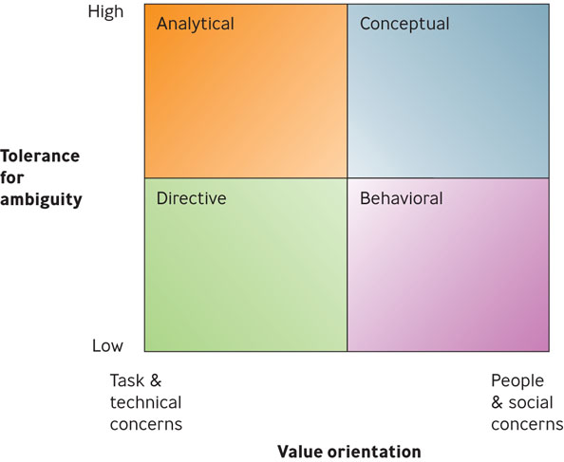
Decision-Making Styles
Figure 7.3

Slide 24
Decision-Making Styles
Directive
  people are efficient, logical, practical, and systematic in their approach to solving problems
  action-oriented, decisive, and likes to focus on facts
Analytical
  considers more information and alternatives

Slide 25
Decision-Making Styles
Conceptual
  takes a broad perspective to problem solving
  likes to consider many options and future possibilities
Behavioral
  supportive, receptive to suggestions, show warmth
  prefer verbal to written information

Slide 26
Question?
Bill is supportive of his employees and prefers to have verbal conversations rather than written memos. His style is:
Analytical
Behavioral
Conceptual
Directive
Notes:
The correct answer is “B” - behavioral
Multimedia Lecture Support Package to Accompany Basic Marketing
Lecture Script 6-*

Slide 27
Which Style Do You Have?
Knowledge of your decision-making style:
Helps you to understand yourself
Can increase your ability to influence others
Gives you an awareness of how people can take the same information and yet arrive at different decisions

Slide 28
Road Map to Ethical Decision Making: A Decision Tree
Is the proposed action legal?
If “yes,” does the proposed action maximize shareholder value?
If “yes,” is the proposed action ethical?
If “no,” would it be ethical not to take the proposed action?

Slide 29
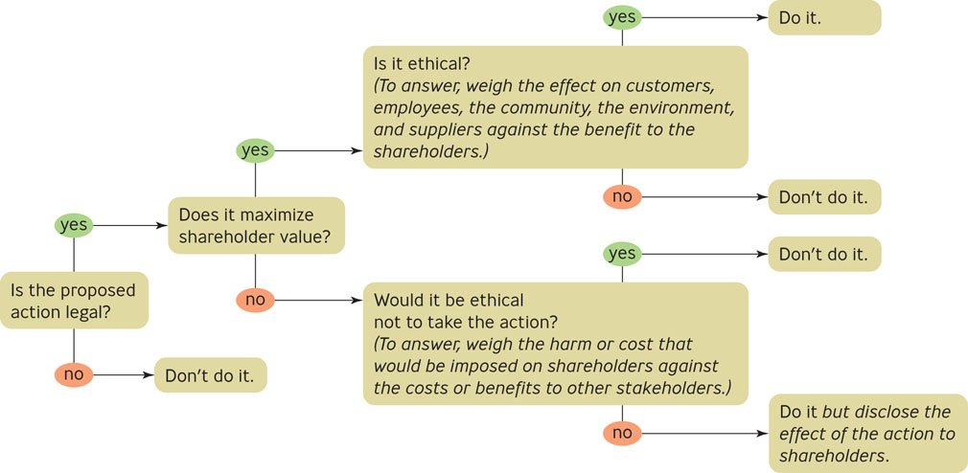
The Ethical Decision Tree
Figure 7.4

Slide 30
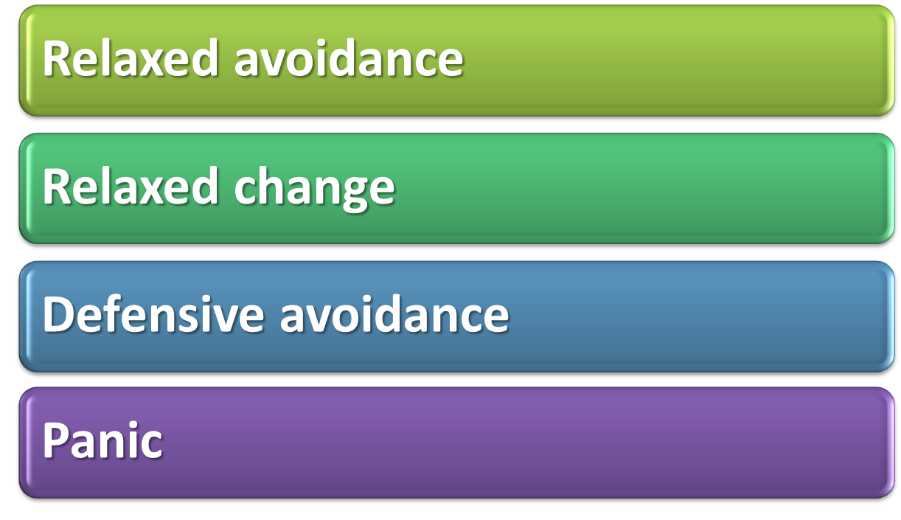
Ineffective Responses to a
Decision Situation
Notes:
Relaxed avoidance - manager decides to take no action in the belief there will be no great negative consequences
Relaxed change - manager realizes that complete inaction will have negative consequences but opts for the first available alternative that involves low risk
Defensive avoidance - manager can’t find a good solution and follows by procrastinating, passing the buck, or denying the risk of any negative consequences
Panic - manager is frantic to get rid of the problem that he can’t deal with the situation realistically
Multimedia Lecture Support Package to Accompany Basic Marketing
Lecture Script 6-*

Slide 31
Three Effective Reactions:
Deciding to Decide
Importance
  “How high priority is this situation?”
Credibility
  “How believable is the information about the situation?”
Urgency
  “How quickly must I act on the information about the situation?”

Slide 32
Common Decision-Making Biases
Availability bias
Confirmation bias
Representativeness bias
Sunk cost bias
Anchoring and adjustment bias
Escalation of commitment bias
Notes:
There are several common decision making biases (called heuristics) that simplify the process of making decisions:
1. When managers use only information that is readily available from memory to make judgments, an availability bias exists
2. When people seek information to support their point of view and discount data that do not, a confirmation bias exists
3. A representativeness bias refers to the tendency to generalize from a small sample or a single event
4. When managers add up all the money already spent on a project and conclude it is too costly to simply abandon it, sunk cost bias exists
5. The tendency to make decisions based on an initial figure is adjustment bias
6. Escalation of commitment bias occurs when decision makers increase their commitment to a project despite negative information about it
Multimedia Lecture Support Package to Accompany Basic Marketing
Lecture Script 6-*

Slide 33
Advantages of Group
Decision Making
Greater pool of knowledge
Different perspectives
Intellectual stimulation
Better understanding of decision rationale
Deeper commitment to the decision

Slide 34

Disadvantages of Group Decision Making
A few people dominate or intimidate
Groupthink
Satisficing
Goal displacement

Slide 35
Groupthink
Groupthink
  occurs when group members strive to agree for the sake of unanimity and thus avoid accurately assessing the decision situation

Slide 36
What Managers Need to Know About Groups & Decision Making
They are less efficient.
Their size affects decision quality.
They may be too confident.
Knowledge counts.

Slide 37
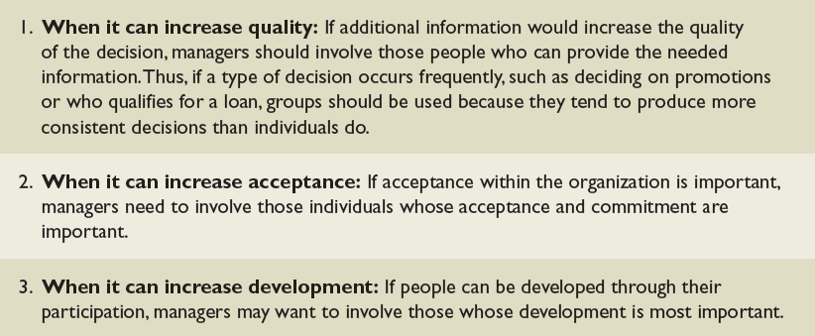
When a Group Can Help in Decision Making
Table 7.3

Slide 38
Participative Management
Participative Management
  process of involving employees in setting goals, making decisions, solving problems, and making changes in the organization

Slide 39
Group Problem-Solving Techniques
Consensus
  occurs when members are able to express their opinions and reach agreement to support the final decision
Brainstorming
  technique used to help groups generate multiple ideas and alternatives for solving problems

Slide 40
Computer-Aided Decision Making
Chauffeur-driven systems
  ask participants to answer predetermined questions on electronic keypads or dials
Group-driven systems
  involves a meeting within a room of participants who express their ideas anonymously on a computer network
  for anonymous networking

