Slide 1
Chapter Six
Strategic Management:
How Exceptional Managers Realize a Grand Design
McGraw-Hill/Irwin
Copyright © 2013 by The McGraw-Hill Companies, Inc. All rights reserved.

Slide 2
Major Questions You Should Be Able to Answer
6.1 Am I really managing if I don’t have a strategy?
6.2 What’s the five-step recipe for the strategic management process?
6.3 How can competitive intelligence, SWOT, and forecasting help me establish my strategy?

Slide 3
Major Questions You Should Be Able to Answer
6.4 How can four techniques—Porter’s competitive forces, competitive strategies, diversification and synergy, and the BCG matrix—help me formulate strategy?
6.5 How does effective execution help managers during the strategic-management process?

Slide 4
The Dynamics of Strategic Planning
Strategy
  large-scale action plan that sets the direction for an organization
Strategic management
  process that involves managers from all parts of the organization in the formulation and the implementation of strategies and strategic goals

Slide 5

Question?
Wal-Mart is guided by the following credo: “Find out what customers want, then provide it to them as cheaply and quickly as possible.” This is Wal-Mart's:
Mission
Vision
Strategy
Forecast
Notes:
The correct answer is “C” - Strategy
Page: 156 LO: 1 Difficulty: Moderate
AACSB: 6 BT: Comprehension
Multimedia Lecture Support Package to Accompany Basic Marketing
Lecture Script 6-*

Slide 6

Why Strategic Management & Strategic Planning are Important
Provide direction and momentum
Encourage new ideas
Develop a sustainable competitive advantage

Slide 7
Why Strategic Management & Strategic Planning are Important
Sustainable competitive advantage occurs when an organization can stay ahead in four areas:
Being responsive to customers
Innovation
Quality
Effectiveness

Slide 8

Example: Developing Competitive Advantage
“Ford is transforming the car into a powerful smartphone”
Ford has developed the Sync in-dash communications platform
Ford is introducing voice-activated apps
A driver can say “I’m hungry” and receive advice on nearby restaurants

Slide 9
What Is an Effective Strategy?
Strategic positioning
  attempts to achieve sustainable competitive advantage by preserving what is distinctive about a company
  “performing different activities from rivals, or performing similar activities in different ways”

Slide 10
What Is an Effective Strategy?
Strategy is the creation of a unique & valuable position
Strategy requires trade-offs in competing
Strategy involves creating a “fit” among activities
Notes:
Few needs, many customers
Broad needs, few customers
Broad needs, many customers
Multimedia Lecture Support Package to Accompany Basic Marketing
Lecture Script 6-*

Slide 11
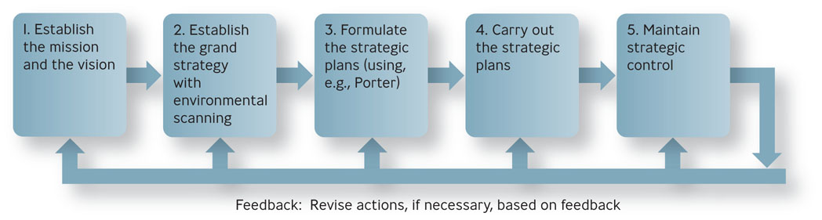
The Strategic-Management Process
Figure 6.1

Slide 12
Question?
Zach manages a small video rental store. In order to determine if strategic planning will be likely to help his business, Zach should assess:
How many competitors he has
Foot traffic by his location
His profitability in the prior six months
Industry trends
Notes:
The correct answer is “A”
Rationale: Strategic planning is not likely to result in a significant improvement unless Zach is in a highly competitive business.
Multimedia Lecture Support Package to Accompany Basic Marketing
Lecture Script 6-*

Slide 13
Common Grand Strategies
Growth strategy
  involves expansion - as in sales revenues, market share, number of employees, or number of customers
Stability
  involves little or no significant change
Defensive
  involves reduction in the organization’s efforts
  retrenchment

Slide 14
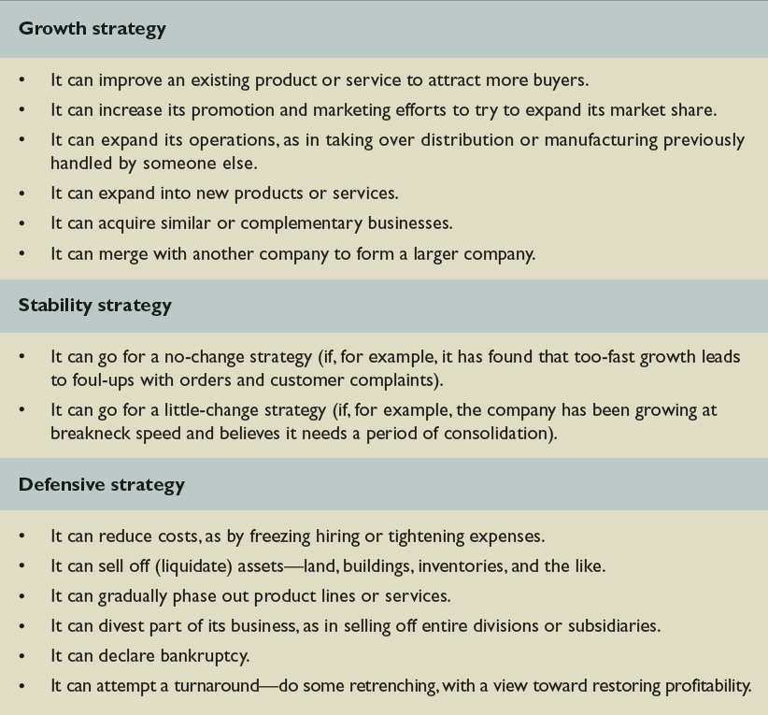
How Companies Can Implement Grand Strategies
Table 6.2

Slide 15
The Strategic Management Process
Strategy formulation
  process of choosing among different strategies and altering them to best fit the organization’s needs
Strategy implementation
  putting strategic plans into effect

Slide 16
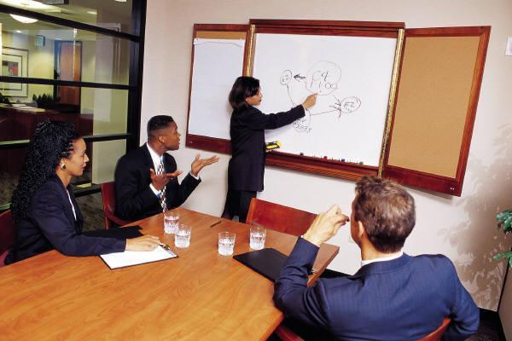
The Strategic Management Process
Strategic control
  consists of monitoring the execution of strategy and making adjustments, if necessary
Engage people
Keep it simple
Stay focused
Keep moving

Slide 17
Competitive Intelligence
Competitive intelligence
  means gaining information about one’s competitors’ activities so that you can anticipate their moves and react appropriately
  public prints and advertising, investor information, informal sources

Slide 18
SWOT Analysis
Environmental scanning
  careful monitoring of an organization’s internal and external environments to detect early signs of opportunities and threats that may influence the firm’s plans

Slide 19
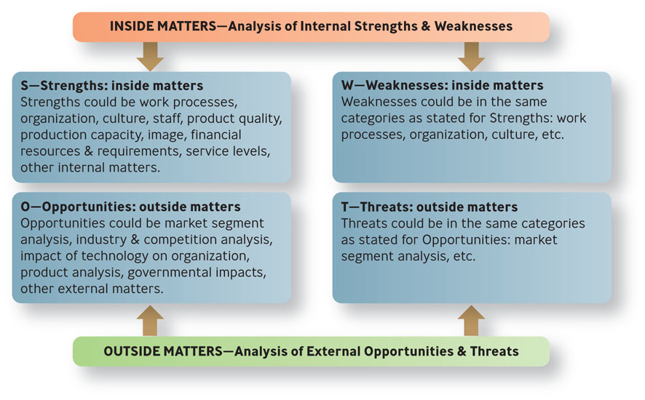
SWOT Analysis
Figure 6.2

Slide 20
SWOT Analysis
Organizational strengths
  skills and capabilities that give the organization special competencies and competitive advantages in executing strategies in pursuit of its mission
Organizational weaknesses
  drawbacks that hinder an organization in executing strategies in pursuit of its mission

Slide 21
Question?
When analyzing the “W” in SWOT analysis, Roberta, the manager might be assessing:
Possible challenges in the market
Competitors' actions
High turnover of employees
Good financial resources of the firm
Notes:
The correct answer is “C” – high turnover
Page: 169
Multimedia Lecture Support Package to Accompany Basic Marketing
Lecture Script 6-*

Slide 22
SWOT Analysis
Organizational opportunities
  environmental factors that the organization may exploit for competitive advantage
Organizational threats
  environmental factors that hinder an organization’s achieving a competitive

Slide 23

Example: How Would You Analyze Toyota?
Internal strengths
  attention to detail and a frugality that shuns waste of every kind
Internal weaknesses
  parts were supplied by outside companies rather than trusted traditional suppliers
External opportunities
  stressed commitment to customers
  still ranks high in quality

Slide 24
Forecasting: Predicting the Future
Trend analysis
  hypothetical extension of a past series of events into the future
Contingency planning
  creation of alternative hypothetical but equally likely future conditions
  also called scenario planning and scenario analysis

Slide 25
Porter’s Five Competitive Forces
Threat of new entrants
Bargaining power of suppliers
Bargaining power of buyers
Threat of substitute products or services
Rivalry among competitors

Slide 26
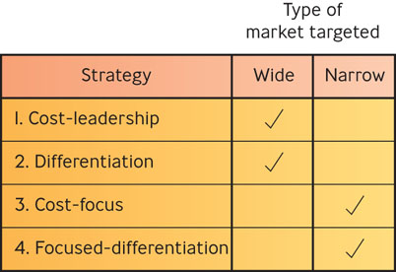
Porter’s Four Competitive Strategies
Figure 6.3

Slide 27

Porter’s Four Competitive Strategies
Cost-leadership strategy
  keep the costs, and hence prices, of a product or service below those of competitors and to target a wide market

Slide 28
Question?
The company's CEO puts pressure on the firm's R&D managers to develop products that can be created cheaply. The firm would be following a ________ strategy:
Cost leadership
Differentiation
Cost focus
Retrenchment
Notes:
The correct answer is “A” – cost leadership
Page: 174 LO: 4 Difficulty: Easy
AACSB: 6 BT: Knowledge
Multimedia Lecture Support Package to Accompany Basic Marketing
Lecture Script 6-*

Slide 29
Porter’s Four Competitive Strategies
Differentiation strategy
  offer products that are of unique and superior value compared to those of competitors but to target a wide market

Slide 30
Porter’s Four Competitive Strategies
Cost-focus strategy
  keep the costs of a product below those of competitors and to target a narrow market
Focused-differentiation
  offer products that are of unique and superior value compared to those of competitors and to target a narrow market

Slide 31

Single-Product versus Diversification
Single-product strategy
  company makes and sells only one product within its market
  Benefit-focus
  Risk-vulnerability

Slide 32
The Diversification Strategy
Diversification
  operating several businesses under one ownership that are not related to one another
  Related, unrelated
Notes:
Unrelated diversification - operating several businesses under one ownership that are not related to one another
Related diversification - an organization under one ownership operates separate businesses that are related to one another.
*

Slide 33
Advantages of Related Diversification
Reduced risk
  because more than one product
Management efficiencies
  administration spread over several businesses
Synergy
  the sum is greater than the parts

Slide 34




The BCG Matrix
BCG matrix
  a means of evaluating strategic business units on the basis of (1) their business growth rates and (2) their share of the market.

Slide 35
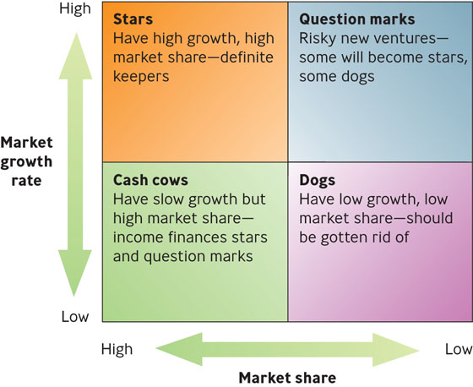
The BCG Matrix
Figure 6.4
Notes:
Market growth is divided into two categories, low and high. Market share is also divided into low and high. Thus, in this matrix,
“Stars” are business units that are highly desirable (high growth, high market share), compared to “Dogs,” which are not so desirable
(low growth, low market share).
*

Slide 36
Execution: Getting Things Done
Execution
  consists of using questioning, analysis, and follow-through in order to mesh strategy with reality, align people with goals, and achieve results promised
  central part of any company’s strategy

Slide 37
Question?
John owns a piano sales and tuning store. He wants to be the biggest retailer in the Midlands. Adding salespeople would be part of his strategic __________.
Locution
Execution
Efficacy
Efficiency
Notes:
The correct answer is “B” – execution. See previous slide.
Multimedia Lecture Support Package to Accompany Basic Marketing
Lecture Script 6-*

Slide 38
The Three Core Processes of Business
People
  Consider who will benefit you in the future
Strategy
  Consider how success will be accomplished
Operations
  Consider what path will be followed

Slide 39
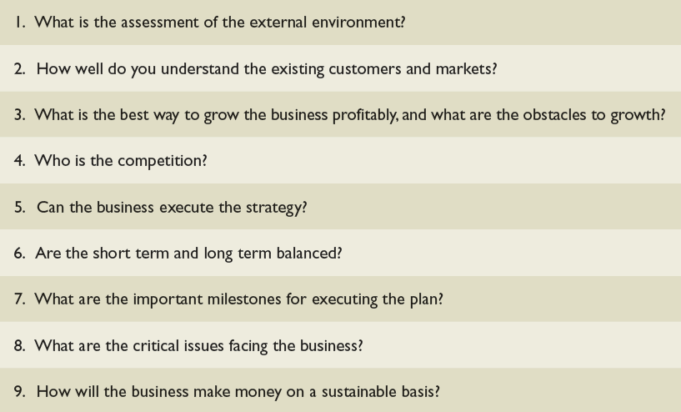
What Questions Should a Strong Strategic Plan Address?
Table 6.4

Slide 40

Building a Foundation of Execution
Know your people & your business
Insist on realism
Set clear goals & priorities
Follow through
Reward the doers
Expand the capabilities
Know yourself
Notes:
Know Your People & Your Business: “Engage Intensely with Your Employees”
Insist on Realism: “Don’t Let Others Avoid Reality”
Set Clear Priorities: “Focus on a Few Rather Than Many Goals”
Follow Through: “Establish Accountability & Check on Results”
Reward the Doers: “Show Top Performers That They Matter”
Expand People’s Capabilities: “Develop the Talent”
Know Yourself: “Do the Hard Work of Understanding Who You Are”
*

