Slide 1
Chapter Two
Management Theory:
Essential Background for the Successful Manager
McGraw-Hill/Irwin
Copyright © 2013 by The McGraw-Hill Companies, Inc. All rights reserved.

Slide 2
Major Questions You Should Be Able to Answer
2.1 What’s the payoff in studying different management perspectives, both yesterday’s and today’s?
2.2 If the name of the game is to manage work more efficiently, what can the classical viewpoint teach me?
2.3 To understand how people are motivated to achieve, what can I learn from the behavioral viewpoint?
2.4 If the manager’s job is to solve problems, how might the two quantitative approaches help?

Slide 3
Major Questions You Should Be Able to Answer
2.5 How can the exceptional manager be helped by the systems viewpoint?
2.6 In the end, is there one best way to manage in all situations?
2.7 Can the quality-management viewpoint offer guidelines for true managerial success?
2.8 How do I build a learning organization?

Slide 4
How We Got to Today’s Management Outlook
Evidence based management
  translating principles based on best evidence into organizational practice, bringing rationality to the decision making process
  Pfeffer and Sutton

Slide 5

Two Overarching Perspectives about Management
Historical perspective
  classical, behavioral, and quantitative
Contemporary perspective
  systems, contingency, and quality-management

Slide 6
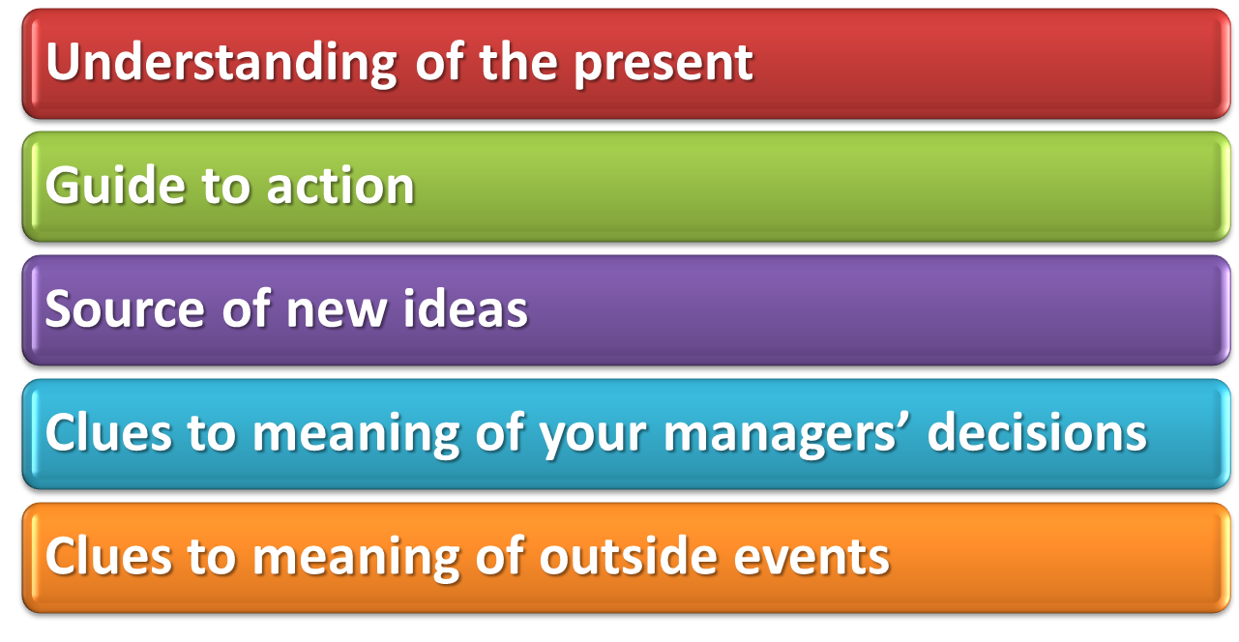
Five Practical Reasons for Studying This Chapter
Notes:
1. Understanding of the present. “Sound theories help us interpret the present,
to understand what is happening and why,” say Christensen and
Raynor. 9 Understanding history will help you understand why some practices
are still favored, whether for right or wrong reasons.
2. Guide to action. Good theories help us make predictions and enable you
to develop a set of principles that will guide your actions.
3. Source of new ideas. It can also provide new ideas that may be useful to
you when you come up against new situations.
4. Clues to meaning of your managers’ decisions. It can help you understand
your firm’s focus, where the top managers are “coming from.”
5. Clues to meaning of outside events. Finally, it may allow you to understand
events outside the organization that could affect it or you.
*

Slide 7
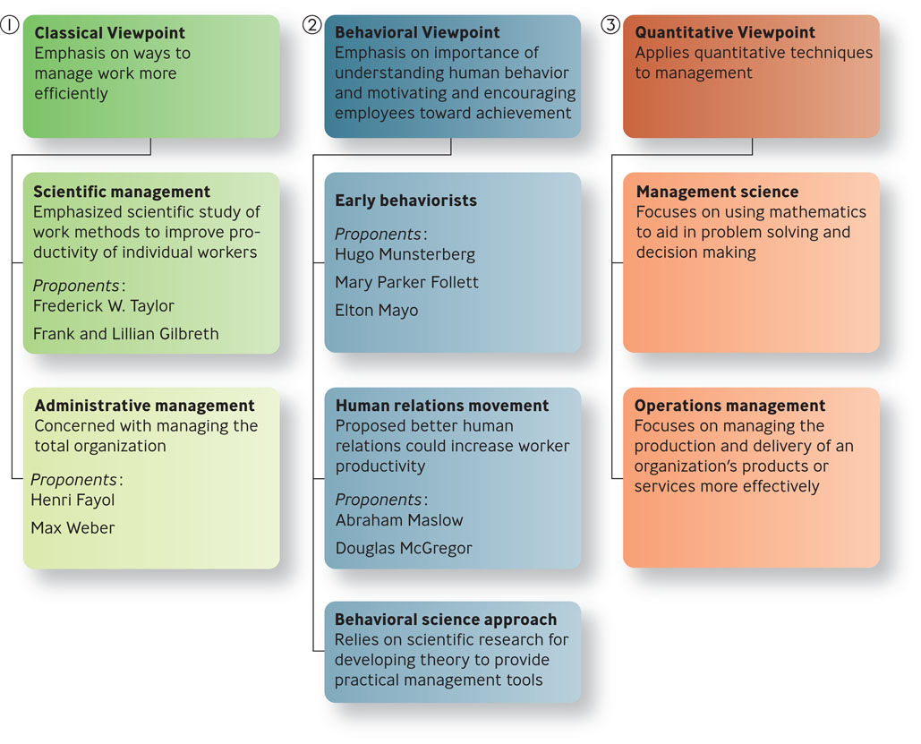
Classical Viewpoint: Scientific & Administrative Management
Figure 2.1

Slide 8

Question?
  Which viewpoint emphasized the scientific study of work methods to improve the productivity of individual workers?
  Scientific management
  Administrative
  management
  Behavioral science
  TQM
Notes:
The correct answer is “A” – scientific management. See next slide.
Multimedia Lecture Support Package to Accompany Basic Marketing
Lecture Script 6-*

Slide 9
Scientific Management: Pioneered by Taylor & the Gilbreths
Scientific management
  emphasized the scientific study of work methods to improve the productivity of individual workers
  Frederick W. Taylor, Frank and Lillian Gilbreth

Slide 10
Scientific Management: Pioneered by Taylor & the Gilbreths
Principles of Scientific Management
Scientifically study each part of the task
Carefully select workers with the right abilities
Give workers the training and incentives to do the task
Use scientific principles to plan the work methods
Notes:
1. Evaluate a task by scientifically studying each part of the task (not use
old rule-of-thumb methods).
2. Carefully select workers with the right abilities for the task.
3. Give workers the training and incentives to do the task with the proper
work methods.
4. Use scientific principles to plan the work methods and ease the way for
workers to do their jobs.
*

Slide 11
Administrative Management: Pioneered by Fayol & Weber
Administrative management
  concerned with managing the total organization
Henri Fayol
  French engineer and industrialist
  first to identify the major functions of management

Slide 12
Administrative Management: Pioneered by Fayol & Weber
Max Weber believed that a bureaucracy was a rational, efficient, ideal organization based on the principles of logic

Slide 13

Five Positive Bureaucratic Features
A well-defined hierarchy of authority
Formal rules and procedures
A clear division of labor
Impersonality
Careers based on
merit
Notes:
A better-performing organization should have five positive bureaucratic features:
1. A well-defined hierarchy of authority.
2. Formal rules and procedures.
3. A clear division of labor, with parts of a complex job being handled by specialists.
4. Impersonality, without reference or connection to a particular person.
5. Careers based on merit.
*

Slide 14
The Problem with the Classical Viewpoint
Mechanistic
Tends to view humans as cogs within a machine, not taking into account the importance of human needs

Slide 15
Why the Classical Viewpoint is Important?
Work activity was amenable to a rational approach
Through the application of scientific methods, time and motion studies, and job specialization it was possible to boost productivity

Slide 16

Question?
  Which viewpoint emphasized the importance of understanding human behavior and of motivating employees toward achievement?
  Scientific management
  Administrative
  management
  Behavioral
  TQM
Notes:
The correct answer is “C” – behavioral viewpoint. See next slide.
Multimedia Lecture Support Package to Accompany Basic Marketing
Lecture Script 6-*

Slide 17
Behavioral Viewpoint: Behaviorism, Human Relations, & Behavioral Science
Behavioral viewpoint
  emphasized the importance of understanding human behavior and of motivating employees toward achievement

Slide 18
Behavioral Viewpoint: Behaviorism, Human Relations, & Behavioral Science
The behavioral viewpoint developed over three phases:
Early behaviorism
The human relations movement
Behavioral science.

Slide 19
Early Behaviorism: Pioneered by Munsterberg, Follett, & Mayo
Hugo Munsterberg
  father of industrial psychology
Study jobs and determine which people are best suited to specific jobs
Identify the psychological conditions under which employees do their best work
Devise management strategies to influence employees to follow management’s interests

Slide 20
Early Behaviorism: Pioneered by Munsterberg, Follett, & Mayo
Mary Parker Follett
  social worker and social philosopher
Organizations should be operated as “communities”
Conflicts should be resolved by having managers and workers talk over differences and find solutions that would satisfy both parties
The work process should be under control of workers with relevant knowledge
Notes:
The following ideas were among her most important:
1. Organizations should be operated as “communities,” with managers and
subordinates working together in harmony.
2. Conflicts should be resolved by having managers and workers talk over
differences and find solutions that would satisfy both parties—a process
she called integration .
3. The work process should be under the control of workers with the relevant
knowledge, rather than of managers, who should act as facilitators.
*

Slide 21
Early Behaviorism: Pioneered by Munsterberg, Follett, & Mayo
Hawthorne effect
  employees worked harder if they received added attention, thought that managers cared about their welfare and that supervisors paid special attention to them
  Elton Mayo

Slide 22

The Human Relations Movement: Pioneered by Maslow & McGregor
Human relations movement
  proposed that better human relations could increase worker productivity
  Abraham Maslow and Douglas McGregor

Slide 23
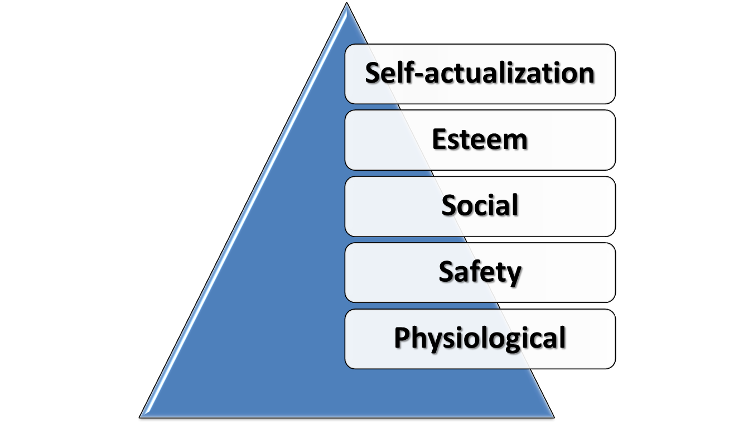
Maslow’s Hierarchy of Needs

Slide 24
Douglas McGregor –
Theory X versus Theory Y
Theory X
  represents a pessimistic, negative view of workers
  workers are irresponsible, resistant to change, lack ambition, hate work, and want to be led
Theory Y
  represents an optimistic, positive view of workers
  Workers are considered capable of accepting responsibility, self-direction, self control and being creative

Slide 25
Why Theory X/Theory Y Is Important
Helps managers understand how their beliefs affect their behavior.
Managers can be more effective by considering how their behavior is shaped by their expectations about human nature

Slide 26
The Behavioral Science Approach
Behavioral science
  relies on scientific research for developing theories about human behavior that can be used to provide practical tools for managers

Slide 27

Quantitative Viewpoints: Management Science & Operations Research
Quantitative management
  application to management of quantitative techniques, such as statistics and computer simulations
  Management science,
  operations management

Slide 28
Question?
  Which viewpoint stresses the use of rational, science-based techniques and mathematical models to improve decision making and strategic planning?
  Scientific management
  Operations management
  Production management
  Management science
Notes:
The correct answer is “D” – management science. See next slide.
Multimedia Lecture Support Package to Accompany Basic Marketing
Lecture Script 6-*

Slide 29
Management Science: Using Mathematics to Solve Management Problems
Management science
  stresses the use of rational, science-based techniques and mathematical models to improve decision making and strategic planning

Slide 30
Operations Management: Helping Organizations Deliver Products or Services More Effectively
Operations management
  focuses on managing the production and delivery of an organization’s products or services more effectively
  work scheduling, production planning, facilities location and design

Slide 31
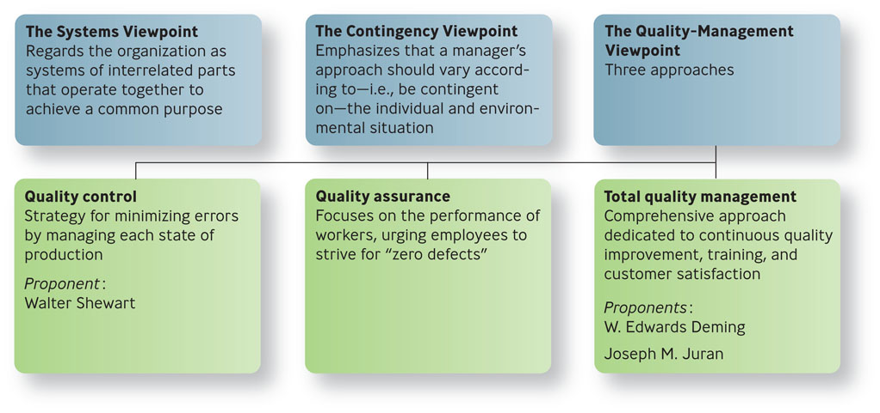
The Contemporary Perspective
Figure 2.2

Slide 32
Systems Viewpoint
Systems viewpoint
  regards the organization as a system of interrelated parts
  collection of subsystems
  part of the larger environment

Slide 33
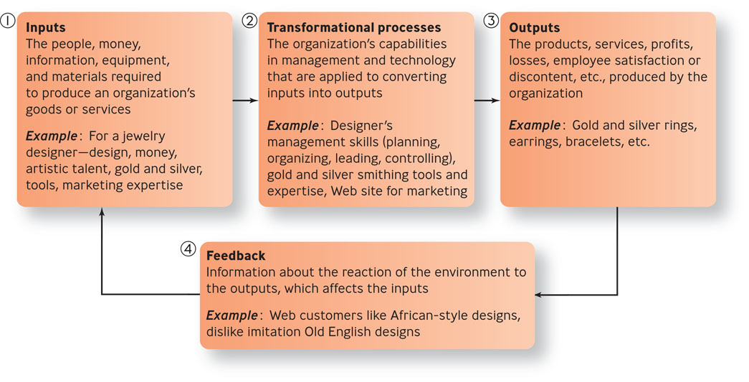
The Four Parts of a System
Figure 2.3

Slide 34

Systems Viewpoint
Open system
  continually interacts with its environment
Closed system
  has little interaction with its environment

Slide 35
Contingency Viewpoint
Contingency viewpoint
  emphasizes that a manager’s approach should vary according to the individual and the environmental situation
  Most practical because it addresses problems on a case-by-case basis

Slide 36
Quality Control & Quality Assurance
Quality
  total ability of a product or service to meet customer needs
Quality control
  the strategy for minimizing errors by managing each stage of production
Quality assurance
  focuses on the performance of workers, urging employees to strive for “zero defects”

Slide 37
Quality-Management Viewpoint
Total quality management (TQM)
  comprehensive approach-led by top management and supported throughout the organization-dedicated to continuous quality improvement, training, and customer satisfaction
  Deming, Juran

Slide 38
Total Quality Management
Make continuous improvement a priority
Get every employee involved
Listen to and learn from customers and employees
Use accurate standards to identify and eliminate problems

Slide 39
The Learning Organization: Handling Knowledge & Modifying Behavior
Learning organization
  organization that actively creates, acquires, and transfers knowledge within itself and is able to modify its behavior to reflect new knowledge

Slide 40
How to Build a Learning Organization:
Three Roles Managers Play
How to build a learning organization
Build a commitment to learning
Work to generate ideas with impact
Work to generalize ideas with impact

