Slide 1
Chapter One
The Exceptional Manager: What You Do, How You Do It
McGraw-Hill/Irwin
Copyright © 2013 by The McGraw-Hill Companies, Inc. All rights reserved.

Slide 2
Major Questions You Should Be Able to Answer
1.1 What are the rewards of being an exceptional manager?
1.2 What are seven challenges I can look forward to as a manager?
1.3 What would I actually do—that is, what would
be my four principal functions—as a manager?
1.4 What are the levels and areas of management I need to know to move up, down, and sideways?

Slide 3
Major Questions You Should Be Able to Answer
1.5 To be an exceptional manager, what roles must I play successfully?
1.6 Do I have what it takes to be an entrepreneur?
1.7 To be a terrific manager, what skills should I cultivate?

Slide 4
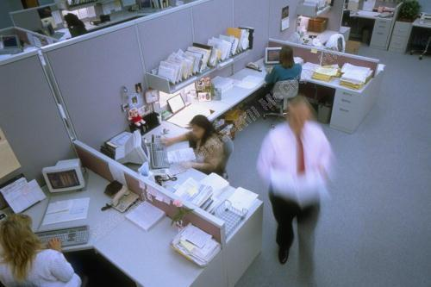
Management: What It Is, What Its Benefits Are
Managers operate within an organization
Organization
a group of people who work together to achieve some specific purpose

Slide 5
Management: What It Is, What Its Benefits Are
Management is defined as
The pursuit of organizational goals efficiently and effectively by
Integrating the work of people through
Planning, organizing, leading, and controlling the organization’s resources

Slide 6

Management: What It Is, What Its Benefits Are
To be efficient means to use resources -people, money, raw materials, and the like -wisely and cost-effectively

Slide 7
Management: What It Is, What Its Benefits Are
To be effective means to achieve results, to make the right decisions and to successfully carry them out so that they achieve organizational goals

Slide 8
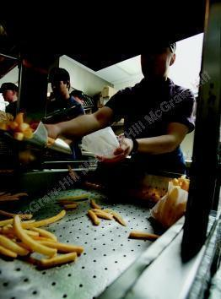
Question?
Burger King decided to add breakfast to its hours of operation in order to increase its customers. This was an attempt to improve the organization's:
Effectiveness
Planning
Leading strategy
Efficiency
Notes:
The correct answer is “A” – effectiveness.
Multimedia Lecture Support Package to Accompany Basic Marketing
Lecture Script 6-*

Slide 9

Example – Efficiency versus Effectiveness
Many companies now use a recorded “telephone menu” of options to answer customer calls
This is efficient for the companies, but not effective
Most consumers prefer a live agent

Slide 10
Rewards of Studying Management
Understanding how to deal with organizations from the outside
Understanding how to relate to your supervisors
Understanding how to interact with co-workers
Understanding how to manage yourself in the workplace

Slide 11
Rewards of Practicing Management
You and your employees can experience a sense of accomplishment
You can stretch your abilities and magnify your range
You can build a catalog of successful products or services

Slide 12
Seven Challenges to Being an Exceptional Manager
Managing for competitive advantage – staying ahead of rivals
Managing for diversity – the future won’t resemble the past
Managing for globalization – the expanding management universe

Slide 13
Seven Challenges to Being an Exceptional Manager (cont.)
Managing for information technology
Managing for ethical standards
Managing for Sustainability— The Business of Green
Managing for your own happiness & life goals

Slide 14
Example – Losing Competitive Advantage: How Did Newspapers Lose Their Way?
First: Giving Away the Product
newspaper proprietors, decided to promote their product by giving it away for free to various Web sites
Second: Relying Too Much on Advertising for Revenue
for decades publishers relied for revenues more on advertising than on readers willing to pay

Slide 15

Managing for Competitive Advantage
Competitive advantage
the ability of an organization to produce goods or services more effectively than competitors do, thereby outperforming them

Slide 16
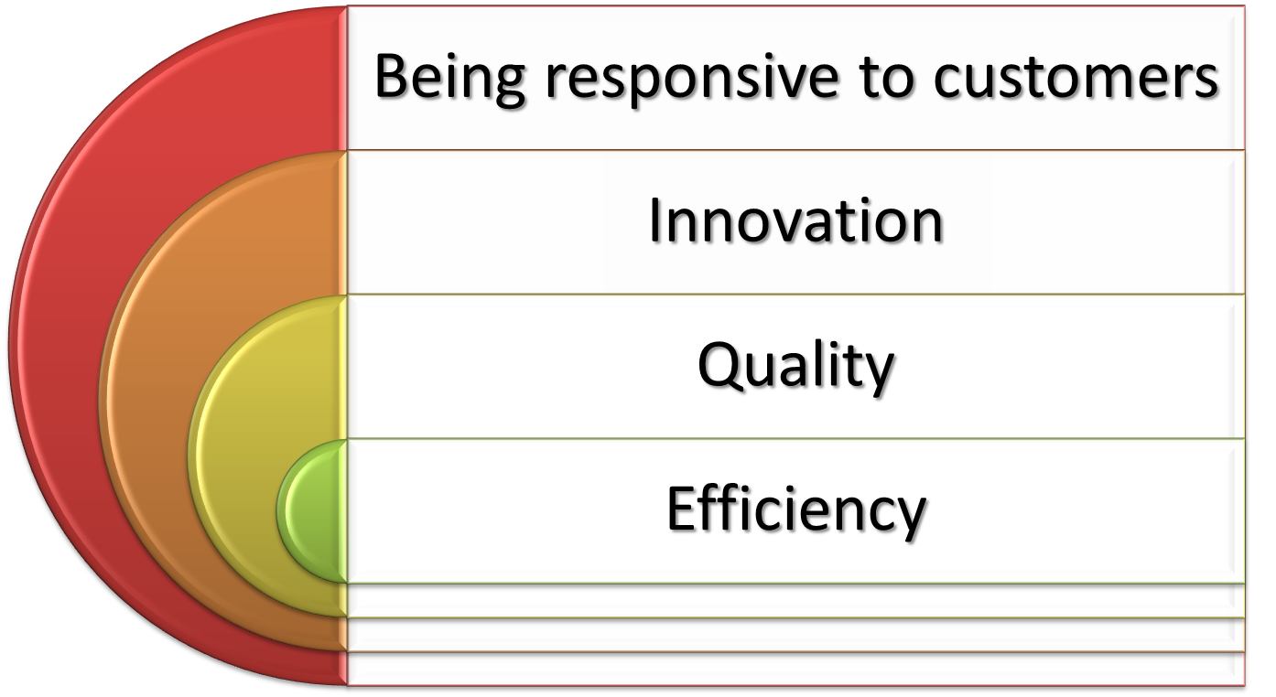
Managing for Competitive Advantage

Slide 17

Question?
John wants his salespeople to use iPhones to improve their sales? Which challenge is he trying to manage?
Diversity
Information technology
Competitive advantage
Globalization
Notes:
The correct answer is “B” – Information technology. See page 10.
Multimedia Lecture Support Package to Accompany Basic Marketing
Lecture Script 6-*

Slide 18
Managing for Information Technology
By 2015, consumers are projected to spend $1.4 trillion online, a rise of 13.5 % annually
Information technology has facilitated e-business, using the Internet to facilitate every aspect of running a business

Slide 19
Managing for Information Technology
Implications of e-business
Far-ranging e-management and e-communication
Accelerated decision making, conflict, and stress
Changes in organizational structure, jobs, goal setting, and knowledge management

Slide 20

Managing for Sustainability
Sustainability
economic development that meets the needs of the present without compromising the ability of future generations to meet their own needs.

Slide 21
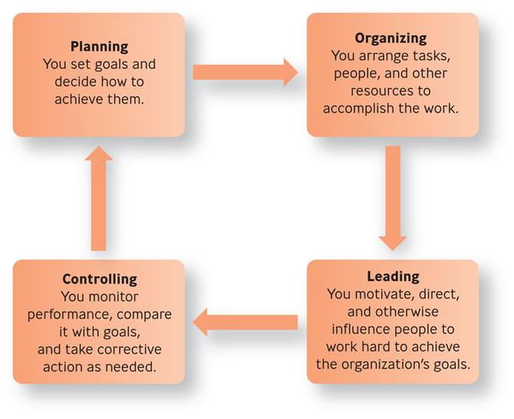
What Managers Do: The Four Principal Functions
Figure 1.1

Slide 22
Question?
Laura runs a sales and expense report at the end of each work day? Which management function is she performing?
Leading
Organizing
Controlling
Planning
Notes:
The correct answer is “C” – controlling. Se
Multimedia Lecture Support Package to Accompany Basic Marketing
Lecture Script 6-*

Slide 23
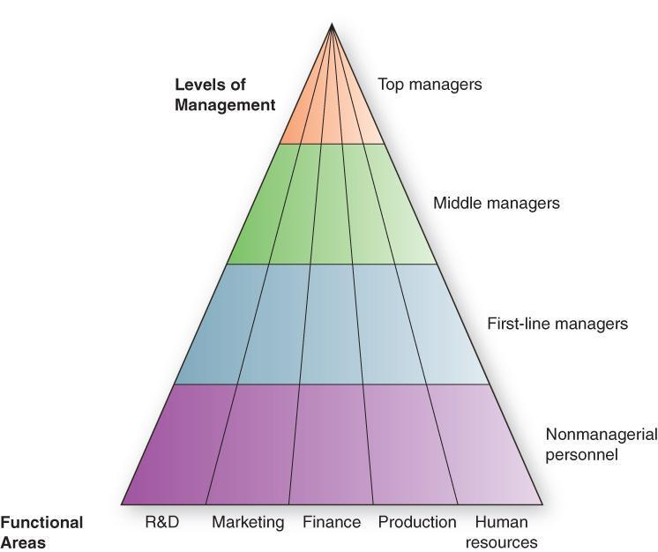
Pyramid Power: Levels & Areas of Management
Figure 1.2

Slide 24

Pyramid Power: Levels & Areas of Management
Top managers
make long-term decisions about the overall direction of the organization and establish the objectives, policies, and strategies for it

Slide 25
Pyramid Power: Levels & Areas of Management
Middle managers
implement the policies and plans of the top managers above them and supervise and coordinate the activities of the first-line managers below them
First-line managers
make short-term operating decisions, directing the daily tasks of nonmanagerial personnel
Notes:
Functional manager
responsible for just one organizational activity
General manager
responsible for several organizational activities
*

Slide 26
Pyramid Power: Levels & Areas of Management
Functional manager
responsible for just one organizational activity
General manager
responsible for several organizational activities

Slide 27
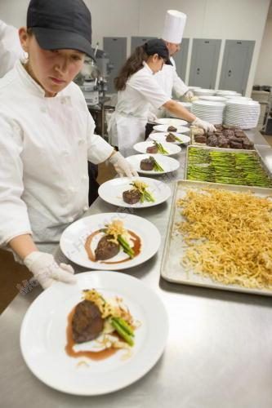
Question?
Donielle supervises the food assembly line workers. What type of manager is she?
Top manager
Middle manager
First-line manager
General manager
Notes:
The correct answer is “C” – first-line manager.
Multimedia Lecture Support Package to Accompany Basic Marketing
Lecture Script 6-*

Slide 28
Roles Managers Must Play Successfully
The manager’s roles: Mintzberg’s useful findings
A manager relies more on verbal than on written communication
A manager works long hours at an intense pace
A manager’s work is characterized by fragmentation, brevity, & variety

Slide 29
Three Types of Managerial Roles
Interpersonal roles
managers interact with people inside and outside their work units
figurehead, leader, liaison
Informational roles
managers receive and communicate information
monitor, disseminator, spokesperson

Slide 30
Three Types of Managerial Roles
Decisional roles
managers use information to make decisions to solve problems or take advantage of opportunities
entrepreneur, disturbance handler, resource allocator, negotiator

Slide 31
Question?
CEO, Gary Kelly sets the direction and strategy for Southwest Airlines. What type of managerial role is he performing?
Interpersonal
Informational
Decisional
Conclusive
Notes:
The correct answer is “D” – Decisional.
Multimedia Lecture Support Package to Accompany Basic Marketing
Lecture Script 6-*

Slide 32

The Entrepreneurial Spirit
Entrepreneurship
process of taking risks to try to create a new empire
Entrepreneur, intrapreneur

Slide 33
The Entrepreneurial Spirit
Entrepreneur
someone who sees a new opportunity for a product or service and launches a business to try to realize it
Notes:
Multimedia Lecture Support Package to Accompany Basic Marketing
Lecture Script 6-*

Slide 34

The Entrepreneurial Spirit
Intrapreneur
someone who works inside an existing organization who sees an opportunity for a product or service and mobilizes the organization’s resources to try to realize it
Notes:
Multimedia Lecture Support Package to Accompany Basic Marketing
Lecture Script 6-*

Slide 35
How Do Entrepreneurs & Managers Differ
Being an entrepreneur is what it takes to start a business
Being a manager is what it takes to grow or maintain a business
Notes:
Both entrepreneurs and managers
-have a high need for achievement
-believe in personal control of destiny
-have high energy levels and an action orientation
-have a high tolerance for ambiguity
Entrepreneurs more than managers
-have high self confidence and tolerance for risk
Multimedia Lecture Support Package to Accompany Basic Marketing
Lecture Script 6-*

Slide 36
The Entrepreneurial Spirit
Necessity entrepreneurs
people who suddenly must earn a living and are simply trying to replace lost income and are hoping a job comes along
Opportunity entrepreneurs
those who start their business out of a burning desire rather than because they lost a job

Slide 37
Question?
George thought there was an opportunity and opened a new deli in Irmo. He is a(n) __________.
Manager
Intrapreneur
Entrepreneur
Omni-preneur
Notes:
The correct answer is “C” – entrepreneur.
Multimedia Lecture Support Package to Accompany Basic Marketing
Lecture Script 6-*

Slide 38
The Skills Exceptional Managers Need
Technical skills
the job-specific knowledge needed to perform well in a specialized field
Conceptual skills
the ability to think analytically, to visualize an organization as a whole and understand how the parts work together

Slide 39

The Skills Exceptional Managers Need
Human skills
the ability to work well in cooperation with other people to get things done

Slide 40
The Most Valued Traits in Managers
The ability to motivate and engage others
The ability to communicate
Work experience outside the United States
High energy levels to meet the demands of global travel and a 24/7 world

