Slide 1
Chapter 14: System Protection
Notes:
*

Slide 2
Chapter 14: System Protection
Goals of Protection
Principles of Protection
Domain of Protection
Access Matrix
Implementation of Access Matrix
Access Control
Revocation of Access Rights
Capability-Based Systems
Language-Based Protection
Notes:
*

Slide 3
Objectives
Discuss the goals and principles of protection in a modern computer system
Explain how protection domains combined with an access matrix are used to specify the resources a process may access
Examine capability and language-based protection systems
Notes:
*

Slide 4
Goals of Protection
In one protection model, computer consists of a collection of objects, hardware or software
Each object has a unique name and can be accessed through a well-defined set of operations
Protection problem - ensure that each object is accessed correctly and only by those processes that are allowed to do so
Notes:
*

Slide 5
Principles of Protection
Guiding principle – principle of least privilege
  Programs, users and systems should be given just enough privileges to perform their tasks
  Limits damage if entity has a bug, gets abused
  Can be static (during life of system, during life of process)
  Or dynamic (changed by process as needed) – domain switching, privilege escalation
  “Need to know” a similar concept regarding access to data
Must consider “grain” aspect
  Rough-grained privilege management easier, simpler, but least privilege now done in large chunks
    For example, traditional Unix processes either have abilities of the associated user, or of root
  Fine-grained management more complex, more overhead, but more protective
    File ACL lists, RBAC
Domain can be user, process, procedure
Notes:
*

Slide 6
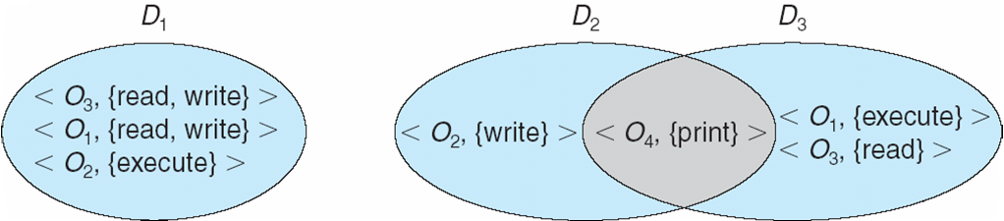
Domain Structure
Access-right = <object-name, rights-set>
where rights-set is a subset of all valid operations that can be performed on the object
Domain = set of access-rights
Notes:
*

Slide 7
Domain Implementation (UNIX)
Domain = user-id
Domain switch accomplished via file system
    Each file has associated with it a domain bit (setuid bit)
    When file is executed and setuid = on, then user-id is set to owner of the file being executed
    When execution completes user-id is reset
Domain switch accomplished via passwords
  su command temporarily switches to another user’s domain when other domain’s password provided
Domain switching via commands
  sudo command prefix executes specified command in another domain (if original domain has privilege or password given)
Notes:
*

Slide 8
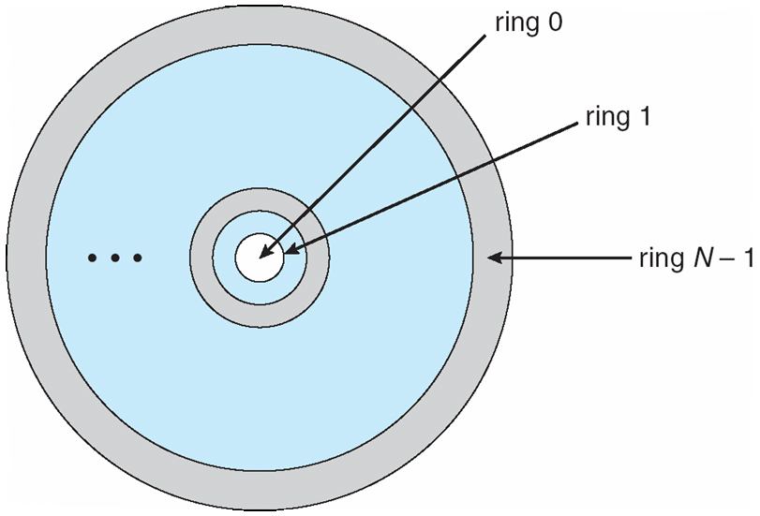
Domain Implementation (MULTICS)
Let D_{i} and D_{j} be any two domain rings
If j < I ⇒ D_{i} ⊆ D_{j}
Notes:
*

Slide 9
Multics Benefits and Limits
Ring / hierarchical structure provided more than the basic kernel / user or root / normal user design
Fairly complex -> more overhead
But does not allow strict need-to-know
  Object accessible in D_{j} but not in D_{i}, then j must be < i
  But then every segment accessible in D_{i} also accessible in D_{j}

Slide 10
Access Matrix
View protection as a matrix (access matrix)
Rows represent domains
Columns represent objects
Access(i, j) is the set of operations that a process executing in Domain_{i} can invoke on Object_{j}
Notes:
*

Slide 11
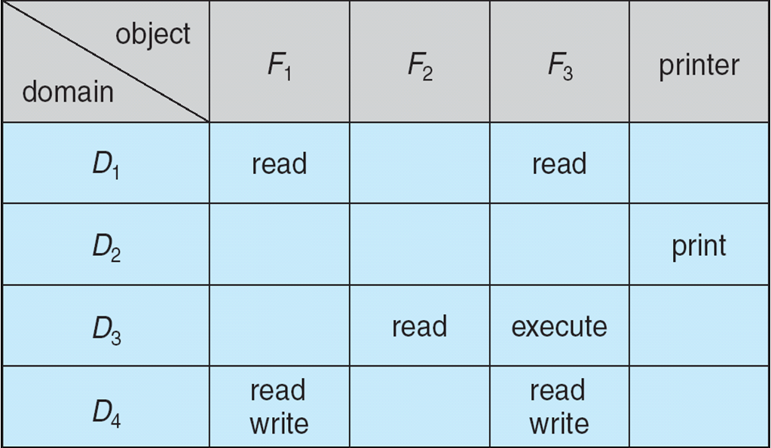
Access Matrix
Notes:
*

Slide 12
Use of Access Matrix
If a process in Domain D_{i} tries to do “op” on object O_{j}, then “op” must be in the access matrix
User who creates object can define access column for that object
Can be expanded to dynamic protection
  Operations to add, delete access rights
  Special access rights:
    owner of O_{i}
    copy op from O_{i} to O_{j} (denoted by “*”)
    control – D_{i} can modify D_{j} access rights
    transfer – switch from domain D_{i} to D_{j}
  Copy and Owner applicable to an object
  Control applicable to domain object
Notes:
*

Slide 13
Use of Access Matrix (Cont.)
Access matrix design separates mechanism from policy
  Mechanism
    Operating system provides access-matrix + rules
    If ensures that the matrix is only manipulated by authorized agents and that rules are strictly enforced
  Policy
    User dictates policy
    Who can access what object and in what mode
But doesn’t solve the general confinement problem
Notes:
*

Slide 14
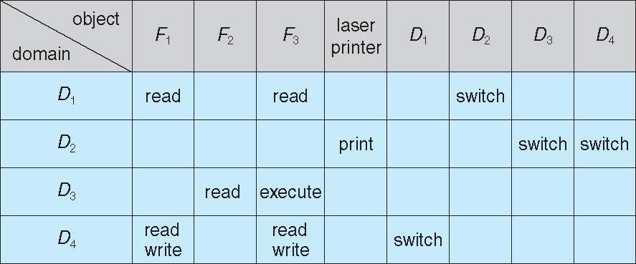
Access Matrix of Figure A with Domains as Objects
Notes:
*

Slide 15
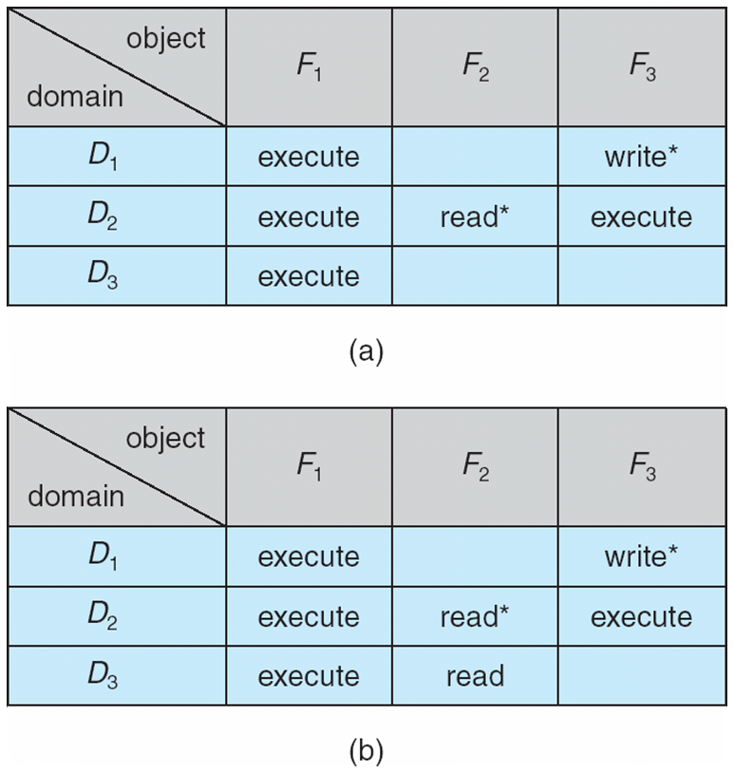
Access Matrix with Copy Rights
Notes:
*

Slide 16
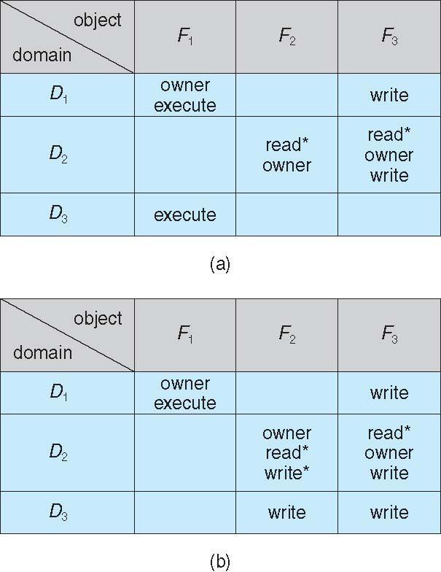
Access Matrix With Owner Rights
Notes:
*

Slide 17
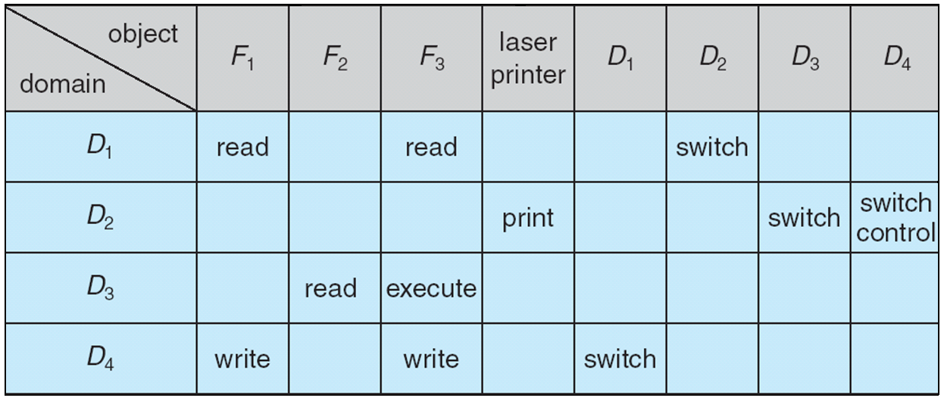
Modified Access Matrix of Figure B
Notes:
*

Slide 18
Implementation of Access Matrix
Generally, a sparse matrix
Option 1 – Global table
  Store ordered triples < domain, object, rights-set > in table
  A requested operation M on object O_{j} within domain D_{i} -> search table for < D_{i}, O_{j}, R_{k} >
    with M ∈ R_{k}
  But table could be large -> won’t fit in main memory
  Difficult to group objects (consider an object that all domains can read)
Option 2 – Access lists for objects
  Each column implemented as an access list for one object
  Resulting per-object list consists of ordered pairs < domain, rights-set > defining all domains with non-empty set of access rights for the object
  Easily extended to contain default set -> If M ∈ default set, also allow access
Notes:
*

Slide 19
Each column = Access-control list for one object
Defines who can perform what operation
Domain 1 = Read, Write
Domain 2 = Read
Domain 3 = Read
Each Row = Capability List (like a key)
For each domain, what operations allowed on what objects
      Object F1 – Read
      Object F4 – Read, Write, Execute
      Object F5 – Read, Write, Delete, Copy

Slide 20
Implementation of Access Matrix (Cont.)
Option 3 – Capability list for domains
  Instead of object-based, list is domain based
  Capability list for domain is list of objects together with operations allows on them
  Object represented by its name or address, called a capability
  Execute operation M on object O_{j}, process requests operation and specifies capability as parameter
    Possession of capability means access is allowed
  Capability list associated with domain but never directly accessible by domain
    Rather, protected object, maintained by OS and accessed indirectly
    Like a “secure pointer”
    Idea can be extended up to applications
Option 4 – Lock-key
  Compromise between access lists and capability lists
  Each object has list of unique bit patterns, called locks
  Each domain as list of unique bit patterns called keys
  Process in a domain can only access object if domain has key that matches one of the locks

Slide 21
Comparison of Implementations
Many trade-offs to consider
  Global table is simple, but can be large
  Access lists correspond to needs of users
    Determining set of access rights for domain non-localized so difficult
    Every access to an object must be checked
      Many objects and access rights -> slow
  Capability lists useful for localizing information for a given process
    But revocation capabilities can be inefficient
  Lock-key effective and flexible, keys can be passed freely from domain to domain, easy revocation
Most systems use combination of access lists and capabilities
  First access to an object -> access list searched
    If allowed, capability created and attached to process
      Additional accesses need not be checked
    After last access, capability destroyed
    Consider file system with ACLs per file

Slide 22
Access Control
Protection can be applied to non-file resources
Solaris 10 provides role-based access control (RBAC) to implement least privilege
  Privilege is right to execute system call or use an option within a system call
  Can be assigned to processes
  Users assigned roles granting access to privileges and programs
    Enable role via password to gain its privileges
  Similar to access matrix
Notes:
*

Slide 23
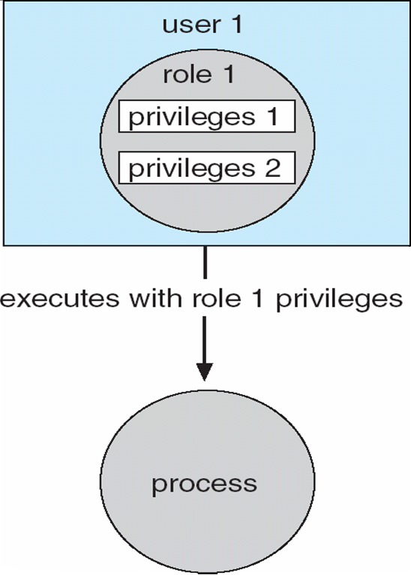
Role-based Access Control in Solaris 10
Notes:
*

Slide 24
Revocation of Access Rights
Various options to remove the access right of a domain to an object
  Immediate vs. delayed
  Selective vs. general
  Partial vs. total
  Temporary vs. permanent
Access List – Delete access rights from access list
  Simple – search access list and remove entry
  Immediate, general or selective, total or partial, permanent or temporary
Capability List – Scheme required to locate capability in the system before capability can be revoked
  Reacquisition – periodic delete, with require and denial if revoked
  Back-pointers – set of pointers from each object to all capabilities of that object (Multics)
  Indirection – capability points to global table entry which points to object – delete entry from global table, not selective (CAL)
  Keys – unique bits associated with capability, generated when capability created
    Master key associated with object, key matches master key for access
    Revocation – create new master key
    Policy decision of who can create and modify keys – object owner or others?
Notes:
*

Slide 25
Capability-Based Systems
Hydra
  Fixed set of access rights known to and interpreted by the system
    i.e. read, write, or execute each memory segment
    User can declare other auxiliary rights and register those with protection system
    Accessing process must hold capability and know name of operation
    Rights amplification allowed by trustworthy procedures for a specific type
  Interpretation of user-defined rights performed solely by user's program; system provides access protection for use of these rights
  Operations on objects defined procedurally – procedures are objects accessed indirectly by capabilities
  Solves the problem of mutually suspicious subsystems
  Includes library of prewritten security routines
Cambridge CAP System
  Simpler but powerful
  Data capability - provides standard read, write, execute of individual storage segments associated with object – implemented in microcode
  Software capability -interpretation left to the subsystem, through its protected procedures
    Only has access to its own subsystem
    Programmers must learn principles and techniques of protection
Notes:
*

Slide 26
Language-Based Protection
Specification of protection in a programming language allows the high-level description of policies for the allocation and use of resources
Language implementation can provide software for protection enforcement when automatic hardware-supported checking is unavailable
Interpret protection specifications to generate calls on whatever protection system is provided by the hardware and the operating system
Notes:
*

Slide 27
Protection in Java 2
Protection is handled by the Java Virtual Machine (JVM)
A class is assigned a protection domain when it is loaded by the JVM
The protection domain indicates what operations the class can (and cannot) perform
If a library method is invoked that performs a privileged operation, the stack is inspected to ensure the operation can be performed by the library
Notes:
*

Slide 28
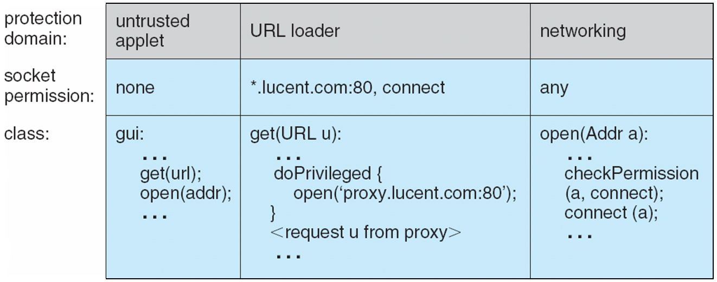
Stack Inspection
Notes:
*

