Slide 1
Chapter 10: File System
Notes:
*

Slide 2
Chapter 10: File System
File Concept
Access Methods
Disk and Directory Structure
File-System Mounting
File Sharing
Protection
Notes:
*

Slide 3
Objectives
To explain the function of file systems
To describe the interfaces to file systems
To discuss file-system design tradeoffs, including access methods, file sharing, file locking, and directory structures
To explore file-system protection
Notes:
*

Slide 4
File Concept
Contiguous logical address space
Types:
  Data
    numeric
    character
    binary
  Program
Contents defined by file’s creator
  Many types
    Consider text file, source file, executable file
Notes:
*

Slide 5
File Attributes
Name – only information kept in human-readable form
Identifier – unique tag (number) identifies file within file system
Type – needed for systems that support different types
Location – pointer to file location on device
Size – current file size
Protection – controls who can do reading, writing, executing
Time, date, and user identification – data for protection, security, and usage monitoring
Information about files are kept in the directory structure, which is maintained on the disk
Many variations, including extended file attributes such as file checksum
Information kept in the directory structure
Notes:
*

Slide 6
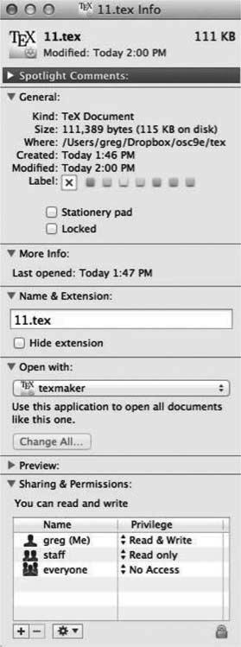
File info Window on Mac OS X
Notes:
*

Slide 7
File Operations
File is an abstract data type
Create
Write – at write pointer location
Read – at read pointer location
Reposition within file - seek
Delete
Truncate
Open(F_{i}) – search the directory structure on disk for entry F_{i}, and move the content of entry to memory
Close (F_{i}) – move the content of entry F_{i} in memory to directory structure on disk
Notes:
*

Slide 8
Open Files
Several pieces of data are needed to manage open files:
  Open-file table: tracks open files
  File pointer: pointer to last read/write location, per process that has the file open
  File-open count: counter of number of times a file is open – to allow removal of data from open-file table when last processes closes it
  Disk location of the file: cache of data access information
  Access rights: per-process access mode information
Notes:
*

Slide 9
Open File Locking
Provided by some operating systems and file systems
  Similar to reader-writer locks
  Shared lock similar to reader lock – several processes can acquire concurrently
  Exclusive lock similar to writer lock
Mediates access to a file
Mandatory or advisory:
  Mandatory – access is denied depending on locks held and requested
  Advisory – processes can find status of locks and decide what to do
Notes:
*

Slide 10
File Locking Example – Java API
import java.io.*;
import java.nio.channels.*;
public class LockingExample {
public static final boolean EXCLUSIVE = false;
public static final boolean SHARED = true;
public static void main(String arsg[]) throws IOException {
FileLock sharedLock = null;
FileLock exclusiveLock = null;
try {
RandomAccessFile raf = new RandomAccessFile("file.txt", "rw");
// get the channel for the file
FileChannel ch = raf.getChannel();
// this locks the first half of the file - exclusive
exclusiveLock = ch.lock(0, raf.length()/2, EXCLUSIVE);
/** Now modify the data . . . */
// release the lock
exclusiveLock.release();
Notes:
*

Slide 11
File Locking Example –
Java API (Cont.)
// this locks the second half of the file - shared
sharedLock = ch.lock(raf.length()/2+1, raf.length(), SHARED);
/** Now read the data . . . */
// release the lock
sharedLock.release();
} catch (java.io.IOException ioe) {
System.err.println(ioe);
}finally {
if (exclusiveLock != null)
exclusiveLock.release();
if (sharedLock != null)
sharedLock.release();
}
}
}
Notes:
*

Slide 12
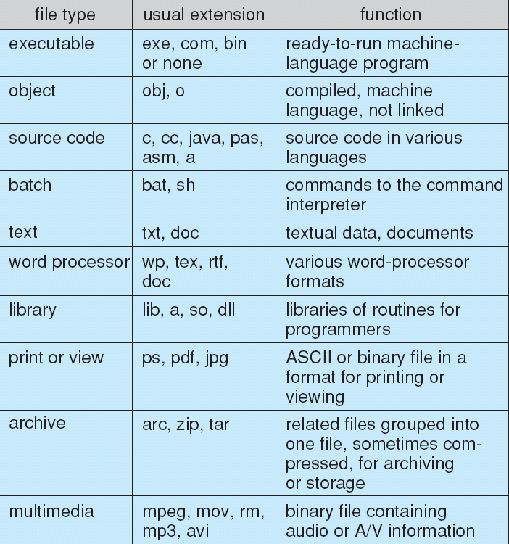
File Types – Name, Extension
Notes:
*

Slide 13
File Structure
None - sequence of words, bytes
Simple record structure
  Lines
  Fixed length
  Variable length
Complex Structures
  Formatted document
  Relocatable load file
Can simulate last two with first method by inserting appropriate control characters
Who decides:
  Operating system
  Program
Notes:
*

Slide 14
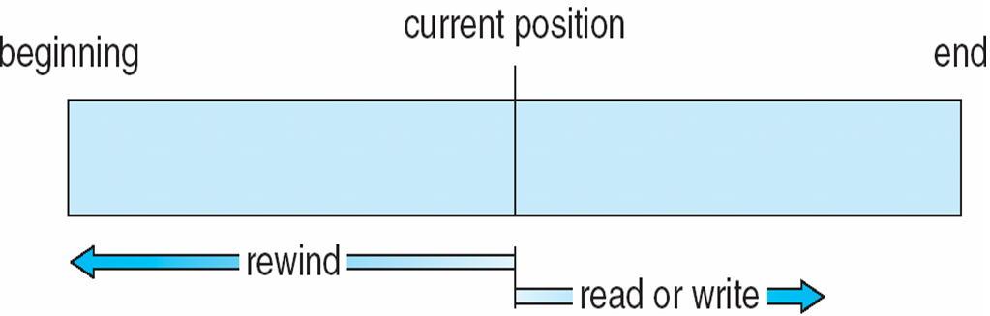
Sequential-access File
Notes:
*

Slide 15
Access Methods
Sequential Access
read next
write next
reset
no read after last write
(rewrite)
Direct Access – file is fixed length logical records
read n
write n
position to n
read next
write next
rewrite n
n = relative block number
Relative block numbers allow OS to decide where file should be placed
  See allocation problem in Ch 11
Notes:
*

Slide 16
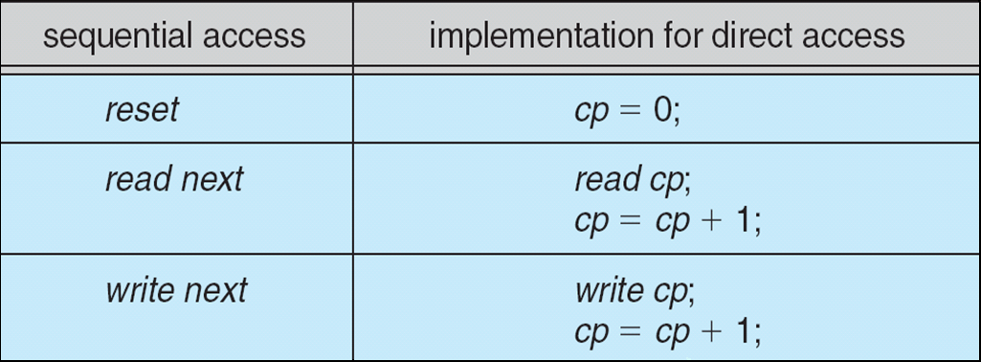
Simulation of Sequential Access on
Direct-access File
Notes:
*

Slide 17
Other Access Methods
Can be built on top of base methods
General involve creation of an index for the file
Keep index in memory for fast determination of location of data to be operated on (consider UPC code plus record of data about that item)
If too large, index (in memory) of the index (on disk)
IBM indexed sequential-access method (ISAM)
  Small master index, points to disk blocks of secondary index
  File kept sorted on a defined key
  All done by the OS
VMS operating system provides index and relative files as another example (see next slide)
Notes:
*

Slide 18
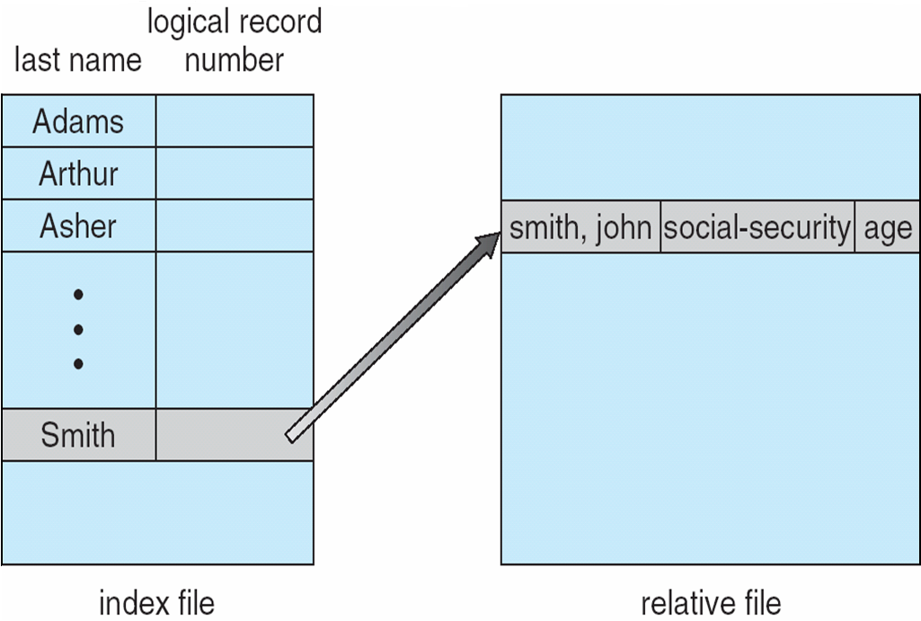
Example of Index and Relative Files
Notes:
*

Slide 19
Directory Structure
A collection of nodes containing information about all files
Directory
Files
F 1
F 2
F 3
F 4
F n
Both the directory structure and the files reside on disk
Notes:
*

Slide 20
Disk Structure
Disk can be subdivided into partitions
Disks or partitions can be RAID protected against failure
Disk or partition can be used raw – without a file system, or formatted with a file system
Partitions also known as minidisks, slices
Entity containing file system known as a volume
Each volume containing file system also tracks that file system’s info in device directory or volume table of contents
As well as general-purpose file systems there are many special-purpose file systems, frequently all within the same operating system or computer
Notes:
*

Slide 21
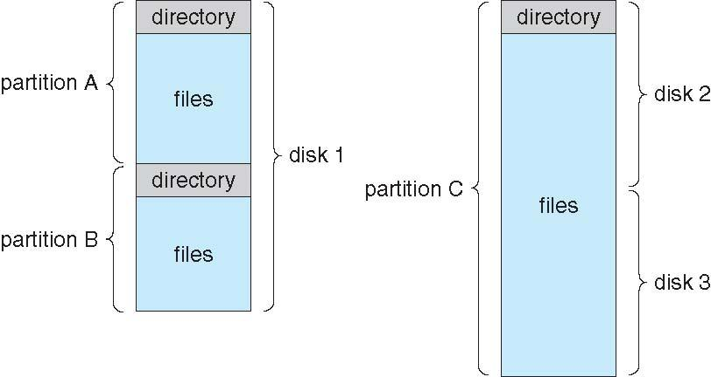
A Typical File-system Organization
Notes:
*

Slide 22
Types of File Systems
We mostly talk of general-purpose file systems
But systems frequently have may file systems, some general- and some special- purpose
Consider Solaris has
  tmpfs – memory-based volatile FS for fast, temporary I/O
  objfs – interface into kernel memory to get kernel symbols for debugging
  ctfs – contract file system for managing daemons
  lofs – loopback file system allows one FS to be accessed in place of another
  procfs – kernel interface to process structures
  ufs, zfs – general purpose file systems
Notes:
*

Slide 23
Operations Performed on Directory
Search for a file
Create a file
Delete a file
List a directory
Rename a file
Traverse the file system
Notes:
*

Slide 24
Organize the Directory (Logically) to Obtain
Efficiency – locating a file quickly
Naming – convenient to users
  Two users can have same name for different files
  The same file can have several different names
Grouping – logical grouping of files by properties, (e.g., all Java programs, all games, …)
Notes:
*

Slide 25
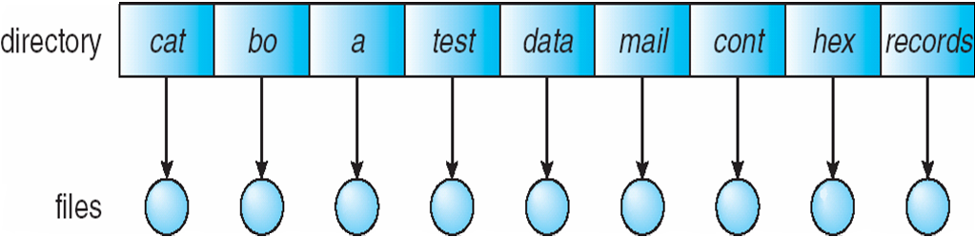
Single-Level Directory
A single directory for all users
Naming problem
Grouping problem
Notes:
*

Slide 26
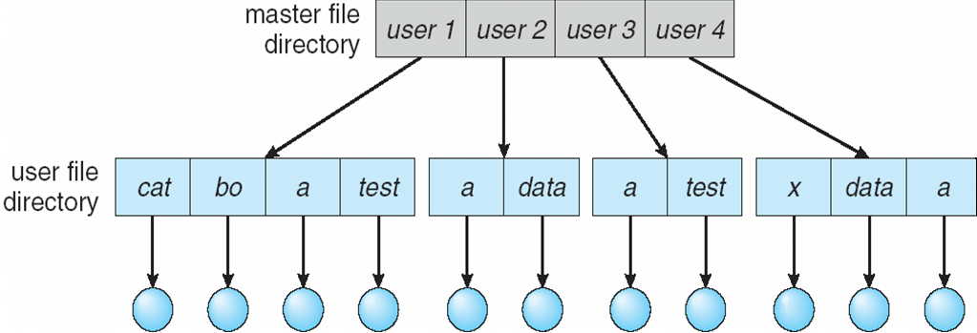
Two-Level Directory
Separate directory for each user
Path name
Can have the same file name for different user
Efficient searching
No grouping capability
Notes:
*

Slide 27
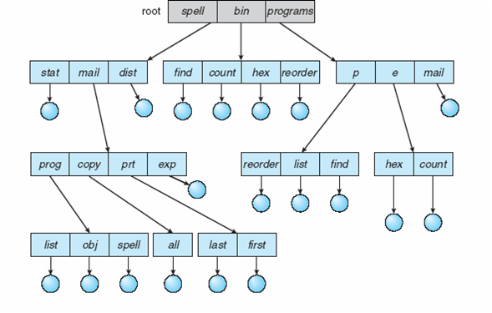
Tree-Structured Directories
Notes:
*

Slide 28
Tree-Structured Directories (Cont.)
Efficient searching
Grouping Capability
Current directory (working directory)
  cd /spell/mail/prog
  type list
Notes:
*

Slide 29
Tree-Structured Directories (Cont)
Absolute or relative path name
Creating a new file is done in current directory
Delete a file
rm <file-name>
Creating a new subdirectory is done in current directory
  mkdir <dir-name>
  Example: if in current directory /mail
  mkdir count
mail
prog
copy
prt
exp
count
Deleting “mail” ⇒ deleting the entire subtree rooted by “mail”
Notes:
*

Slide 30
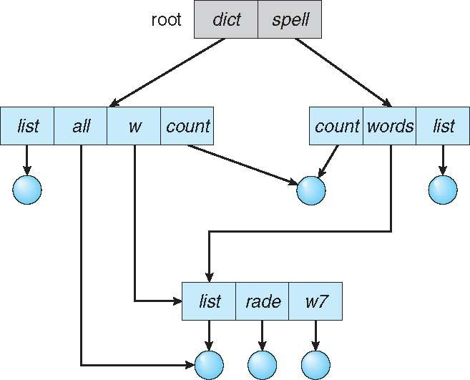
Acyclic-Graph Directories
Have shared subdirectories and files
Notes:
*

Slide 31
Acyclic-Graph Directories (Cont.)
Two different names (aliasing)
If dict deletes list ⇒ dangling pointer
Solutions:
  Backpointers, so we can delete all pointers
  Variable size records a problem
  Backpointers using a daisy chain organization
  Entry-hold-count solution
New directory entry type
  Link – another name (pointer) to an existing file
  Resolve the link – follow pointer to locate the file
Notes:
*

Slide 32
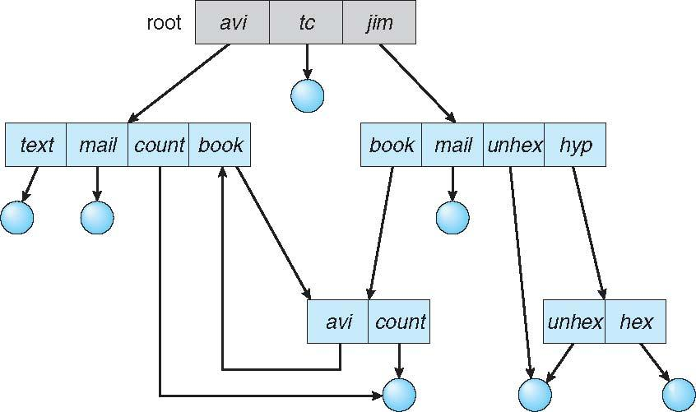
General Graph Directory
Notes:
*

Slide 33
General Graph Directory (Cont.)
How do we guarantee no cycles?
  Allow only links to file not subdirectories
  Garbage collection
  Every time a new link is added use a cycle detection algorithm to determine whether it is OK
Notes:
*

Slide 34
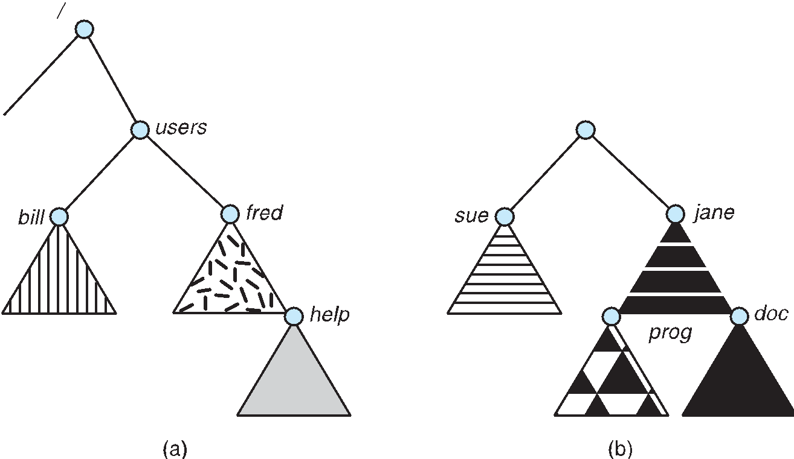
File System Mounting
A file system must be mounted before it can be accessed
A unmounted file system (i.e., Fig. 10-11(b)) is mounted at a mount point
Notes:
*

Slide 35
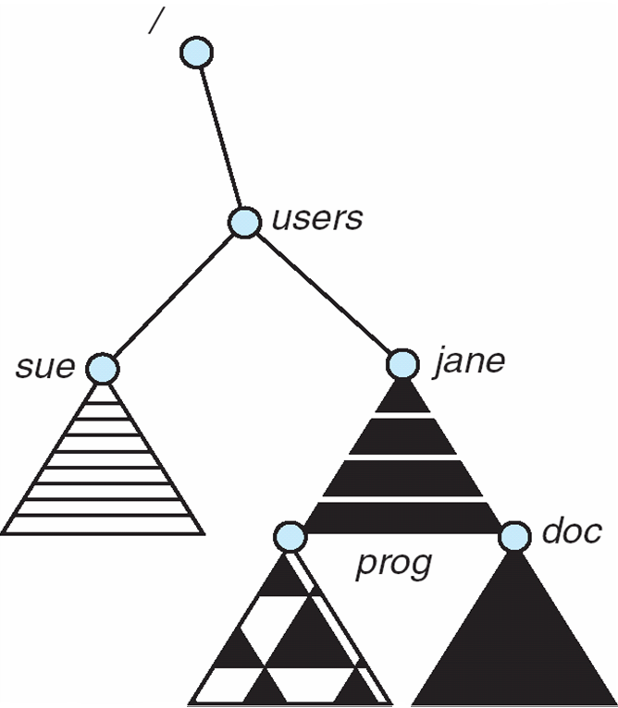
Mount Point
Notes:
*

Slide 36
File Sharing
Sharing of files on multi-user systems is desirable
Sharing may be done through a protection scheme
On distributed systems, files may be shared across a network
Network File System (NFS) is a common distributed file-sharing method
If multi-user system
  User IDs identify users, allowing permissions and protections to be per-user
  Group IDs allow users to be in groups, permitting group access rights
  Owner of a file / directory
  Group of a file / directory
Notes:
*

Slide 37
File Sharing – Remote File Systems
Uses networking to allow file system access between systems
  Manually via programs like FTP
  Automatically, seamlessly using distributed file systems
  Semi automatically via the world wide web
Client-server model allows clients to mount remote file systems from servers
  Server can serve multiple clients
  Client and user-on-client identification is insecure or complicated
  NFS is standard UNIX client-server file sharing protocol
  CIFS is standard Windows protocol
  Standard operating system file calls are translated into remote calls
Distributed Information Systems (distributed naming services) such as LDAP, DNS, NIS, Active Directory implement unified access to information needed for remote computing
Notes:
*

Slide 38
File Sharing – Failure Modes
All file systems have failure modes
  For example corruption of directory structures or other non-user data, called metadata
Remote file systems add new failure modes, due to network failure, server failure
Recovery from failure can involve state information about status of each remote request
Stateless protocols such as NFS v3 include all information in each request, allowing easy recovery but less security
Notes:
*

Slide 39
File Sharing – Consistency Semantics
Specify how multiple users are to access a shared file simultaneously
  Similar to Ch 6 process synchronization algorithms
    Tend to be less complex due to disk I/O and network latency (for remote file systems
  Andrew File System (AFS) implemented complex remote file sharing semantics
  Unix file system (UFS) implements:
    Writes to an open file visible immediately to other users of the same open file
    Sharing file pointer to allow multiple users to read and write concurrently
  AFS has session semantics
    Writes only visible to sessions starting after the file is closed
Notes:
*

Slide 40
Protection
File owner/creator should be able to control:
  what can be done
  by whom
Types of access
  Read
  Write
  Execute
  Append
  Delete
  List
Notes:
*

Slide 41
Access Lists and Groups
Mode of access: read, write, execute
Three classes of users on Unix / Linux
RWX
a) owner access 7 ⇒ 1 1 1
RWX
b) group access 6 ⇒ 1 1 0
RWX
c) public access 1 ⇒ 0 0 1
Ask manager to create a group (unique name), say G, and add some users to the group.
For a particular file (say game) or subdirectory, define an appropriate access.
owner
group
public
chmod
761
game
Attach a group to a file
chgrp G game
Notes:
*

Slide 42
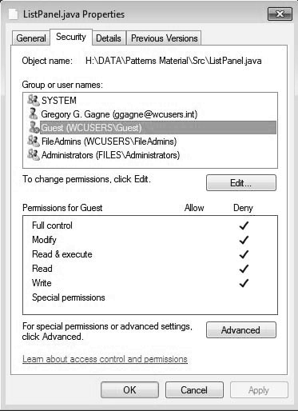
Windows 7 Access-Control List Management
Notes:
*

Slide 43
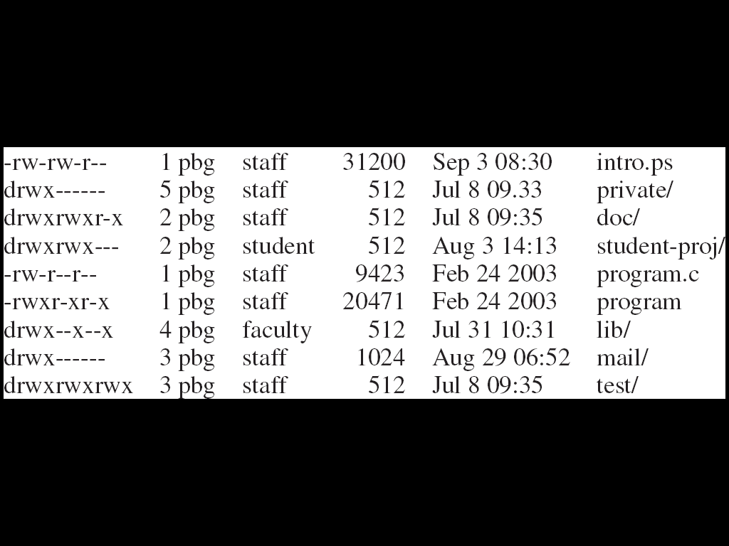
A Sample UNIX Directory Listing
Notes:
*

