Slide 1
Chapter 10: File System
Notes:
*

Slide 2
File Concept
Contiguous logical address space
Types:
  Data
    numeric
    character
    binary
  Program
Contents defined by file’s creator
  Many types
    Consider text file, source file, executable file
Notes:
*

Slide 3
File Attributes
Name – only information kept in human-readable form
Identifier – unique tag (number) identifies file within file system
Type – needed for systems that support different types
Location – pointer to file location on device
Size – current file size
Protection – controls who can do reading, writing, executing
Time, date, and user identification – data for protection, security, and usage monitoring
Information about files are kept in the directory structure, which is maintained on the disk
Many variations, including extended file attributes such as file checksum
Information kept in the directory structure
Notes:
*

Slide 4
File Operations
File is an abstract data type
Create
Write – at write pointer location
Read – at read pointer location
Reposition within file - seek
Delete
Truncate
Open(F_{i}) – search the directory structure on disk for entry F_{i}, and move the content of entry to memory
Close (F_{i}) – move the content of entry F_{i} in memory to directory structure on disk
Notes:
*

Slide 5
Open Files
Several pieces of data are needed to manage open files:
  Open-file table: tracks open files
  File pointer: pointer to last read/write location, per process that has the file open
  File-open count: counter of number of times a file is open – to allow removal of data from open-file table when last processes closes it
  Disk location of the file: cache of data access information
  Access rights: per-process access mode information
Notes:
*

Slide 6
Open File Locking
Provided by some operating systems and file systems
  Similar to reader-writer locks
  Shared lock similar to reader lock – several processes can acquire concurrently
  Exclusive lock similar to writer lock
Mediates access to a file
Mandatory or advisory:
  Mandatory – access is denied depending on locks held and requested
  Advisory – processes can find status of locks and decide what to do
Notes:
*

Slide 7
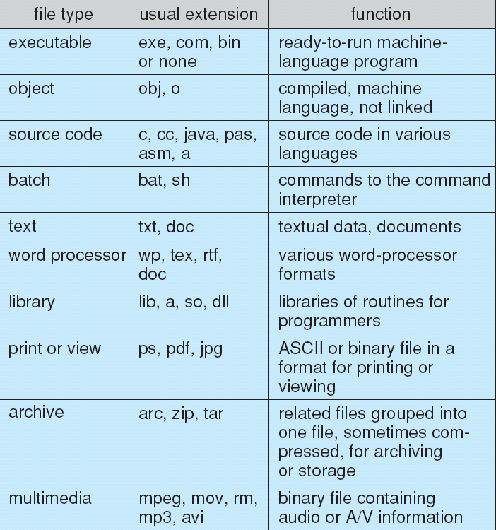
File Types – Name, Extension
Notes:
*

Slide 8
File Structure
None - sequence of words, bytes
Simple record structure
  Lines
  Fixed length
  Variable length
Complex Structures
  Formatted document
  Relocatable load file
Can simulate last two with first method by inserting appropriate control characters
Who decides:
  Operating system
  Program
Notes:
*

Slide 9
Access Methods
Sequential Access
read next
write next
reset
no read after last write
(rewrite)
Direct Access – file is fixed length logical records
read n
write n
position to n
read next
write next
rewrite n
n = relative block number
Relative block numbers allow OS to decide where file should be placed
  See allocation problem in Ch 11
Notes:
*

Slide 10
Directory Structure
A collection of nodes containing information about all files
Directory
Files
F 1
F 2
F 3
F 4
F n
Both the directory structure and the files reside on disk
Notes:
*

Slide 11
Types of File Systems
We mostly talk of general-purpose file systems
But systems frequently have may file systems, some general- and some special- purpose
Consider Solaris has
  tmpfs – memory-based volatile FS for fast, temporary I/O
  objfs – interface into kernel memory to get kernel symbols for debugging
  ctfs – contract file system for managing daemons
  lofs – loopback file system allows one FS to be accessed in place of another
  procfs – kernel interface to process structures
  ufs, zfs – general purpose file systems
Notes:
*

Slide 12
Operations Performed on Directory
Search for a file
Create a file
Delete a file
List a directory
Rename a file
Traverse the file system
Notes:
*

Slide 13
Organize the Directory (Logically) to Obtain
Efficiency – locating a file quickly
Naming – convenient to users
  Two users can have same name for different files
  The same file can have several different names
Grouping – logical grouping of files by properties, (e.g., all Java programs, all games, …)
Notes:
*

Slide 14
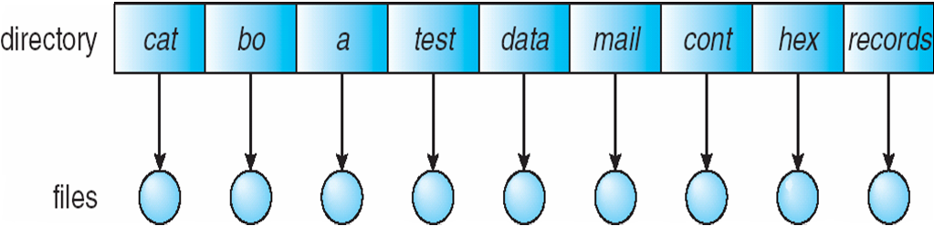
Single-Level Directory
A single directory for all users
Naming problem
Grouping problem
Notes:
*

Slide 15
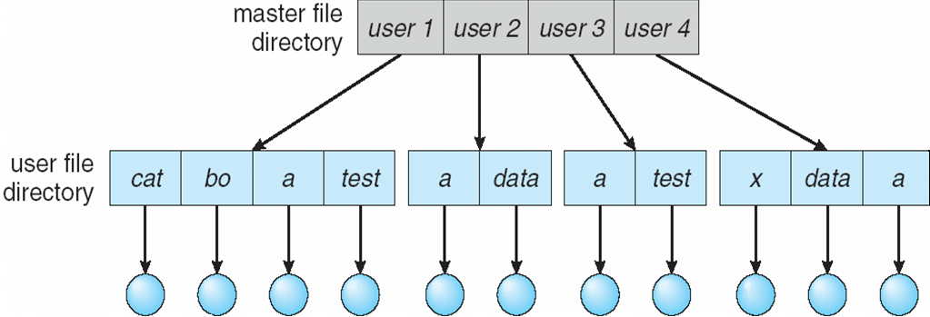
Two-Level Directory
Separate directory for each user
Path name
Can have the same file name for different user
Efficient searching
No grouping capability
Notes:
*

Slide 16
Tree-Structured Directories (Cont.)
Efficient searching
Grouping Capability
Current directory (working directory)
  cd /spell/mail/prog
  type list
Notes:
*

Slide 17
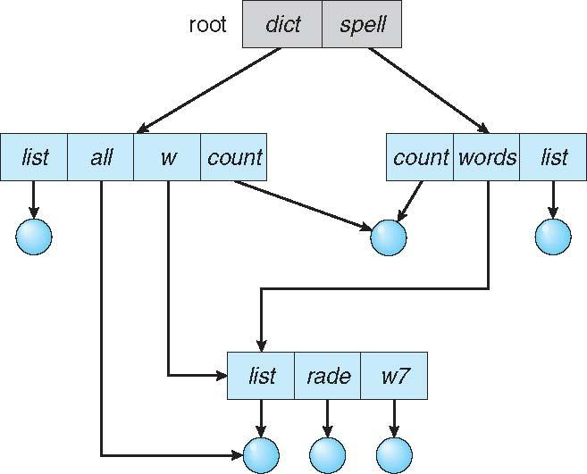
Acyclic-Graph Directories
Have shared subdirectories and files
Notes:
*

Slide 18
General Graph Directory (Cont.)
How do we guarantee no cycles?
  Allow only links to file not subdirectories
  Garbage collection
  Every time a new link is added use a cycle detection algorithm to determine whether it is OK
Notes:
*

Slide 19
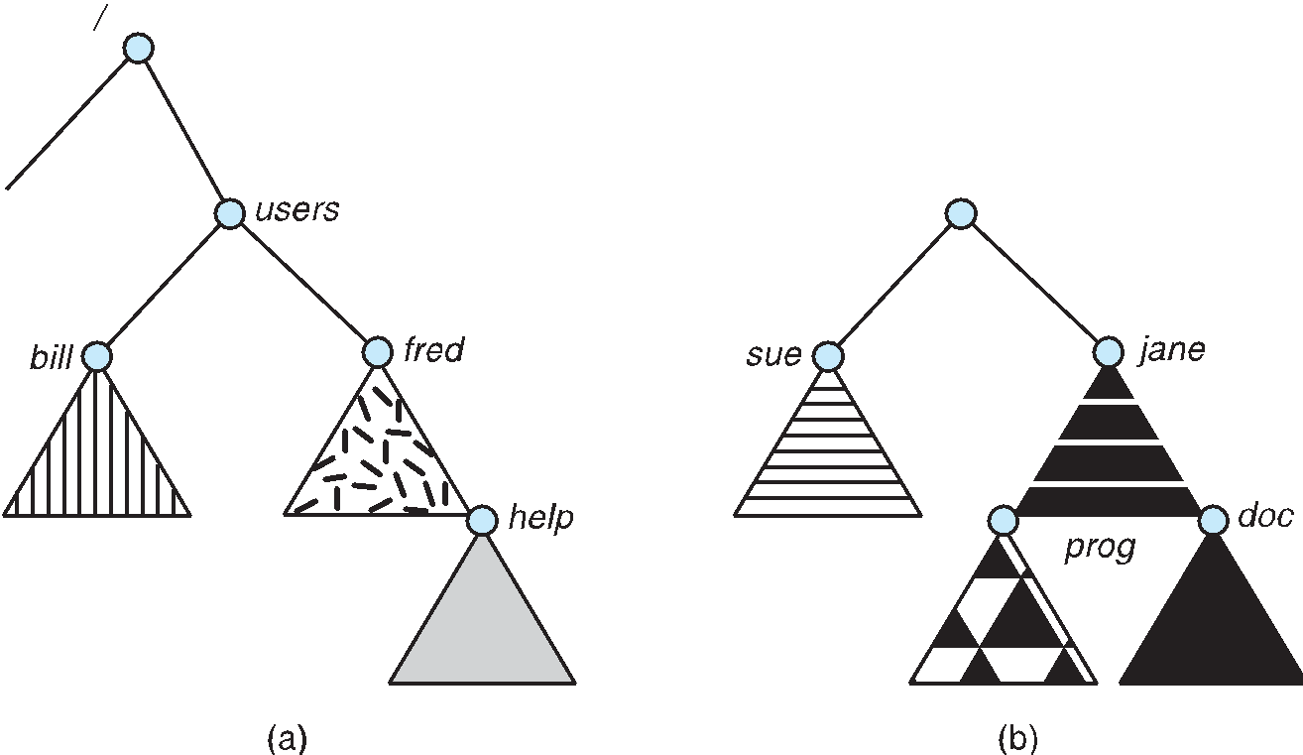
File System Mounting
A file system must be mounted before it can be accessed
A unmounted file system (i.e., Fig. 10-11(b)) is mounted at a mount point
Notes:
*

Slide 20
File Sharing
Sharing of files on multi-user systems is desirable
Sharing may be done through a protection scheme
On distributed systems, files may be shared across a network
Network File System (NFS) is a common distributed file-sharing method
If multi-user system
  User IDs identify users, allowing permissions and protections to be per-user
  Group IDs allow users to be in groups, permitting group access rights
  Owner of a file / directory
  Group of a file / directory
Notes:
*

Slide 21
Protection
File owner/creator should be able to control:
  what can be done
  by whom
Types of access
  Read
  Write
  Execute
  Append
  Delete
  List
Notes:
*

