Slide 1
Chapter 9: Virtual-Memory Management
Notes:
*

Slide 2
Background
Virtual memory – separation of user logical memory from physical memory
  Only part of the program needs to be in memory for execution
  Logical address space can therefore be much larger than physical address space
  Allows address spaces to be shared by several processes
  Allows for more efficient process creation
  More programs running concurrently
  Less I/O needed to load or swap processes
Virtual memory can be implemented via:
  Demand paging
  Demand segmentation
Notes:
*

Slide 3
Virtual Address Space
Enables sparse address spaces with holes left for growth, dynamically linked libraries, etc
System libraries shared via mapping into virtual address space
Shared memory by mapping pages read-write into virtual address space
Pages can be shared during fork(), speeding process creation

Slide 4
Demand Paging
Could bring entire process into memory at load time
Or bring a page into memory only when it is needed
  Less I/O needed, no unnecessary I/O
  Less memory needed
  Faster response
  More users
Page is needed ⇒ reference to it
  invalid reference ⇒ abort
  not-in-memory ⇒ bring to memory
Lazy swapper – never swaps a page into memory unless page will be needed
  Swapper that deals with pages is a pager
Notes:
*

Slide 5
Valid-Invalid Bit
With each page table entry a valid–invalid bit is associated
(v ⇒ in-memory – memory resident, i ⇒ not-in-memory)
Initially valid–invalid bit is set to i on all entries
Example of a page table snapshot:
During address translation, if valid–invalid bit in page table entry
is I ⇒ page fault
Frame #
valid-invalid bit
v
v
v
v
i
….
i
i
page table
Notes:
*

Slide 6
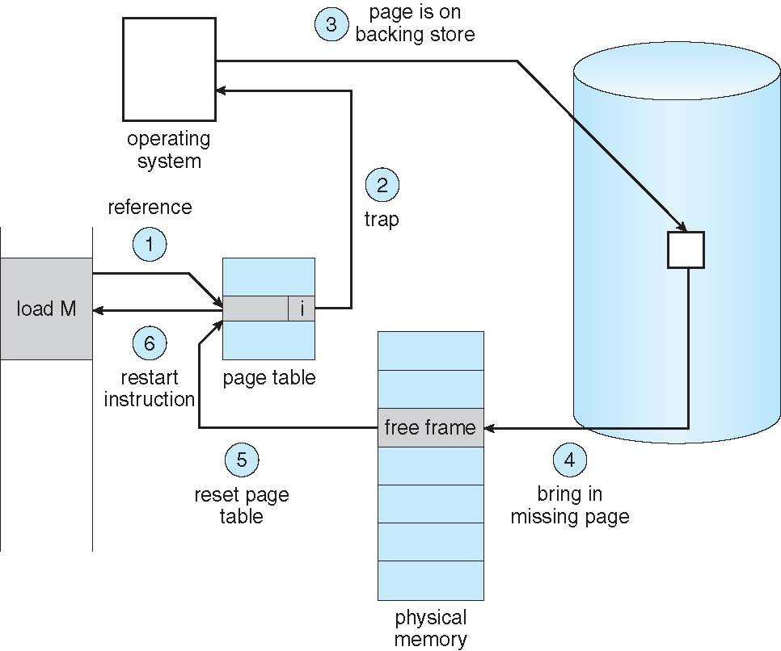
Steps in Handling a Page Fault
Notes:
*

Slide 7
Copy-on-Write
Copy-on-Write (COW) allows both parent and child processes to initially share the same pages in memory
  If either process modifies a shared page, only then is the page copied
COW allows more efficient process creation as only modified pages are copied
In general, free pages are allocated from a pool of zero-fill-on-demand pages
  Why zero-out a page before allocating it?
vfork() variation on fork() system call has parent suspend and child using copy-on-write address space of parent
  Designed to have child call exec()
  Very efficient
Notes:
*

Slide 8
What Happens if There is no Free Frame?
Used up by process pages
Also in demand from the kernel, I/O buffers, etc
How much to allocate to each?
Page replacement – find some page in memory, but not really in use, page it out
  Algorithm – terminate? swap out? replace the page?
  Performance – want an algorithm which will result in minimum number of page faults
Same page may be brought into memory several times
Notes:
*

Slide 9
Page and Frame Replacement Algorithms
Frame-allocation algorithm determines
  How many frames to give each process
  Which frames to replace
Page-replacement algorithm
  Want lowest page-fault rate on both first access and re-access
Evaluate algorithm by running it on a particular string of memory references (reference string) and computing the number of page faults on that string
  String is just page numbers, not full addresses
  Repeated access to the same page does not cause a page fault
In all our examples, the reference string is
7,0,1,2,0,3,0,4,2,3,0,3,0,3,2,1,2,0,1,7,0,1
Notes:
*

Slide 10
First-In-First-Out (FIFO) Algorithm
Reference string: 7,0,1,2,0,3,0,4,2,3,0,3,0,3,2,1,2,0,1,7,0,1
3 frames (3 pages can be in memory at a time per process)
Can vary by reference string: consider 1,2,3,4,1,2,5,1,2,3,4,5
  Adding more frames can cause more page faults!
    Belady’s Anomaly
How to track ages of pages?
  Just use a FIFO queue
1
7
2
4 0 7
2
0
3
15 page faults
2 1 0
3
1
0
3 2 1
Notes:
*

Slide 11
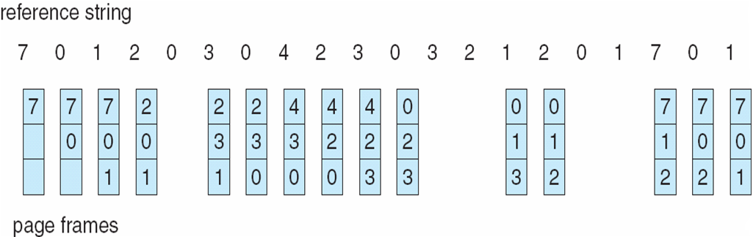
FIFO Page Replacement
Notes:
*

Slide 12
Optimal Algorithm
Replace page that will not be used for longest period of time
  9 is optimal for the example on the next slide
How do you know this?
  Can’t read the future
Used for measuring how well your algorithm performs
Notes:
*

Slide 13
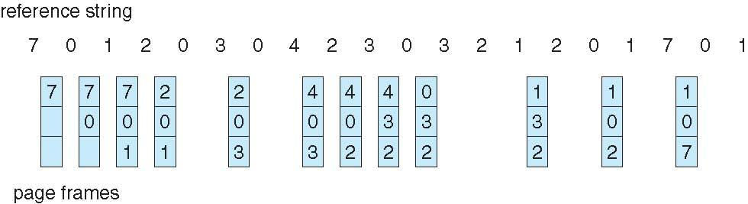
Least Recently Used (LRU) Algorithm
Use past knowledge rather than future
Replace page that has not been used in the most amount of time
Associate time of last use with each page
12 faults – better than FIFO but worse than OPT
Generally good algorithm and frequently used
But how to implement?
Notes:
*

Slide 14
LRU Approximation Algorithms
LRU needs special hardware and still slow
Reference bit
  With each page associate a bit, initially = 0
  When page is referenced bit set to 1
  Replace any with reference bit = 0 (if one exists)
    We do not know the order, however
Second-chance algorithm
  Generally FIFO, plus hardware-provided reference bit
  Clock replacement
  If page to be replaced has
    Reference bit = 0 -> replace it
    reference bit = 1 then:
      set reference bit 0, leave page in memory
      replace next page, subject to same rules
Notes:
*

Slide 15
Counting Algorithms
Keep a counter of the number of references that have been made to each page
  Not common
LFU Algorithm: replaces page with smallest count
MFU Algorithm: based on the argument that the page with the smallest count was probably just brought in and has yet to be used
Notes:
*

Slide 16
Page-Buffering Algorithms
Keep a pool of free frames, always
  Then frame available when needed, not found at fault time
  Read page into free frame and select victim to evict and add to free pool
  When convenient, evict victim
Possibly, keep list of modified pages
  When backing store otherwise idle, write pages there and set to non-dirty
Possibly, keep free frame contents intact and note what is in them
  If referenced again before reused, no need to load contents again from disk
  Generally useful to reduce penalty if wrong victim frame selected

Slide 17
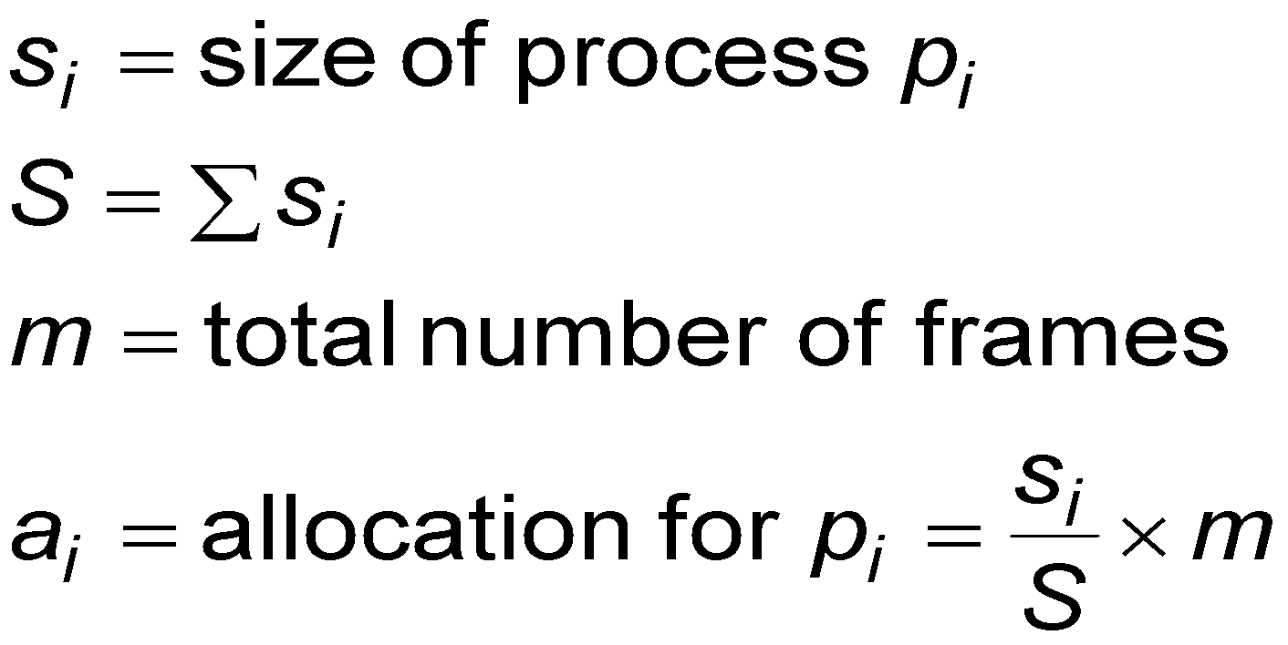
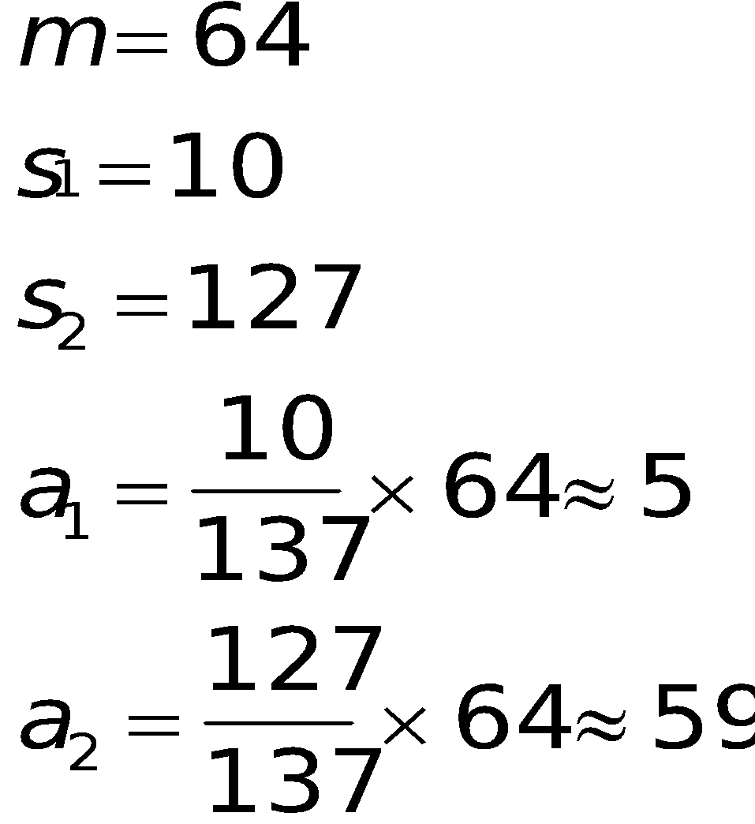
Fixed Allocation
Equal allocation – For example, if there are 100 frames (after allocating frames for the OS) and 5 processes, give each process 20 frames
  Keep some as free frame buffer pool
Proportional allocation – Allocate according to the size of process
  Dynamic as degree of multiprogramming, process sizes change
Notes:
*

Slide 18
Priority Allocation
Use a proportional allocation scheme using priorities rather than size
If process P_{i} generates a page fault,
  select for replacement one of its frames
  select for replacement a frame from a process with lower priority number
Notes:
*

Slide 19
Global vs. Local Allocation
Global replacement – process selects a replacement frame from the set of all frames; one process can take a frame from another
  But then process execution time can vary greatly
  But greater throughput so more common
Local replacement – each process selects from only its own set of allocated frames
  More consistent per-process performance
  But possibly underutilized memory
Notes:
*

Slide 20
Non-Uniform Memory Access
So far all memory accessed equally
Many systems are NUMA – speed of access to memory varies
  Consider system boards containing CPUs and memory, interconnected over a system bus
Optimal performance comes from allocating memory “close to” the CPU on which the thread is scheduled
  And modifying the scheduler to schedule the thread on the same system board when possible
  Solved by Solaris by creating lgroups
    Structure to track CPU / Memory low latency groups
    Used my schedule and pager
    When possible schedule all threads of a process and allocate all memory for that process within the lgroup

Slide 21
Thrashing
If a process does not have “enough” pages, the page-fault rate is very high
  Page fault to get page
  Replace existing frame
  But quickly need replaced frame back
  This leads to:
    Low CPU utilization
    Operating system thinking that it needs to increase the degree of multiprogramming
    Another process added to the system
Thrashing ≡ a process is busy swapping pages in and out
Notes:
*

Slide 22
Demand Paging and Thrashing
Why does demand paging work?
Locality model
  Process migrates from one locality to another
  Localities may overlap
Why does thrashing occur?
Σ size of locality > total memory size
  Limit effects by using local or priority page replacement
Notes:
*

Slide 23
Memory-Mapped Files
Memory-mapped file I/O allows file I/O to be treated as routine memory access by mapping a disk block to a page in memory
A file is initially read using demand paging
  A page-sized portion of the file is read from the file system into a physical page
  Subsequent reads/writes to/from the file are treated as ordinary memory accesses
Simplifies and speeds file access by driving file I/O through memory rather than read() and write() system calls
Also allows several processes to map the same file allowing the pages in memory to be shared
But when does written data make it to disk?
  Periodically and / or at file close() time
  For example, when the pager scans for dirty pages
Notes:
*

Slide 24
Memory-Mapped File Technique for all I/O
Some OSes uses memory mapped files for standard I/O
Process can explicitly request memory mapping a file via mmap() system call
  Now file mapped into process address space
For standard I/O (open(), read(), write(), close()), mmap anyway
  But map file into kernel address space
  Process still does read() and write()
    Copies data to and from kernel space and user space
  Uses efficient memory management subsystem
    Avoids needing separate subsystem
COW can be used for read/write non-shared pages
Memory mapped files can be used for shared memory (although again via separate system calls)

Slide 25
Allocating Kernel Memory
Treated differently from user memory
Often allocated from a free-memory pool
  Kernel requests memory for structures of varying sizes
  Some kernel memory needs to be contiguous
    I.e. for device I/O
Notes:
*

Slide 26
Buddy System
Allocates memory from fixed-size segment consisting of physically-contiguous pages
Memory allocated using power-of-2 allocator
  Satisfies requests in units sized as power of 2
  Request rounded up to next highest power of 2
  When smaller allocation needed than is available, current chunk split into two buddies of next-lower power of 2
    Continue until appropriate sized chunk available
For example, assume 256KB chunk available, kernel requests 21KB
  Split into A_{L} _{and} A_{r} of 128KB each
    One further divided into B_{L} and B_{R} of 64KB
      One further into C_{L} and C_{R} of 32KB each – one used to satisfy request
Advantage – quickly coalesce unused chunks into larger chunk
Disadvantage - fragmentation
Notes:
*

Slide 27
Slab Allocator
Alternate strategy
Slab is one or more physically contiguous pages
Cache consists of one or more slabs
Single cache for each unique kernel data structure
  Each cache filled with objects – instantiations of the data structure
When cache created, filled with objects marked as free
When structures stored, objects marked as used
If slab is full of used objects, next object allocated from empty slab
  If no empty slabs, new slab allocated
Benefits include no fragmentation, fast memory request satisfaction
Notes:
*

Slide 28
Other Issues – Page Size
Sometimes OS designers have a choice
  Especially if running on custom-built CPU
Page size selection must take into consideration:
  Fragmentation
  Page table size
  Resolution
  I/O overhead
  Number of page faults
  Locality
  TLB size and effectiveness
Always power of 2, usually in the range 2¹² (4,096 bytes) to 2²² (4,194,304 bytes)
On average, growing over time
Notes:
*

Slide 29
Other Issues – TLB Reach
TLB Reach - The amount of memory accessible from the TLB
TLB Reach = (TLB Size) X (Page Size)
Ideally, the working set of each process is stored in the TLB
  Otherwise there is a high degree of page faults
Increase the Page Size
  This may lead to an increase in fragmentation as not all applications require a large page size
Provide Multiple Page Sizes
  This allows applications that require larger page sizes the opportunity to use them without an increase in fragmentation
Notes:
*

Slide 30
Other Issues – I/O interlock
I/O Interlock – Pages must sometimes be locked into memory
Consider I/O - Pages that are used for copying a file from a device must be locked from being selected for eviction by a page replacement algorithm
Notes:
*

Slide 31
Windows XP
Uses demand paging with clustering. Clustering brings in pages surrounding the faulting page
Processes are assigned working set minimum and working set maximum
Working set minimum is the minimum number of pages the process is guaranteed to have in memory
A process may be assigned as many pages up to its working set maximum
When the amount of free memory in the system falls below a threshold, automatic working set trimming is performed to restore the amount of free memory
Working set trimming removes pages from processes that have pages in excess of their working set minimum
Notes:
*

Slide 32
Solaris
Maintains a list of free pages to assign faulting processes
Lotsfree – threshold parameter (amount of free memory) to begin paging
Desfree – threshold parameter to increasing paging
Minfree – threshold parameter to being swapping
Paging is performed by pageout process
Pageout scans pages using modified clock algorithm
Scanrate is the rate at which pages are scanned. This ranges from slowscan to fastscan
Pageout is called more frequently depending upon the amount of free memory available
Priority paging gives priority to process code pages
Notes:
*

