Slide 1
Chapter 3: Process Concept

Slide 2
Process Concept
An operating system executes a variety of programs:
  Batch system – jobs
  Time-shared systems – user programs or tasks
Textbook uses the terms job and process almost interchangeably
Process – a program in execution; process execution must progress in sequential fashion
Multiple parts
  The program code, also called text section
  Current activity including program counter, processor registers
  Stack containing temporary data
    Function parameters, return addresses, local variables
  Data section containing global variables
  Heap containing memory dynamically allocated during run time
Program is passive entity stored on disk (executable file), process is active
  Program becomes process when executable file loaded into memory
Execution of program started via GUI mouse clicks, command line entry of its name, etc
One program can be several processes
  Consider multiple users executing the same program

Slide 3
Process State
As a process executes, it changes state
  new: The process is being created
  running: Instructions are being executed
  waiting: The process is waiting for some event to occur
  ready: The process is waiting to be assigned to a processor
  terminated: The process has finished execution

Slide 4
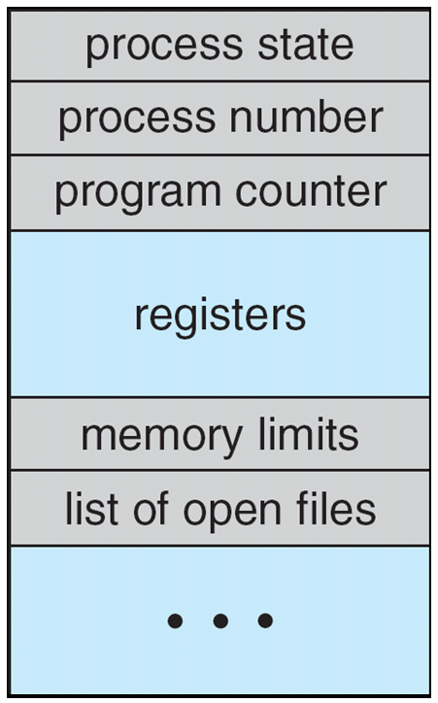
Process Control Block (PCB)
Information associated with each process
(also called task control block)
Process state – running, waiting, etc
Program counter – location of instruction to next execute
CPU registers – contents of all process-centric registers
CPU scheduling information- priorities, scheduling queue pointers
Memory-management information – memory allocated to the process
Accounting information – CPU used, clock time elapsed since start, time limits
I/O status information – I/O devices allocated to process, list of open files

Slide 5
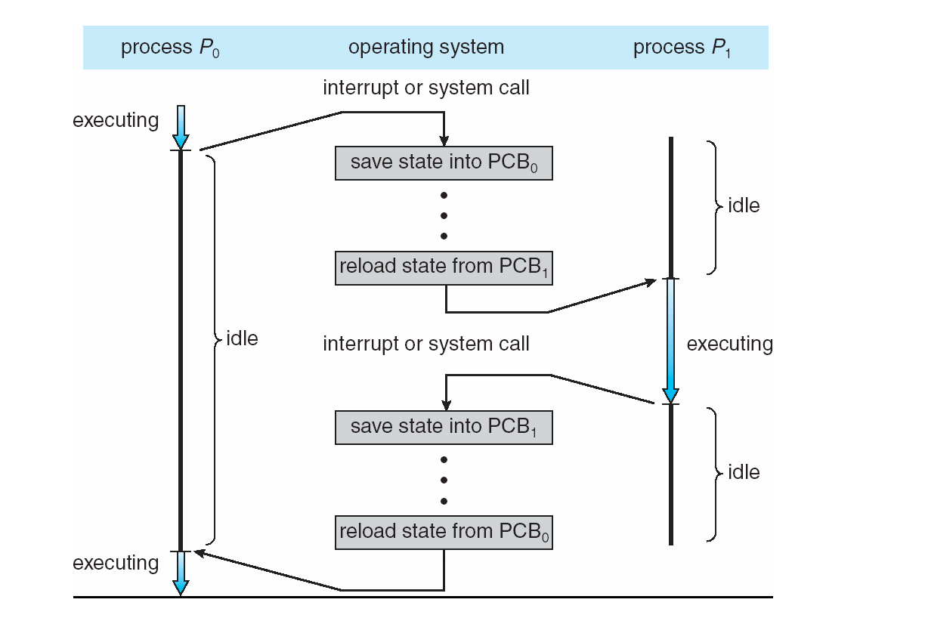
CPU Switch From Process to Process

Slide 6
Threads
So far, process has a single thread of execution
Consider having multiple program counters per process
  Multiple locations can execute at once
    Multiple threads of control -> threads
Must then have storage for thread details, multiple program counters in PCB
See next chapter

Slide 7
Process Scheduling
Maximize CPU use, quickly switch processes onto CPU for time sharing
Process scheduler selects among available processes for next execution on CPU
Maintains scheduling queues of processes
  Job queue – set of all processes in the system
  Ready queue – set of all processes residing in main memory, ready and waiting to execute
  Device queues – set of processes waiting for an I/O device
  Processes migrate among the various queues

Slide 8
Schedulers
Long-term scheduler (or job scheduler) – selects which processes should be brought into the ready queue
Short-term scheduler (or CPU scheduler) – selects which process should be executed next and allocates CPU
  Sometimes the only scheduler in a system
Short-term scheduler is invoked very frequently (milliseconds) ⇒ (must be fast)
Long-term scheduler is invoked very infrequently (seconds, minutes) ⇒ (may be slow)
The long-term scheduler controls the degree of multiprogramming
Processes can be described as either:
  I/O-bound process – spends more time doing I/O than computations, many short CPU bursts
  CPU-bound process – spends more time doing computations; few very long CPU bursts
Long-term scheduler strives for good process mix

Slide 9
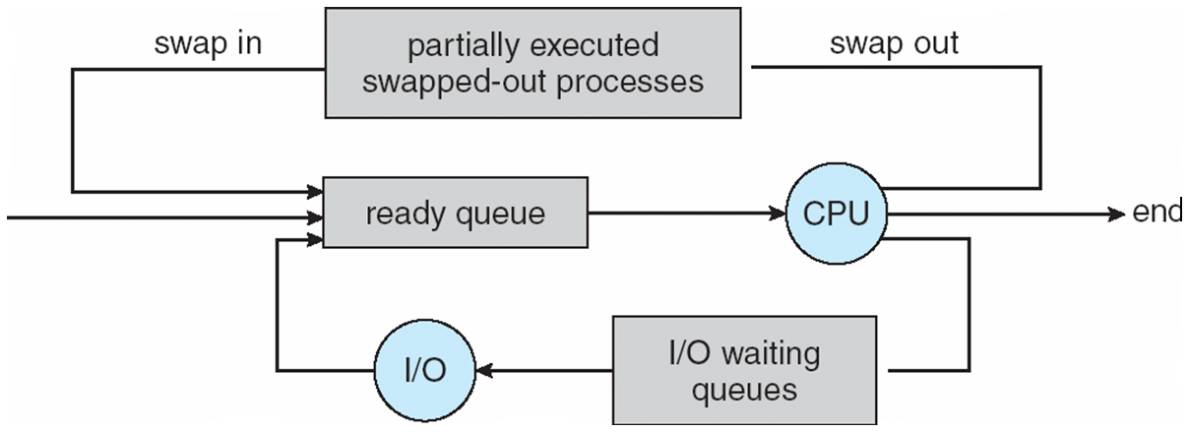
Addition of Medium Term Scheduling
Medium-term scheduler can be added if degree of multiple programming needs to decrease
  Remove process from memory, store on disk, bring back in from disk to continue execution: swapping

Slide 10
Context Switch
When CPU switches to another process, the system must save the state of the old process and load the saved state for the new process via a context switch
Context of a process represented in the PCB
Context-switch time is overhead; the system does no useful work while switching
  The more complex the OS and the PCB -> longer the context switch
Time dependent on hardware support
  Some hardware provides multiple sets of registers per CPU -> multiple contexts loaded at once

Slide 11
Operations on Processes
System must provide mechanisms for process creation, termination, and so on as detailed next

Slide 12
Process Creation
Parent process create children processes, which, in turn create other processes, forming a tree of processes
Generally, process identified and managed via a process identifier (pid)
Resource sharing options
  Parent and children share all resources
  Children share subset of parent’s resources
  Parent and child share no resources
Execution options
  Parent and children execute concurrently
  Parent waits until children terminate

Slide 13
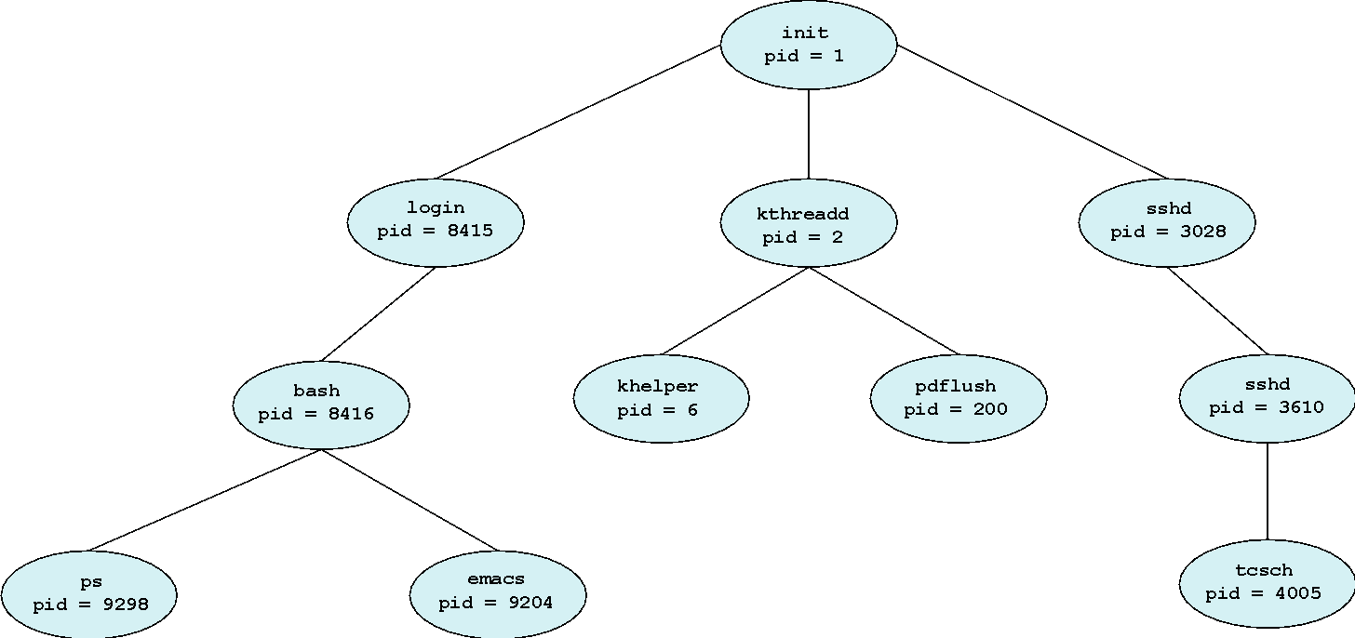
A Tree of Processes in Linux

Slide 14
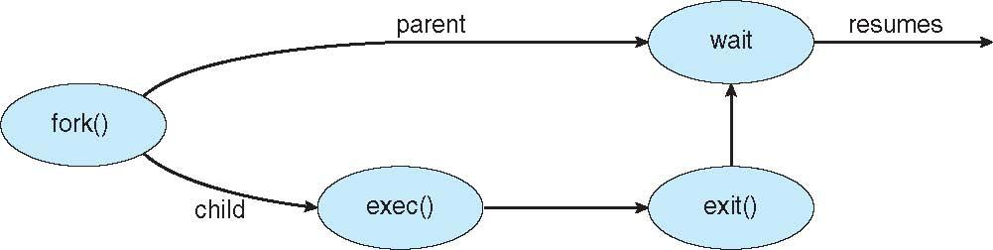
Process Creation (Cont.)
Address space
  Child duplicate of parent
  Child has a program loaded into it
UNIX examples
  fork() system call creates new process
  exec() system call used after a fork() to replace the process’ memory space with a new program

Slide 15
Process Termination
Process executes last statement and asks the operating system to delete it (exit())
  Output data from child to parent (via wait())
  Process’ resources are deallocated by operating system
Parent may terminate execution of children processes (abort())
  Child has exceeded allocated resources
  Task assigned to child is no longer required
  If parent is exiting
    Some operating systems do not allow child to continue if its parent terminates
      All children terminated - cascading termination
Wait for termination, returning the pid:
pid t pid; int status;
pid = wait(&status);
If no parent waiting, then terminated process is a zombie
If parent terminated, processes are orphans

Slide 16
Cooperating Processes
Independent process cannot affect or be affected by the execution of another process
Cooperating process can affect or be affected by the execution of another process
Advantages of process cooperation
  Information sharing
  Computation speed-up
  Modularity
  Convenience

Slide 17
Producer-Consumer Problem
Paradigm for cooperating processes, producer process produces information that is consumed by a consumer process
  unbounded-buffer places no practical limit on the size of the buffer
  bounded-buffer assumes that there is a fixed buffer size

Slide 18
Direct Communication
Processes must name each other explicitly:
  send (P, message) – send a message to process P
  receive(Q, message) – receive a message from process Q
Properties of communication link
  Links are established automatically
  A link is associated with exactly one pair of communicating processes
  Between each pair there exists exactly one link
  The link may be unidirectional, but is usually bi-directional

Slide 19
Indirect Communication
Messages are directed and received from mailboxes (also referred to as ports)
  Each mailbox has a unique id
  Processes can communicate only if they share a mailbox
Properties of communication link
  Link established only if processes share a common mailbox
  A link may be associated with many processes
  Each pair of processes may share several communication links
  Link may be unidirectional or bi-directional

Slide 20
Synchronization
Message passing may be either blocking or non-blocking
Blocking is considered synchronous
  Blocking send has the sender block until the message is received
  Blocking receive has the receiver block until a message is available
Non-blocking is considered asynchronous
  Non-blocking send has the sender send the message and continue
  Non-blocking receive has the receiver receive a valid message or null
}

Slide 21
Communications in Client-Server Systems
Sockets
Remote Procedure Calls
Pipes
Remote Method Invocation (Java)

Slide 22
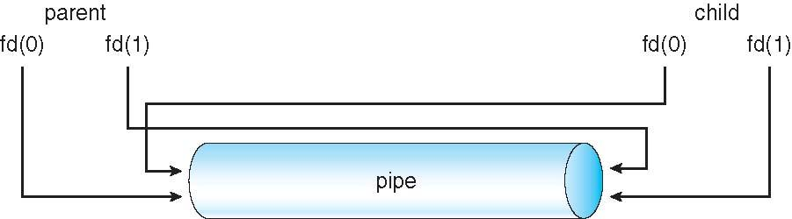
Ordinary Pipes
Ordinary Pipes allow communication in standard producer-consumer style
Producer writes to one end (the write-end of the pipe)
Consumer reads from the other end (the read-end of the pipe)
Ordinary pipes are therefore unidirectional
Require parent-child relationship between communicating processes
Windows calls these anonymous pipes
See Unix and Windows code samples in textbook

