Slide 1
Chapter 1: Introduction
Notes:
*

Slide 2
Computer Startup
bootstrap program is loaded at power-up or reboot
  Typically stored in ROM or EPROM, generally known as firmware
  Initializes all aspects of system
  Loads operating system kernel and starts execution

Slide 3
Common Functions of Interrupts
Interrupt transfers control to the interrupt service routine generally, through the interrupt vector, which contains the addresses of all the service routines
Interrupt architecture must save the address of the interrupted instruction
A trap or exception is a software-generated interrupt caused either by an error or a user request
An operating system is interrupt driven

Slide 4
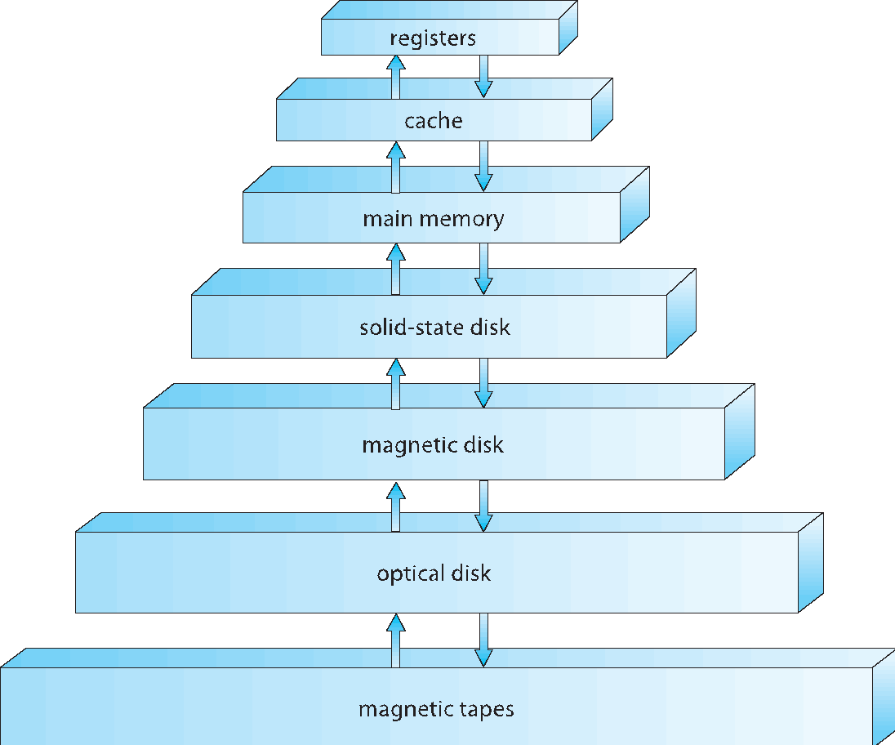
Storage-Device Hierarchy

Slide 5
Caching
Important principle, performed at many levels in a computer (in hardware, operating system, software)
Information in use copied from slower to faster storage temporarily
Faster storage (cache) checked first to determine if information is there
  If it is, information used directly from the cache (fast)
  If not, data copied to cache and used there
Cache smaller than storage being cached
  Cache management important design problem
  Cache size and replacement policy

Slide 6
Computer-System Architecture
Most systems use a single general-purpose processor (PDAs through mainframes)
  Most systems have special-purpose processors as well
Multiprocessors systems growing in use and importance
  Also known as parallel systems, tightly-coupled systems
  Advantages include:
    Increased throughput
    Economy of scale
    Increased reliability – graceful degradation or fault tolerance
  Two types:
    Asymmetric Multiprocessing
    Symmetric Multiprocessing

Slide 7
Operating-System Operations
Interrupt driven by hardware
Software error or request creates exception or trap
  Division by zero, request for operating system service
Other process problems include infinite loop, processes modifying each other or the operating system
Dual-mode operation allows OS to protect itself and other system components
  User mode and kernel mode
  Mode bit provided by hardware
    Provides ability to distinguish when system is running user code or kernel code
    Some instructions designated as privileged, only executable in kernel mode
    System call changes mode to kernel, return from call resets it to user
Increasingly CPUs support multi-mode operations
  i.e. virtual machine manager (VMM) mode for guest VMs

Slide 8
Process Management Activities
The operating system is responsible for the following activities in connection with process management:
Creating and deleting both user and system processes
Suspending and resuming processes
Providing mechanisms for process synchronization
Providing mechanisms for process communication
Providing mechanisms for deadlock handling

Slide 9
Memory Management
All data in memory before and after processing
All instructions in memory in order to execute
Memory management determines what is in memory when
  Optimizing CPU utilization and computer response to users
Memory management activities
  Keeping track of which parts of memory are currently being used and by whom
  Deciding which processes (or parts thereof) and data to move into and out of memory
  Allocating and deallocating memory space as needed

Slide 10
Storage Management
OS provides uniform, logical view of information storage
  Abstracts physical properties to logical storage unit - file
  Each medium is controlled by device (i.e., disk drive, tape drive)
    Varying properties include access speed, capacity, data-transfer rate, access method (sequential or random)
File-System management
  Files usually organized into directories
  Access control on most systems to determine who can access what
  OS activities include
    Creating and deleting files and directories
    Primitives to manipulate files and dirs
    Mapping files onto secondary storage
    Backup files onto stable (non-volatile) storage media

Slide 11
Protection and Security
Protection – any mechanism for controlling access of processes or users to resources defined by the OS
Security – defense of the system against internal and external attacks
  Huge range, including denial-of-service, worms, viruses, identity theft, theft of service
Systems generally first distinguish among users, to determine who can do what
  User identities (user IDs, security IDs) include name and associated number, one per user
  User ID then associated with all files, processes of that user to determine access control
  Group identifier (group ID) allows set of users to be defined and controls managed, then also associated with each process, file
  Privilege escalation allows user to change to effective ID with more rights

Slide 12
Computing Environments - Traditional
Stand-alone general purpose machines
But blurred as most systems interconnect with others (i.e. the Internet)
Portals provide web access to internal systems
Network computers (thin clients) are like Web terminals
Mobile computers interconnect via wireless networks
Networking becoming ubiquitous – even home systems use firewalls to protect home computers from Internet attacks

