Slide 1
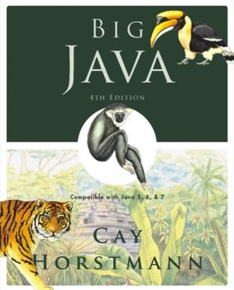
Chapter 5 – Decisions
Big Java by Cay Horstmann
Copyright © 2009 by John Wiley & Sons. All rights reserved.

Slide 2
Chapter Goals
To be able to implement decisions using if statements
To understand how to group statements into blocks
To learn how to compare integers, floating-point numbers, strings, and objects
To recognize the correct ordering of decisions in multiple branches
To program conditions using Boolean operators and variables
T To understand the importance of test coverage
Big Java by Cay Horstmann
Copyright © 2009 by John Wiley & Sons. All rights reserved.

Slide 3
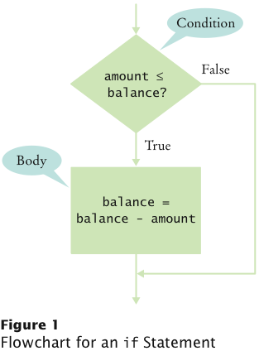
The if Statement
The if statement lets a program carry out different actions depending on a condition
if (amount <= balance)
balance = balance – amount;
Big Java by Cay Horstmann
Copyright © 2009 by John Wiley & Sons. All rights reserved.

Slide 4
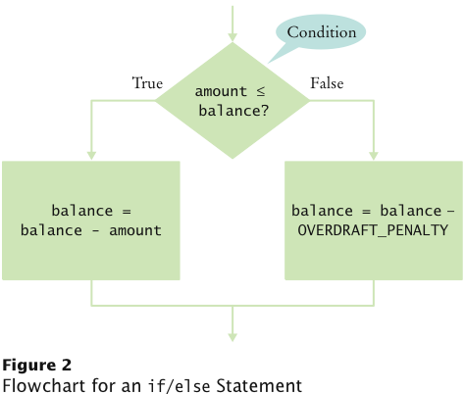
The if/else Statement
if (amount <= balance)
balance = balance – amount;
else
balance = balance – OVERDRAFT_PENALTY
Big Java by Cay Horstmann
Copyright © 2009 by John Wiley & Sons. All rights reserved.

Slide 5
Statement Types
Simple statement:
balance = balance - amount;
Compound statement:
if (balance >= amount) balance = balance - amount;
Also loop statements — Chapter 6
Block statement:
{
double newBalance = balance - amount;
balance = newBalance;
}
Big Java by Cay Horstmann
Copyright © 2009 by John Wiley & Sons. All rights reserved.

Slide 6
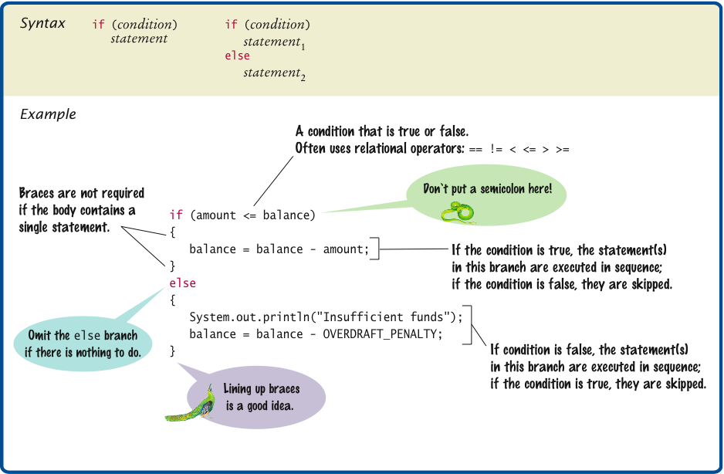
Syntax 5.1 The if Statement
Big Java by Cay Horstmann
Copyright © 2009 by John Wiley & Sons. All rights reserved.

Slide 7
Self Check 5.1
Why did we use the condition amount <= balance and not amount < balance in the example for the if/else statement?
Answer: If the withdrawal amount equals the balance, the result should be a zero balance and no penalty.

Slide 8
Self Check 5.2
What is logically wrong with the statement
if (amount <= balance) newBalance = balance - amount; balance = newBalance;
and how do you fix it?
Answer: Only the first assignment statement is part of the if statement. Use braces to group both assignment statements into a block statement.

Slide 9
Comparing Values: Relational Operators
Relational operators compare values
Java | Math Notation | Description
> | > | Greater than
>= | ≥ | Greater than or equal
< | < | Less than
<= | ≤ | Less than or equal
== | = | Equal
!= | ≠ | Not equal
Big Java by Cay Horstmann
Copyright © 2009 by John Wiley & Sons. All rights reserved.

Slide 10
Comparing Values: Relational Operators
The == denotes equality testing:
a = 5; // Assign 5 to a
if (a == 5) ... // Test whether a equals 5
Relational operators have lower precedence than arithmetic operators:
amount + fee <= balance
Big Java by Cay Horstmann
Copyright © 2009 by John Wiley & Sons. All rights reserved.

Slide 11
Comparing Floating-Point Numbers
Consider this code:
double r = Math.sqrt(2);
double d = r * r - 2;
if (d == 0)
System.out.println("sqrt(2)squared minus 2 is 0");
else
System.out.println("sqrt(2)squared minus 2 is not 0 but "
+ d);
It prints:
sqrt(2)squared minus 2 is not 0 but 4.440892098500626E-16
Big Java by Cay Horstmann
Copyright © 2009 by John Wiley & Sons. All rights reserved.

Slide 12
Comparing Floating-Point Numbers
To avoid roundoff errors, don’t use == to compare floating-point numbers
To compare floating-point numbers test whether they are close enough: |x - y| ≤ ε
final double EPSILON = 1E-14;
if (Math.abs(x - y) <= EPSILON)
// x is approximately equal to y
ε is a small number such as 10⁻¹⁴
Big Java by Cay Horstmann
Copyright © 2009 by John Wiley & Sons. All rights reserved.

Slide 13
Comparing Strings
To test whether two strings are equal to each other, use equals method:
if (string1.equals(string2)) . . .
Don’t use == for strings!
if (string1 == string2) // Not useful
== tests identity, equals tests equal contents
Case insensitive test:
if (string1.equalsIgnoreCase(string2))
Big Java by Cay Horstmann
Copyright © 2009 by John Wiley & Sons. All rights reserved.

Slide 14
Comparing Strings
string1.compareTo(string2) < 0 means:
string1 comes before string2 in the dictionary
string1.compareTo(string2) > 0 means:
string1 comes after string2
string1.compareTo(string2) == 0 means:
string1 equals string2
"car" comes before "cargo"
All uppercase letters come before lowercase:
"Hello" comes before "car"
Big Java by Cay Horstmann
Copyright © 2009 by John Wiley & Sons. All rights reserved.

Slide 15
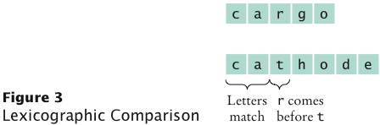
Lexicographic Comparison
Big Java by Cay Horstmann
Copyright © 2009 by John Wiley & Sons. All rights reserved.

Slide 16
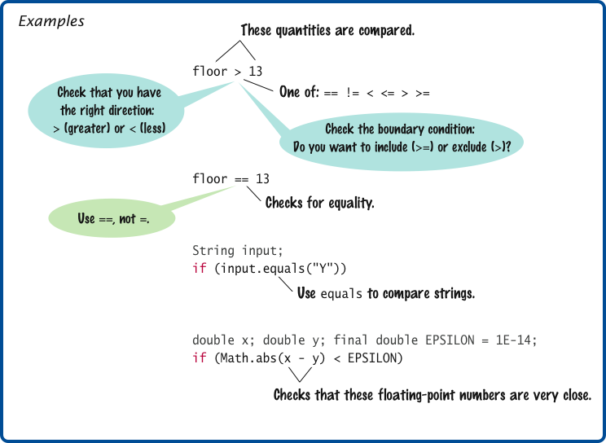
Syntax 5.2 Comparisons
Big Java by Cay Horstmann
Copyright © 2009 by John Wiley & Sons. All rights reserved.

Slide 17
Comparing Objects
== tests for identity, equals for identical content
Rectangle box1 = new Rectangle(5, 10, 20, 30);
Rectangle box2 = box1;
Rectangle box3 = new Rectangle(5, 10, 20, 30);
box1 != box3, but box1.equals(box3)
box1 == box2
Caveat: equals must be defined for the class
Big Java by Cay Horstmann
Copyright © 2009 by John Wiley & Sons. All rights reserved.

Slide 18
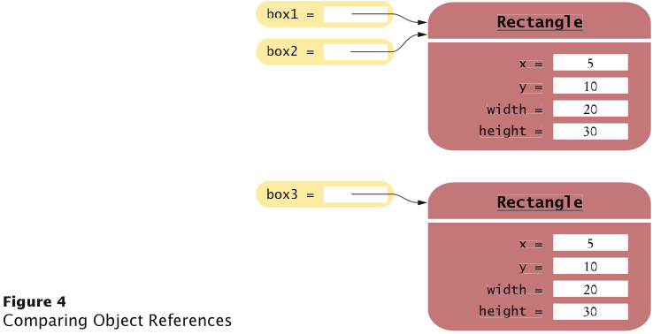
Object Comparison
Big Java by Cay Horstmann
Copyright © 2009 by John Wiley & Sons. All rights reserved.

Slide 19
Testing for null
null reference refers to no object: String middleInitial = null; // Not set if ( ... ) middleInitial = middleName.substring(0, 1);
Can be used in tests: if (middleInitial == null) System.out.println(firstName + " " + lastName); else System.out.println(firstName + " " + middleInitial + ". " + lastName);
Use ==, not equals, to test for null
null is not the same as the empty string ""
Big Java by Cay Horstmann
Copyright © 2009 by John Wiley & Sons. All rights reserved.

Slide 20
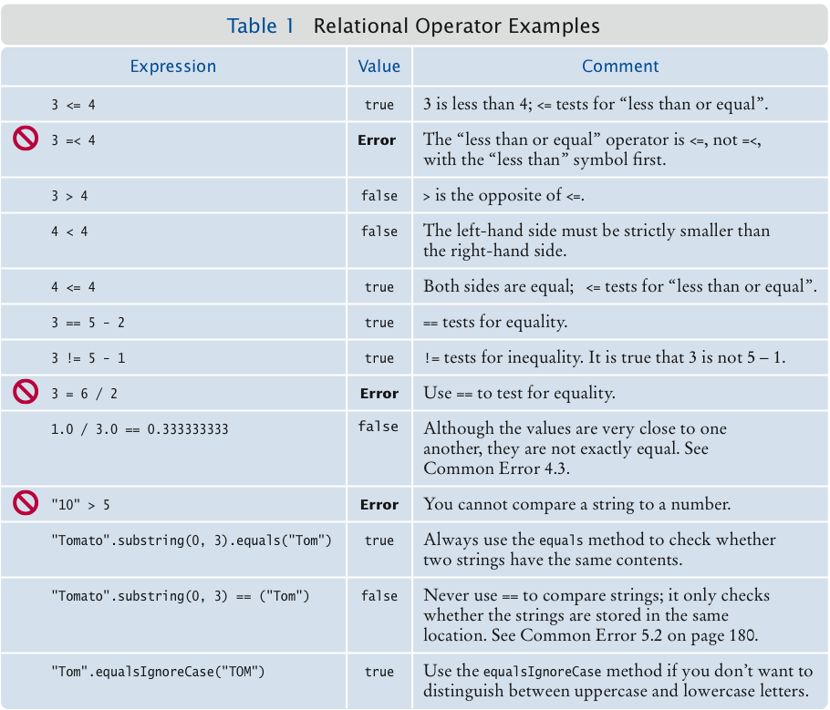
Relational Operator Examples
Big Java by Cay Horstmann
Copyright © 2009 by John Wiley & Sons. All rights reserved.

Slide 21
Self Check 5.3
What is the value of s.length() if s is
the empty string ""?
the string " " containing a space?
null?
Answer: (a) 0; (b) 1; (c) an exception occurs.

Slide 22
Self Check 5.4
Which of the following comparisons are syntactically incorrect? Which of them are syntactically correct, but logically questionable?
String a = "1";
String b = "one";
double x = 1;
double y = 3 * (1.0 / 3);
a == "1"
a == null
a.equals("")
a == b
a == x
x == y
x - y == null
x.equals(y)
Answer: Syntactically incorrect: e, g, h. Logically questionable: a, d, f.

Slide 23
Multiple Alternatives: Sequences of Comparisons
if (condition₁)
statement₁;
else if (condition₂)
statement₂;
...
else
statement₄;
The first matching condition is executed
Order matters:
if (richter >= 0) // always passes
r = "Generally not felt by people";
else if (richter >= 3.5) // not tested
r = "Felt by many people, no destruction";
...
Big Java by Cay Horstmann
Copyright © 2009 by John Wiley & Sons. All rights reserved.

Slide 24
Multiple Alternatives: Sequences of Comparisons
Don’t omit else:
if (richter >= 8.0)
r = "Most structures fall";
if (richter >= 7.0) // omitted else--ERROR
r = "Many buildings destroyed";
Big Java by Cay Horstmann
Copyright © 2009 by John Wiley & Sons. All rights reserved.

Slide 25

Animation 5.1: Multiple Alternatives
Big Java by Cay Horstmann
Copyright © 2009 by John Wiley & Sons. All rights reserved.

Slide 26
ch05/quake/Earthquake.java
1 /**
2 A class that describes the effects of an earthquake.
3 */
4 public class Earthquake
5 {
6 private double richter;
7
8 /**
9 Constructs an Earthquake object.
10 @param magnitude the magnitude on the Richter scale
11 */
12 public Earthquake(double magnitude)
13 {
14 richter = magnitude;
15 }
16
Continued
Big Java by Cay Horstmann
Copyright © 2009 by John Wiley & Sons. All rights reserved.

Slide 27
ch05/quake/Earthquake.java (cont.)
17 /**
18 Gets a description of the effect of the earthquake.
19 @return the description of the effect
20 */
21 public String getDescription()
22 {
23 String r;
24 if (richter >= 8.0)
25 r = "Most structures fall";
26 else if (richter >= 7.0)
27 r = "Many buildings destroyed";
28 else if (richter >= 6.0)
29 r = "Many buildings considerably damaged, some collapse";
30 else if (richter >= 4.5)
31 r = "Damage to poorly constructed buildings";
32 else if (richter >= 3.5)
33 r = "Felt by many people, no destruction";
34 else if (richter >= 0)
35 r = "Generally not felt by people";
36 else
37 r = "Negative numbers are not valid";
38 return r;
39 }
40 }
Big Java by Cay Horstmann
Copyright © 2009 by John Wiley & Sons. All rights reserved.

Slide 28
ch05/quake/EarthquakeRunner.java
1 import java.util.Scanner;
2
3 /**
4 This program prints a description of an earthquake of a given magnitude.
5 */
6 public class EarthquakeRunner
7 {
8 public static void main(String[] args)
9 {
10 Scanner in = new Scanner(System.in);
11
12 System.out.print("Enter a magnitude on the Richter scale: ");
13 double magnitude = in.nextDouble();
14 Earthquake quake = new Earthquake(magnitude);
15 System.out.println(quake.getDescription());
16 }
17 }
Program Run:
Enter a magnitude on the Richter scale: 7.1
Many buildings destroyed
Big Java by Cay Horstmann
Copyright © 2009 by John Wiley & Sons. All rights reserved.

Slide 29
Multiple Alternatives: Nested Branches
Branch inside another branch:
if (condition₁)
{
if (condition_{1a})
statement_{1a};
else
statement_{1b};
}
else
statement₂;
Big Java by Cay Horstmann
Copyright © 2009 by John Wiley & Sons. All rights reserved.

Slide 30
Animation 5.2: Nested Branches
Big Java by Cay Horstmann
Copyright © 2009 by John Wiley & Sons. All rights reserved.

Slide 31
Tax Schedule
If your filing status is Single |  | If your filing status is Married
Tax Bracket | Percentage | Tax Bracket | Percentage
$0 ... $32,000 | 10% | 0 ... $64,000 | 10%
Amount over $32,000 | 25% | Amount over $64,000 | 25%
Big Java by Cay Horstmann
Copyright © 2009 by John Wiley & Sons. All rights reserved.

Slide 32
Nested Branches
Compute taxes due, given filing status and income figure:
branch on the filing status
for each filing status, branch on income level
The two-level decision process is reflected in two levels of if statements
We say that the income test is nested inside the test for filing status
Big Java by Cay Horstmann
Copyright © 2009 by John Wiley & Sons. All rights reserved.

Slide 33
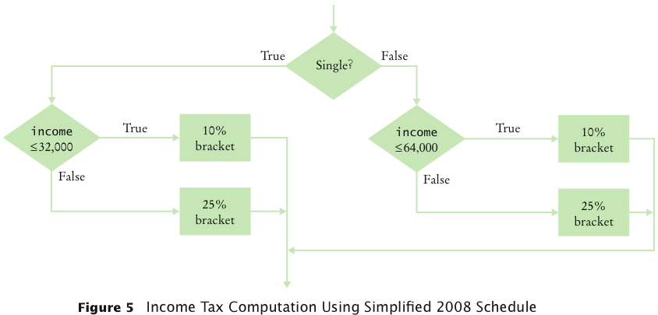
Nested Branches
Big Java by Cay Horstmann
Copyright © 2009 by John Wiley & Sons. All rights reserved.

Slide 34
ch05/tax/TaxReturn.java
1 /**
2 A tax return of a taxpayer in 2008.
3 */
4 public class TaxReturn
5 {
6 public static final int SINGLE = 1;
7 public static final int MARRIED = 2;
8
9 private static final double RATE1 = 0.10;
10 private static final double RATE2 = 0.25;
11 private static final double RATE1_SINGLE_LIMIT = 32000;
12 private static final double RATE1_MARRIED_LIMIT = 64000;
13
14 private double income;
15 private int status;
16
Continued
Big Java by Cay Horstmann
Copyright © 2009 by John Wiley & Sons. All rights reserved.

Slide 35
ch05/tax/TaxReturn.java (cont.)
17 /**
18 Constructs a TaxReturn object for a given income and
19 marital status.
20 @param anIncome the taxpayer income
21 @param aStatus either SINGLE or MARRIED
22 */
23 public TaxReturn(double anIncome, int aStatus)
24 {
25 income = anIncome;
26 status = aStatus;
27 }
28
29 public double getTax()
30 {
31 double tax1 = 0;
32 double tax2 = 0;
33
Continued
Big Java by Cay Horstmann
Copyright © 2009 by John Wiley & Sons. All rights reserved.

Slide 36
ch05/tax/TaxReturn.java (cont.)
34 if (status == SINGLE)
35 {
36 if (income <= RATE1_SINGLE_LIMIT)
37 {
38 tax1 = RATE1 * income;
39 }
40 else
41 {
42 tax1 = RATE1 * RATE1_SINGLE_LIMIT;
43 tax2 = RATE2 * (income - RATE1_SINGLE_LIMIT);
44 }
45 }
46 else
47 {
48 if (income <= RATE1_MARRIED_LIMIT)
49 {
50 tax1 = RATE1 * income;
51 }
52 else
53 {
54 tax1 = RATE1 * RATE1_MARRIED_LIMIT;
55 tax2 = RATE2 * (income - RATE1_MARRIED_LIMIT);
56 }
57 }
58
59 return tax1 + tax2;
60 }
61 }
Big Java by Cay Horstmann
Copyright © 2009 by John Wiley & Sons. All rights reserved.

Slide 37
ch05/tax/TaxCalculator.java
1 import java.util.Scanner;
2
3 /**
4 This program calculates a simple tax return.
5 */
6 public class TaxCalculator
7 {
8 public static void main(String[] args)
9 {
10 Scanner in = new Scanner(System.in);
11
12 System.out.print("Please enter your income: ");
13 double income = in.nextDouble();
14
15 System.out.print("Are you married? (Y/N) ");
16 String input = in.next();
17 int status;
18 if (input.equalsIgnoreCase("Y"))
19 status = TaxReturn.MARRIED;
20 else
21 status = TaxReturn.SINGLE;
22 TaxReturn aTaxReturn = new TaxReturn(income, status);
23
24 System.out.println("Tax: "
25 + aTaxReturn.getTax());
26 }
27 }
Continued
Big Java by Cay Horstmann
Copyright © 2009 by John Wiley & Sons. All rights reserved.

Slide 38
ch05/tax/TaxCalculator.java (cont.)
Program Run:
Please enter your income: 50000
Are you married? (Y/N) N
Tax: 11211.5
Big Java by Cay Horstmann
Copyright © 2009 by John Wiley & Sons. All rights reserved.

Slide 39
Self Check 5.5
The if/else/else statement for the earthquake strength first tested for higher values, then descended to lower values. Can you reverse that order?
Answer: Yes, if you also reverse the comparisons:
if (richter < 3.5)
r = "Generally not felt by people";
else if (richter < 4.5)
r = "Felt by many people, no destruction";
else if (richter < 6.0)
r = "Damage to poorly constructed buildings";
...

Slide 40
Self Check 5.6
Some people object to higher tax rates for higher incomes, claiming that you might end up with less money after taxes when you get a raise for working hard. What is the flaw in this argument?
Answer: The higher tax rate is only applied on the income in the higher bracket. Suppose you are single and make $31,900. Should you try to get a $200 raise? Absolutely: you get to keep 90 percent of the first $100 and 75 percent of the next $100.

Slide 41
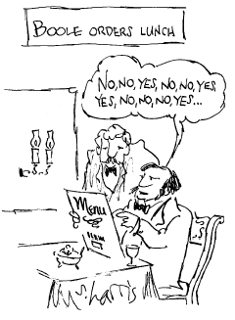
Using Boolean Expressions: The boolean Type
George Boole (1815-1864): pioneer in the study of logic
value of expression amount < 1000 is true or false
boolean type: one of these 2 truth values
Big Java by Cay Horstmann
Copyright © 2009 by John Wiley & Sons. All rights reserved.

Slide 42
Using Boolean Expressions: Predicate Method
A predicate method returns a boolean value:
public boolean isOverdrawn()
{
return balance < 0;
}
Use in conditions:
if (harrysChecking.isOverdrawn())
Useful predicate methods in Character class:
isDigit
isLetter
isUpperCase
isLowerCase
Big Java by Cay Horstmann
Copyright © 2009 by John Wiley & Sons. All rights reserved.

Slide 43
Using Boolean Expressions: Predicate Method
if (Character.isUpperCase(ch)) ...
Useful predicate methods in Scanner class: hasNextInt() and hasNextDouble():
if (in.hasNextInt()) n = in.nextInt();
Big Java by Cay Horstmann
Copyright © 2009 by John Wiley & Sons. All rights reserved.

Slide 44
Using Boolean Expressions: The Boolean Operators
&& and
|| or
! not
if (0 < amount && amount < 1000) . . .
if (input.equals("S") || input.equals("M")) . . .
if (!input.equals("S")) . . .
Big Java by Cay Horstmann
Copyright © 2009 by John Wiley & Sons. All rights reserved.

Slide 45
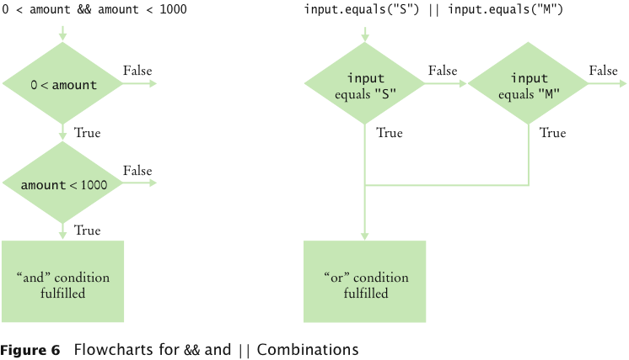
&& and || Operators
Big Java by Cay Horstmann
Copyright © 2009 by John Wiley & Sons. All rights reserved.

Slide 46
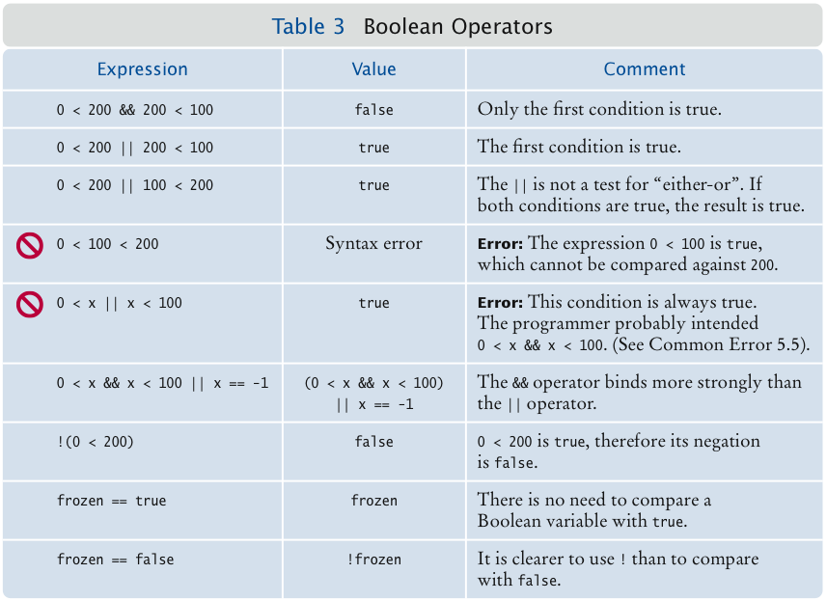
Boolean Operators
Big Java by Cay Horstmann
Copyright © 2009 by John Wiley & Sons. All rights reserved.

Slide 47
Truth Tables
A | B | A && B
true | true | true
true | false | false
false | Any | false
A | B | A || B
true | Any | true
false | true | true
false | false | false
A | !A
true | false
false | true
Big Java by Cay Horstmann
Copyright © 2009 by John Wiley & Sons. All rights reserved.

Slide 48
Using Boolean Variables
private boolean married;
Set to truth value:
married = input.equals("M");
Use in conditions:
if (married) ... else ...
if (!married) ...
Also called flag
It is considered gauche to write a test such as
if (married == true) ... // Don't
Just use the simpler test
if (married) ...
Big Java by Cay Horstmann
Copyright © 2009 by John Wiley & Sons. All rights reserved.

Slide 49
Self Check 5.7
When does the statement
system.out.println (x > 0 || x < 0);
print false?
Answer: When x is zero.

Slide 50
Self Check 5.8
Rewrite the following expression, avoiding the comparison with false:
if (character.isDigit(ch) == false) ...
Answer: if (!Character.isDigit(ch)) ...

Slide 51
Code Coverage
Black-box testing: Test functionality without consideration of internal structure of implementation
White-box testing: Take internal structure into account when designing tests
Test coverage: Measure of how many parts of a program have been tested
Make sure that each part of your program is exercised at least once by one test case E.g., make sure to execute each branch in at least one test case
Big Java by Cay Horstmann
Copyright © 2009 by John Wiley & Sons. All rights reserved.

Slide 52
Code Coverage
Include boundary test cases: Legal values that lie at the boundary of the set of acceptable inputs
Tip: Write first test cases before program is written completely → gives insight into what program should do
Big Java by Cay Horstmann
Copyright © 2009 by John Wiley & Sons. All rights reserved.

Slide 53
Self Check 5.9
How many test cases do you need to cover all branches of the getDescription method of the Earthquake class?
Answer: 7.

Slide 54
Self Check 5.10
Give a boundary test case for the EarthquakeRunner program. What output do you expect?
Answer: An input of 0 should yield an output of "Generally not felt by people". (If the output is "Negative numbers are not allowed", there is an error in the program.)

