Slide 1

Chapter Three - Implementing Classes
Big Java by Cay Horstmann
Copyright © 2009 by John Wiley & Sons. All rights reserved.

Slide 2
Chapter Goals
To become familiar with the process of implementing classes
To be able to implement simple methods
To understand the purpose and use of constructors
To understand how to access instance variables and local variables
To be able to write javadoc comments
G To implement classes for drawing graphical shapes
Big Java by Cay Horstmann
Copyright © 2009 by John Wiley & Sons. All rights reserved.

Slide 3

Instance Variables
Example: tally counter
Simulator statements:
Counter tally = new Counter();
tally.count();
tally.count();
int result = tally.getValue(); // Sets result to 2
Each counter needs to store a variable that keeps track of how many times the counter has been advanced
Big Java by Cay Horstmann
Copyright © 2009 by John Wiley & Sons. All rights reserved.

Slide 4
Instance Variables
Instance variables store the data of an object
Instance of a class: an object of the class
The class declaration specifies the instance variables:
public class Counter
{
private int value;
…
}
Big Java by Cay Horstmann
Copyright © 2009 by John Wiley & Sons. All rights reserved.

Slide 5
Instance Variables
An instance variable declaration consists of the following parts:
access specifier (private)
type of variable (such as int)
name of variable (such as value)
Each object of a class has its own set of instance variables
You should declare all instance variables as private
Big Java by Cay Horstmann
Copyright © 2009 by John Wiley & Sons. All rights reserved.

Slide 6
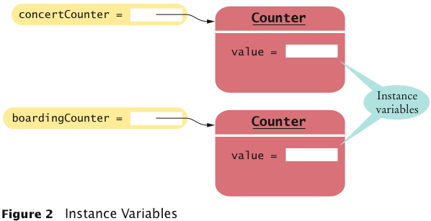
Instance Variables
Big Java by Cay Horstmann
Copyright © 2009 by John Wiley & Sons. All rights reserved.

Slide 7
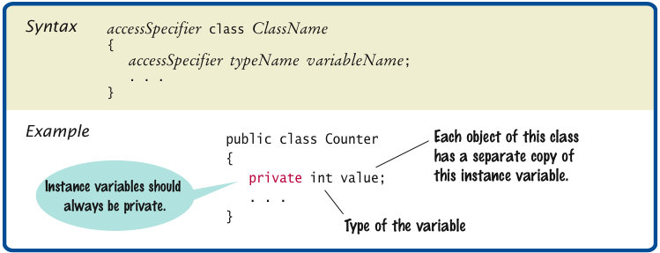
Syntax 3.1 Instance Variable Declaration
Big Java by Cay Horstmann
Copyright © 2009 by John Wiley & Sons. All rights reserved.

Slide 8
Accessing Instance Variables
The count method advances the counter value by 1:
public void count()
{
value = value + 1;
}
The getValue method returns the current value:
public int getValue()
{
return value;
}
Private instance variables can only be accessed by methods of the same class
Big Java by Cay Horstmann
Copyright © 2009 by John Wiley & Sons. All rights reserved.

Slide 9
Self Check 3.1
Supply the body of a method public void reset() that resets the counter back to zero.
Answer:
public void reset()
{
value = 0;
}
Big Java by Cay Horstmann
Copyright © 2009 by John Wiley & Sons. All rights reserved.

Slide 10
Self Check 3.2
Suppose you use a class Clock with private instance variables hours and minutes. How can you access these variables in your program?
Answer: You can only access them by invoking the methods of the Clock class.
Big Java by Cay Horstmann
Copyright © 2009 by John Wiley & Sons. All rights reserved.

Slide 11
Instance Variables
Encapsulation is the process of hiding object data and providing methods for data access
To encapsulate data, declare instance variables as private and declare public methods that access the variables
Encapsulation allows a programmer to use a class without having to know its implementation
Information hiding makes it simpler for the implementor of a class to locate errors and change implementations
Big Java by Cay Horstmann
Copyright © 2009 by John Wiley & Sons. All rights reserved.

Slide 12
Self Check 3.3
Consider the Counter class. A counter’s value starts at 0 and is advanced by the count method, so it should never be negative. Suppose you found a negative value variable during testing. Where would you look for the error?
Answer: In one of the methods of the Counter class.
Big Java by Cay Horstmann
Copyright © 2009 by John Wiley & Sons. All rights reserved.

Slide 13
Self Check 3.4
In Chapters 1 and 2, you used System.out as a black box to cause output to appear on the screen. Who designed and implemented System.out?
Answer: The programmers who designed and implemented the Java library.
Big Java by Cay Horstmann
Copyright © 2009 by John Wiley & Sons. All rights reserved.

Slide 14
Self Check 3.5
Suppose you are working in a company that produces personal finance software. You are asked to design and implement a class for representing bank accounts. Who will be the users of your class?
Answer: Other programmers who work on the personal finance application.
Big Java by Cay Horstmann
Copyright © 2009 by John Wiley & Sons. All rights reserved.

Slide 15
Specifying the Public Interface of a Class
Behavior of bank account (abstraction):
deposit money
withdraw money
get balance
Big Java by Cay Horstmann
Copyright © 2009 by John Wiley & Sons. All rights reserved.

Slide 16
Specifying the Public Interface of a Class: Methods
Methods of BankAccount class:
deposit
withdraw
getBalance
We want to support method calls such as the following:
harrysChecking.deposit(2000); harrysChecking.withdraw(500); System.out.println(harrysChecking.getBalance());
Big Java by Cay Horstmann
Copyright © 2009 by John Wiley & Sons. All rights reserved.

Slide 17
Specifying the Public Interface of a Class: Method Declaration
access specifier (such as public)
return type (such as String or void)
method name (such as deposit)
list of parameters (double amount for deposit)
method body in { }
Examples:
public void deposit(double amount) { . . . }
public void withdraw(double amount) { . . . }
public double getBalance() { . . . }
Big Java by Cay Horstmann
Copyright © 2009 by John Wiley & Sons. All rights reserved.

Slide 18
Specifying the Public Interface of a Class: Method Header
access specifier (such as public)
return type (such as void or double)
method name (such as deposit)
list of parameter variables (such as double amount)
Examples:
public void deposit(double amount)
public void withdraw(double amount)
public double getBalance()
Big Java by Cay Horstmann
Copyright © 2009 by John Wiley & Sons. All rights reserved.

Slide 19
Specifying the Public Interface of a Class: Constructor Declaration
A constructor initializes the instance variables
Constructor name = class name
public BankAccount()
{
// body--filled in later
}
Constructor body is executed when new object is created
Statements in constructor body will set the internal data of the object that is being constructed
All constructors of a class have the same name
Compiler can tell constructors apart because they take different parameters
Big Java by Cay Horstmann
Copyright © 2009 by John Wiley & Sons. All rights reserved.

Slide 20
BankAccount Public Interface
The public constructors and methods of a class form the public interface of the class:
public class BankAccount
{
// private variables--filled in later
// Constructors public BankAccount()
{
// body--filled in later
}
public BankAccount(double initialBalance)
{
// body--filled in later
}
Continued
Big Java by Cay Horstmann
Copyright © 2009 by John Wiley & Sons. All rights reserved.

Slide 21
BankAccount Public Interface (cont.)
// Methods
public void deposit(double amount)
{
// body--filled in later
}
public void withdraw(double amount)
{
// body--filled in later
}
public double getBalance()
{
// body--filled in later
}
}
Big Java by Cay Horstmann
Copyright © 2009 by John Wiley & Sons. All rights reserved.

Slide 22
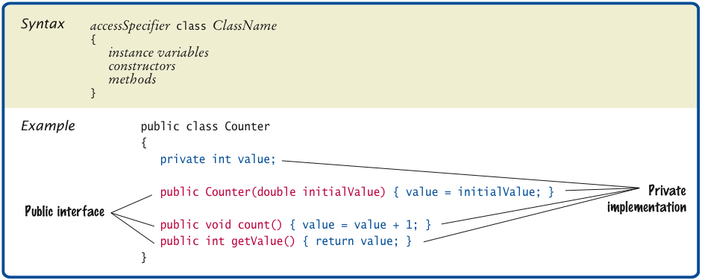
Syntax 3.2 Class Declaration
Big Java by Cay Horstmann
Copyright © 2009 by John Wiley & Sons. All rights reserved.

Slide 23
Self Check 3.6
How can you use the methods of the public interface to empty the harrysChecking bank account?
Answer:
harrysChecking.withdraw(harrysChecking.getBalance())
Big Java by Cay Horstmann
Copyright © 2009 by John Wiley & Sons. All rights reserved.

Slide 24
Self Check 3.7
What is wrong with this sequence of statements?
BankAccount harrysChecking = new BankAccount(10000);
System.out.println(harrysChecking.withdraw(500));
Answer: The withdraw method has return type void. It doesn’t return a value. Use the getBalance method to obtain the balance after the withdrawal.
Big Java by Cay Horstmann
Copyright © 2009 by John Wiley & Sons. All rights reserved.

Slide 25
Self Check 3.8
Suppose you want a more powerful bank account abstraction that keeps track of an account number in addition to the balance. How would you change the public interface to accommodate this enhancement?
Answer: Add an accountNumber parameter to the constructors, and add a getAccountNumber method. There is no need for a setAccountNumber method – the account number never changes after construction.
Big Java by Cay Horstmann
Copyright © 2009 by John Wiley & Sons. All rights reserved.

Slide 26
Commenting the Public Interface
/** Withdraws money from the bank account. @param amount the amount to withdraw */ public void withdraw(double amount) { //implementation filled in later } /** Gets the current balance of the bank account. @return the current balance */ public double getBalance() { //implementation filled in later }
Big Java by Cay Horstmann
Copyright © 2009 by John Wiley & Sons. All rights reserved.

Slide 27
Class Comment
/**
A bank account has a balance that can be changed by
deposits and withdrawals.
*/
public class BankAccount
{
. . .
}
Provide documentation comments for
every class
every method
every parameter
every return value
Big Java by Cay Horstmann
Copyright © 2009 by John Wiley & Sons. All rights reserved.

Slide 28
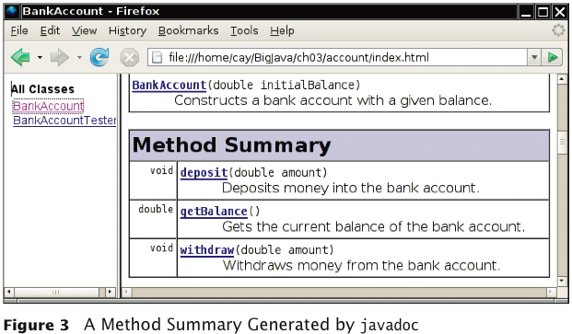
Javadoc Method Summary
Big Java by Cay Horstmann
Copyright © 2009 by John Wiley & Sons. All rights reserved.

Slide 29
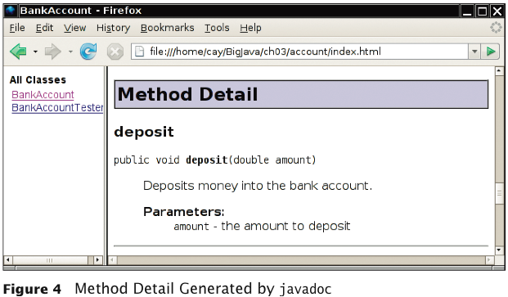
Javadoc Method Detail
Big Java by Cay Horstmann
Copyright © 2009 by John Wiley & Sons. All rights reserved.

Slide 30
Self Check 3.9
Provide documentation comments for the Counter class of Section 3.1.
Answer:
/**
This class models a tally counter.
*/
public class Counter
{
private int value;
/**
Gets the current value of this counter.
@return the current value
*/
public int getValue()
{
return value;
}
Continued
Big Java by Cay Horstmann
Copyright © 2009 by John Wiley & Sons. All rights reserved.

Slide 31
Self Check 3.9 (cont.)
/**
Advances the value of this counter by 1.
*/
public void count()
{
value = value + 1;
}
}
Big Java by Cay Horstmann
Copyright © 2009 by John Wiley & Sons. All rights reserved.

Slide 32
Self Check 3.10
Suppose we enhance the BankAccount class so that each account has an account number. Supply a documentation comment for the constructor
public BankAccount(int accountNumber, double initialBalance)
Answer:
/**
Constructs a new bank account with a given initial balance.
@param accountNumber the account number for this account
@param initialBalance the initial balance for this account
*/
Big Java by Cay Horstmann
Copyright © 2009 by John Wiley & Sons. All rights reserved.

Slide 33
Self Check 3.11
Why is the following documentation comment questionable?
/**
Each account has an account number.
@return the account number of this account
*/
public int getAccountNumber()
Answer: The first sentence of the method description should describe the method – it is displayed in isolation in the summary table.
Big Java by Cay Horstmann
Copyright © 2009 by John Wiley & Sons. All rights reserved.

Slide 34
Implementing Constructors
Constructors contain instructions to initialize the instance variables of an object:
public BankAccount()
{
balance = 0;
}
public BankAccount(double initialBalance)
{
balance = initialBalance;
}
Big Java by Cay Horstmann
Copyright © 2009 by John Wiley & Sons. All rights reserved.

Slide 35
Constructor Call Example
Statement:
BankAccount harrysChecking = new BankAccount(1000);
Create a new object of type BankAccount
Call the second constructor (because a construction parameter is supplied in the constructor call)
Set the parameter variable initialBalance to 1000
Set the balance instance variable of the newly created object to initialBalance
Return an object reference, that is, the memory location of the object, as the value of the new expression
Store that object reference in the harrysChecking variable
Big Java by Cay Horstmann
Copyright © 2009 by John Wiley & Sons. All rights reserved.

Slide 36
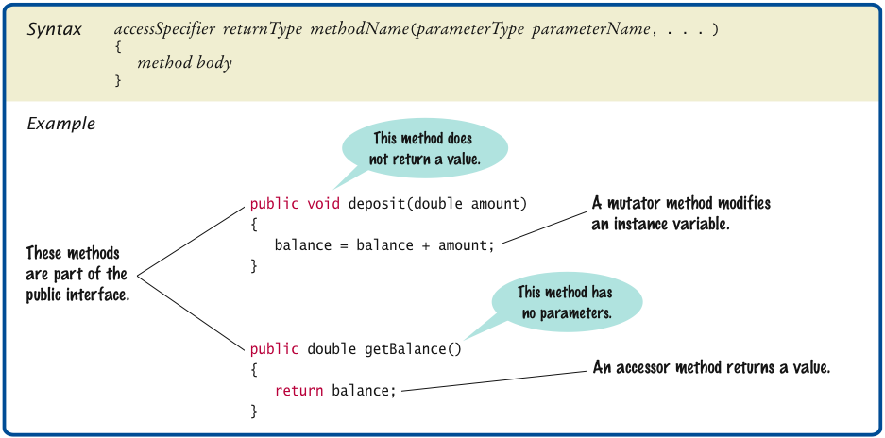
Syntax 3.3 Method Declaration
Big Java by Cay Horstmann
Copyright © 2009 by John Wiley & Sons. All rights reserved.

Slide 37
Implementing Methods
deposit method:
public void deposit(double amount)
{
balance = balance + amount;
}
Big Java by Cay Horstmann
Copyright © 2009 by John Wiley & Sons. All rights reserved.

Slide 38
Method Call Example
Statement:
harrysChecking.deposit(500);
Set the parameter variable amount to 500
Fetch the balance variable of the object whose location is stored in harrysChecking
Add the value of amount to balance
Store the sum in the balance instance variable, overwriting the old value
Big Java by Cay Horstmann
Copyright © 2009 by John Wiley & Sons. All rights reserved.

Slide 39
Implementing Methods
public void withdraw(double amount)
{
balance = balance - amount;
}
public double getBalance()
{
return balance;
}
Big Java by Cay Horstmann
Copyright © 2009 by John Wiley & Sons. All rights reserved.

Slide 40
ch03/account/BankAccount.java
1 /**
2 A bank account has a balance that can be changed by
3 deposits and withdrawals.
4 */
5 public class BankAccount
6 {
7 private double balance;
8
9 /**
10 Constructs a bank account with a zero balance.
11 */
12 public BankAccount()
13 {
14 balance = 0;
15 }
16
17 /**
18 Constructs a bank account with a given balance.
19 @param initialBalance the initial balance
20 */
21 public BankAccount(double initialBalance)
22 {
23 balance = initialBalance;
24 }
Continued
Big Java by Cay Horstmann
Copyright © 2009 by John Wiley & Sons. All rights reserved.

Slide 41
ch03/account/BankAccount.java (cont.)
25
26 /**
27 Deposits money into the bank account.
28 @param amount the amount to deposit
29 */
30 public void deposit(double amount)
31 {
32 balance = balance + amount;
33 }
34
35 /**
36 Withdraws money from the bank account.
37 @param amount the amount to withdraw
38 */
39 public void withdraw(double amount)
40 {
41 balance = balance - amount;
42 }
43
Continued
Big Java by Cay Horstmann
Copyright © 2009 by John Wiley & Sons. All rights reserved.

Slide 42
ch03/account/BankAccount.java (cont.)
44 /**
45 Gets the current balance of the bank account.
46 @return the current balance
47 */
48 public double getBalance()
49 {
50 return balance;
51 }
52 }
Big Java by Cay Horstmann
Copyright © 2009 by John Wiley & Sons. All rights reserved.

Slide 43
Self Check 3.12
Suppose we modify the BankAccount class so that each bank account has an account number. How does this change affect the instance variables?
Answer:
An instance variable
private int accountNumber;
needs to be added to the class.
Big Java by Cay Horstmann
Copyright © 2009 by John Wiley & Sons. All rights reserved.

Slide 44
Self Check 3.13
Why does the following code not succeed in robbing mom’s bank account?
public class BankRobber
{
public static void main(String[] args)
{
BankAccount momsSavings = new BankAccount(1000);
momsSavings.balance = 0;
}
}
Answer: Because the balance instance variable is accessed from the main method of BankRobber. The compiler will report an error because balance has private access in BankAccount.
Big Java by Cay Horstmann
Copyright © 2009 by John Wiley & Sons. All rights reserved.

Slide 45
Self Check 3.14
The Rectangle class has four instance variables: x, y, width, and height. Give a possible implementation of the getWidth method.
Answer:
public int getWidth()
{
return width;
}
Big Java by Cay Horstmann
Copyright © 2009 by John Wiley & Sons. All rights reserved.

Slide 46
Self Check 3.15
Give a possible implementation of the translate method of the Rectangle class.
Answer: There is more than one correct answer. One possible implementation is as follows:
public void translate(int dx, int dy)
{
int newx = x + dx;
x = newx;
int newy = y + dy;
y = newy;
}
Big Java by Cay Horstmann
Copyright © 2009 by John Wiley & Sons. All rights reserved.

Slide 47
Unit Testing
Unit test: Verifies that a class works correctly in isolation, outside a complete program
To test a class, use an environment for interactive testing, or write a tester class
Tester class: A class with a main method that contains statements to test another class
Typically carries out the following steps:
Construct one or more objects of the class that is being tested
Invoke one or more methods
Print out one or more results
Print the expected results
Continued
Big Java by Cay Horstmann
Copyright © 2009 by John Wiley & Sons. All rights reserved.

Slide 48
ch03/account/BankAccountTester.java
1 /**
2 A class to test the BankAccount class.
3 */
4 public class BankAccountTester
5 {
6 /**
7 Tests the methods of the BankAccount class.
8 @param args not used
9 */
10 public static void main(String[] args)
11 {
12 BankAccount harrysChecking = new BankAccount();
13 harrysChecking.deposit(2000);
14 harrysChecking.withdraw(500);
15 System.out.println(harrysChecking.getBalance());
16 System.out.println("Expected: 1500");
17 }
18 }
Program Run:
1500
Expected: 1500
Big Java by Cay Horstmann
Copyright © 2009 by John Wiley & Sons. All rights reserved.

Slide 49
Unit Testing (cont.)
Details for building the program vary. In most environments, you need to carry out these steps:
Make a new subfolder for your program
Make two files, one for each class
Compile both files
Run the test program
Big Java by Cay Horstmann
Copyright © 2009 by John Wiley & Sons. All rights reserved.

Slide 50
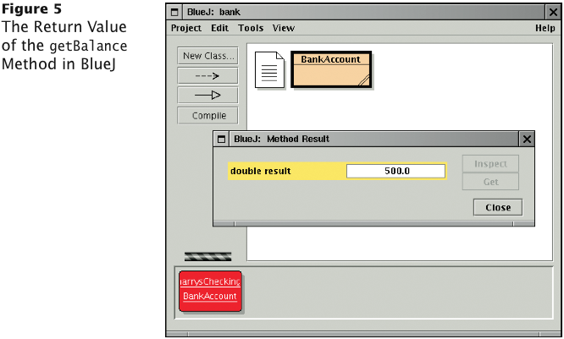
Testing With BlueJ
Big Java by Cay Horstmann
Copyright © 2009 by John Wiley & Sons. All rights reserved.

Slide 51
Self Check 3.16
When you run the BankAccountTester program, how many objects of class BankAccount are constructed? How many objects of type BankAccountTester?
Answer: One BankAccount object, no BankAccountTester object. The purpose of the BankAccountTester class is merely to hold the main method.
Big Java by Cay Horstmann
Copyright © 2009 by John Wiley & Sons. All rights reserved.

Slide 52
Self Check 3.17
Why is the BankAccountTester class unnecessary in development environments that allow interactive testing, such as BlueJ?
Answer: In those environments, you can issue interactive commands to construct BankAccount objects, invoke methods, and display their return values.
Big Java by Cay Horstmann
Copyright © 2009 by John Wiley & Sons. All rights reserved.

Slide 53
Local Variables
Local and parameter variables belong to a method
When a method or constructor runs, its local and parameter variables come to life
When the method or constructor exits, they are removed immediately
Instance variables belongs to an objects, not methods
When an object is constructed, its instance variables are created
The instance variables stay alive until no method uses the object any longer
Big Java by Cay Horstmann
Copyright © 2009 by John Wiley & Sons. All rights reserved.

Slide 54
Local Variables
In Java, the garbage collector periodically reclaims objects when they are no longer used
Instance variables are initialized to a default value, but you must initialize local variables
Big Java by Cay Horstmann
Copyright © 2009 by John Wiley & Sons. All rights reserved.

Slide 55
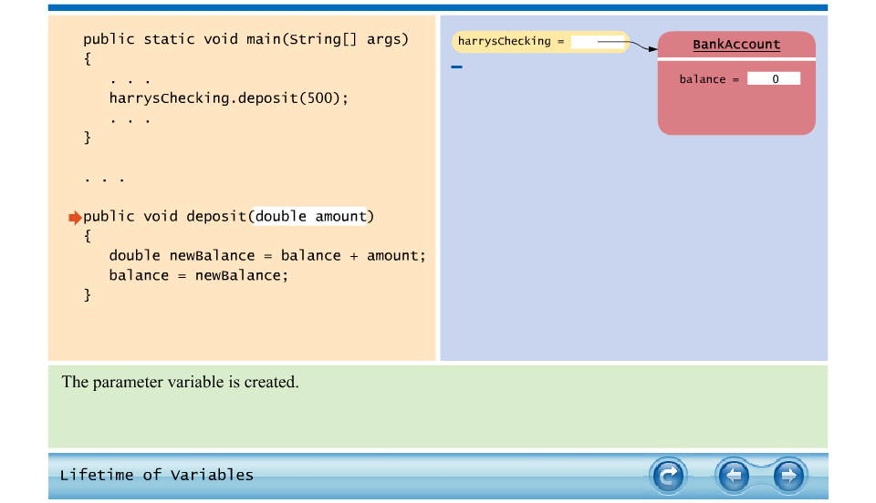
Animation 3.1: Lifetime of Variables
Big Java by Cay Horstmann
Copyright © 2009 by John Wiley & Sons. All rights reserved.

Slide 56
Self Check 3.18
What do local variables and parameter variables have in common? In which essential aspect do they differ?
Answer: Variables of both categories belong to methods – they come alive when the method is called, and they die when the method exits. They differ in their initialization. Parameter variables are initialized with the call values; local variables must be explicitly initialized.
Big Java by Cay Horstmann
Copyright © 2009 by John Wiley & Sons. All rights reserved.

Slide 57
Self Check 3.19
Why was it necessary to introduce the local variable change in the giveChange method? That is, why didn’t the method simply end with the statement
return payment - purchase;
Answer: After computing the change due, payment and purchase were set to zero. If the method returned payment - purchase, it would always return zero.
Big Java by Cay Horstmann
Copyright © 2009 by John Wiley & Sons. All rights reserved.

Slide 58
Implicit Parameter
The implicit parameter of a method is the object on which the method is invoked
public void deposit(double amount)
{
balance = balance + amount;
}
In the call
momsSavings.deposit(500)
The implicit parameter is momsSavings and the explicit parameter is 500
When you refer to an instance variable inside a method, it means the instance variable of the implicit parameter
Big Java by Cay Horstmann
Copyright © 2009 by John Wiley & Sons. All rights reserved.

Slide 59
Implicit Parameters and this
The this reference denotes the implicit parameter
balance = balance + amount;
actually means
this.balance = this.balance + amount;
When you refer to an instance variable in a method, the compiler automatically applies it to the this reference
Big Java by Cay Horstmann
Copyright © 2009 by John Wiley & Sons. All rights reserved.

Slide 60
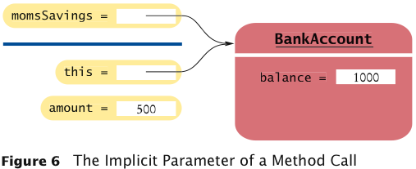
Implicit Parameters and this
Big Java by Cay Horstmann
Copyright © 2009 by John Wiley & Sons. All rights reserved.

Slide 61
Implicit Parameters and this
Some programmers feel that manually inserting the this reference before every instance variable reference makes the code clearer:
public BankAccount(double initialBalance)
{
this.balance = initialBalance;
}
Big Java by Cay Horstmann
Copyright © 2009 by John Wiley & Sons. All rights reserved.

Slide 62
Implicit Parameters and this
A method call without an implicit parameter is applied to the same object
Example:
public class BankAccount
{
. . .
public void monthlyFee()
{
withdraw(10); // Withdraw $10 from this account
}
}
The implicit parameter of the withdraw method is the (invisible) implicit parameter of the monthlyFee method
Big Java by Cay Horstmann
Copyright © 2009 by John Wiley & Sons. All rights reserved.

Slide 63
Implicit Parameters and this
You can use the this reference to make the method easier to read:
public class BankAccount
{
. . .
public void monthlyFee()
{
this.withdraw(10); // Withdraw $10 from this account
}
}
Big Java by Cay Horstmann
Copyright © 2009 by John Wiley & Sons. All rights reserved.

Slide 64
Self Check 3.20
How many implicit and explicit parameters does the withdraw method of the BankAccount class have, and what are their names and types?
Answer: One implicit parameter, called this, of type BankAccount, and one explicit parameter, called amount, of type double.
Big Java by Cay Horstmann
Copyright © 2009 by John Wiley & Sons. All rights reserved.

Slide 65
Self Check 3.21
In the deposit method, what is the meaning of this.amount? Or, if the expression has no meaning, why not?
Answer: It is not a legal expression. this is of type BankAccount and the BankAccount class has no variable named amount. s
Big Java by Cay Horstmann
Copyright © 2009 by John Wiley & Sons. All rights reserved.

Slide 66
Self Check 3.22
How many implicit and explicit parameters does the main method of the BankAccountTester class have, and what are they called?
Answer: No implicit parameter – the main method is not ivoked on any object – and one explicit parameter, called args.
Big Java by Cay Horstmann
Copyright © 2009 by John Wiley & Sons. All rights reserved.

Slide 67
Shape Classes
Good practice: Make a class for each graphical shape
public class Car
{
public Car(int x, int y)
{
// Remember position
. . .
}
public void draw(Graphics2D g2)
{
// Drawing instructions
. . .
}
}
Big Java by Cay Horstmann
Copyright © 2009 by John Wiley & Sons. All rights reserved.

Slide 68
Drawing Cars
Draw two cars: one in top-left corner of window, and another in the bottom right
Compute bottom right position, inside paintComponent method:
int x = getWidth() - 60; int y = getHeight() - 30;
Car car2 = new Car(x, y);
getWidth and getHeight are applied to object that executes paintComponent
If window is resized paintComponent is called and car position recomputed
Continued
Big Java by Cay Horstmann
Copyright © 2009 by John Wiley & Sons. All rights reserved.

Slide 69
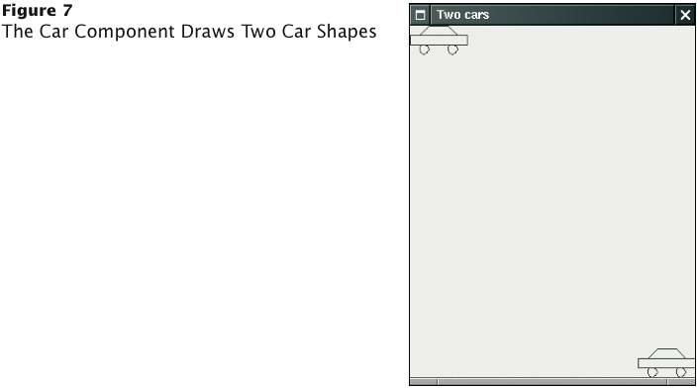
Drawing Cars (cont.)
Big Java by Cay Horstmann
Copyright © 2009 by John Wiley & Sons. All rights reserved.

Slide 70
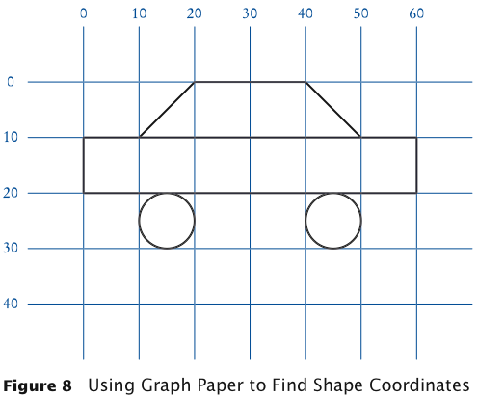
Plan Complex Shapes on Graph Paper
Big Java by Cay Horstmann
Copyright © 2009 by John Wiley & Sons. All rights reserved.

Slide 71
Classes of Car Drawing Program
Car: responsible for drawing a single car
Two objects of this class are constructed, one for each car
CarComponent: displays the drawing
CarViewer: shows a frame that contains a CarComponent
Big Java by Cay Horstmann
Copyright © 2009 by John Wiley & Sons. All rights reserved.

Slide 72
ch03/car/Car.java
1 import java.awt.Graphics2D;
2 import java.awt.Rectangle;
3 import java.awt.geom.Ellipse2D;
4 import java.awt.geom.Line2D;
5 import java.awt.geom.Point2D;
6
7 /**
8 A car shape that can be positioned anywhere on the screen.
9 */
10 public class Car
11 {
12 private int xLeft;
13 private int yTop;
14
15 /**
16 Constructs a car with a given top left corner.
17 @param x the x coordinate of the top left corner
18 @param y the y coordinate of the top left corner
19 */
20 public Car(int x, int y)
21 {
22 xLeft = x;
23 yTop = y;
24 }
Continued
Big Java by Cay Horstmann
Copyright © 2009 by John Wiley & Sons. All rights reserved.

Slide 73
ch03/car/Car.java (cont.)
25
26 /**
27 Draws the car.
28 @param g2 the graphics context
29 */
30 public void draw(Graphics2D g2)
31 {
32 Rectangle body
33 = new Rectangle(xLeft, yTop + 10, 60, 10);
34 Ellipse2D.Double frontTire
35 = new Ellipse2D.Double(xLeft + 10, yTop + 20, 10, 10);
36 Ellipse2D.Double rearTire
37 = new Ellipse2D.Double(xLeft + 40, yTop + 20, 10, 10);
38
39 // The bottom of the front windshield
40 Point2D.Double r1
41 = new Point2D.Double(xLeft + 10, yTop + 10);
42 // The front of the roof
43 Point2D.Double r2
44 = new Point2D.Double(xLeft + 20, yTop);
45 // The rear of the roof
46 Point2D.Double r3
47 = new Point2D.Double(xLeft + 40, yTop);
Continued
Big Java by Cay Horstmann
Copyright © 2009 by John Wiley & Sons. All rights reserved.

Slide 74
ch03/car/Car.java (cont.)
48 // The bottom of the rear windshield
49 Point2D.Double r4
50 = new Point2D.Double(xLeft + 50, yTop + 10);
51
52 Line2D.Double frontWindshield
53 = new Line2D.Double(r1, r2);
54 Line2D.Double roofTop
55 = new Line2D.Double(r2, r3);
56 Line2D.Double rearWindshield
57 = new Line2D.Double(r3, r4);
58
59 g2.draw(body);
60 g2.draw(frontTire);
61 g2.draw(rearTire);
62 g2.draw(frontWindshield);
63 g2.draw(roofTop);
64 g2.draw(rearWindshield);
65 }
66 }
Big Java by Cay Horstmann
Copyright © 2009 by John Wiley & Sons. All rights reserved.

Slide 75
ch03/car/CarComponent.java
1 import java.awt.Graphics;
2 import java.awt.Graphics2D;
3 import javax.swing.JComponent;
4
5 /**
6 This component draws two car shapes.
7 */
8 public class CarComponent extends JComponent
9 {
10 public void paintComponent(Graphics g)
11 {
12 Graphics2D g2 = (Graphics2D) g;
13
14 Car car1 = new Car(0, 0);
15
16 int x = getWidth() - 60;
17 int y = getHeight() - 30;
18
19 Car car2 = new Car(x, y);
20
21 car1.draw(g2);
22 car2.draw(g2);
23 }
24 }
Big Java by Cay Horstmann
Copyright © 2009 by John Wiley & Sons. All rights reserved.

Slide 76
ch03/car/CarViewer.java
1 import javax.swing.JFrame;
2
3 public class CarViewer
4 {
5 public static void main(String[] args)
6 {
7 JFrame frame = new JFrame();
8
9 frame.setSize(300, 400);
10 frame.setTitle("Two cars");
11 frame.setDefaultCloseOperation(JFrame.EXIT_ON_CLOSE);
12
13 CarComponent component = new CarComponent();
14 frame.add(component);
15
16 frame.setVisible(true);
17 }
18 }
Big Java by Cay Horstmann
Copyright © 2009 by John Wiley & Sons. All rights reserved.

Slide 77
Self Check 3.23
Which class needs to be modified to have the two cars positioned next to each other?
Answer: CarComponent
Big Java by Cay Horstmann
Copyright © 2009 by John Wiley & Sons. All rights reserved.

Slide 78
Self Check 3.24
Which class needs to be modified to have the car tires painted in black, and what modification do you need to make?
Answer: In the draw method of the Car class, call
g2.fill(frontTire);
g2.fill(rearTire);
Big Java by Cay Horstmann
Copyright © 2009 by John Wiley & Sons. All rights reserved.

Slide 79
Self Check 3.25
How do you make the cars twice as big?
Answer: Double all measurements in the draw method of the Car class.
Big Java by Cay Horstmann
Copyright © 2009 by John Wiley & Sons. All rights reserved.

Slide 80

Drawing Graphical Shapes
Rectangle leftRectangle = new Rectangle(100, 100, 30, 60);
Rectangle rightRectangle = new Rectangle(160, 100, 30, 60);
Line2D.Double topLine = new Line2D.Double(130, 100, 160, 100);
Line2D.Double bottomLine = new Line2D.Double(130, 160, 160, 160);
Big Java by Cay Horstmann
Copyright © 2009 by John Wiley & Sons. All rights reserved.

