Slide 1

Chapter 2 – Using Objects
Big Java by Cay Horstmann
Copyright © 2009 by John Wiley & Sons. All rights reserved.

Slide 2
Chapter Goals
To learn about variables
To understand the concepts of classes and objects
To be able to call methods
To learn about parameters and return values
To be able to browse the API documentation
T To implement test programs
To understand the difference between objects and object references
G To write programs that display simple shapes
Big Java by Cay Horstmann
Copyright © 2009 by John Wiley & Sons. All rights reserved.

Slide 3
Types
A type defines a set of values and the operations that can be carried out on the values
Examples:
  13 has type int
  "Hello, World" has type String
  System.out has type PrintStream
Java has separate types for integers and floating-point numbers
  The double type denotes floating-point numbers
A value such as 13 or 1.3 that occurs in a Java program is called a number literal
Big Java by Cay Horstmann
Copyright © 2009 by John Wiley & Sons. All rights reserved.

Slide 4
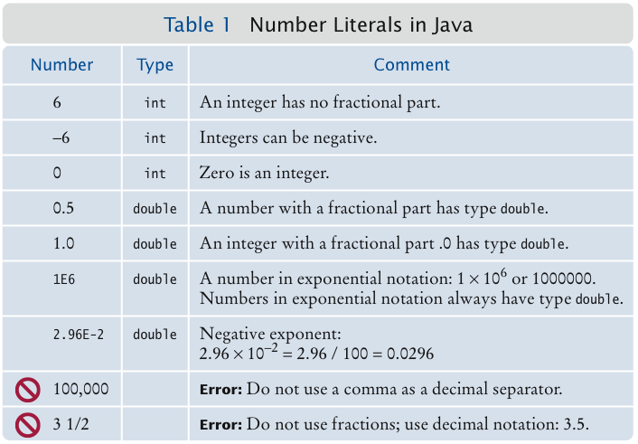
Number Literals
Big Java by Cay Horstmann
Copyright © 2009 by John Wiley & Sons. All rights reserved.
Notes:
*

Slide 5
Number Types
A type defines a set of values and the operations that can be carried out on the values
Number types are primitive types
  Numbers are not objects
Numbers can be combined by arithmetic operators such as +, -, and *
Big Java by Cay Horstmann
Copyright © 2009 by John Wiley & Sons. All rights reserved.

Slide 6
Self Check 2.1
What is the type of the values 0 and "0"?
  Answer: int and String.

Slide 7
Self Check 2.2
Which number type would you use for storing the area of a circle?
  Answer: double.

Slide 8
Self Check 2.3
Why is the expression 13.println() an error?
  Answer: An int is not an object, and you cannot call a method on it.

Slide 9
Self Check 2.4
Write an expression to compute the average of the values x and y.
  Answer: (x + y) * 0.5

Slide 10
Variables
Use a variable to store a value that you want to use at a later time
A variable has a type, a name, and a value:
  String greeting = "Hello, World!”
  PrintStream printer = System.out;
  int width = 13;
Variables can be used in place of the values that they store:
  printer.println(greeting);
  // Same as System.out.println("Hello, World!”)
  printer.println(width);
  // Same asSystem.out.println(20)
Big Java by Cay Horstmann
Copyright © 2009 by John Wiley & Sons. All rights reserved.

Slide 11
Variables
It is an error to store a value whose type does not match the type of the variable:
  String greeting = 20; // ERROR: Types don’t match
Big Java by Cay Horstmann
Copyright © 2009 by John Wiley & Sons. All rights reserved.

Slide 12
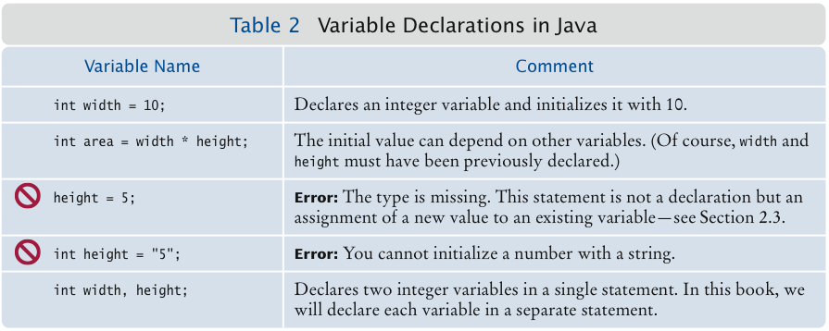
Variable Declarations
Big Java by Cay Horstmann
Copyright © 2009 by John Wiley & Sons. All rights reserved.

Slide 13
Identifiers
Identifier: name of a variable, method, or class
Rules for identifiers in Java:
  Can be made up of letters, digits, and the underscore (_) and dollar sign ($) characters
  Cannot start with a digit
  Cannot use other symbols such as ? or %
  Spaces are not permitted inside identifiers
  You cannot use reserved words such as public
  They are case sensitive
Big Java by Cay Horstmann
Copyright © 2009 by John Wiley & Sons. All rights reserved.

Slide 14
Identifiers
By convention, variable names start with a lowercase letter
  “Camel case”: Capitalize the first letter of a word in a compound word such as farewellMessage
By convention, class names start with an uppercase letter
Do not use the $ symbol in names — it is intended for names that are automatically generated by tools
Big Java by Cay Horstmann
Copyright © 2009 by John Wiley & Sons. All rights reserved.

Slide 15
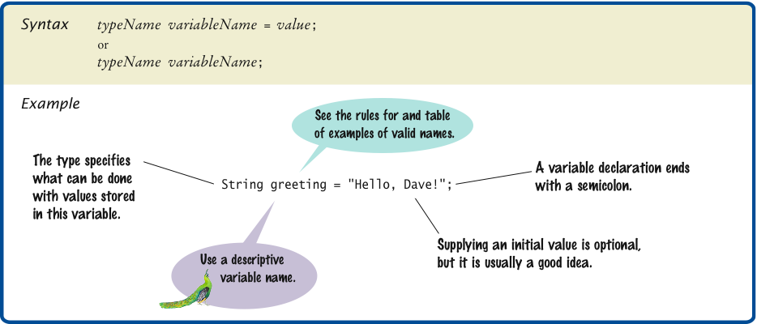
Syntax 2.1 Variable Declaration
Big Java by Cay Horstmann
Copyright © 2009 by John Wiley & Sons. All rights reserved.

Slide 16
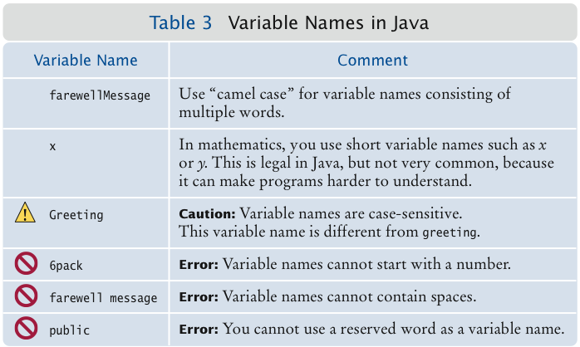
Variable Names
Big Java by Cay Horstmann
Copyright © 2009 by John Wiley & Sons. All rights reserved.

Slide 17
Self Check 2.5
Which of the following are legal identifiers?
Greeting1
g
void
101dalmatians
Hello, World
<greeting>
  Answer: Only the first two are legal identifiers.

Slide 18
Self Check 2.6
Define a variable to hold your name. Use camel case in the variable name.
  Answer:
  String myName = "John Q. Public";

Slide 19
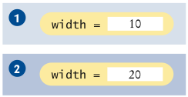

The Assignment Operator
Assignment operator: =
Used to change the value of a variable:
  int width= 10;
  width = 20;
Big Java by Cay Horstmann
Copyright © 2009 by John Wiley & Sons. All rights reserved.

Slide 20

Uninitialized Variables
It is an error to use a variable that has never had a value assigned to it:
  int height;
  width = height; // ERROR—uninitialized variable height
Remedy: assign a value to the variable before you use it:
  int height = 30;
  width = height; // OK
Even better, initialize the variable when you declare it:
  int height = 30;
  int width = height; // OK
Big Java by Cay Horstmann
Copyright © 2009 by John Wiley & Sons. All rights reserved.

Slide 21
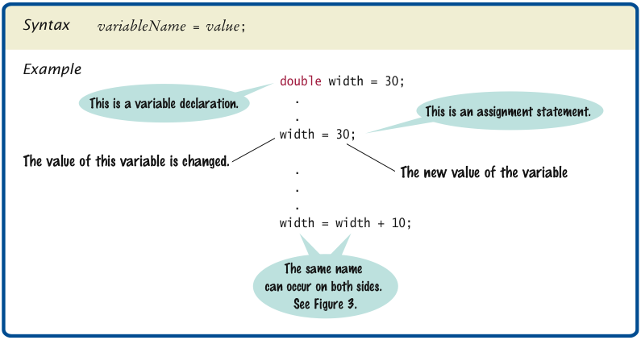
Syntax 2.2 Assignment
Big Java by Cay Horstmann
Copyright © 2009 by John Wiley & Sons. All rights reserved.

Slide 22
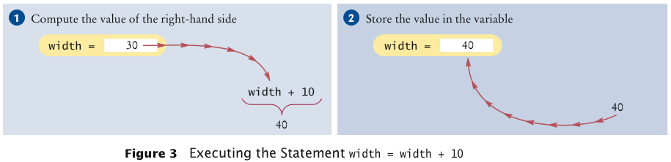
Assignment
The right-hand side of the = symbol can be a mathematical expression:
  width = height + 10;
Means:
  compute the value of width + 10
  store that value in the variable width
Big Java by Cay Horstmann
Copyright © 2009 by John Wiley & Sons. All rights reserved.

Slide 23
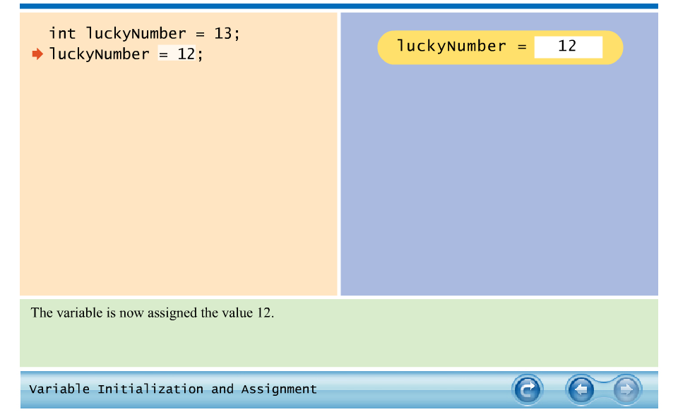
Animation 2.1: Variable Initialization and Assignment
Big Java by Cay Horstmann
Copyright © 2009 by John Wiley & Sons. All rights reserved.

Slide 24
Self Check 2.7
Is 12 = 12 a valid expression in the Java language?
Answer: No, the left-hand side of the = operator must be a variable.

Slide 25
Self Check 2.8
How do you change the value of the greeting variable to
"Hello, Nina!"?
Answer:
greeting = "Hello, Nina!";
Note that
String greeting = "Hello, Nina!";
is not the right answer – that statement defines a new variable.

Slide 26
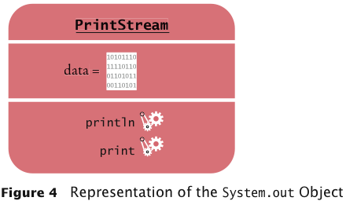
Objects and Classes
Object: entity that you can manipulate in your programs (by calling methods)
Each object belongs to a class
Example: System.out belongs to the class PrintStream
Big Java by Cay Horstmann
Copyright © 2009 by John Wiley & Sons. All rights reserved.

Slide 27
Methods
Method: sequence of instructions that accesses the data of an object
You manipulate objects by calling its methods
Class: declares the methods that you can apply to its objects
Class determines legal methods:
String greeting = "Hello";
greeting.println() // Error
greeting.length() // OK
Public Interface: specifies what you can do with the objects of a class
Big Java by Cay Horstmann
Copyright © 2009 by John Wiley & Sons. All rights reserved.

Slide 28
Overloaded Method
Overloaded method: when a class declares two methods with the same name, but different parameters
  Example: the PrintStream class declares a second method, also called println, as
    public void println(int output)
Big Java by Cay Horstmann
Copyright © 2009 by John Wiley & Sons. All rights reserved.

Slide 29
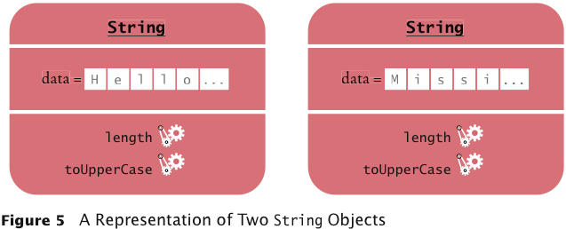
A Representation of Two String Objects
Big Java by Cay Horstmann
Copyright © 2009 by John Wiley & Sons. All rights reserved.

Slide 30
String Methods
length: counts the number of characters in a string:
String greeting = "Hello, World!";
int n = greeting.length(); // sets n to 13
toUpperCase: creates another String object that contains the characters of the original string, with lowercase letters converted to uppercase:
  String river = "Mississippi";
  String bigRiver = river.toUpperCase();
  // sets bigRiver to "MISSISSIPPI"
When applying a method to an object, make sure method is defined in the appropriate class:
System.out.length(); // This method call is an error
Big Java by Cay Horstmann
Copyright © 2009 by John Wiley & Sons. All rights reserved.

Slide 31
Self Check 2.9
How can you compute the length of the string "Mississippi"?
  Answer: river.length() or "Mississippi".length()

Slide 32
Self Check 2.10
How can you print out the uppercase version of
"Hello, World!"?
  Answer:
    System.out.println(greeting.toUpperCase());

Slide 33
Self Check 2.11
Is it legal to call river.println()? Why or why not?
  Answer: It is not legal. The variable river has type String. The println method is not a method of the String class.

Slide 34
Parameters
Parameter: an input to a method
Implicit parameter: the object on which a method is invoked:
  System.out.println(greeting)
Explicit parameters: all parameters except the implicit parameter:
  System.out.println(greeting)
Not all methods have explicit parameters:
  greeting.length() // has no explicit parameter
Big Java by Cay Horstmann
Copyright © 2009 by John Wiley & Sons. All rights reserved.

Slide 35
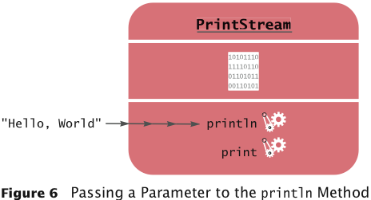
Passing a Parameter
Big Java by Cay Horstmann
Copyright © 2009 by John Wiley & Sons. All rights reserved.

Slide 36
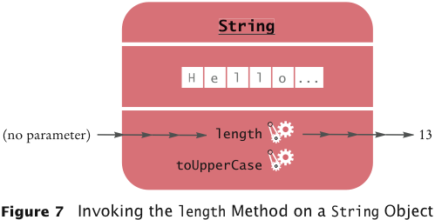
Return Values
Return value: a result that the method has computed for use by the code that called it:
  int n = greeting.length(); // return value stored in n
Big Java by Cay Horstmann
Copyright © 2009 by John Wiley & Sons. All rights reserved.

Slide 37
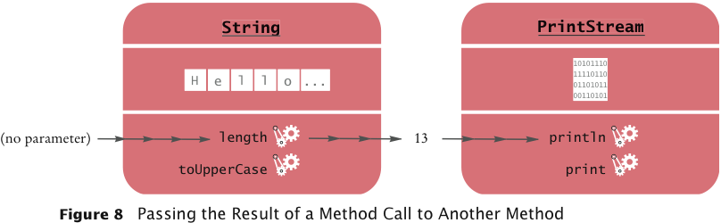
Passing Return Values
You can also use the return value as a parameter of another method:
  System.out.println(greeting.length());
Not all methods return values. Example: println
Big Java by Cay Horstmann
Copyright © 2009 by John Wiley & Sons. All rights reserved.

Slide 38
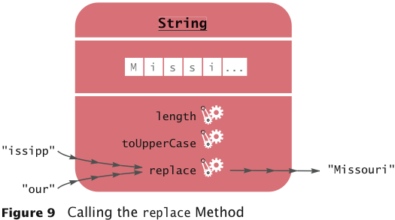
A More Complex Call
String method replace carries out a search-and-replace operation:
  river.replace("issipp", "our”)
  // constructs a new string ("Missouri")
This method call has
  one implicit parameter: the string "Mississippi"
  two explicit parameters: the strings "issipp" and "our"
  a return value: the string "Missouri"
Big Java by Cay Horstmann
Copyright © 2009 by John Wiley & Sons. All rights reserved.

Slide 39
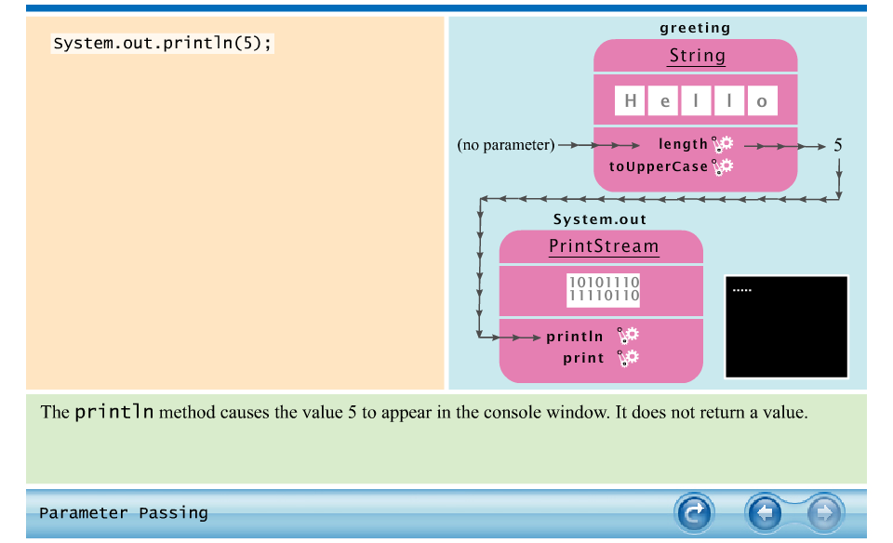
Animation 2.2: Parameter Passing
Big Java by Cay Horstmann
Copyright © 2009 by John Wiley & Sons. All rights reserved.

Slide 40
Self Check 2.12
What are the implicit parameters, explicit parameters, and return values in the method call river.length()?
  Answer: The implicit parameter is river. There is no explicit parameter. The return value is 11.

Slide 41
Self Check 2.13
What is the result of the call river.replace("p", "s")?
Answer: "Missississi".

Slide 42
Self Check 2.14
What is the result of the call
  greeting.replace("World", "Dave").length()?
  Answer: 12.

Slide 43
Self Check 2.15
How is the toUpperCase method defined in the String class?
  Answer: As public String toUpperCase(), with no explicit parameter and return type String.

Slide 44
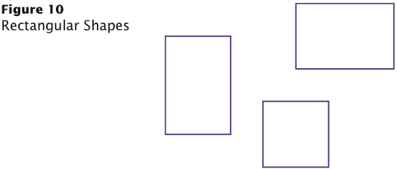
Rectangular Shapes and Rectangle Objects
Objects of type Rectangle describe rectangular shapes:
Big Java by Cay Horstmann
Copyright © 2009 by John Wiley & Sons. All rights reserved.

Slide 45
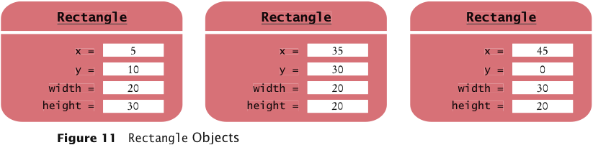
Rectangular Shapes and Rectangle Objects
A Rectangle object isn’t a rectangular shape – it is an object that contains a set of numbers that describe the rectangle:
Big Java by Cay Horstmann
Copyright © 2009 by John Wiley & Sons. All rights reserved.

Slide 46
Constructing Objects
new Rectangle(5, 10, 20, 30)
Detail:
  The new operator makes a Rectangle object
  It uses the parameters (in this case, 5, 10, 20, and 30) to initialize the data of the object
  It returns the object
Usually the output of the new operator is stored in a variable:
  Rectangle box = new Rectangle(5, 10, 20, 30);
Big Java by Cay Horstmann
Copyright © 2009 by John Wiley & Sons. All rights reserved.

Slide 47
Constructing Objects
Construction: the process of creating a new object
The four values 5, 10, 20, and 30 are called the construction parameters
Some classes let you construct objects in multiple ways:
  new Rectangle()
  // constructs a rectangle with its top-left corner
  // at the origin (0, 0), width 0, and height 0
Big Java by Cay Horstmann
Copyright © 2009 by John Wiley & Sons. All rights reserved.

Slide 48
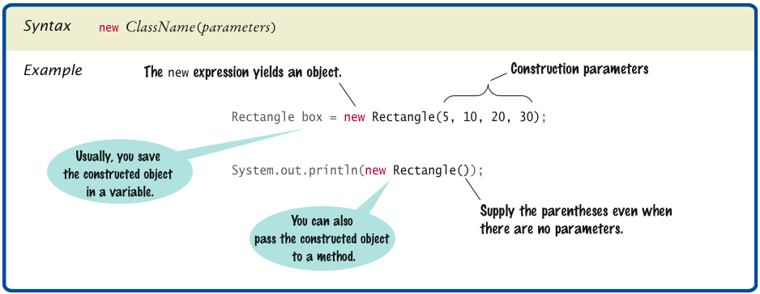
Syntax 2.3 Object Construction
Big Java by Cay Horstmann
Copyright © 2009 by John Wiley & Sons. All rights reserved.

Slide 49
Self Check 2.16
How do you construct a square with center (100, 100) and side length 20?
  Answer:
    new Rectangle(90, 90, 20, 20)

Slide 50
Self Check 2.17
The getWidth method returns the width of a Rectangle object. What does the following statement print?
System.out.println(new Rectangle().getWidth()); Answer:
    0

Slide 51
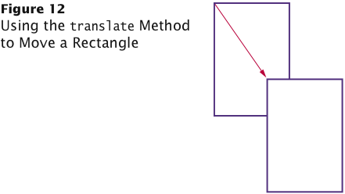
Accessor and Mutator Methods
Accessor method: does not change the state of its implicit parameter:
  double width = box.getWidth();
Mutator method: changes the state of its implicit parameter:
  box.translate(15, 25);
Big Java by Cay Horstmann
Copyright © 2009 by John Wiley & Sons. All rights reserved.

Slide 52
Self Check 2.18
Is the toUpperCase method of the String class an accessor or a mutator?
  Answer: An accessor – it doesn’t modify the original string but returns a new string with uppercase letters.

Slide 53
Self Check 2.19
Which call to translate is needed to move the box rectangle so that its top-left corner is the origin (0, 0)?
  Answer: box.translate(-5, -10), provided the method is called immediately after storing the new rectangle into box.

Slide 54
The API Documentation
API: Application Programming Interface
API documentation: lists classes and methods in the Java library
http://java.sun.com/javase/7/docs/api/index.html
Big Java by Cay Horstmann
Copyright © 2009 by John Wiley & Sons. All rights reserved.

Slide 55
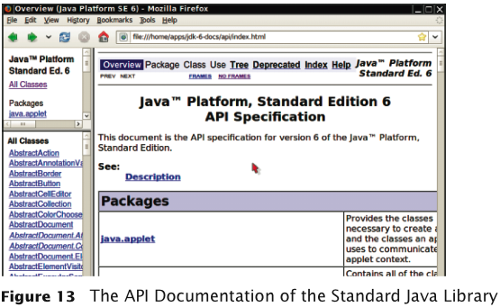
The API Documentation of the Standard Java Library
Big Java by Cay Horstmann
Copyright © 2009 by John Wiley & Sons. All rights reserved.

Slide 56
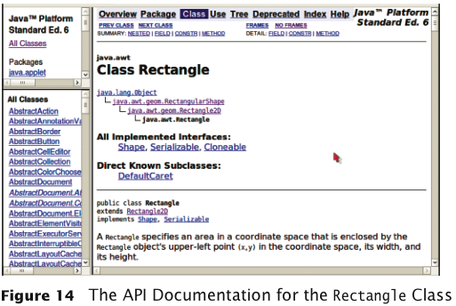
The API Documentation for the Rectangle Class
Big Java by Cay Horstmann
Copyright © 2009 by John Wiley & Sons. All rights reserved.

Slide 57
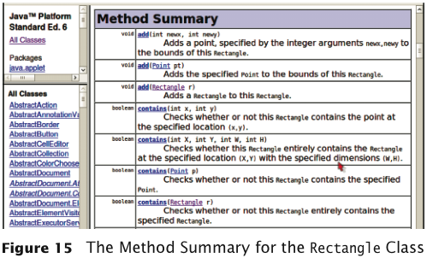
Method Summary
Big Java by Cay Horstmann
Copyright © 2009 by John Wiley & Sons. All rights reserved.

Slide 58
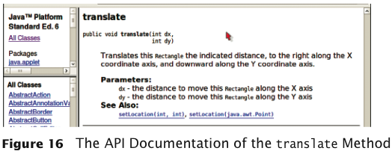
Detailed Method Description
The detailed description of a method shows:
The action that the method carries out
The parameters that the method receives
The value that it returns (or the reserved word void if the method doesn’t return any value)
Big Java by Cay Horstmann
Copyright © 2009 by John Wiley & Sons. All rights reserved.

Slide 59
Packages
Package: a collection of classes with a related purpose
Import library classes by specifying the package and class name:
  import java.awt.Rectangle;
You don’t need to import classes in the java.lang package such as String and System
Big Java by Cay Horstmann
Copyright © 2009 by John Wiley & Sons. All rights reserved.

Slide 60
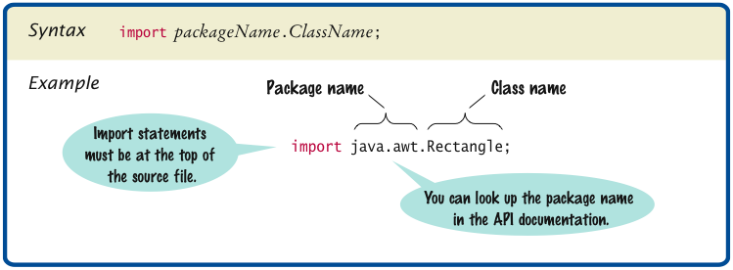
Syntax 2.4 Importing a Class from a Package
Big Java by Cay Horstmann
Copyright © 2009 by John Wiley & Sons. All rights reserved.

Slide 61
Self Check 2.20
Look at the API documentation of the String class. Which method would you use to obtain the string "hello, world!" from the string "Hello, World!"?
  Answer: toLowerCase

Slide 62
Self Check 2.21
In the API documentation of the String class, look at the description of the trim method. What is the result of applying trim to the string " Hello, Space ! "? (Note the spaces in the string.)
  Answer: "Hello, Space !" – only the leading and trailing spaces are trimmed.

Slide 63
Self Check 2.22
The Random class is defined in the java.util package. What do you need to do in order to use that class in your program?
  Answer: Add the statement
    import java.util.Random;
  at the top of your program.

Slide 64
Implementing a Test Program
Provide a tester class.
Supply a main method.
Inside the main method, construct one or more objects.
Apply methods to the objects.
Display the results of the method calls.
Display the values that you expect to get.
Big Java by Cay Horstmann
Copyright © 2009 by John Wiley & Sons. All rights reserved.

Slide 65
ch02/rectangle/MoveTester.java
1 import java.awt.Rectangle;
2
3 public class MoveTester
4 {
5 public static void main(String[] args)
6 {
7 Rectangle box = new Rectangle(5, 10, 20, 30);
8
9 // Move the rectangle
10 box.translate(15, 25);
11
12 // Print information about the moved rectangle
13 System.out.print("x: ");
14 System.out.println(box.getX());
15 System.out.println("Expected: 20");
16
17 System.out.print("y: ");
18 System.out.println(box.getY());
19 System.out.println("Expected: 35");
20 }
21 }
Big Java by Cay Horstmann
Copyright © 2009 by John Wiley & Sons. All rights reserved.

Slide 66
ch02/rectangle/MoveTester.java (cont.)
Program Run:
  x: 20
  Expected: 20
  y: 35
  Expected: 35
Big Java by Cay Horstmann
Copyright © 2009 by John Wiley & Sons. All rights reserved.

Slide 67
Self Check 2.23
Suppose we had called box.translate(25, 15) instead of box.translate(15, 25). What are the expected outputs?
  Answer:
    x: 30, y: 25

Slide 68
Self Check 2.24
Why doesn’t the MoveTester program print the width and height of the rectangle?
  Answer: Because the translate method doesn’t modify the shape of the rectangle.

Slide 69
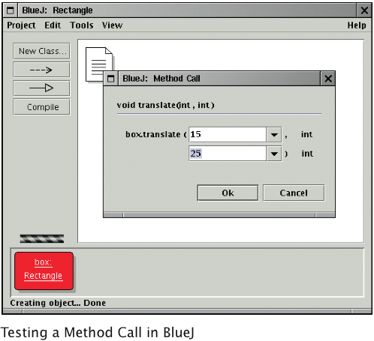
Testing Classes in an Interactive Environment
Big Java by Cay Horstmann
Copyright © 2009 by John Wiley & Sons. All rights reserved.

Slide 70
Object References
Object reference: describes the location of an object
The new operator returns a reference to a new object:
Rectangle box = new Rectangle();
Multiple object variables can refer to the same object:
Rectangle box = new Rectangle(5, 10, 20, 30);
Rectangle box2 = box;
box2.translate(15, 25);
Primitive type variables ≠ object variables
Big Java by Cay Horstmann
Copyright © 2009 by John Wiley & Sons. All rights reserved.

Slide 71
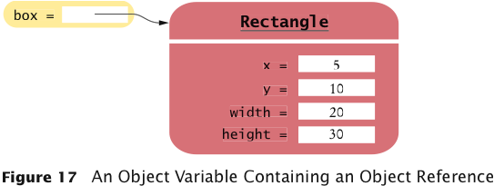
Object Variables and Number Variables
Big Java by Cay Horstmann
Copyright © 2009 by John Wiley & Sons. All rights reserved.

Slide 72
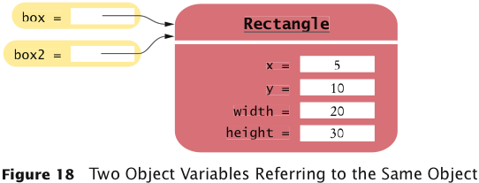

Object Variables and Number Variables
Big Java by Cay Horstmann
Copyright © 2009 by John Wiley & Sons. All rights reserved.

Slide 73

Copying Numbers
int luckyNumber = 13;
Big Java by Cay Horstmann
Copyright © 2009 by John Wiley & Sons. All rights reserved.

Slide 74
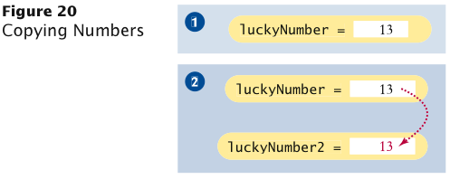
Copying Numbers (cont.)
int luckyNumber = 13;
int luckyNumber2 = luckyNumber;
Big Java by Cay Horstmann
Copyright © 2009 by John Wiley & Sons. All rights reserved.

Slide 75
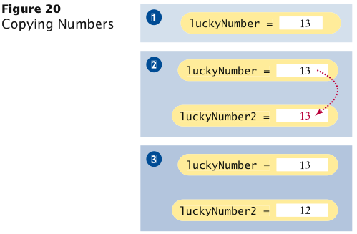
Copying Numbers (cont.)
int luckyNumber = 13;
int luckyNumber2 = luckyNumber;
luckyNumber2 = 12;
Big Java by Cay Horstmann
Copyright © 2009 by John Wiley & Sons. All rights reserved.

Slide 76
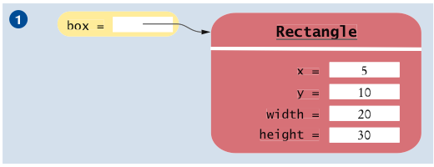
Copying Object References
Rectangle box = new Rectangle(5, 10, 20, 30);
Big Java by Cay Horstmann
Copyright © 2009 by John Wiley & Sons. All rights reserved.

Slide 77
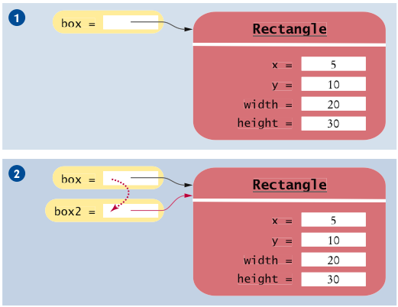
Copying Object References (cont.)
Rectangle box = new Rectangle(5, 10, 20, 30);
Rectangle box2 = box;
Big Java by Cay Horstmann
Copyright © 2009 by John Wiley & Sons. All rights reserved.

Slide 78
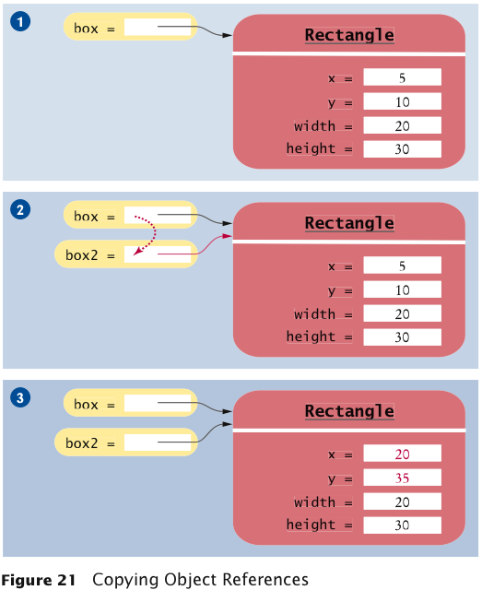
Copying Object References (cont.)
Rectangle box = new Rectangle(5, 10, 20, 30);
Rectangle box2 = box;
Box2.translate(15, 25);
Big Java by Cay Horstmann
Copyright © 2009 by John Wiley & Sons. All rights reserved.

Slide 79
Self Check 2.25
What is the effect of the assignment greeting2 = greeting?
  Answer: Now greeting and greeting2 both refer to the same String object.

Slide 80
Self Check 2.26
After calling greeting2.toUpperCase(), what are the contents of greeting and greeting2?
  Answer: Both variables still refer to the same string, and the string has not been modified. Recall that the toUpperCase method constructs a new string that contains uppercase characters, leaving the original string unchanged.

Slide 81

Mainframes – When Dinosaurs Ruled the Earth
Big Java by Cay Horstmann
Copyright © 2009 by John Wiley & Sons. All rights reserved.

Slide 82
Graphical Applications and Frame Windows
To show a frame:
Construct an object of the JFrame class:
  JFrame frame = new JFrame();
2. Set the size of the frame:
  frame.setSize(300, 400);
If you’d like, set the title of the frame:
  frame.setTitle("An Empty Frame");
4. Set the “default close operation”:
  frame.setDefaultCloseOperation(JFrame.EXIT_ON_CLOSE);
5. Make the frame visible:
  frame.setVisible(true);
Big Java by Cay Horstmann
Copyright © 2009 by John Wiley & Sons. All rights reserved.

Slide 83
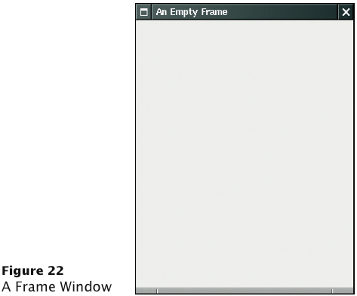
A Frame Window
Big Java by Cay Horstmann
Copyright © 2009 by John Wiley & Sons. All rights reserved.

Slide 84
ch02/emptyframe/EmptyFrameViewer.java
1 import javax.swing.JFrame;
2
3 public class EmptyFrameViewer
4 {
5 public static void main(String[] args)
6 {
7 JFrame frame = new JFrame();
8
9 frame.setSize(300, 400);
10 frame.setTitle("An Empty Frame");
11 frame.setDefaultCloseOperation(JFrame.EXIT_ON_CLOSE);
12
13 frame.setVisible(true);
14 }
15 }
Big Java by Cay Horstmann
Copyright © 2009 by John Wiley & Sons. All rights reserved.

Slide 85
Self Check 2.27
How do you display a square frame with a title bar that reads "Hello, World!”?
  Answer: Modify the EmptyFrameViewer program as follows:
    frame.setSize(300, 300);
    frame.setTitle("Hello, World!");

Slide 86
Self Check 2.28
How can a program display two frames at once?
  Answer: Construct two JFrame objects, set each of their sizes, and call setVisible(true) on each of them.

Slide 87
Drawing on a Component
In order to display a drawing in a frame, define a class that extends the JComponent class
Place drawing instructions inside the paintComponent method. That method is called whenever the component needs to be repainted:
public class RectangleComponent extends JComponent
{
public void paintComponent(Graphics g)
{
Drawing instructions go here
}
}
Big Java by Cay Horstmann
Copyright © 2009 by John Wiley & Sons. All rights reserved.

Slide 88
Classes Graphics and Graphics2D
Graphics class lets you manipulate the graphics state (such as current color)
Graphics2D class has methods to draw shape objects
Use a cast to recover the Graphics2D object from the Graphics parameter:
public class RectangleComponent extends JComponent
{
public void paintComponent(Graphics g)
{
// Recover Graphics2D
Graphics2D g2 = (Graphics2D) g;
. . .
}
}
Big Java by Cay Horstmann
Copyright © 2009 by John Wiley & Sons. All rights reserved.

Slide 89
Classes Graphics and Graphics2D
Call method draw of the Graphics2D class to draw shapes, such as rectangles, ellipses, line segments, polygons, and arcs:
public class RectangleComponent extends JComponent
{
public void paintComponent(Graphics g)
{
. . .
Rectangle box = new Rectangle(5, 10, 20, 30);
g2.draw(box);
. . .
}
}
Big Java by Cay Horstmann
Copyright © 2009 by John Wiley & Sons. All rights reserved.

Slide 90
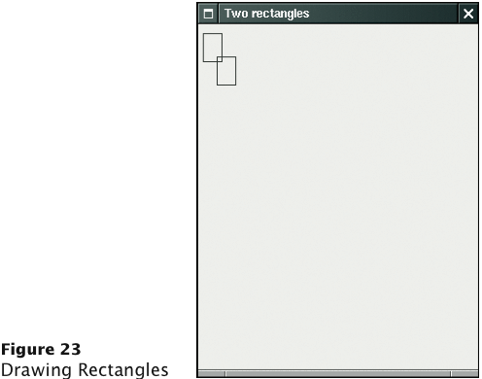
Drawing Rectangles
Big Java by Cay Horstmann
Copyright © 2009 by John Wiley & Sons. All rights reserved.

Slide 91
ch02/rectangles/RectangleComponent.java
1 import java.awt.Graphics;
2 import java.awt.Graphics2D;
3 import java.awt.Rectangle;
4 import javax.swing.JComponent;
5
6 /**
7 A component that draws two rectangles.
8 */
9 public class RectangleComponent extends JComponent
10 {
11 public void paintComponent(Graphics g)
12 {
13 // Recover Graphics2D
14 Graphics2D g2 = (Graphics2D) g;
15
16 // Construct a rectangle and draw it
17 Rectangle box = new Rectangle(5, 10, 20, 30);
18 g2.draw(box);
19
Continued
Big Java by Cay Horstmann
Copyright © 2009 by John Wiley & Sons. All rights reserved.

Slide 92
ch02/rectangles/RectangleComponent.java (cont.)
20 // Move rectangle 15 units to the right and 25 units down
21 box.translate(15, 25);
22
23 // Draw moved rectangle
24 g2.draw(box);
25 }
26 }
Big Java by Cay Horstmann
Copyright © 2009 by John Wiley & Sons. All rights reserved.

Slide 93
Using a Component
Construct a frame.
Construct an object of your component class: RectangleComponent component = new RectangleComponent();
Add the component to the frame:
frame.add(component);
Make the frame visible.
Big Java by Cay Horstmann
Copyright © 2009 by John Wiley & Sons. All rights reserved.

Slide 94
ch02/rectangles/RectangleViewer.java
1 import javax.swing.JFrame;
2
3 public class RectangleViewer
4 {
5 public static void main(String[] args)
6 {
7 JFrame frame = new JFrame();
8
9 frame.setSize(300, 400);
10 frame.setTitle("Two rectangles");
11 frame.setDefaultCloseOperation(JFrame.EXIT_ON_CLOSE);
12
13 RectangleComponent component = new RectangleComponent();
14 frame.add(component);
15
16 frame.setVisible(true);
17 }
18 }
Big Java by Cay Horstmann
Copyright © 2009 by John Wiley & Sons. All rights reserved.

Slide 95
Self Check 2.29
How do you modify the program to draw two squares?
  Answer:
    Rectangle box = new Rectangle(5, 10, 20, 20);

Slide 96
Self Check 2.30
How do you modify the program to draw one rectangle and one square?
  Answer: Replace the call to box.translate(15, 25) with
    box = new Rectangle(20, 35, 20, 20);

Slide 97
Self Check 2.31
What happens if you call g.draw(box) instead of g2.draw(box)?
  Answer: The compiler complains that g doesn’t have a draw method.

Slide 98
Applets
Applet: program that runs inside a web browser
To implement an applet, use this code outline:
public class MyApplet extends JApplet
{
public void paint(Graphics g)
{
// Recover Graphics2D
Graphics2D g2 = (Graphics2D) g;
// Drawing instructions go here
. . .
}
}
Big Java by Cay Horstmann
Copyright © 2009 by John Wiley & Sons. All rights reserved.

Slide 99
Applets
This is almost the same outline as for a component, with two minor differences:
  You extend JApplet, not JComponent
  You place the drawing code inside the paint method, not inside paintComponent
To run an applet, you need an HTML file with the applet tag
An HTML file can have multiple applets; add a separate applet tag for each applet
You view applets with the applet viewer or a Java enabled browser:
    appletviewer RectangleApplet.html
Big Java by Cay Horstmann
Copyright © 2009 by John Wiley & Sons. All rights reserved.

Slide 100
ch02/applet/RectangleApplet.java
1 import java.awt.Graphics;
2 import java.awt.Graphics2D;
3 import java.awt.Rectangle;
4 import javax.swing.JApplet;
5
6 /**
7 An applet that draws two rectangles.
8 */
9 public class RectangleApplet extends JApplet
10 {
11 public void paint(Graphics g)
12 {
13 // Prepare for extended graphics
14 Graphics2D g2 = (Graphics2D) g;
15
16 // Construct a rectangle and draw it
17 Rectangle box = new Rectangle(5, 10, 20, 30);
18 g2.draw(box);
19
Continued
Big Java by Cay Horstmann
Copyright © 2009 by John Wiley & Sons. All rights reserved.

Slide 101
ch02/applet/RectangleApplet.java (cont.)
20 // Move rectangle 15 units to the right and 25 units down
21 box.translate(15, 25);
22
23 // Draw moved rectangle
24 g2.draw(box);
25 }
26 }
27
Big Java by Cay Horstmann
Copyright © 2009 by John Wiley & Sons. All rights reserved.

Slide 102
ch02/applet/RectangleApplet.html
1 <applet code="RectangleApplet.class" width="300" height="400">
2 </applet>
Big Java by Cay Horstmann
Copyright © 2009 by John Wiley & Sons. All rights reserved.

Slide 103
ch02/applet/RectangleAppletExplained.html
1 <html>
2 <head>
3 <title>Two rectangles</title>
4 </head>
5 <body>
6 <p>Here is my <i>first applet</i>:</p>
7 <applet code="RectangleApplet.class" width="300" height="400">
8 </applet>
9 </body>
10 </html>
Big Java by Cay Horstmann
Copyright © 2009 by John Wiley & Sons. All rights reserved.

Slide 104
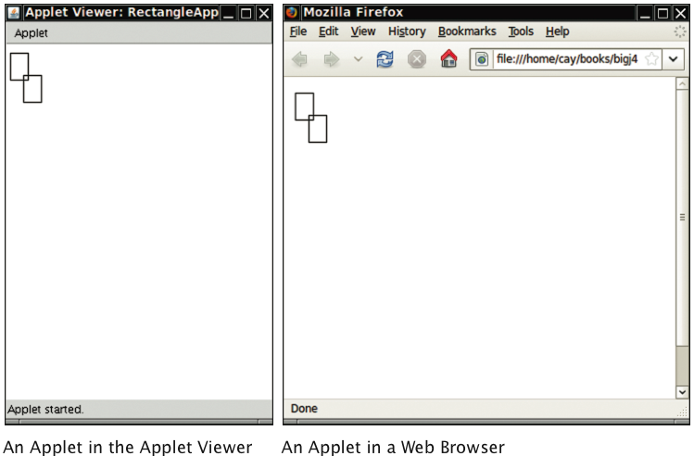
Applets
Big Java by Cay Horstmann
Copyright © 2009 by John Wiley & Sons. All rights reserved.

Slide 105
Ellipses
Ellipse2D.Double describes an ellipse
This class is an inner class – doesn’t matter to us except for the
import statement:
    import java.awt.geom.Ellipse2D; // no .Double
Must construct and draw the shape:
    Ellipse2D.Double ellipse =
    new Ellipse2D.Double(x, y, width, height);
    g2.draw(ellipse);
Big Java by Cay Horstmann
Copyright © 2009 by John Wiley & Sons. All rights reserved.

Slide 106
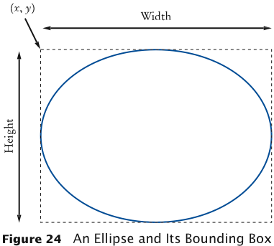
An Ellipse
Big Java by Cay Horstmann
Copyright © 2009 by John Wiley & Sons. All rights reserved.

Slide 107
Drawing Lines
To draw a line:
    Line2D.Double segment =
    new Line2D.Double(x1, y1, x2, y2);
    g2.draw(segment);
or,
    Point2D.Double from = new Point2D.Double(x1, y1);
    Point2D.Double to = new Point2D.Double(x2, y2);
    Line2D.Double segment = new Line2D.Double(from, to);
    g2.draw(segment);
Big Java by Cay Horstmann
Copyright © 2009 by John Wiley & Sons. All rights reserved.

Slide 108
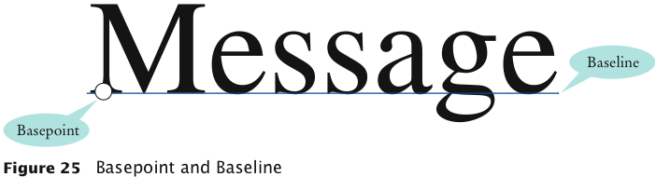
Drawing Text
g2.drawString("Message", 50, 100);
Big Java by Cay Horstmann
Copyright © 2009 by John Wiley & Sons. All rights reserved.

Slide 109
Colors
Standard colors Color.BLUE, Color.RED, Color.PINK, etc.
Specify red, green, blue between 0 and 255:
  Color magenta = new Color(255, 0, 255);
Set color in graphics context:
  g2.setColor(magenta);
Color is used when drawing and filling shapes:
  g2.fill(rectangle); // filled with current color
Big Java by Cay Horstmann
Copyright © 2009 by John Wiley & Sons. All rights reserved.

Slide 110
Predefined Colors and Their RGB Values
Color | RGB Value
Color.BLACK | 0, 0, 0
Color.BLUE | 0, 0, 255
Color.CYAN | 0, 255, 255
Color.GRAY | 128, 128, 128
Color.DARKGRAY | 64, 64, 64
Color.LIGHTGRAY | 192, 192, 192
Color.GREEN | 0, 255, 0
Color.MAGENTA | 255, 0, 255
Color.ORANGE | 255, 200, 0
Color.PINK | 255, 175, 175
Color.RED | 255, 0, 0
Color.WHITE | 255, 255, 255
Color.YELLOW | 255, 255, 0
Big Java by Cay Horstmann
Copyright © 2009 by John Wiley & Sons. All rights reserved.

Slide 111
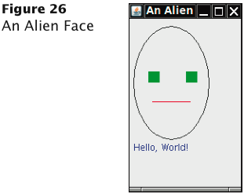
Alien Face
Big Java by Cay Horstmann
Copyright © 2009 by John Wiley & Sons. All rights reserved.

Slide 112
ch02/face/FaceComponent.java
1 import java.awt.Color;
2 import java.awt.Graphics;
3 import java.awt.Graphics2D;
4 import java.awt.Rectangle;
5 import java.awt.geom.Ellipse2D;
6 import java.awt.geom.Line2D;
7 import javax.swing.JComponent;
8
9 /**
10 A component that draws an alien face
11 */
12 public class FaceComponent extends JComponent
13 {
14 public void paintComponent(Graphics g)
15 {
16 // Recover Graphics2D
17 Graphics2D g2 = (Graphics2D) g;
18
Continued
Big Java by Cay Horstmann
Copyright © 2009 by John Wiley & Sons. All rights reserved.

Slide 113
ch02/face/FaceComponent.java (cont.)
19 // Draw the head
20 Ellipse2D.Double head = new Ellipse2D.Double(5, 10, 100, 150);
21 g2.draw(head);
22
23 // Draw the eyes
24 g2.setColor(Color.GREEN);
25 Rectangle eye = new Rectangle(25, 70, 15, 15);
26 g2.fill(eye);
27 eye.translate(50, 0);
28 g2.fill(eye);
29
30 // Draw the mouth
31 Line2D.Double mouth = new Line2D.Double(30, 110, 80, 110);
32 g2.setColor(Color.RED);
33 g2.draw(mouth);
34
35 // Draw the greeting
36 g2.setColor(Color.BLUE);
37 g2.drawString("Hello, World!", 5, 175);
38 }
39 }
Big Java by Cay Horstmann
Copyright © 2009 by John Wiley & Sons. All rights reserved.

Slide 114
ch02/face/FaceViewer.java
1 import javax.swing.JFrame;
2
3 public class FaceViewer
4 {
5 public static void main(String[] args)
6 {
7 JFrame frame = new JFrame();
8 frame.setSize(150, 250);
9 frame.setTitle("An Alien Face");
10 frame.setDefaultCloseOperation(JFrame.EXIT_ON_CLOSE);
11
12 FaceComponent component = new FaceComponent();
13 frame.add(component);
14
15 frame.setVisible(true);
16 }
17 }
Big Java by Cay Horstmann
Copyright © 2009 by John Wiley & Sons. All rights reserved.

Slide 115
Self Check 2.32
Give instructions to draw a circle with center (100, 100) and radius 25.
  Answer:
    g2.draw(new Ellipse2D.Double(75, 75, 50, 50));

Slide 116
Self Check 2.33
Give instructions to draw a letter "V" by drawing two line segments.
  Answer:
  Line2D.Double segment1 = new Line2D.Double(0, 0, 10, 30);
  g2.draw(segment1);
  Line2D.Double segment2 = new Line2D.Double(10, 30, 20, 0);
  g2.draw(segment2);

Slide 117
Self Check 2.34
Give instructions to draw a string consisting of the letter "V”.
  Answer:
    g2.drawString("V", 0, 30);

Slide 118
Self Check 2.35
What are the RGB color values of Color.BLUE?
Answer: 0, 0, and 255

Slide 119
Self Check 2.36
How do you draw a yellow square on a red background?
  Answer: First fill a big red square, then fill a small yellow square inside:
    g2.setColor(Color.RED);
    g2.fill(new Rectangle(0, 0, 200, 200));
    g2.setColor(Color.YELLOW);
    g2.fill(new Rectangle(50, 50, 100, 100));

