Slide 1
Data Communication
Concepts

Slide 2
Data Communication Concepts
Elements of a network
  Protocols
  Messages
  Media
  Devices

Slide 3
Data Communication Concepts
Elements of a network
  Protocols
  Messages
  Media
  Devices
Rules about how messages are sent, received, directed, and interpreted. Like grammar in a human language.

Slide 4
Data Communication Concepts
Elements of a network
  Protocols
  Messages
  Media
  Devices
Data that is sent and received as part of a communication. Two parts: protocol header and data payload. Protocol header is the envelope in which data is carried.

Slide 5
Data Communication Concepts
Elements of a network
  Protocols
  Messages
  Media
  Devices
Material through which the messages move. Wired—copper (electrical) or fiber (optical). Wireless—any non-conducting material (radio waves).

Slide 6
Data Communication Concepts
Elements of a network
  Protocols
  Messages
  Media
  Devices
Equipment that sends, receives, or directs messages through media. Endpoints or intermediate devices.

Slide 7
Data Communication Concepts
OSI and TCP/IP models
  OSI Model: does not specify concrete protocols, but rather specifies the functions that concrete protocols will need to implement at each layer

Slide 8
Data Communication Concepts
OSI and TCP/IP models
  OSI Model: does not specify concrete protocols, but rather specifies the functions that concrete protocols will need to implement at each layer
Application
Transmits raw bits in either code words or symbols. No knowledge of the data it transmits. Examples: high and low voltages over copper twisted pair wire, or colors of light in fiber
Presentation
Session
Transport
Network
Data Link
Physical

Slide 9
Data Communication Concepts
OSI and TCP/IP models
  OSI Model: does not specify concrete protocols, but rather specifies the functions that concrete protocols will need to implement at each layer
Application
Groups of bits called frames sent and received on a single network type. Handles synchronization and collision detection or avoidance. Protocol examples include Ethernet, Token Ring, FDDI, and 802.11 (wireless).
Presentation
Session
Transport
Network
Data Link
Physical

Slide 10
Data Communication Concepts
OSI and TCP/IP models
  OSI Model: does not specify concrete protocols, but rather specifies the functions that concrete protocols will need to implement at each layer
Application
Makes it possible to send units of information (packets) across different kinds of networks (routing). Uniform addressing schema, network congestion control. Protocol examples include IP (internet protocol), IPX (internetwork packet exchange), and ICMP (internet control message protocol).
Presentation
Session
Transport
Network
Data Link
Physical

Slide 11
Data Communication Concepts
OSI and TCP/IP models
  OSI Model: does not specify concrete protocols, but rather specifies the functions that concrete protocols will need to implement at each layer
Application
Ensures reliable delivery of packets, error recovery, flow control, congestion control, and multiplexing of the network by several applications at once. Example protocols include TCP (transmission control protocol) and UDP (user datagram protocol).
Presentation
Session
Transport
Network
Data Link
Physical

Slide 12
Data Communication Concepts
OSI and TCP/IP models
  OSI Model: does not specify concrete protocols, but rather specifies the functions that concrete protocols will need to implement at each layer
Application
Provides enhanced end-to-end session services such as authentication and authorization. Example protocols include PAP (password authentication protocol), NetBIOS, and PPTP (point-to-point tunneling protocol)
Presentation
Session
Transport
Network
Data Link
Physical

Slide 13
Data Communication Concepts
OSI and TCP/IP models
  OSI Model: does not specify concrete protocols, but rather specifies the functions that concrete protocols will need to implement at each layer
Application
Manages the way data is represented and formatted via encryption, compression, serialization, and encodings. Example protocols include ASCII and XML.
Presentation
Session
Transport
Network
Data Link
Physical

Slide 14
Data Communication Concepts
OSI and TCP/IP models
  OSI Model: does not specify concrete protocols, but rather specifies the functions that concrete protocols will need to implement at each layer
Provides protocols for specific applications. Examples include FTP (file transfer protocol), SMTP (simple mail transfer protocol), SNMP (simple network management protocol), LDAP (lightweight directory access protocol), and HTTP (hypertext transfer protocol). Most are defined in RFCs.
Application
Presentation
Session
Transport
Network
Data Link
Physical

Slide 15
Data Communication Concepts
OSI and TCP/IP models
  TCP/IP model: a real-world protocol stack used for most network communication today

Slide 16
Data Communication Concepts
OSI and TCP/IP models
  TCP/IP model: a real-world protocol stack used for most network communication today.
OSI model
TCP/IP model
Application
Application
Presentation
Session
Transport
Transport
Network
Network
Data Link
Data Link
Physical
Physical

Slide 17
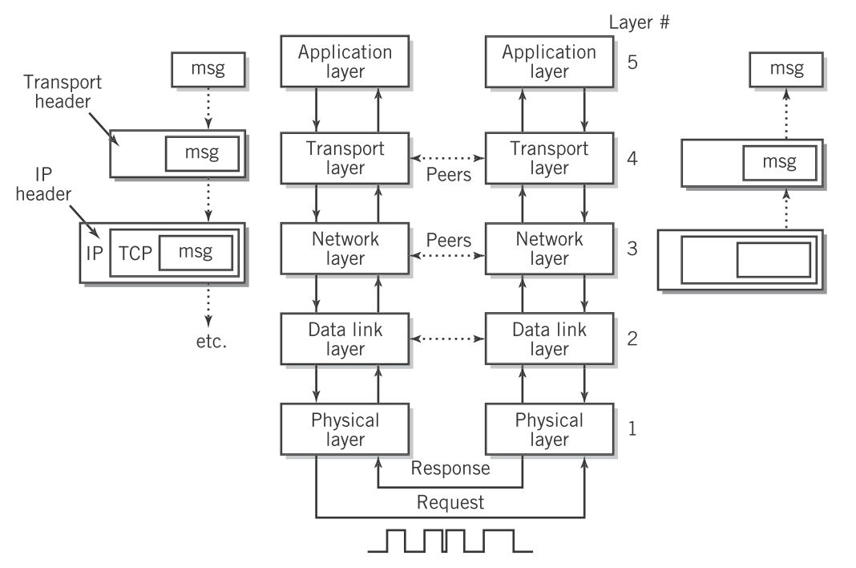
Data Communication Concepts
OSI and TCP/IP models
  Layer separate concerns and build interoperability between different manufacturers.
Englander, 2009, p. 388

Slide 18
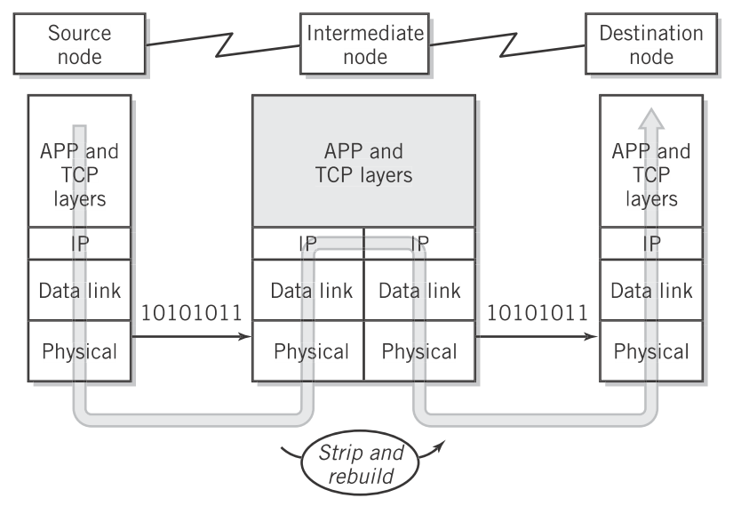
Data Communication Concepts
OSI and TCP/IP models
  Intermediate devices examine headers and reformat protocol data units for the next hop.
Encapsulation
Decapsulation
Englander, 2009, p. 395

Slide 19
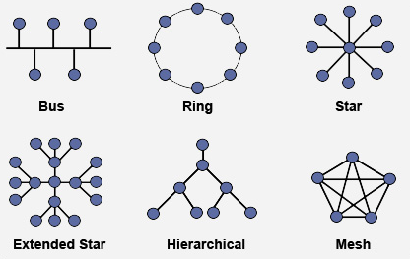
Data Communication Concepts
Network Topologies
  Logical vs. physical layouts
Source: http://learn-networking.com/network-design/a-guide-to-network-topology

Slide 20
Data Communication Concepts
Summary
  Networks consist of protocols, messages, media, and devices.
  The OSI model provides seven layers of functionality that are concretely provided in the 5 layers of TCP/IP.
  As data moves down layers, it is encapsulated in the lower protocol data unit, and as it moves up, it is decapsulated.
  Networks can be arranged logically and physically as busses, stars, rings, meshes or hybrids of each.

Slide 21
References
  Englander, I. (2009). The architecture of computer hardware and systems software: an information technology approach. Wiley.

