Slide 1
Storage Hierarchy and Disk Technology

Slide 2
Storage Hierarchy and Disk Technology
Storage Hierarchy
  Performance is driven by latency and bandwidth.
  The more layers away from the CPU . . .
    . . . the higher the latency
    . . . the larger the capacity

Slide 3
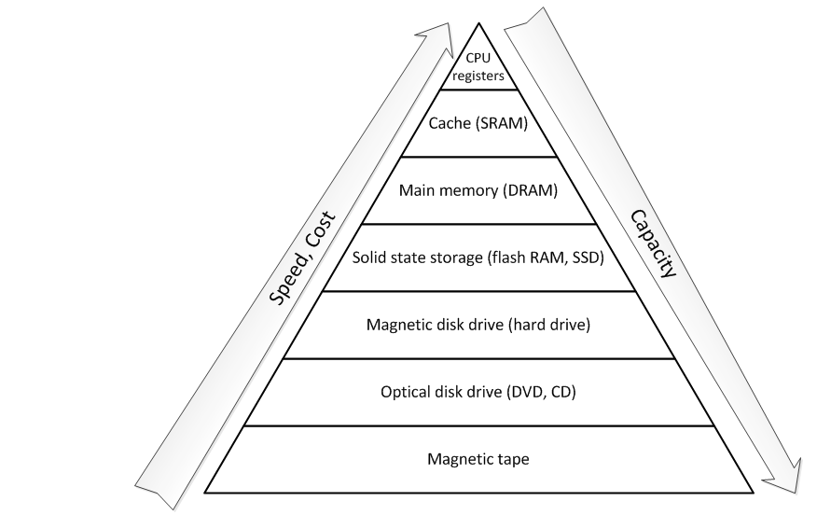
Storage Hierarchy and Disk Technology
Storage Hierarchy

Slide 4
Storage Hierarchy and Disk Technology
Storage Hierarchy
CPU
Primary
storage
Secondary
storage

Slide 5
Storage Hierarchy and Disk Technology
Storage Hierarchy
CPU
Primary
storage
Some layers exist strictly to cache lower layers.
Secondary
storage

Slide 6
Storage Hierarchy and Disk Technology
Storage Hierarchy
CPU
Primary
storage
Secondary
storage
Other layers can set aside just a portion as cache.

Slide 7
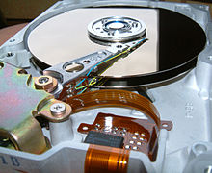
Storage Hierarchy and Disk Technology
Magnetic Disk Technology
  Terminology
    Platter: a spinning disc within a drive, made of glass or aluminum, and coated with magnetic media
    Head: floats above the media, reading or writing the magnetically encoded data
Source: Wikipedia

Slide 8
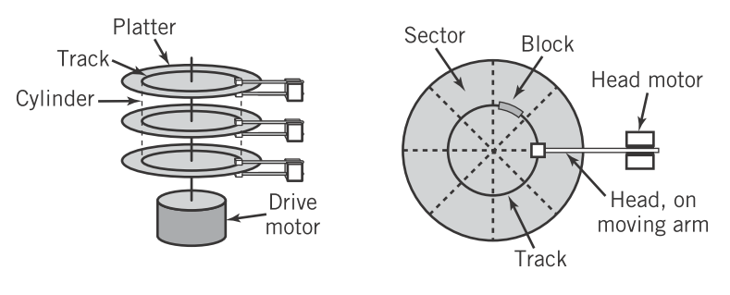
Storage Hierarchy and Disk Technology
Magnetic Disk Technology
  Terminology
    Track: a ring on a single platter
    Cylinder: a track across all platters
    Sector: a wedge shaped slice of a platter
    Block: the intersection of a track and a sector
Englander, 2009, p. 311

Slide 9
Storage Hierarchy and Disk Technology
Magnetic Disk Technology
  Terminology
    Seek time: time to move the head to the desired track
    Latency time: time to rotate the desired sector to be under the head
    Transfer time: time to read a block after seek and latency are accounted for
    CAV (constant angular velocity): used by HDD; disk always spins at the same speed. Problem: wastes space on the outer rings
    CLV (constant linear velocity): The number of bits passing under the head is constant. Faster angular velocity at the inner tracks; slower on the outer.

Slide 10
Storage Hierarchy and Disk Technology
RAID
  Disks often fail because they are at least partly mechanical. RAID (redundant array of independent disks) attempts to improve redundancy and bandwidth.
  Combine three primary functions:
    Mirroring
    Striping
    Parity checks

Slide 11
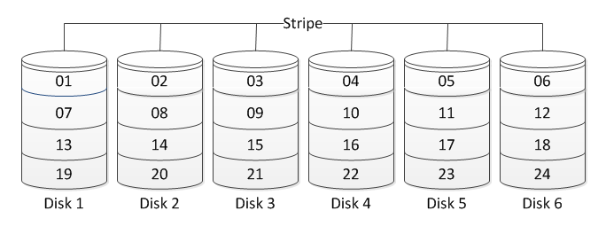
Storage Hierarchy and Disk Technology
RAID
  RAID 0: Striping

Slide 12
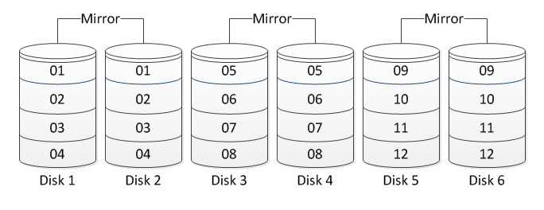
Storage Hierarchy and Disk Technology
RAID
  RAID 1: Mirroring

Slide 13
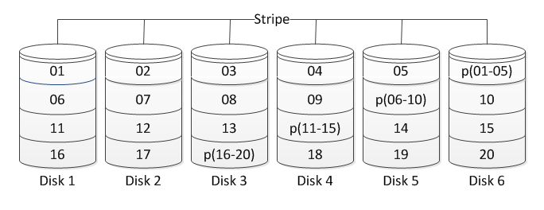
Storage Hierarchy and Disk Technology
RAID
  RAID 5: Striping with distributed parity

Slide 14
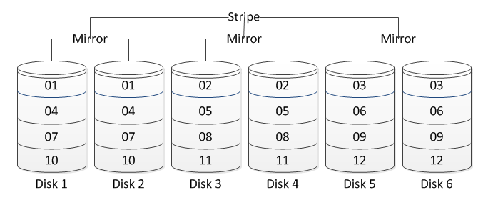
Storage Hierarchy and Disk Technology
RAID
  RAID 10: Stripe across mirrors

Slide 15
Storage Hierarchy and Disk Technology
Summary
  Memory hierarchy shows the inverse relationship between speed and capacity in computing systems.
  Magnetic disks have several kinds of latency: seek time, rotational delay, and transfer time.
  RAID attempts to compensate for latency and failures by employing striping, mirroring, and parity checks.

Slide 16
References
  Englander, I. (2009). The architecture of computer hardware and systems software: an information technology approach. Wiley.

