Slide 1
Memory Performance Enhancements

Slide 2
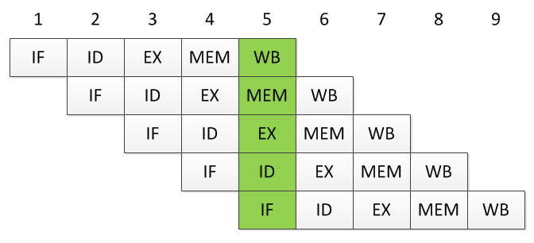
Memory Performance Enhancements
Recall CPU Pipelining
  Works on the assumption that each stage of the pipeline takes the same amount of time: one clock cycle
    But access to memory is several orders of magnitude slower!

Slide 3
Memory Performance Enhancements
Recall CPU Pipelining
  Works on the assumption that each stage of the pipeline takes the same amount of time: one clock cycle
    But access to memory is several orders of magnitude slower!
How is one-cycle memory access achieved?

Slide 4
Memory Performance Enhancements
Three complementary approaches
  Wide path memory access
  Memory interleaving
  Cache memory

Slide 5
Memory Performance Enhancements
Three complementary approaches
  Wide path memory access
  Memory interleaving
  Cache memory
All three are used simultaneously in the system design.

Slide 6
Memory Performance Enhancements
Wide path memory access
  Accessing memory has high latency but also high bandwidth.

Slide 7
Memory Performance Enhancements
Wide path memory access
  Accessing memory has high latency but also high bandwidth.
Latency is the amount of time it takes for a round trip, i.e., the time from when the CS, R/W signals are asserted until the data is in the MDR.

Slide 8
Memory Performance Enhancements
Wide path memory access
  Accessing memory has high latency but also high bandwidth.
Bandwidth is the amount of data that can be returned per unit time.

Slide 9
Memory Performance Enhancements
Pipelining increases the bandwidth (instructions executed per unit time) but not the latency of a single instruction—that is still 5 cycles.
Wide path memory access
  Accessing memory has high latency but also high bandwidth.
Latency
Bandwidth

Slide 10
Memory Performance Enhancements
Wide path memory access
  Accessing memory has high latency but also high bandwidth.
    In the same manner as pipelining, memory bandwidth can be increased.
    Requests for memory aren’t satisfied 1 byte at a time, but rather 4, 8, or even 16 bytes at a time.
    Requires a wider bus between CPU and memory.

Slide 11
Memory Performance Enhancements
Memory interleaving
  A second technique for increasing bandwidth to memory is interleaving.
    Distributing addresses across blocks of memory so that memory requests can be parallelized.

Slide 12
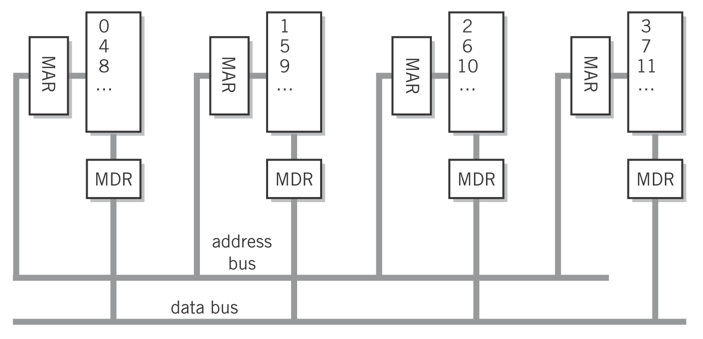
Memory Performance Enhancements
Memory interleaving
  A second technique for increasing bandwidth to memory is interleaving.
    Distributing addresses across blocks of memory so that memory requests can be parallelized.
Englander, 2009, p. 58

Slide 13
Memory Performance Enhancements
Since memory requests are typically for contiguous addresses, the number of blocks is tied closely to the width of the data bus between the CPU and memory. This bus should be at least 4 bytes wide.
Memory interleaving
  A second technique for increasing bandwidth to memory is interleaving.
    Distributing addresses across blocks of memory so that memory requests can be parallelized.
Englander, 2009, p. 58

Slide 14
Memory Performance Enhancements
Cache Memory
  Cache memory is the only technique that tries to minimize latency.
    DRAM has high latency but is inexpensive.
    SRAM has low latency but is expensive.

Slide 15
Memory Performance Enhancements
Cache Memory
  Cache memory is the only technique that tries to minimize latency.
    DRAM has high latency but is inexpensive.
    SRAM has low latency but is expensive.
Use a small amount of expensive SRAM as a buffer against the large amount of DRAM.

Slide 16
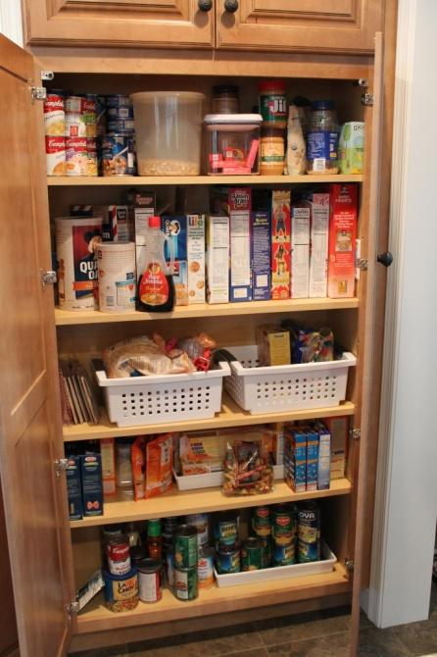

Memory Performance Enhancements
Cache Memory
Source: http://makinglemonadeblog.com/wp-content/uploads/2013/03/IMG_0332-682x1024.jpg and http://tagsoftegypt.com/supermarket.jpg

Slide 17
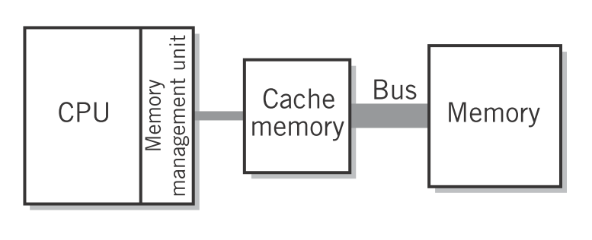
Memory Performance Enhancements
Cache Memory
  Hit: Requested data exists in cache—very fast.
  Miss: Data not in cache, fetch from memory, copy into cache, and then treat as a hit.
Englander, 2009, p. 58
Hit ratios can be as high as 90%

Slide 18
Memory Performance Enhancements
Cache Memory
  Cache entries consist of:
    Tag: address
    Data: copy of memory
    Dirty bit: indicates if data in cache is newer than contents of memory

Slide 19
Memory Performance Enhancements
Cache Memory
  Cache replacement algorithm
    Once cache fills, a miss will cause an existing line to be replaced. Which one?
      Least recently used (LRU)
      First in first out (FIFO)
      Least frequently used
      Random
      Etc.

Slide 20
Memory Performance Enhancements
Cache Memory
  What should happen on a memory write?
    Write through—write to cache and then immediately write to memory. Safe, simple, slow.
    Write back—write only to cache. Use dirty bit to write back to memory when line is replaced. Complicated, fast.

Slide 21
Memory Performance Enhancements
Cache Memory
  What should happen on a memory write?
    Write through—write to cache and then immediately write to memory. Safe, simple, slow.
    Write back—write only to cache. Use dirty bit to write back to memory when line is replaced. Complicated, fast.
Cache coherency gets particularly tricky with multiple cores and multiple levels of cache.

Slide 22
Memory Performance Enhancements
Summary
  Latency is the round trip time to deliver a single request. Bandwidth is the number of requests that can be fulfilled in a unit time.
  Three ways of improving memory performance:
    Wide path memory access—increase bandwidth to memory by fetching multiple bytes at a time.
    Memory interleaving—increase bandwidth to memory by fetching in parallel across blocks.
    Cache memory—decrease latency to memory by having fast copies closer to the CPU. Must keep memory synchronized with cache.

Slide 23
References
  Englander, I. (2009). The architecture of computer hardware and systems software: an information technology approach. Wiley.

