Slide 1
CPU Performance
Enhancements

Slide 2
CPU Performance Enhancements
General Enhancements
  Use RISC-based techniques
    Fewer instruction formats, fixed-length → faster decoding
    More general purpose registers → fewer memory accesses

Slide 3
CPU Performance Enhancements
Clock cycle and instruction cycle
  Most instructions take several clock cycles to execute:
    Fetch the new instruction [IF].
    Decode the instruction [ID].
    Execute the instruction [EX].
    Access memory (if needed) [MEM].
    Write back to the registers [WB].
  Each stage takes a clock cycle, so complete execution takes 5 cycles. Can we do better?

Slide 4

CPU Performance Enhancements
Clock cycle and instruction cycle
  Waiting for all five stages of instruction execution to complete is like building something from start to finish.
Is each instruction unique like a building?
Source: http://blog.gogrid.com/wp-content/uploads/2009/01/house-construction.png

Slide 5

CPU Performance Enhancements
Clock cycle and instruction cycle
  Or can the CPU overlap the execution of several instructions at once because they’re all similar?
Or is it more like a car on an assembly line?
Source: http://media.pennlive.com/opinion/photo/car-assembly-line-art-c348bd70da852397.jpg

Slide 6
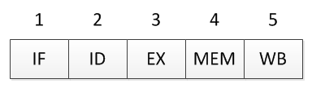
CPU Performance Enhancements
Clock cycle and instruction cycle
  Five stages of instruction execution

Slide 7
CPU Performance Enhancements
Clock cycle and instruction cycle
  Five stages of instruction execution
Notice that the ALU used in stage 3 is idle in stages 1, 2, 4, and 5. The same can be said for other components if they are all discrete. Underutilized hardware!

Slide 8
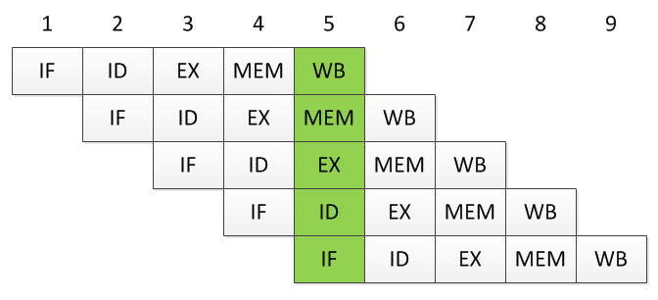
CPU Performance Enhancements
Clock cycle and instruction cycle
  Five stages of instruction execution
  Solution: offset and overlap in a pipeline.

Slide 9
CPU Performance Enhancements
Clock cycle and instruction cycle
  Five stages of instruction execution
  Solution: offset and overlap in a pipeline.
By cycle 5, the CPU is executing 5 instructions at once. After this, one instruction completes every cycle. An n-stage pipelined CPU is n times faster than a non-pipelined CPU.

Slide 10
CPU Performance Enhancements
Clock cycle and instruction cycle
  Problems with pipelining
    Dependencies (register interlock)—if an instruction needs a result from the immediately preceding instruction, that result won’t be written back until WB, but the result is needed in EX.

Slide 11
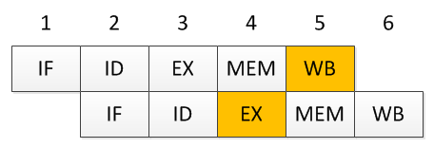
CPU Performance Enhancements
Clock cycle and instruction cycle
  Problems with pipelining
    Dependencies (register interlock)—if an instruction needs a result from the immediately preceding instruction, that result won’t be written back until WB, but the result is needed in EX.
Three solutions: forward the result from EX₁ to EX₂, introduce a stall, or reorder the instructions to eliminate the dependency.

Slide 12
CPU Performance Enhancements
Clock cycle and instruction cycle
  Problems with pipelining
    Branching—when the instruction being executed is a branch, we can’t know if the branch will be taken until after stage 3. But by that time, other instructions are “in flight.”

Slide 13
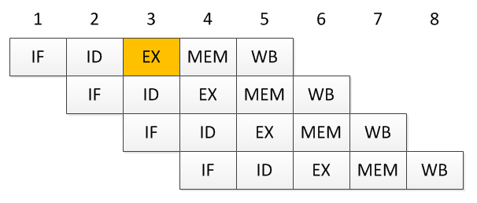
CPU Performance Enhancements
Clock cycle and instruction cycle
  Problems with pipelining
    Branching—when the instruction being executed is a branch, we can’t know if the branch will be taken until after stage 3. But by that time, other instructions are “in flight.”
Should these two instructions execute? Not if the branch is taken.

Slide 14
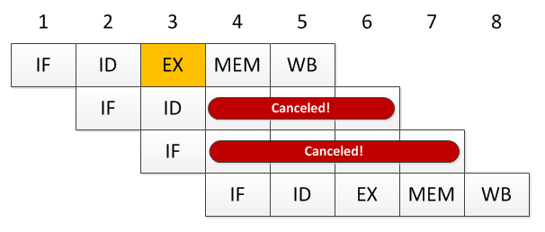
CPU Performance Enhancements
Clock cycle and instruction cycle
  Problems with pipelining
    Branching – when the instruction being executed is a branch, we can’t know if the branch will be taken until after stage 3. But by that time, other instructions are “in flight.”
Solution: “Predict” that the branch is not taken (allowing instructions to fly), and then cancel them if we predicted wrong.

Slide 15
CPU Performance Enhancements
Superscalar Processing
  RISC and pipelining lets each functional unit in a CPU be fully utilized all of the time.
    But, what if there were multiple ALUs or multiple decoders? Then multiple instructions could be executed at once.
    Prerequisite: Multiple instructions should be fetched at once via a large path to memory.

Slide 16
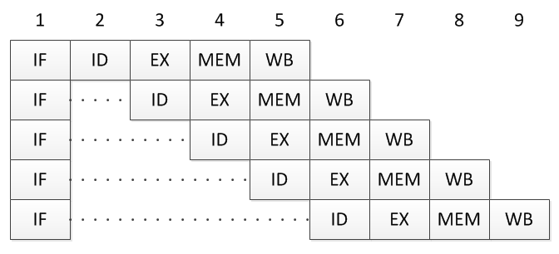
CPU Performance Enhancements
Superscalar Processing
Scalar processing: only one copy of each functional unit in the CPU

Slide 17
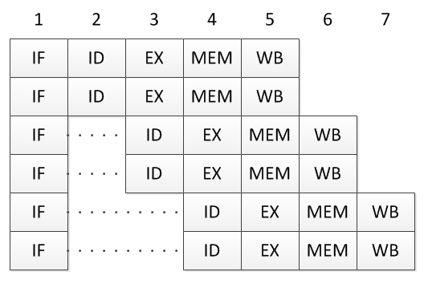
CPU Performance Enhancements
Superscalar processing: more than one copy of each functional unit in the CPU
Superscalar Processing

Slide 18
CPU Performance Enhancements
Superscalar Processing
  Problems with superscalar processing
    Same general categories as with pipelining: dependencies and branches
    Except now forwards, stalls, or canceling may need to be between several functional units!
    CPUs become very complex again, yet it is common to have 2 to 4 separate pipelines per core in modern processors.

Slide 19
CPU Performance Enhancements
Summary
  RISC-based CPUs offer general performance enhancements due to simplified formats and single-clock cycle execution.
  Pipelining allows multiple instructions to be in various stages of execution at once.
  Superscalar processing duplicates pipelines in a single core to have multiple instructions executing simultaneously.
  Data dependencies and branches are hazards to both pipelining and superscalar architectures.

