Slide 1
RISC vs. CISC

Slide 2
RISC vs. CISC
Definitions
CISC: Complex Instruction Set Computers
RISC: Reduced Instruction Set Computers

Slide 3
RISC vs. CISC
Motivation for CISC
Early computers had very little and very slow memory. Thus, the fewer instructions fetched, the faster the computer could be.
General characteristics:
High number of operations (300+)
Compilers have less work to do to translate HLL into machine code.
Large number of instruction formats
Multi-clock cycle instructions
Fewer registers; more memory access
Large number of transistors, CPU complexity, therefore higher CPU prices

Slide 4
RISC vs. CISC
Motivation for RISC
As memory capacities grew, there was less need for high code density. Also, pushing clock rates higher on CISC hardware was difficult. A simpler processor could be clocked faster.
General characteristics:
Lower number of operations (150+)
Compilers have more work to do.
Small number of instruction formats
All instructions take one cycle.
Load/store architecture
Smaller number of transistors, lower CPU complexity, therefore lower CPU prices

Slide 5
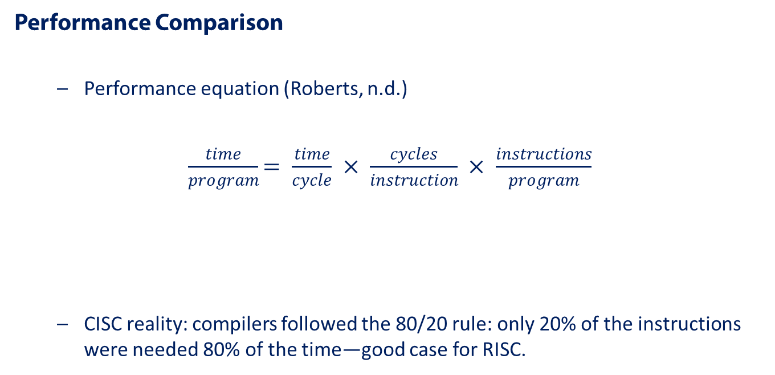
RISC vs. CISC
RISC tries to minimize this.
CISC tries to minimize this

Slide 6
RISC vs. CISC
RISC and CISC today
RISC performs better and costs less.
CISC adapted by adding a hardware layer that decodes most CISC instructions into RISC-like instructions that actually execute.
Market factors keep CISC alive (Intel x86 and x64).
RISC has rapidly gained market share (ARM—Advanced RISC Machines) in portable devices due to simpler design requiring less power.

Slide 7
RISC vs. CISC
Summary
CISC processors require more CPU transistors in an effort to maximize code density in memory.
RISC processors use a simpler design in an effort to reduce the number of cycles per instruction.
The only major CISC architecture today is the Intel x86 and x64. Nearly all else is RISC.

Slide 8
References
Roberts, E. (n.d.). RISC vs. CISC. Retrieved June 29, 2013 from http://www-cs-faculty.stanford.edu/~eroberts/courses/soco/projects/risc/risccisc/

