Slide 1
CHAPTER 7:
The CPU and Memory
The Architecture of Computer Hardware, Systems Software & Networking:
An Information Technology Approach
4th Edition, Irv Englander
John Wiley and Sons ©2010
PowerPoint slides authored by Wilson Wong, Bentley University
PowerPoint slides for the 3rd edition were co-authored with Lynne Senne, Bentley College

Slide 2
CPU: Major Components
ALU (arithmetic logic unit)
  Performs calculations and comparisons
CU (control unit)
  Performs fetch/execute cycle
    Accesses program instructions and issues commands to the ALU
    Moves data to and from CPU registers and other hardware components
  Subcomponents:
    Memory management unit: supervises fetching instructions and data from memory
    I/O Interface: sometimes combined with memory management unit as Bus Interface Unit
Copyright 2010 John Wiley & Sons, Inc.
7-*
Notes:
*

Slide 3
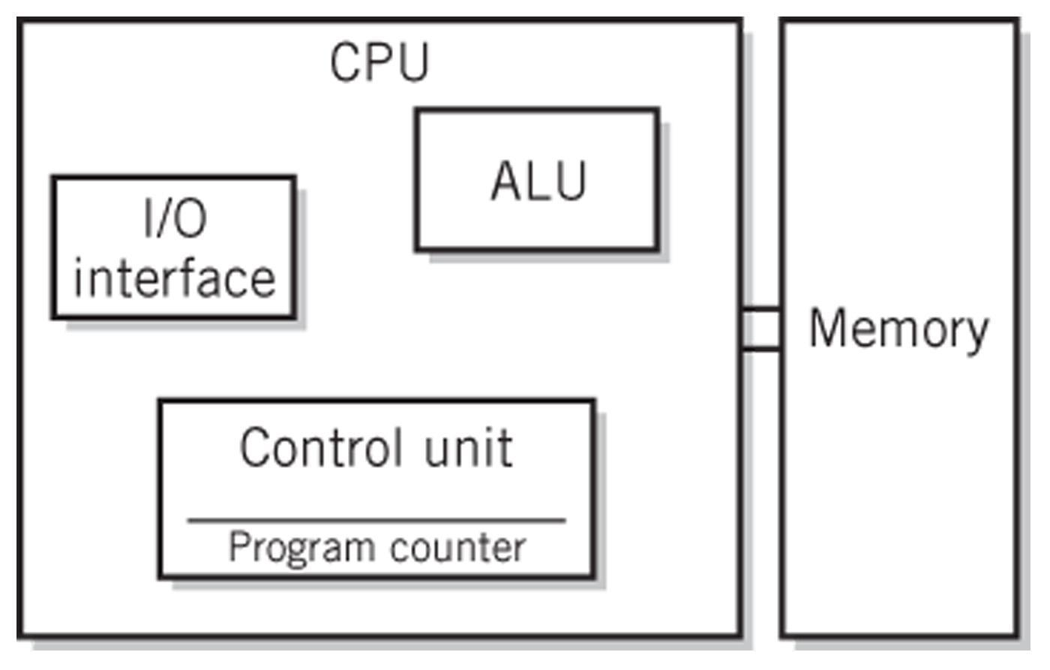
System Block Diagram
Copyright 2010 John Wiley & Sons, Inc.
7-*
Notes:
*

Slide 4
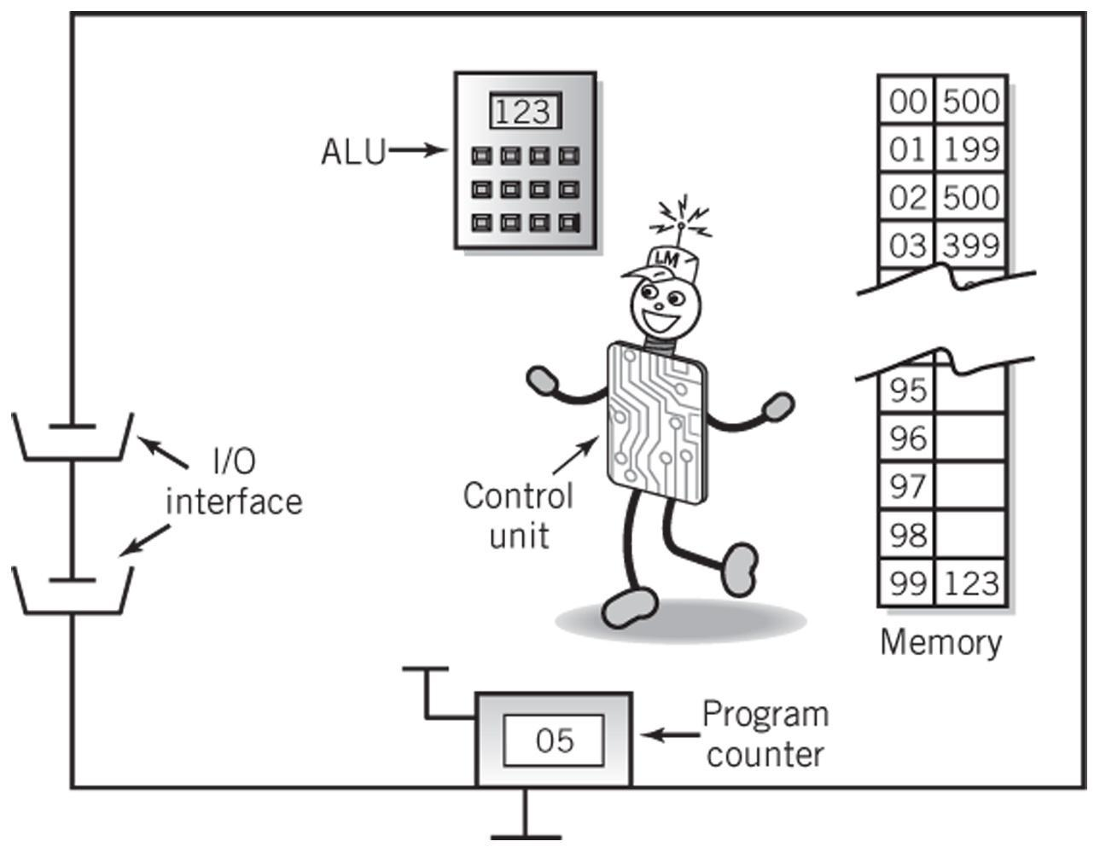
The Little Man Computer
Copyright 2010 John Wiley & Sons, Inc.
7-*
Notes:
*

Slide 5
Concept of Registers
Small, permanent storage locations within the CPU used for a particular purpose
Manipulated directly by the Control Unit
Wired for specific function
Size in bits or bytes (not in MB like memory)
Can hold data, an address or an instruction
How many registers does the LMC have?
What are the registers in the LMC?
Copyright 2010 John Wiley & Sons, Inc.
7-*
Notes:
*

Slide 6
Registers
Use of Registers
  Scratchpad for currently executing program
    Holds data needed quickly or frequently
  Stores information about status of CPU and currently executing program
    Address of next program instruction
    Signals from external devices
General Purpose Registers
  User-visible registers
  Hold intermediate results or data values, e.g., loop counters
  Equivalent to LMC’s calculator
  Typically several dozen in current CPUs
Copyright 2010 John Wiley & Sons, Inc.
7-*
Notes:
*

Slide 7
Special-Purpose Registers
Program Count Register (PC)
  Also called instruction pointer
Instruction Register (IR)
  Stores instruction fetched from memory
Memory Address Register (MAR)
Memory Data Register (MDR)
Status Registers
  Status of CPU and currently executing program
  Flags (one bit Boolean variable) to track condition like arithmetic carry and overflow, power failure, internal computer error
Copyright 2010 John Wiley & Sons, Inc.
7-*
Notes:
*

Slide 8
Register Operations
Stores values from other locations (registers and memory)
Addition and subtraction
Shift or rotate data
Test contents for conditions such as zero or positive
Copyright 2010 John Wiley & Sons, Inc.
7-*
Notes:
*

Slide 9
Operation of Memory
Each memory location has a unique address
Address from an instruction is copied to the MAR which finds the location in memory
CPU determines if it is a store or retrieval
Transfer takes place between the MDR and memory
MDR is a two way register
Copyright 2010 John Wiley & Sons, Inc.
7-*
Notes:
*

Slide 10
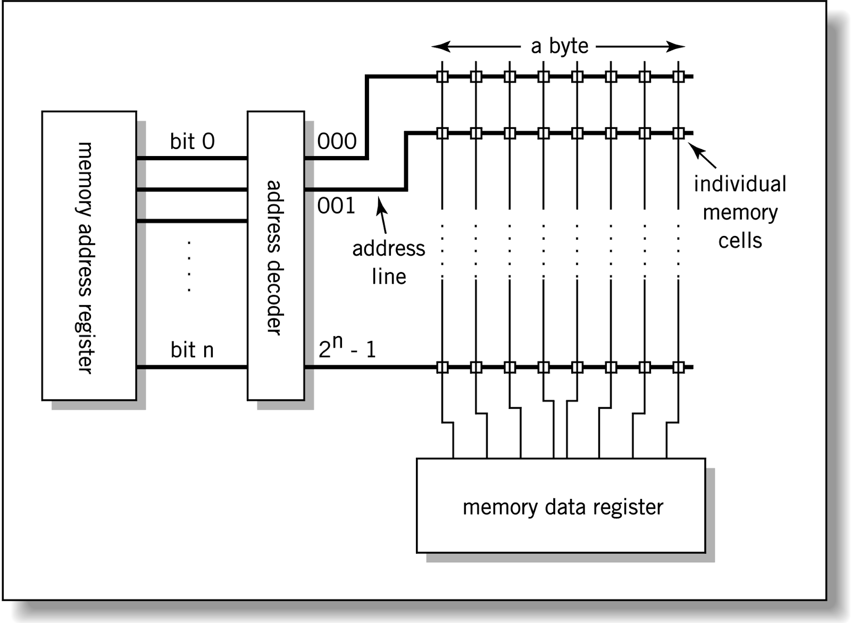
Relationship between MAR,
MDR and Memory
Address
Data
Copyright 2010 John Wiley & Sons, Inc.
7-*
Notes:
*

Slide 11
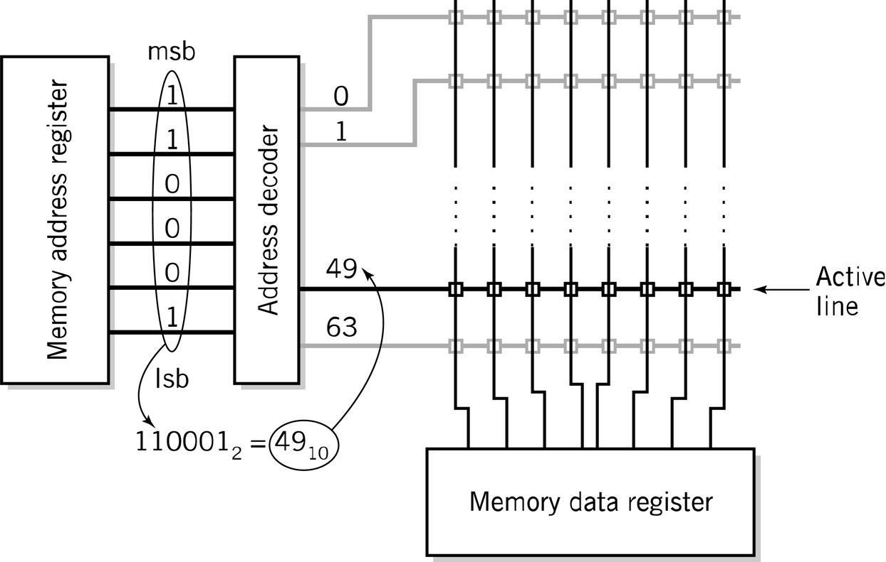
MAR-MDR Example
Copyright 2010 John Wiley & Sons, Inc.
7-*
Notes:
*

Slide 12
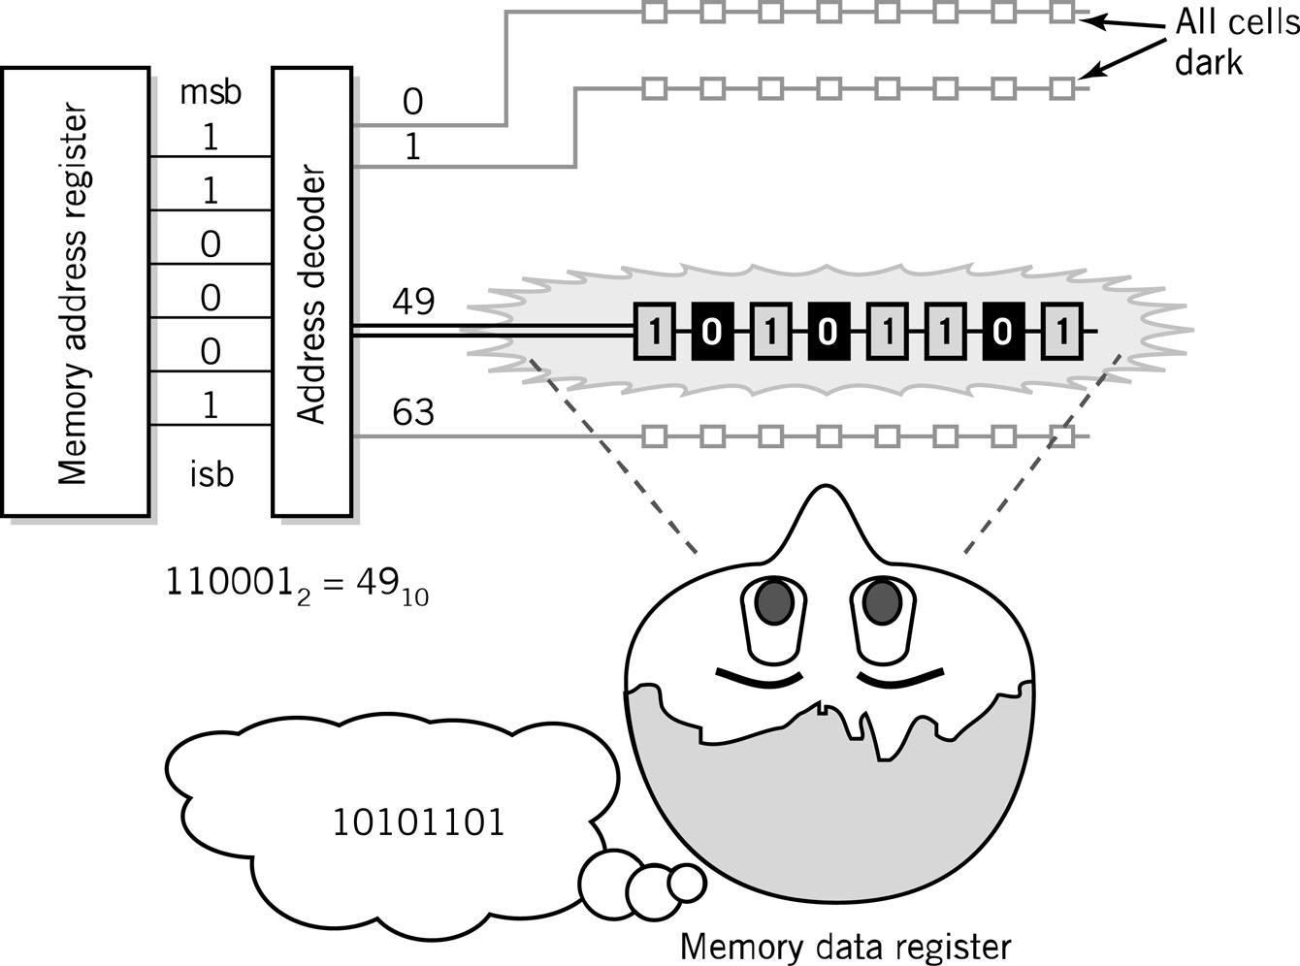
Visual Analogy of Memory
Copyright 2010 John Wiley & Sons, Inc.
7-*
Notes:
*

Slide 13
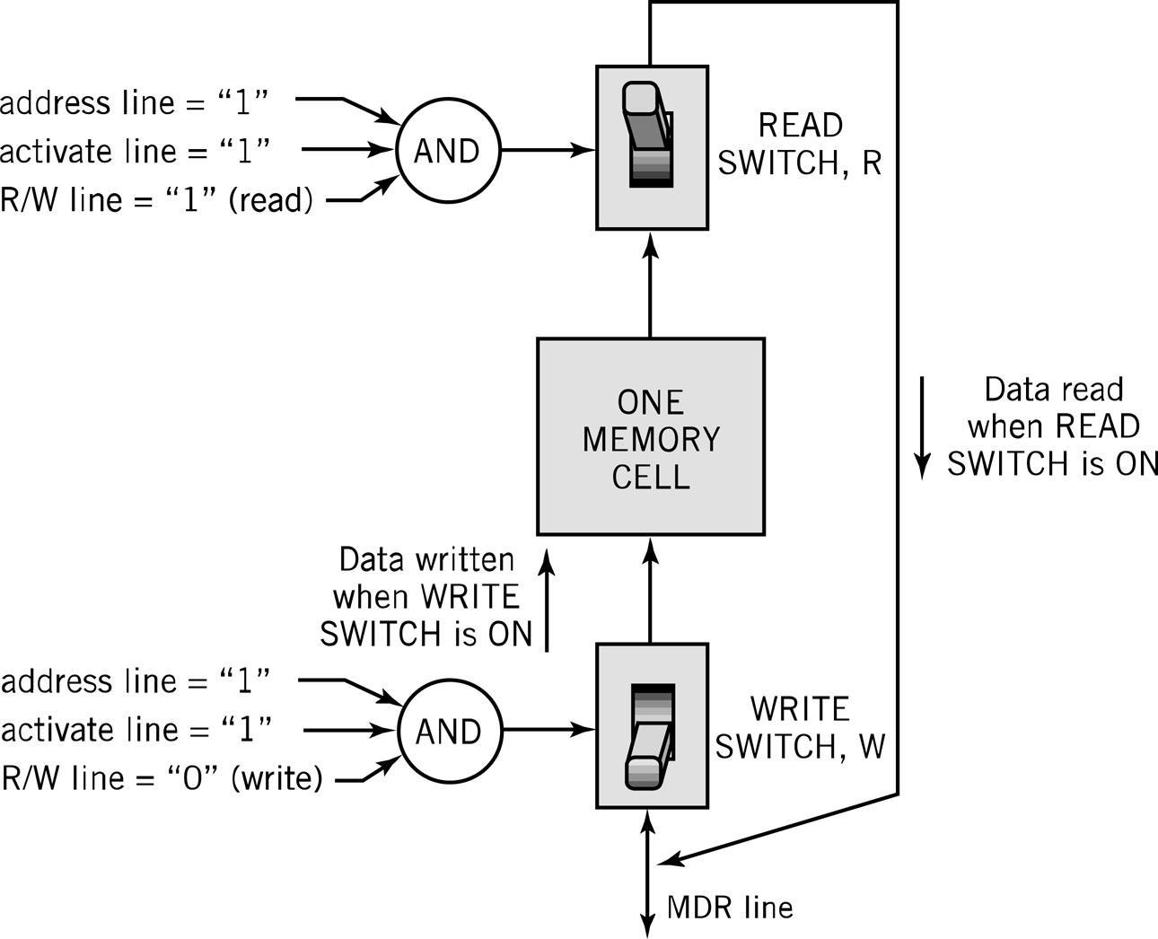
Individual Memory Cell
Copyright 2010 John Wiley & Sons, Inc.
7-*
Notes:
*

Slide 14
Memory Capacity
Determined by two factors
  1. Number of bits in the MAR
    LMC = 100 (00 to 99)
    2^{K} where K = width of the register in bits
  2. Size of the address portion of the instruction
    4 bits allows 16 locations
    8 bits allows 256 locations
    32 bits allows 4,294,967,296 or 4 GB
Copyright 2010 John Wiley & Sons, Inc.
7-*
Notes:
*

Slide 15
RAM: Random Access Memory
DRAM (Dynamic RAM)
  Most common, cheap, less electrical power, less heat, smaller space
  Volatile: must be refreshed (recharged with power) 1000’s of times each second
SRAM (static RAM)
  Faster and more expensive than DRAM
  Volatile
  Small amounts are often used in cache memory for high-speed memory access
Copyright 2010 John Wiley & Sons, Inc.
7-*
Notes:
*

Slide 16
Nonvolatile Memory
ROM
  Read-only Memory
  Holds software that is not expected to change over the life of the system
EEPROM
  Electrically Erasable Programmable ROM
Flash Memory
  Faster than disks but more expensive
  Uses hot carrier injection to store bits of data
  Slow rewrite time compared to RAM
  Useful for nonvolatile portable computer storage
Copyright 2010 John Wiley & Sons, Inc.
7-*
Notes:
*

Slide 17
Fetch-Execute Cycle
Two-cycle process because both instructions and data are in memory
Fetch
  Decode or find instruction, load from memory into register and signal ALU
Execute
  Performs operation that instruction requires
  Move/transform data
Copyright 2010 John Wiley & Sons, Inc.
7-*
Notes:
*

Slide 18
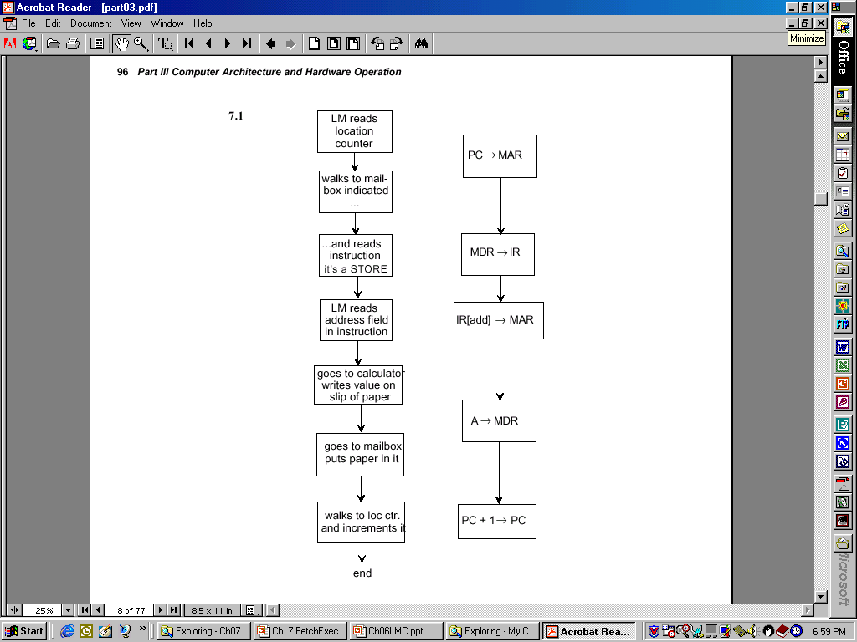
LMC vs. CPU
Fetch and Execute Cycle
Copyright 2010 John Wiley & Sons, Inc.
7-*
Notes:
*

Slide 19
Load Fetch/Execute Cycle
PC → MAR | Transfer the address from the PC to the MAR
MDR → IR | Transfer the instruction to the IR
IR[address] → MAR | Address portion of the instruction loaded in MAR
MDR → A | Actual data copied into the accumulator
PC + 1 → PC | Program Counter incremented
Copyright 2010 John Wiley & Sons, Inc.
7-*
Notes:
*

Slide 20
Store Fetch/Execute Cycle
PC → MAR | Transfer the address from the PC to the MAR
MDR → IR | Transfer the instruction to the IR
IR[address] → MAR | Address portion of the instruction loaded in MAR
A → MDR* | Accumulator copies data into MDR
PC + 1 → PC | Program Counter incremented
*Notice how Step #4 differs for LOAD and STORE
Copyright 2010 John Wiley & Sons, Inc.
7-*
Notes:
*

Slide 21
ADD Fetch/Execute Cycle
PC → MAR | Transfer the address from the PC to the MAR
MDR → IR | Transfer the instruction to the IR
IR[address] → MAR | Address portion of the instruction loaded in MAR
A + MDR → A | Contents of MDR added to contents of accumulator
PC + 1 → PC | Program Counter incremented
Copyright 2010 John Wiley & Sons, Inc.
7-*
Notes:
*

Slide 22
LMC Fetch/Execute
SUBTRACT
PC → MAR
MDR → IR
IR[addr] → MAR
A – MDR → A
PC + 1 → PC
IN
PC → MAR
MDR → IR
IOR → A
PC + 1 → PC
OUT
PC → MAR
MDR → IR
A → IOR
PC + 1 → PC
HALT
PC → MAR
MDR → IR
BRANCH
PC → MAR
MDR → IR
IR[addr] → PC
BRANCH on Condition
PC → MAR
MDR → IR
If condition false: PC + 1 → PC
If condition true: IR[addr] → PC
Copyright 2010 John Wiley & Sons, Inc.
7-*
Notes:
*

Slide 23
Bus
The physical connection that makes it possible to transfer data from one location in the computer system to another
Group of electrical or optical conductors for carrying signals from one location to another
  Wires or conductors printed on a circuit board
  Line: each conductor in the bus
4 kinds of signals
  Data
  Addressing
  Control signals
  Power (sometimes)
Copyright 2010 John Wiley & Sons, Inc.
7-*
Notes:
*

Slide 24
Bus Characteristics
Number of separate conductors
Data width in bits carried simultaneously
Addressing capacity
Lines on the bus are for a single type of signal or shared
Throughput - data transfer rate in bits per second
Distance between two endpoints
Number and type of attachments supported
Type of control required
Defined purpose
Features and capabilities
Copyright 2010 John Wiley & Sons, Inc.
7-*
Notes:
*

Slide 25
Bus Categorizations
Parallel vs. serial buses
Direction of transmission
  Simplex – unidirectional
  Half duplex – bidirectional, one direction at a time
  Full duplex – bidirectional simultaneously
Method of interconnection
  Point-to-point – single source to single destination
    Cables – point-to-point buses that connect to an external device
  Multipoint bus – also broadcast bus or multidrop bus
    Connect multiple points to one another
Copyright 2010 John Wiley & Sons, Inc.
7-*

Slide 26
Parallel vs. Serial Buses
Parallel
  High throughput because all bits of a word are transmitted simultaneously
  Expensive and require a lot of space
  Subject to radio-generated electrical interference which limits their speed and length
  Generally used for short distances such as CPU buses and on computer motherboards
Serial
  1 bit transmitted at a timed
  Single data line pair and a few control lines
  For many applications, throughput is higher than for parallel because of the lack of electrical interference
Copyright 2010 John Wiley & Sons, Inc.
7-*

Slide 27
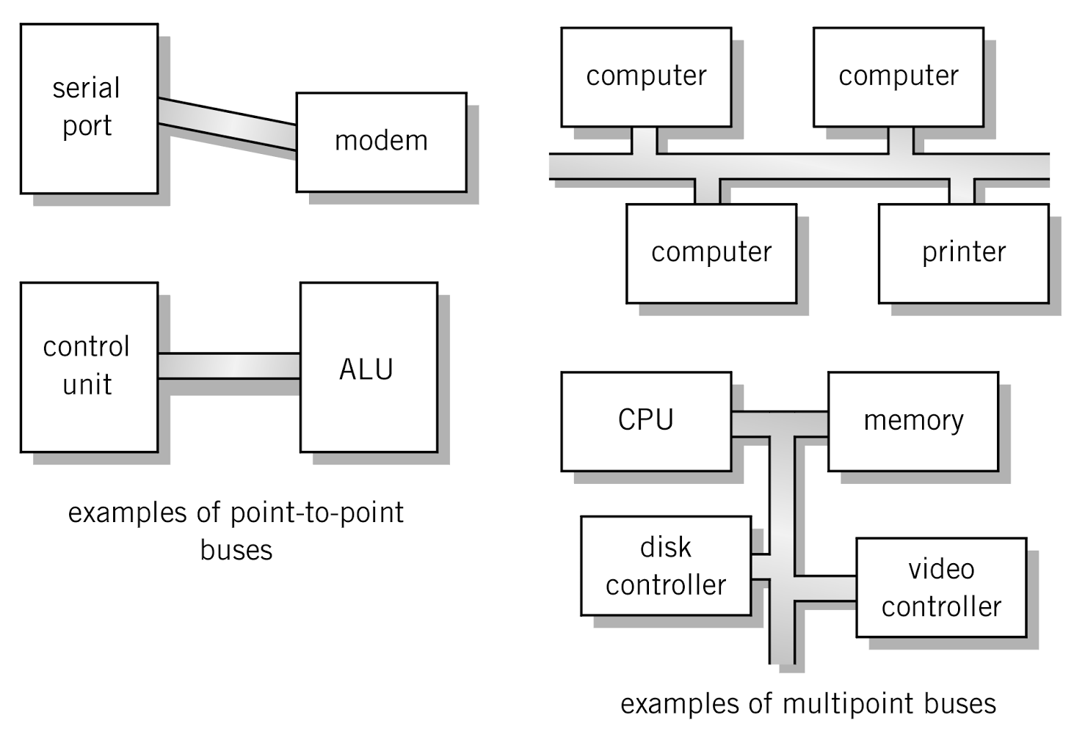
Point-to-point vs. Multipoint
Plug-in device
Broadcast bus Example: Ethernet
Shared among multiple devices
Copyright 2010 John Wiley & Sons, Inc.
7-*
Notes:
*

Slide 28
Classification of Instructions
Data Movement (load, store)
  Most common, greatest flexibility
  Involve memory and registers
  What’s this size of a word ? 16? 32? 64 bits?
Arithmetic
  Operators + - / * ^
  Integers and floating point
Boolean Logic
  Often includes at least AND, XOR, and NOT
Single operand manipulation instructions
  Negating, decrementing, incrementing, set to 0
Copyright 2010 John Wiley & Sons, Inc.
7-*
Notes:
*

Slide 29
More Instruction Classifications
Bit manipulation instructions
  Flags to test for conditions
Shift and rotate
Program control
Stack instructions
Multiple data instructions
I/O and machine control
Copyright 2010 John Wiley & Sons, Inc.
7-*
Notes:
*

Slide 30
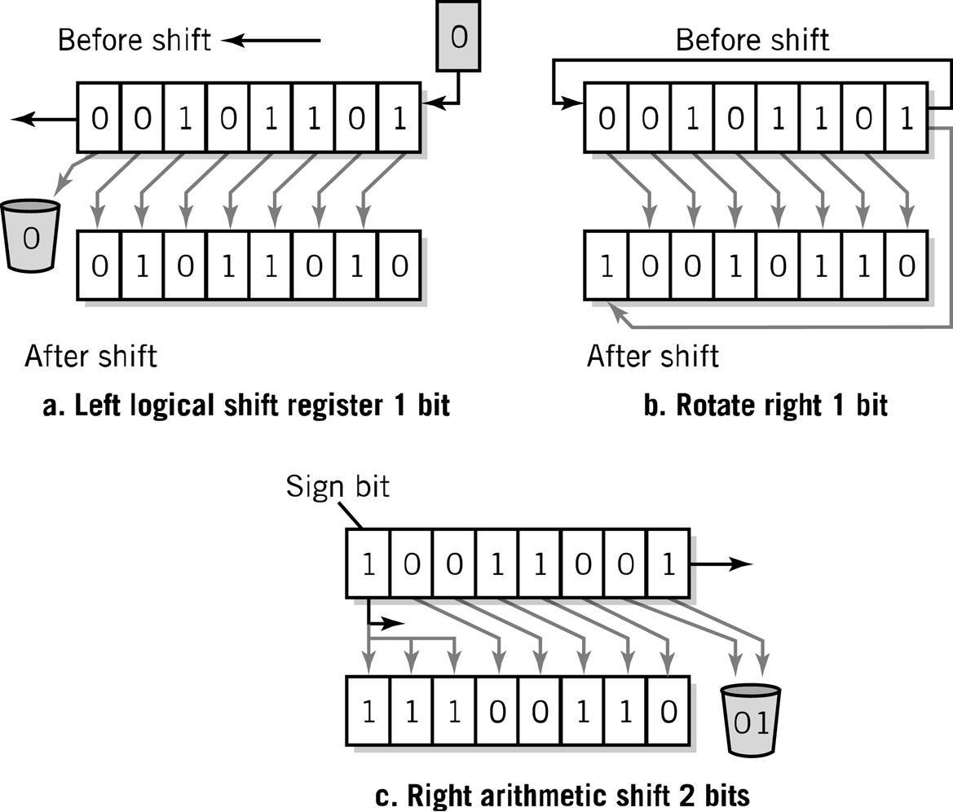
Register Shifts and Rotates
Copyright 2010 John Wiley & Sons, Inc.
7-*
Notes:
*

Slide 31
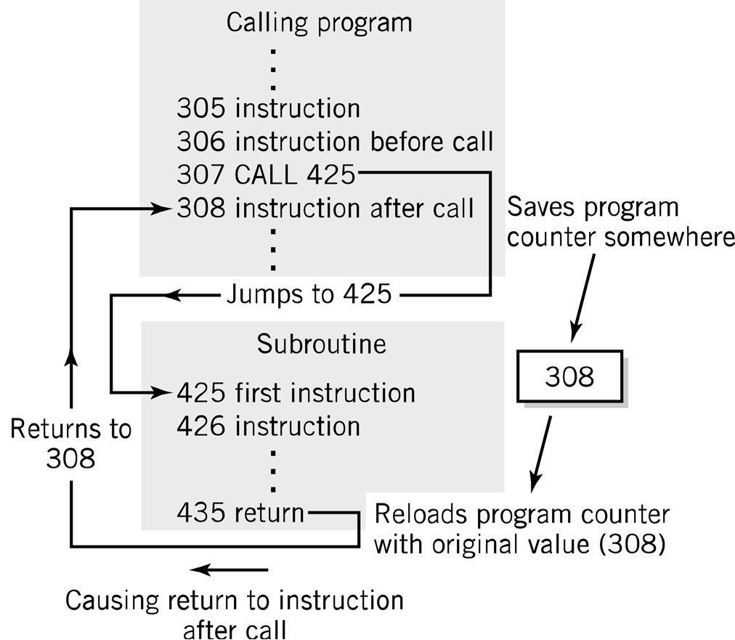
Program Control Instructions
Program control
  Jump and branch
  Subroutine call
  and return
Copyright 2010 John Wiley & Sons, Inc.
7-*
Notes:
*

Slide 32
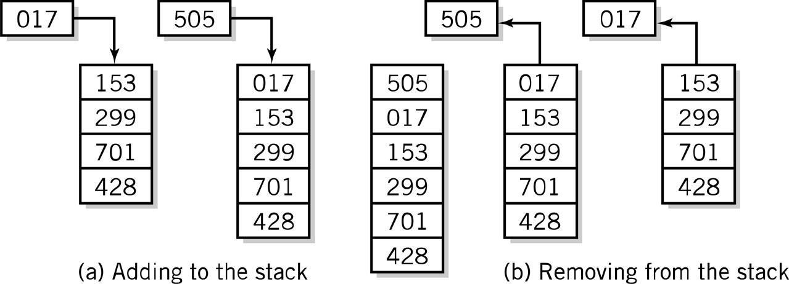
Stack Instructions
Stack instructions
  LIFO method for organizing information
  Items removed in the reverse order from that in which they are added
Push
Pop
Copyright 2010 John Wiley & Sons, Inc.
7-*
Notes:
*

Slide 33
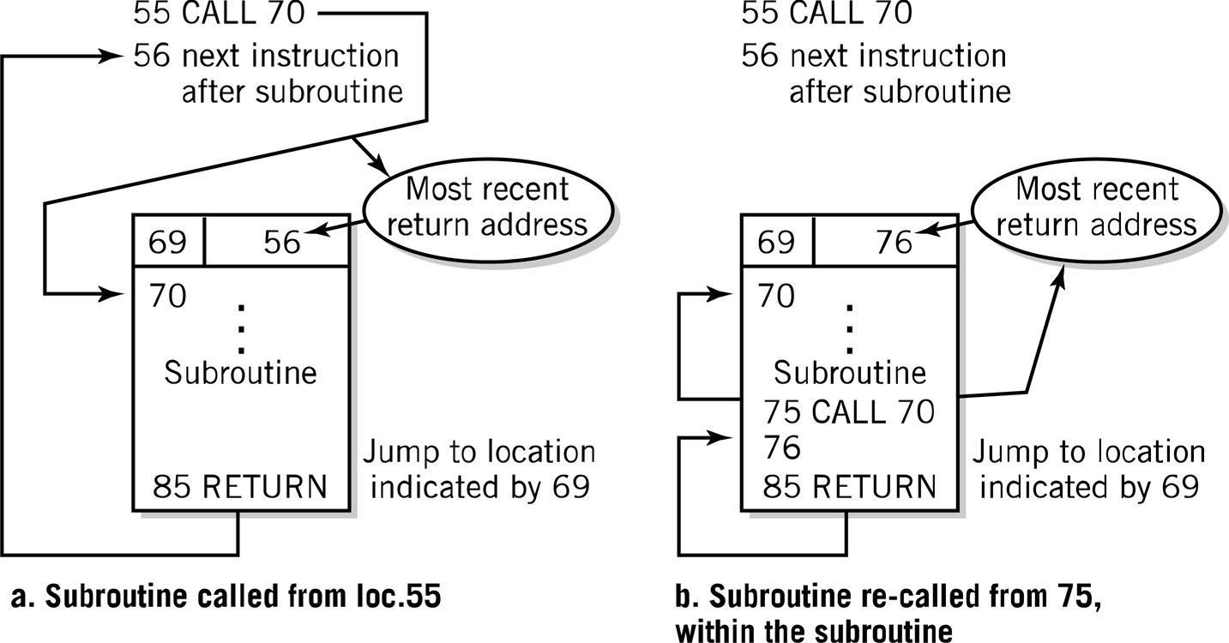
Fixed Location Subroutine
Return Address Storage: Oops!
Copyright 2010 John Wiley & Sons, Inc.
7-*
Notes:
*

Slide 34
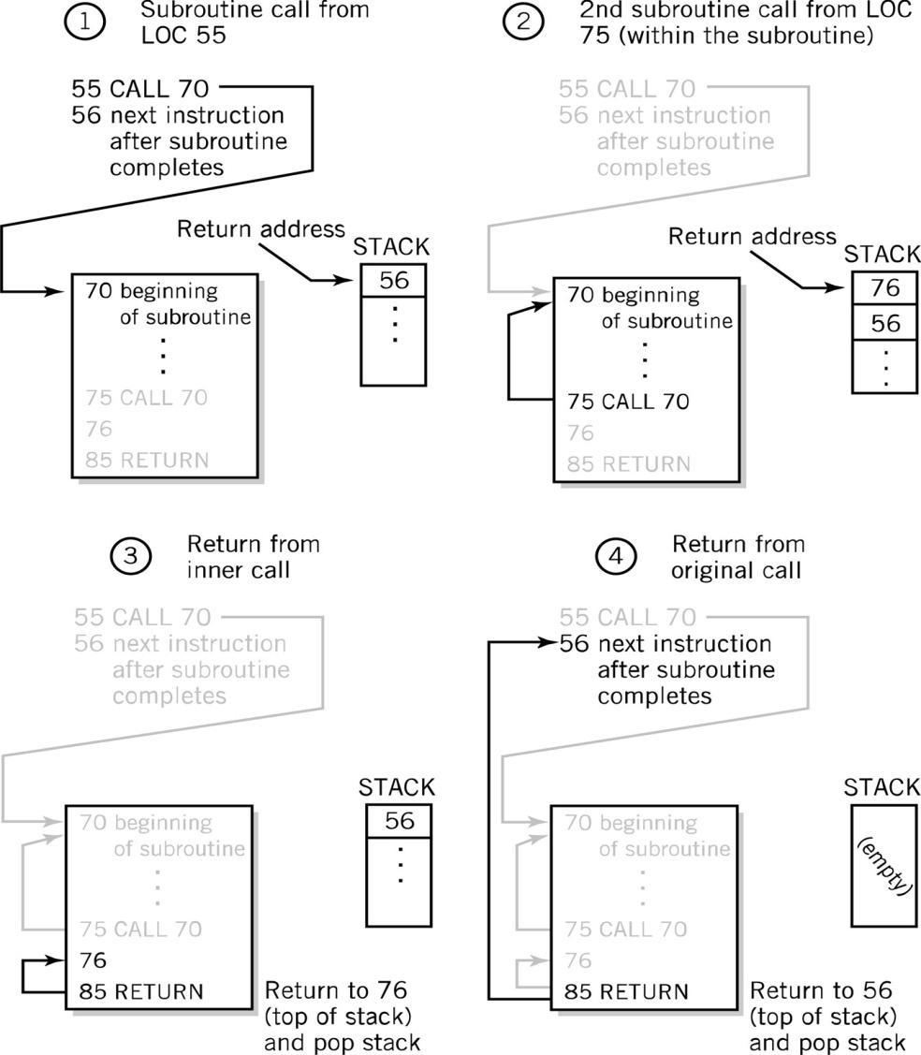
Stack Subroutine Return Address Storage
Copyright 2010 John Wiley & Sons, Inc.
7-*
Notes:
*

Slide 35
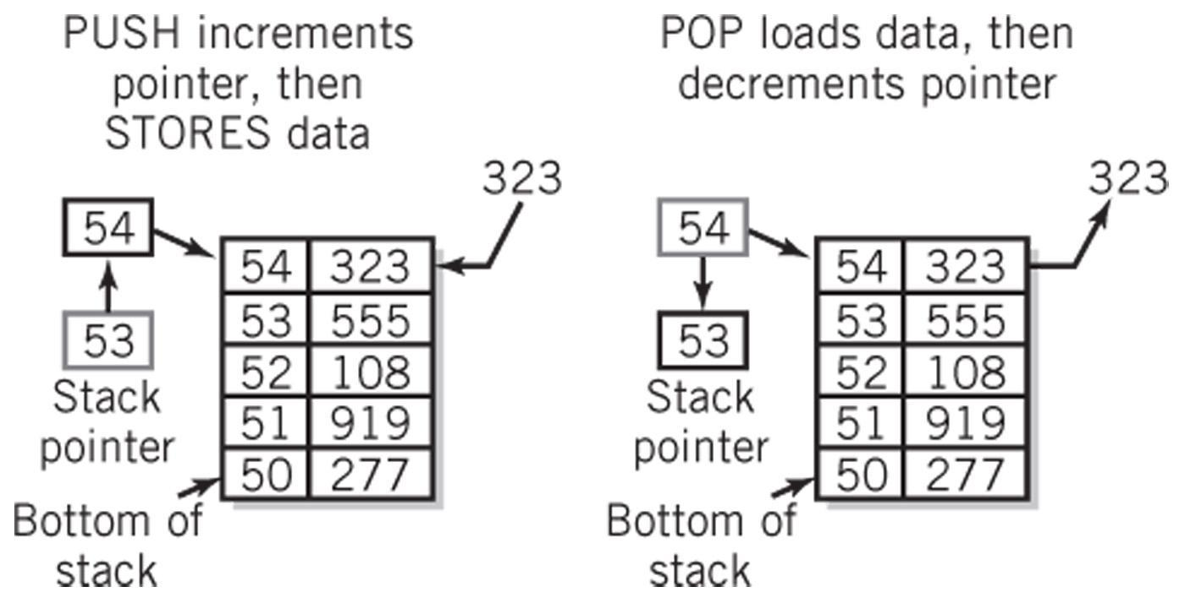
Block of Memory as a Stack
Copyright 2010 John Wiley & Sons, Inc.
7-*

Slide 36
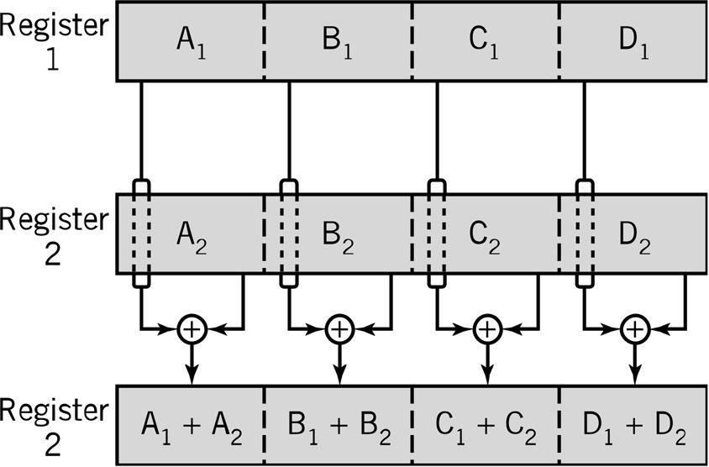
Multiple Data Instructions
Perform a single operation on multiple pieces of data simultaneously
  SIMD: Single Instruction, Multiple Data
  Commonly used in multimedia, vector and array processing applications
Copyright 2010 John Wiley & Sons, Inc.
7-*
Notes:
*

Slide 37
Instruction Elements
OPCODE: task
Source OPERAND(s)
Result OPERAND
  Location of data (register, memory)
    Explicit: included in instruction
    Implicit: default assumed
Addresses
Source
OPERAND
Result
OPERAND
OPCODE
Copyright 2010 John Wiley & Sons, Inc.
7-*
Notes:
*

Slide 38
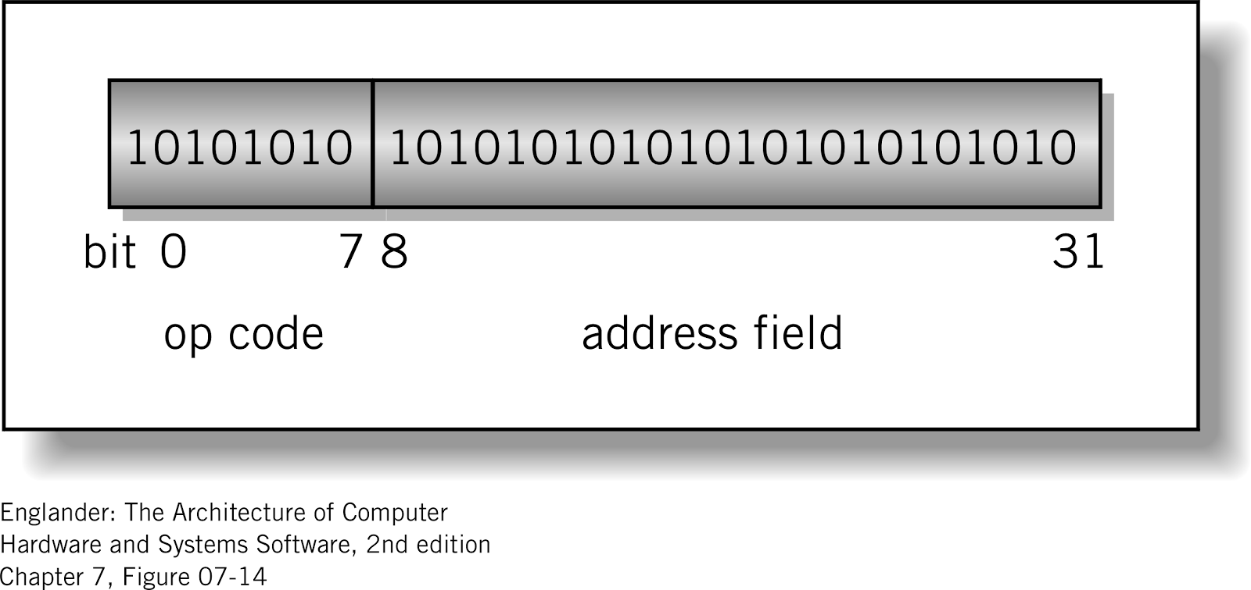
Instruction Format
Machine-specific template that specifies
  Length of the op code
  Number of operands
  Length of operands
Simple
32-bit Instruction Format
Copyright 2010 John Wiley & Sons, Inc.
7-*
Notes:
*

Slide 39
Instructions
Instruction
  Direction given to a computer
  Causes electrical or optical signals to be sent through specific circuits for processing
Instruction set
  Design defines functions performed by the processor
  Differentiates computer architecture by the
    Number of instructions
    Complexity of operations performed by individual instructions
    Data types supported
    Format (layout, fixed vs. variable length)
    Use of registers
    Addressing (size, modes)
Copyright 2010 John Wiley & Sons, Inc.
7-*
Notes:
*

Slide 40
Instruction Word Size
Fixed vs. variable size
  Pipelining has mostly eliminated variable instruction size architectures
Most current architectures use 32-bit or 64-bit words
Addressing Modes
  Direct
    Mode used by the LMC
  Register Deferred
  Also immediate, indirect, indexed
Copyright 2010 John Wiley & Sons, Inc.
7-*

Slide 41
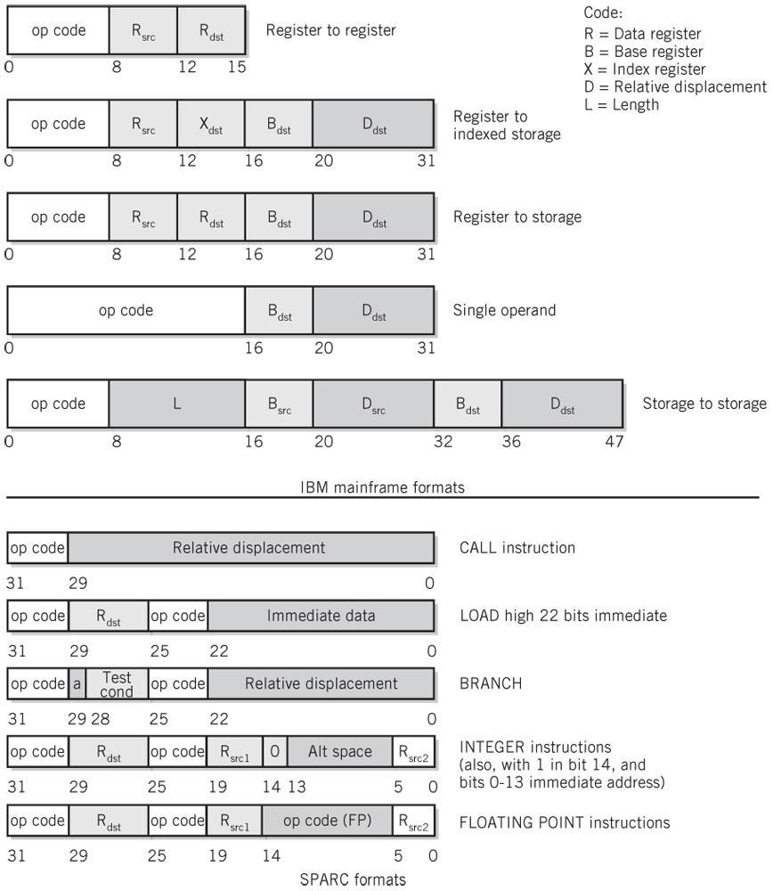
Instruction Format Examples
Copyright 2010 John Wiley & Sons, Inc.
7-*
Notes:
*

Slide 42
Copyright 2010 John Wiley & Sons
All rights reserved. Reproduction or translation of this work beyond that permitted in section 117 of the 1976 United States Copyright Act without express permission of the copyright owner is unlawful. Request for further information should be addressed to the Permissions Department, John Wiley & Sons, Inc. The purchaser may make back-up copies for his/her own use only and not for distribution or resale. The Publisher assumes no responsibility for errors, omissions, or damages caused by the use of these programs or from the use of the information contained herein.”
Copyright 2010 John Wiley & Sons, Inc.
7-*

