Slide 1
Assembly Language

Slide 2
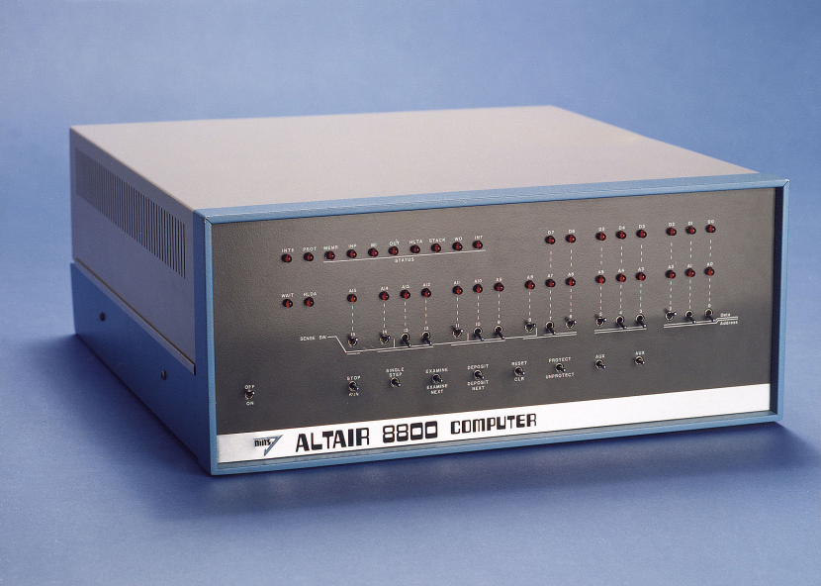
Assembly Language
Generations of programming languages
  First generation: programmed directly in binary using wires or switches.
Image credit: http://professornerdster.com/wp-content/uploads/2012/04/altair_8800.jpeg

Slide 3
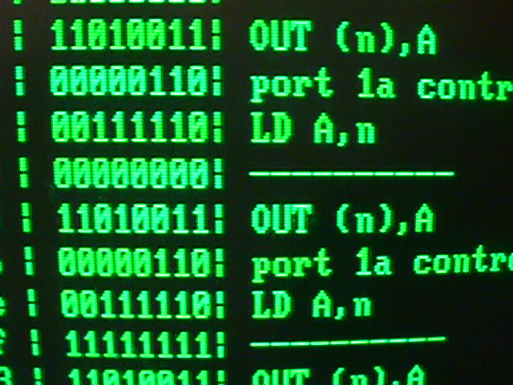
Assembly Language
Generations of programming languages
  Second generation: assembly language. Human readable, converted directly to machine code.
Image credit: http://www.coprolite.com/zhb/pooldog/grnscn.jpg

Slide 4
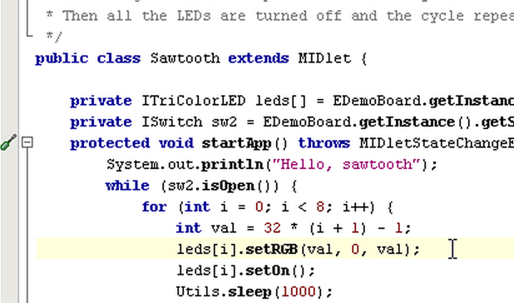
Assembly Language
Generations of programming languages
  Third generation: high-level languages, while loops, if-then-else, structured. Most programming today, including object-oriented.
Image credit: http://www.sunspotworld.com/Tutorial/pngs/swemul06.png

Slide 5
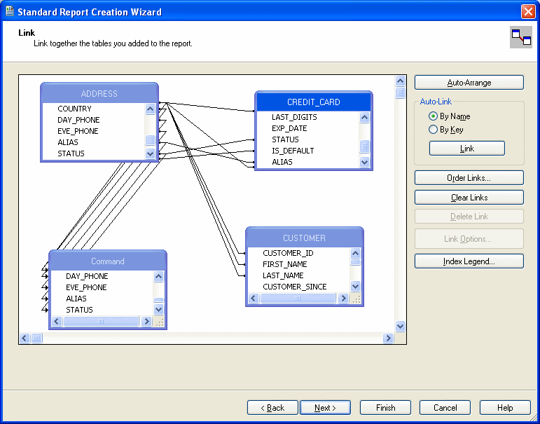
Assembly Language
Generations of programming languages
  Fourth generation: 1990s natural languages, non-procedural, report generation. Use programs to generate other programs. Limited use today.
Image credit: http://docs.oracle.com/cd/E13167_01/aldsp/docs25/appdev/wwimages/CrystalReportsStep4.gif

Slide 6
Assembly Language
Generations of programming languages
  Key idea: Regardless of the language of writing, computers only process machine code.
  All non-machine code goes through a translation phase into machine code.
    Code generators
    Compilers
    Assemblers

Slide 7
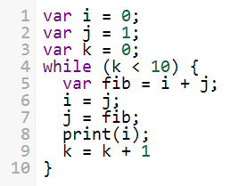
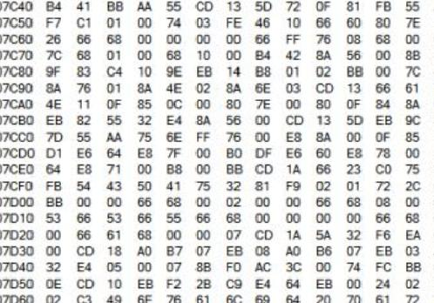
Assembly Language
Language translation process
  High level languages use comparison constructs, loops, variables, etc.
  Machine code is binary, directly executed by CPU.
How does this…
…become this?

Slide 8
Assembly Language
Language translation process
  Convert high level language to if/goto.

Slide 9
Assembly Language
Language translation process
  Convert high level language
  to if/goto.
i = 0
j = 1
k = 0
loop: if (k – 10 == 0) goto done
fib = i + j
i = j
j = fib
print i
k = k + 1
goto loop
done: halt
Use labels for branch targets.

Slide 10
Assembly Language
Language translation process
  Convert if/goto to assembly
  (LMC here).
loop: LDA k ; if (k - 10 == 0) goto done
SUB ten ;
BRZ done ;
LDA i ; fib = i + j
ADD j ;
STO fib ;
LDA j ; i = j
STO i ;
LDA fib ; j = fib
STO j ;
LDA i ; print i
OUT ;
LDA k ; k = k + 1
ADD one ;
STO k ;
BR loop ; goto loop
done: HLT ; halt

Slide 11
Assembly Language
Language translation process
  Convert if/goto to assembly
  (LMC here).
loop: LDA k ; if (k - 10 == 0) goto done
SUB ten ;
BRZ done ;
LDA i ; fib = i + j
ADD j ;
STO fib ;
LDA j ; i = j
STO i ;
LDA fib ; j = fib
STO j ;
LDA i ; print i
OUT ;
LDA k ; k = k + 1
ADD one ;
STO k ;
BR loop ; goto loop
done: HLT ; halt
; data section
j: DAT 0 ; i = 0
i: DAT 1 ; j = 1
k: DAT 0 ; k = 0
fib: DAT 0 ;
ten: DAT 10 ;
one: DAT 1 ;

Slide 12
Assembly Language
Language translation process
  Assemble the instructions to machine code.

Slide 13
Assembly Language
Box | Code | Assembler
01 | 520 | LDA k
02 | 222 | SUB ten
03 | 717 | BRZ done
04 | 519 | LDA i
05 | 119 | ADD j
06 | 321 | STO fib
07 | 519 | LDA j
08 | 319 | STO i
09 | 521 | LDA fib
10 | 319 | STO j
11 | 519 | LDA i
12 | 902 | OUT
13 | 520 | LDA k
14 | 123 | ADD one
15 | 320 | STO k
16 | 601 | BR loop
17 | 000 | HLT
Language translation process
  Assemble the
  instructions to
  machine code.
loop: LDA k ; if (k - 10 == 0) goto done
SUB ten ;
BRZ done ;
LDA i ; fib = i + j
ADD j ;
STO fib ;
LDA j ; i = j
STO i ;
LDA fib ; j = fib
STO j ;
LDA i ; print i
OUT ;
LDA k ; k = k + 1
ADD one ;
STO k ;
BR loop ; goto loop
done: HLT ; halt

Slide 14
Assembly Language
Box | Code | Assembler
01 | 520 | LDA k
02 | 222 | SUB ten
03 | 717 | BRZ done
04 | 519 | LDA i
05 | 119 | ADD j
06 | 321 | STO fib
07 | 519 | LDA j
08 | 319 | STO i
09 | 521 | LDA fib
10 | 319 | STO j
11 | 519 | LDA i
12 | 902 | OUT
13 | 520 | LDA k
14 | 123 | ADD one
15 | 320 | STO k
16 | 601 | BR loop
17 | 000 | HLT
Language translation process
  Assemble the
  instructions to
  machine code.
loop: LDA k ; if (k - 10 == 0) goto done
SUB ten ;
BRZ done ;
LDA i ; fib = i + j
ADD j ;
STO fib ;
LDA j ; i = j
STO i ;
LDA fib ; j = fib
STO j ;
LDA i ; print i
OUT ;
LDA k ; k = k + 1
ADD one ;
STO k ;
BR loop ; goto loop
done: HLT ; halt
j is in box 18
i is in box 19
k is in box 20
fib is in box 21
ten is in box 22
one is in box 23

Slide 15
Assembly Language
Summary
  High level languages are convenient to read and write for humans.
  Computers execute only binary machine code.
  Conversion between the two is required.
    Compilers translate high level languages to machine code.
    Assemblers translate assembly language into machine code.
  Use if/goto pseudo-code as an intermediate language between high level and assembler.

Slide 16
References
  Englander, I. (2009). The architecture of computer hardware and systems software: an information technology approach. Wiley.

