Slide 1
Data Formats

Slide 2
Representing data
Everything is binary
  Computers use switches (on/off) to represent
  state and computation.
    Binary is the logical language.
    How are characters, images, and sounds represented in binary?

Slide 3
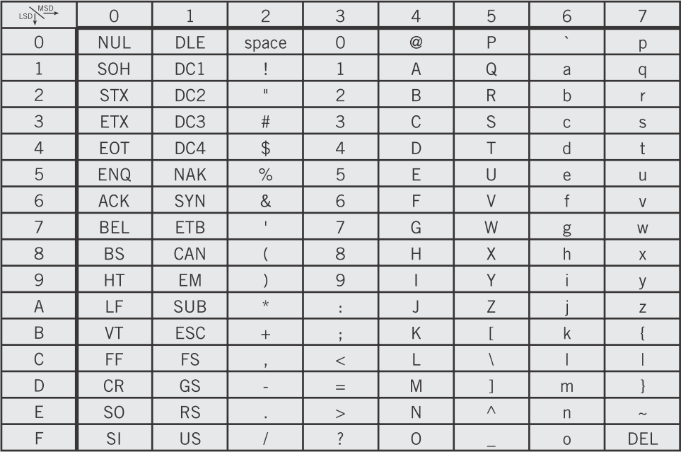
Representing data
Everything is binary
  Standard data representations
    Characters: ASCII, Unicode: mapping from binary numbers into printable characters
Englander, 2009, p. 102

Slide 4
Representing data
Everything is binary
  Standard data representations
    Characters: ASCII, Unicode: mapping from binary numbers into printable characters
The CPU sees 1001 0111 but, interpreted as ASCII, we see “W” printed on the screen.
Englander, 2009, p. 102

Slide 5
Representing data
Everything is binary
  Standard data representations
    Characters: ASCII, Unicode: mapping from binary numbers into printable characters
    Implications: Conversion of numbers to printed strings is needed.
      “1234” and 1234 are radically different.

Slide 6
Representing data
Everything is binary
  Standard data representations
    Characters: ASCII, Unicode: mapping from binary numbers into printable characters
    Implications: Conversion of numbers to printed strings is needed.
      “1234” and 1234 are radically different.
0111 0001 0111 0010 0111 0011 0111 0100
0000 0000 0000 0000 0000 0100 1101 0010

Slide 7

Representing data
Everything is binary
  Standard data representations
    Images: pixels (picture elements) represented by red, green, blue, and alpha (transparency) 8-bit quantities

Slide 8
Representing data
Everything is binary
  Standard data representations
    Images: pixels (picture elements) represented by red, green, blue, and alpha (transparency) 8-bit quantities
RGBA(FB, C5, 27, FF)
RGBA(F8, 84, 12, FF)
RGBA(9C, 0A, 0B, FF)

Slide 9
Representing data
Everything is binary
  Standard data representations
    Images: pixels (picture elements) represented by red, green, blue, and alpha (transparency) 8-bit quantities
    A color is just a 32-bit number. A picture is just a grid (rows and columns) of colors.

Slide 10
Representing data
Everything is binary
  Standard data representations
    Images: pixels (picture elements) represented by red, green, blue, and alpha (transparency) 8-bit quantities
    A color is just a 32-bit number. A picture is just a grid (rows and columns) of colors.
In practice, an 8 megapixel image (3263x2448) would take 32 megabytes of space uncompressed. Advanced compression techniques (JPEG) reduce this to about 2 megabytes.

Slide 11
Representing data
Everything is binary
  Standard data representations
    Sounds: a wave. Frequency (pitch), amplitude (loudness). Sample the amplitude many times per second. Record the amplitude as a number.

Slide 12
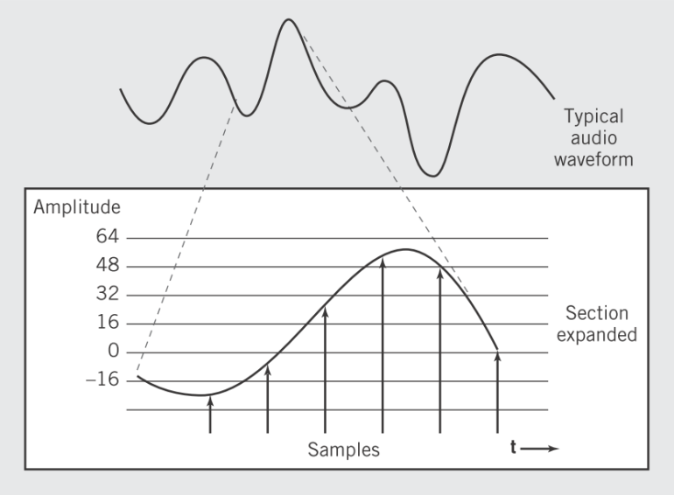
Representing data
Everything is binary
  Standard data representations
    Sounds: a wave. Frequency (pitch), amplitude (loudness). Sample the amplitude many times per second. Record the amplitude as a number.
Englander, 2009, p. 120

Slide 13
Representing data
Everything is binary
  Standard data representations
    Sounds: a wave. Frequency (pitch), amplitude (loudness). Sample the amplitude many times per second. Record the amplitude as a number.
    CD-quality is 16-bit sample, 2 channels, each at 44,000 Hz = 10 Mb per minute in raw format.
    Advanced data compression (mpeg) reduces sizes by 11-to-1 by eliminating sounds the human ear can’t distinguish (psycho-acoustic model).

Slide 14
Representing data
Everything is binary
  Standard data representations
    Video: a series of pictures (flipbook) and sounds.

Slide 15
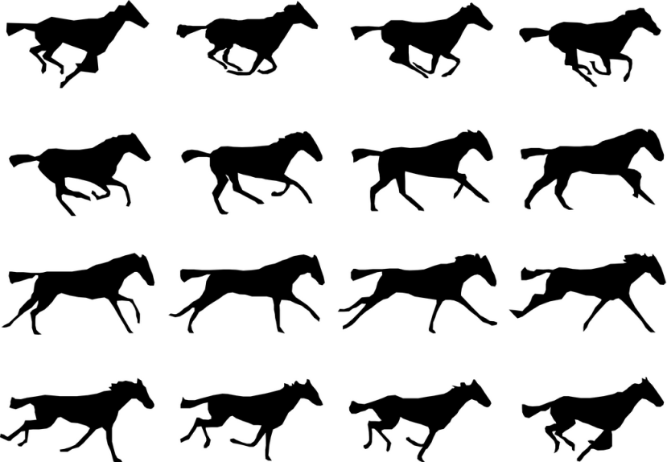
Representing data
Everything is binary
  Standard data representations
    Video: a series of pictures (flipbook) and sounds.
Brall, 2011

Slide 16
Representing data
Everything is binary
  Standard data representations
    Video: a series of pictures (flipbook) and sounds.
Not much changes from frame to frame. Why store everything?
Brall, 2011

Slide 17
Representing data
Everything is binary
  Standard data representations
    Video: a series of pictures (flipbook) and sounds.
    Advanced compression (MPEG) encodes only differences between frames.

Slide 18

Representing data
Everything is binary
  Standard data representations
    Video: a series of pictures (flipbook) and sounds.
    Advanced compression (MPEG) encodes only differences between frames.

Slide 19
Representing data
Everything is binary
  Standard data representations
    Video: a series of pictures (flipbook) and sounds.
    Advanced compression (MPEG) encodes only differences between frames.
I-frames: standard JPEG picture compression.

Slide 20
Representing data
Everything is binary
  Standard data representations
    Video: a series of pictures (flipbook) and sounds.
    Advanced compression (MPEG) encodes only differences between frames.
P-frames: differences from previous I-frame or P-frame only.

Slide 21
Representing data
Everything is binary
  Standard data representations
    Video: a series of pictures (flipbook) and sounds.
    Advanced compression (MPEG) encodes only differences between frames.
B-frames: differences from either adjacent frame (forward or backward).

Slide 22
Data Formats
Summary
  Computers manipulate binary numbers.
  All data representations inside computer systems (characters, images, sounds, video) are ways of encoding and decoding data for human use.
  Standard encodings for:
    Characters: ASCII, Unicode
    Pictures: RGBA colors as a matrix
    Sounds: samples of amplitude
    Videos: Flipbook pictures with only differences between key frames.

Slide 23
References
  Englander, I. (2009). The architecture of computer hardware and systems software: an information technology approach. Wiley.
  Brall, Jeff. (2011). Flip book proof of concept. Retrieved June 27, 2013 from http://jeffbrall.wordpress.com/2011/01/29/flip-book-proof-of-concept-2/

