Slide 1
Introduction and Components

Slide 2
Why study computer organization?
“To be a professional in any field of computing today, one should not regard the computer as just a black box that executes programs by magic. All students of computing should acquire some understanding and appreciation of a computer system’s functional components, their characteristics, their performance, and their interactions… in order to structure a program so that it runs more efficiently on a real machine… [and] understand the tradeoff among various components such as CPU clock speed vs. memory size” (Engel & Roberts, 2001).

Slide 3
What is a system?
“A system is a collection of components linked together and organized in such a way as to be recognizable as a single unit” (Englander, 2009, p. 40).
Notes:
Environment: outside the system boundary.
Interface: manner with which external entities interact with the system
Components: sub systems (stakeholders, data, people, processes). Can start with a large system and break it down into smaller subsystems using decomposition and abstraction.
Links: communication pathways or data flows between components or the environment.

Slide 4
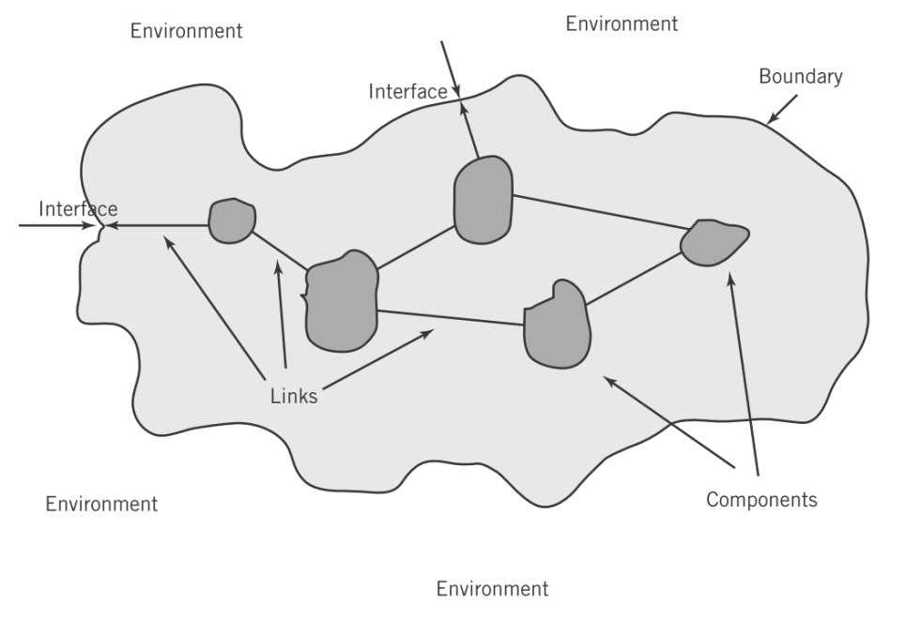
What is a system?
“A system is a collection of components linked together and organized in such a way as to be recognizable as a single unit” (Englander, 2009, p. 40).
Englander, 2009, p. 44
Notes:
Environment: outside the system boundary.
Interface: manner with which external entities interact with the system
Components: sub systems (stakeholders, data, people, processes). Can start with a large system and break it down into smaller subsystems using decomposition and abstraction.
Links: communication pathways or data flows between components or the environment.

Slide 5
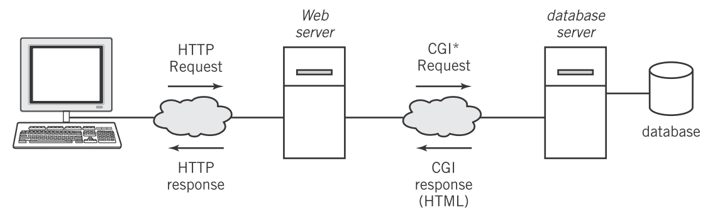
What is a system?
“A system is a collection of components linked together and organized in such a way as to be recognizable as a single unit” (Englander, 2009, p. 40).
Englander, 2009, p. 54
Notes:
Environment: outside the system boundary.
Interface: manner with which external entities interact with the system
Components: sub systems (stakeholders, data, people, processes). Can start with a large system and break it down into smaller subsystems using decomposition and abstraction.
Links: communication pathways or data flows between components or the environment.

Slide 6
What is an architecture?
“The fundamental properties, and the patterns of relationships, connections, constraints, and linkages among the components and between the system and its environment are known collectively as the architecture of the system” (Englander, 2009, p. 45).

Slide 7
What is an architecture?
  Elements of an information system architecture
    Hardware
    Software
    Data
    People
    Networks
“The fundamental properties, and the patterns of relationships, connections, constraints, and linkages among the components and between the system and its environment are known collectively as the architecture of the system” (Englander, 2009, p. 45).

Slide 8
What is an architecture?
  Elements of an information system architecture
    Hardware
    Software
    Data
    People
    Networks
“The fundamental properties, and the patterns of relationships, connections, constraints, and linkages among the components and between the system and its environment are known collectively as the architecture of the system” (Englander, 2009, p. 45).
Components
Links

Slide 9
What is an architecture?
  Elements of an information system architecture
    Hardware
    Software
    Data
    People
    Networks
“The fundamental properties, and the patterns of relationships, connections, constraints, and linkages among the components and between the system and its environment are known collectively as the architecture of the system” (Englander, 2009, p. 45).
Components
Each of these can itself be a system with its own architecture.
Links

Slide 10
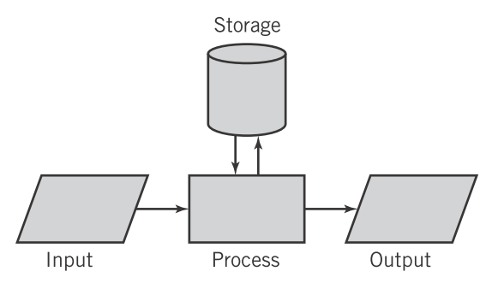
Hardware architecture
Models for computation
Englander, 2009, p. 10

Slide 11
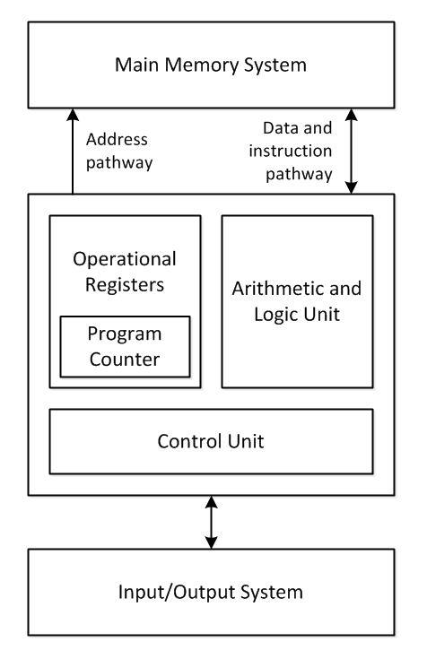
Hardware architecture
Models for computation
Englander, 2009, p. 10
Von Neumann architecture

Slide 12
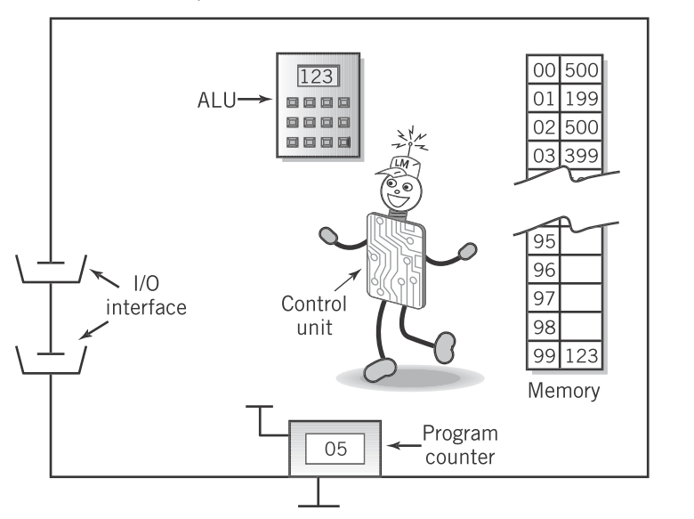
Hardware architecture
Models for computation
Englander, 2009, p. 10
Little Man Computer
Englander, 2009, p. 201

Slide 13
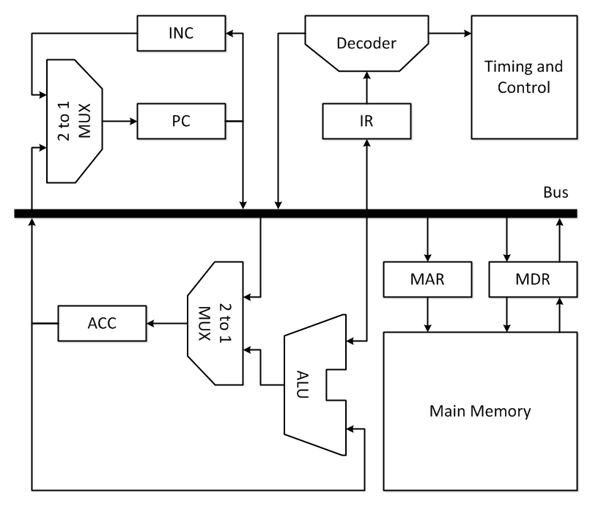
Hardware architecture
Models for computation
Englander, 2009, p. 10
Englander, 2009, p. 201

Slide 14
Hardware architecture
Models for computation
  Abstraction of hardware as a programming language
    Input/output
    Arithmetic, logic, and assignment
    Selection, conditional branching (if-then-else, if-goto)
    Looping, unconditional branching (while, for, repeat-until, goto)

Slide 15
Introduction and Components
Summary
  Studying computer organization is important for any technology professional.
  Information systems consist of components and links between them (hardware, software, data, people, networks).
  Information systems can be viewed at varying levels of detail and abstraction.

Slide 16
References
  Engel, G., & Roberts, E. (2001). Computing curricula 2001 computer science. IEEE-CS, ACM. Final Report
  Englander, I. (2009). The architecture of computer hardware and systems software: an information technology approach. Wiley.

